Slide 1
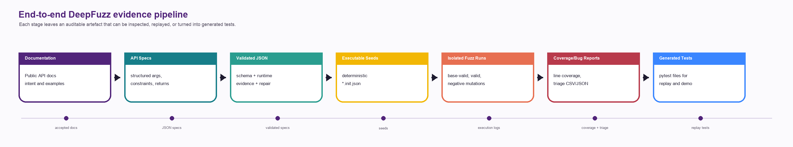
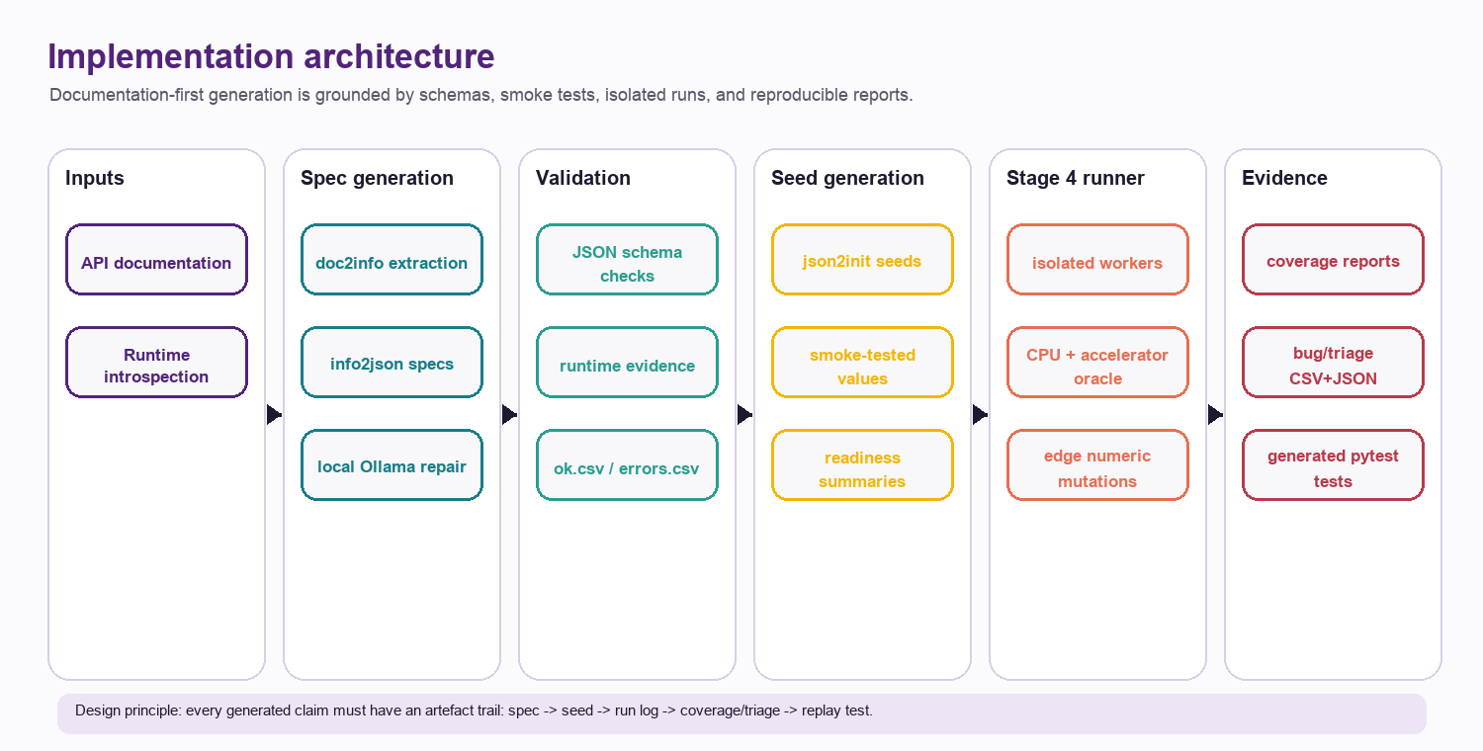
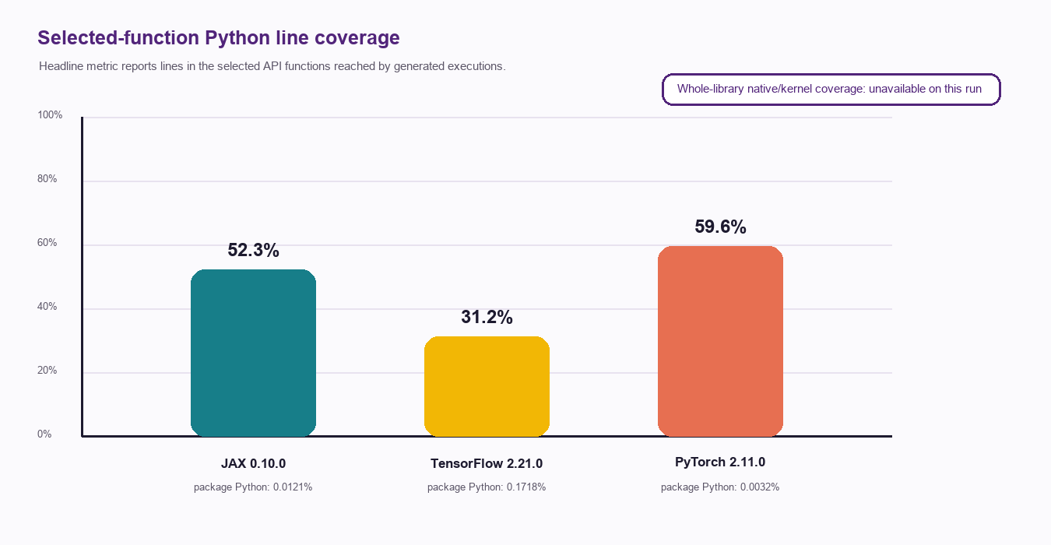
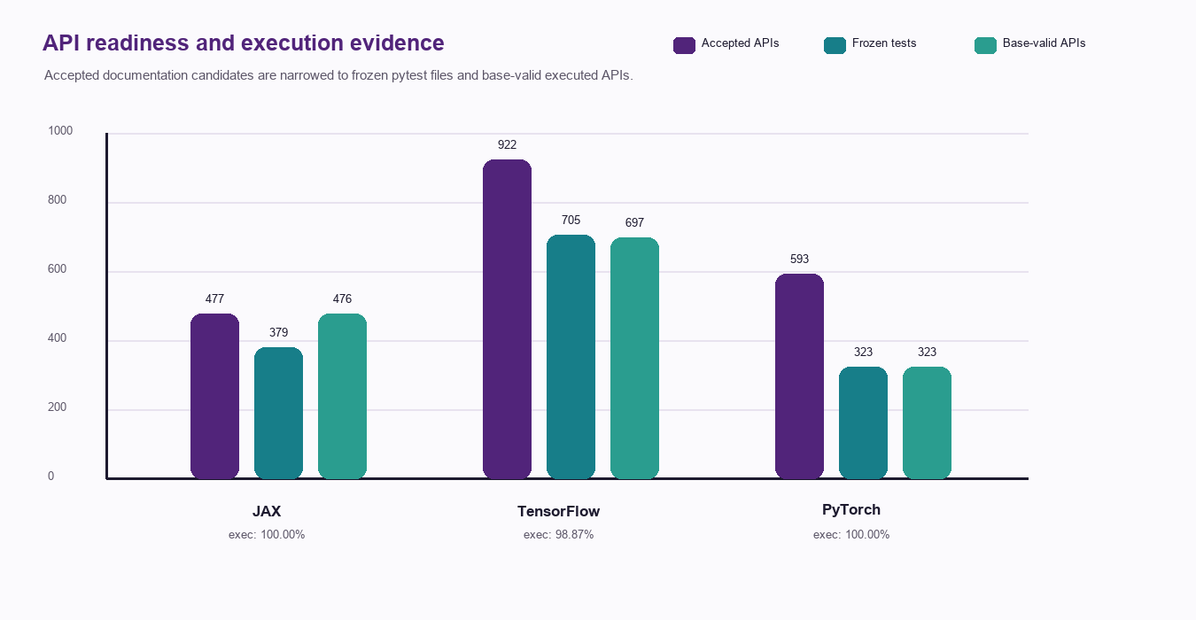
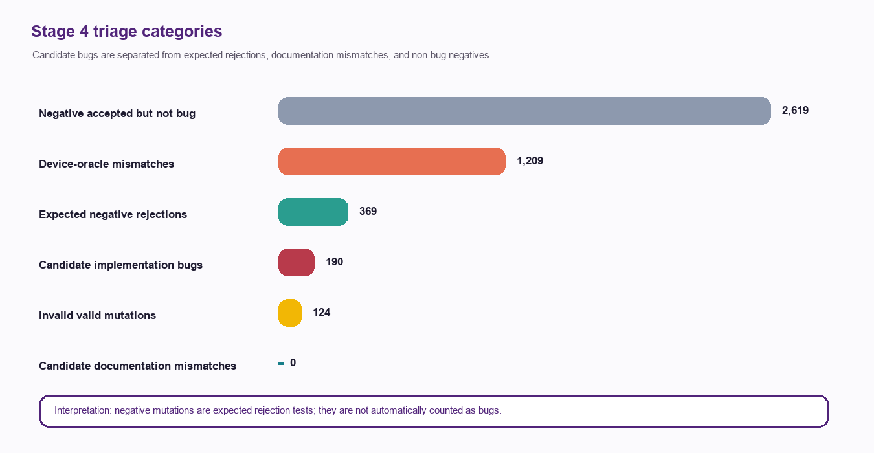

DeepFuzz: Documentation-Driven Fuzz Testing for Deep-Learning APIs
Poster claim
From API documentation to executable seeds, generated tests, coverage evidence, and bug triage for JAX, TensorFlow, and PyTorch
DeepFuzz turns natural-language API documentation into reproducible fuzzing artefacts: specs, seeds, pytest files, coverage reports, and strict triage evidence.
Aryan Gupta
UQ School of Electrical Engineering and Computer Science
1,992
1,407
12,383
190
1,209
accepted documentation APIs
frozen generated pytest tests
valid generated programs
candidate implementation-bug records
device-oracle mismatch records
Motivation / Problem
Results From Final Thesis Runs
Implementation Architecture
- Deep-learning APIs are large, fast moving, and hard to test manually.
- Documentation captures intended behaviour but is not directly executable.
- Manual examples rarely exercise edge values, invalid inputs, or device differences.
Source of truth: pipeline_runs/{jax,tensorflow,torch}/*-thesis-all and stage4/results/*-thesis-all-coverage.
Library
Accepted
Tests
Base-valid
API exec.
Func cov.
Valid progs
Cand. bugs
Device mm.
JAX 0.10.0
477
379
476/476
100.0%
52.3032%
3,421
2
0
Research Aim
TensorFlow 2.21.0
922
705
697/705
98.8652%
31.2415%
6,866
3
0
Convert public API documentation into deterministic fuzz tests and auditable evidence across JAX, TensorFlow, and PyTorch.
PyTorch 2.11.0
593
323
323/323
100.0%
59.5745%
2,096
185
1,209
Native/kernel coverage from binary wheels is recorded as unavailable_on_this_run; the headline metric is selected-function Python line coverage.
Why Existing Testing Is Hard
Demonstration Artefacts
- Library docs mix prose, examples, constraints, and partial error behaviour.
- Executability depends on installed versions, tensor types, shapes, and runtime devices.
- Whole-library coverage under binary wheels hides the behaviour of selected APIs.
- Replay one generated pytest for jax.numpy.sin.
- Inspect per-API seed JSON and generated test file.
- Show Stage 4 coverage report and torch bug_report.csv.
- Explain one path: documentation -> spec -> seed -> fuzz run -> evidence.
Innovation And Contribution
Triage And Oracles
- Documentation-first, runtime-grounded test generation.
- Multi-stage validation and local LLM repair before fuzzing.
- Reproducible run manifests and per-API artefact trails.
- Selected-function coverage avoids misleading whole-library claims.
- Strict triage separates bugs, doc mismatches, expected rejections, and pipeline failures.
Analysis / Conclusion
DeepFuzz is a complete, reproducible software-engineering pipeline. It reaches every base-valid API in JAX and PyTorch and 98.8652% in TensorFlow; reports combine selected-function coverage with execution, seed, generated-test, and triage evidence.
Device oracle and edge numeric mutations were enabled; candidate records require manual confirmation before upstream reporting.
References: project README, final_report.json, coverage_report.json, bug_report.csv, and run_manifest.json from committed *-thesis-all runs.
Acknowledgements
CRICOS 00025B • TEQSA PRV12080
uq.edu.au
UQ EECS thesis guidance and assessment rubric; public JAX, TensorFlow, and PyTorch documentation; open-source Python testing and coverage tooling.
School of Electrical Engineering and Computer Science

