Slide 1
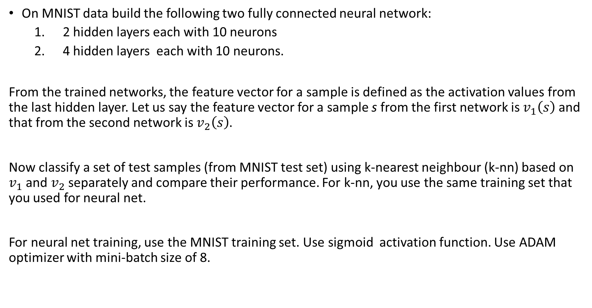
On MNIST data build the following two fully connected neural network:
2 hidden layers each with 10 neurons
4 hidden layers each with 10 neurons.
From the trained networks, the feature vector for a sample is defined as the activation values from the last hidden layer. Let us say the feature vector for a sample s from the first network is $v_{1}\left(s\right)$ and that from the second network is $v_{2}\left(s\right)$.
Now classify a set of test samples (from MNIST test set) using k-nearest neighbour (k-nn) based on $v_{1}$ and $v_{2}$ separately and compare their performance. For k-nn, you use the same training set that you used for neural net.
For neural net training, use the MNIST training set. Use sigmoid activation function. Use ADAM optimizer with mini-batch size of 8.

