Slide 1

Forward and Reverse Image Steganography Using odd-even bits
Marathwada Mitra Mandal's College of Engineering
Department of Computer Engineering
Made By: Aryan Sawale (BC162) Apoorv Pandit (BC152) Class: BE-I

Slide 2
Introduction
Steganography, derived from the Greek words "steganos" (hidden or covered) and "graphein" (writing), is an ancient practice of concealing information within seemingly ordinary messages or physical objects. It has been employed for centuries to ensure the privacy of communications. Unlike cryptography, which involves encoding and decoding data, steganography focuses on the covert embedding of data into various digital formats, such as text, images, audio, and video, without altering their apparent nature.
In this comprehensive project, we introduce a robust image steganography technique that leverages an innovative odd/even pixel distribution scheme and incorporates a two-parameter random function for concealing secret messages, with a paramount focus on security and integrity
Our approach goes beyond mere concealment; it also embraces the realm of digital forensics by rigorously examining the image metadata to strengthen the overall security and forensic aspect of the project.

Slide 3
Motivation
Blockchain has been around since the 1980s. But it has been recently highlighted because of cryptocurrencies, NFTs, metaverse etc.
But blockchain is not only for monetary benefits, it can actually be used to improve our day to day lives. The motivation behind choosing this domain was to explore these use cases while emphasizing one of them
The problems in supply chain are nothing new and it's easy to see why. These products travel globally with old infrastructure and some of the documentation is still done manually. This leads to problems like counterfeit drugs, fraud, quality control etc.
Even during covid we saw how there was shortage of essential items everywhere. The sudden increase in demand exposed a lot of vulnerabilities in the existing system. To fix some of these vulnerabilities we can turn to blockchain.

Slide 4
Problem Statement
Analysing the current problems faced by the medical supply chain and investigating their solutions using blockchain technology.

Slide 5
Scope
In this seminar, problems faced by the medical supply chain are identified and their various proposed solutions are compared and analysed.
Blockchain technology is defined along with its benefits over centralized systems.
A decentralized application is proposed which can simulate the medical supply chain and maintain transparency.

Slide 6
Literature Survey
Paper A. Musamih et al., "A Blockchain-Based Approach for Drug Traceability in Healthcare Supply Chain," in IEEE Access, vol. 9, pp. 9728-9743, 2021, doi: 10.1109/ACCESS.2021.3049920.
Description Proposed an Ethereum blockchain-based approach leveraging smart contracts and decentralized off-chain storage overcoming the limitations of current healthcare supply chain
Advantages Uses off-chain storage which is a low-cost solution to store supply chain transactions data to ensure reliability, accessibility, and integrity of the stored data.
Disadvantages The system can be improved by using a private blockchain platform such as Hyperledger fabric

Slide 7
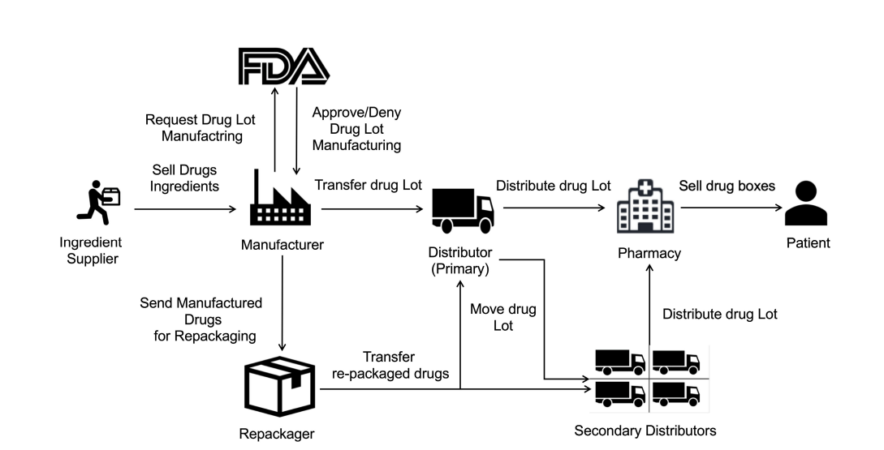

Slide 8
Literature Survey
Paper T. Bocek, B. B. Rodrigues, T. Strasser and B. Stiller, "Blockchains everywhere - a use-case of blockchains in the pharma supply-chain," 2017 IFIP/IEEE Symposium on Integrated Network and Service Management (IM), 2017, pp. 772-777, doi: 10.23919/INM.2017.7987376.
Description Platform which uses IoT leveraging blockchain technology to monitor environmental conditions such as temperature and humidity to ensure quality control of sensitive medical shipments.
Advantages Uses Ethereum network and their startup has successfully completed their pilot shipments with their first clients.
Disadvantages Only an android app is developed. A web app would increase accessibility and reach.

Slide 9
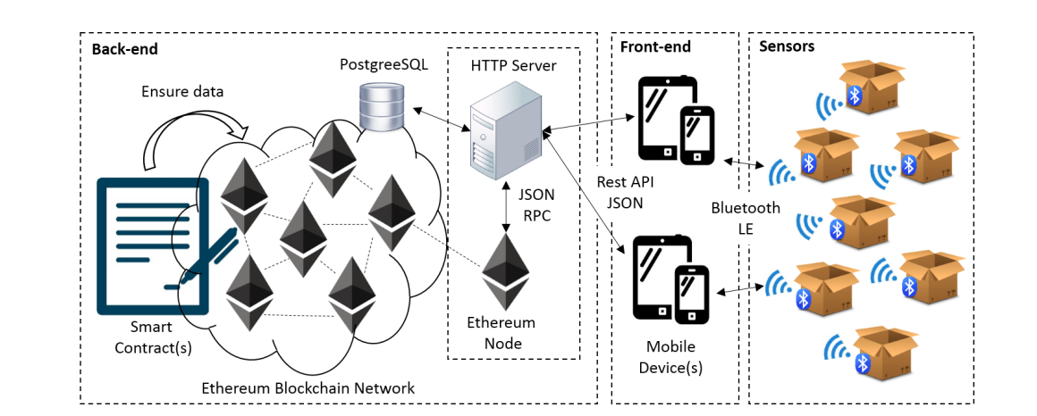

Slide 10
Literature Survey
Paper R. W. Ahmad, K. Salah, R. Jayaraman, I. Yaqoob, M. Omar and S. Ellahham, "Blockchain-Based Forward Supply Chain and Waste Management for COVID-19 Medical Equipment and Supplies," in IEEE Access, vol. 9, pp. 44905-44927, 2021, doi: 10.1109/ACCESS.2021.3066503.
Description Proposed a decentralized blockchain-based solution to automate forward supply chain processes for the COVID-19 medical equipment and enable information exchange among all the stakeholders involved in their waste management.
Advantages Used decentralized storage of interplanetary file systems (IPFS) which keeps the burden off the chain.
Disadvantages The system can be improved by using a private blockchain platform such as Hyperledger fabric

Slide 11
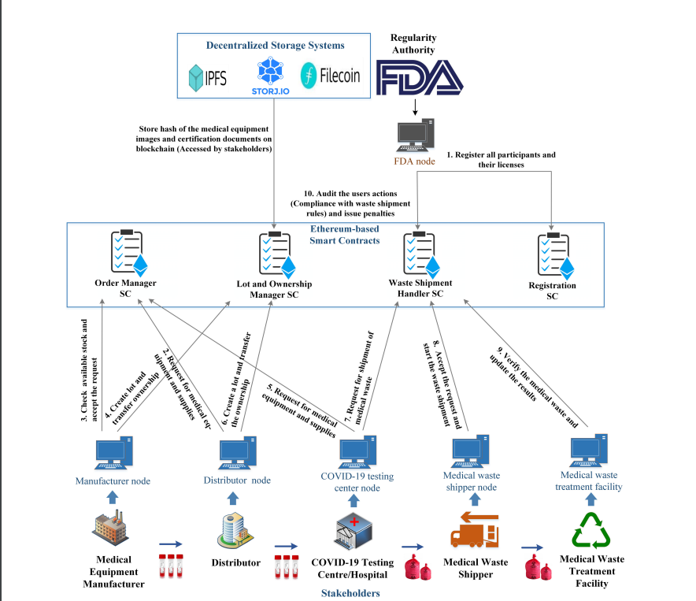

Slide 12
Literature Survey
Paper Abbas, Khizar & Muhammad, Afaq & Ahmed Khan, Talha & Song, Wang-Cheol. (2020). A Blockchain and Machine Learning-Based Drug Supply Chain Management and Recommendation System for Smart Pharmaceutical Industry. Electronics. 9. 852. 10.3390/electronics9050852.
Description The proposed system consists of two main modules: blockchain-based drug supply chain management and machine learning-based drug recommendation system for consumers.
Advantages Uses a private network with Hyperledger fabrics.
Disadvantages The system can be tested in real life and the machine learning models can be improved in terms of accuracy and recommendation results.

Slide 13
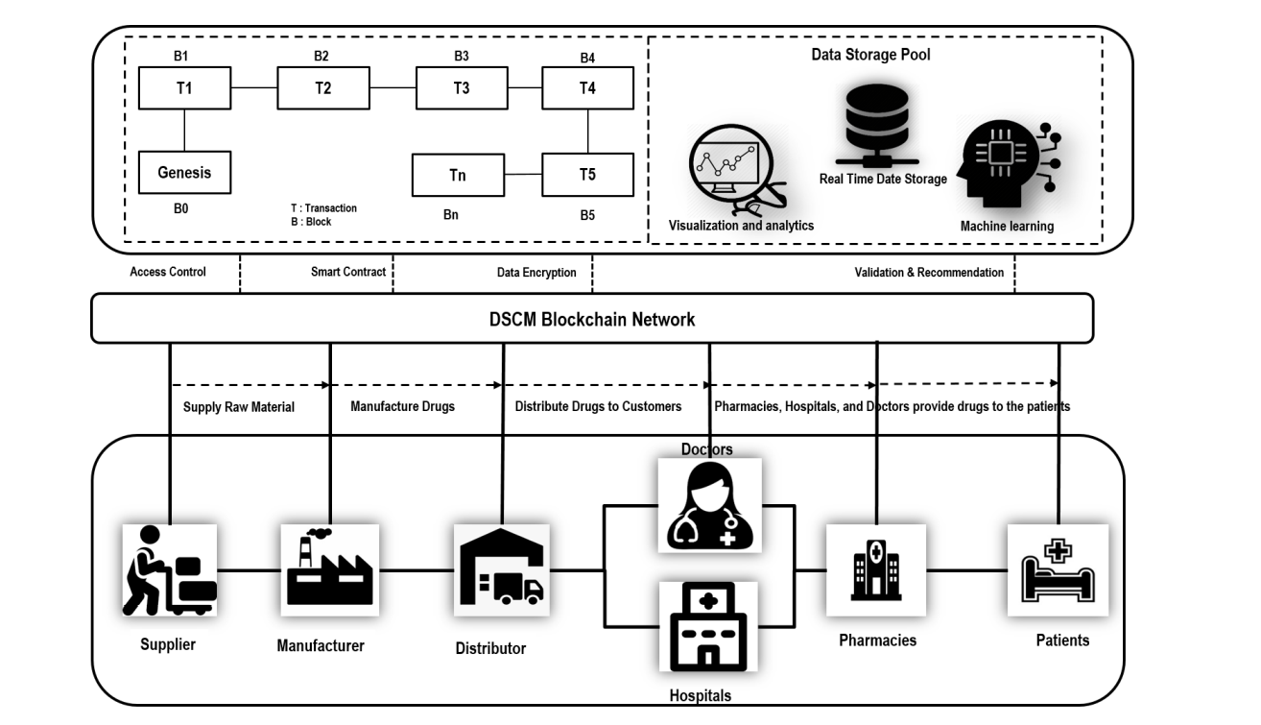

Slide 14
Proposed Technology
The stakeholders are identified:
Raw material suppliers
Manufacturers
Distributers
Retailers
They will interact with the application using crypto accounts which will be used for authentication.
The frontend of the application will be created using React and smart contracts are created using Solidity which contain the logic of the application.
The data is stored and retrieved from the Ethereum blockchain network.
The web app will be deployed and available for use from anywhere.

Slide 15
Software Required
Truffle
A development environment, testing framework and asset pipeline for blockchains using the Ethereum Virtual Machine (EVM).
Ganache
A personal blockchain for Ethereum development that can be used to deploy contracts, develop applications, and run tests.
React
React is a free and open-source front-end JavaScript library for building user interfaces based on UI components.
Node
Node.js is an open-source, cross-platform, back-end JavaScript runtime environment that runs on a JavaScript Engine and executes JavaScript code outside a web browser.
MetaMask
MetaMask is a software cryptocurrency wallet used to interact with the Ethereum blockchain. It allows users to access their Ethereum wallet through a browser extension or mobile app, which can then be used to interact with decentralized applications.

Slide 16
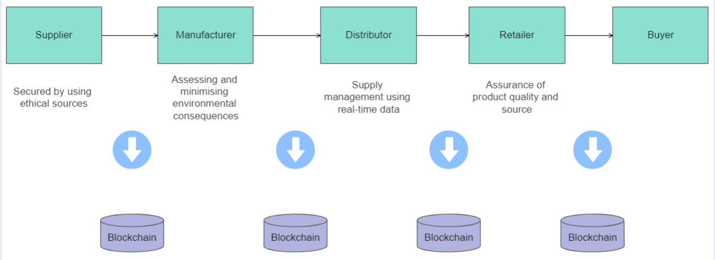
System Architecture

Slide 17
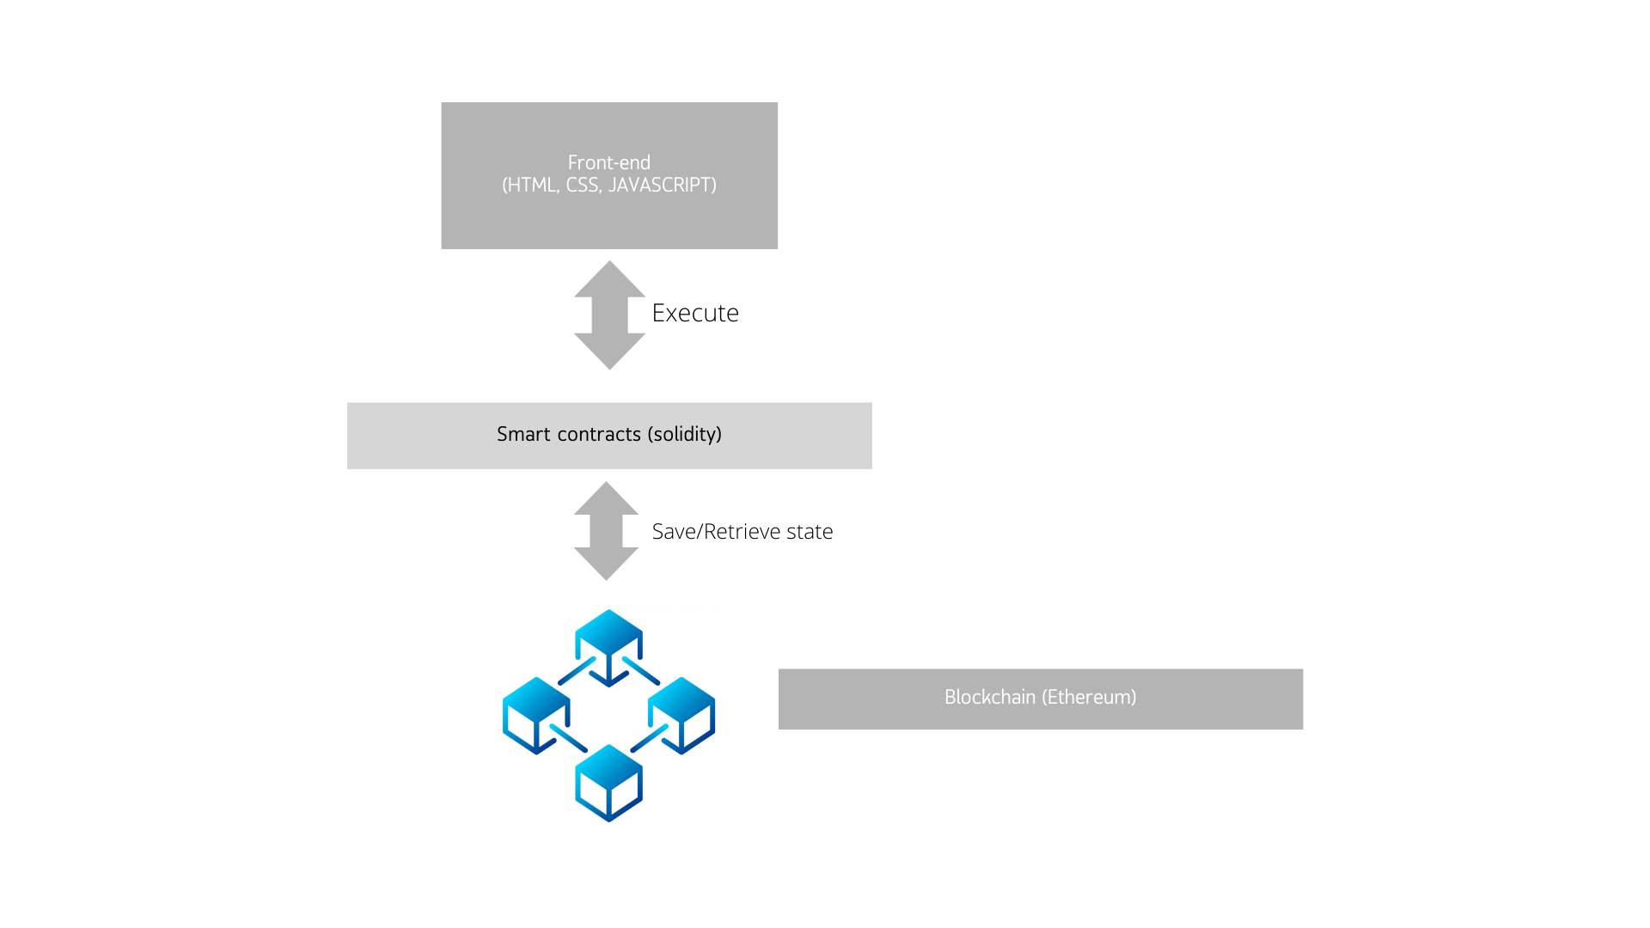
Application Architecture

Slide 18
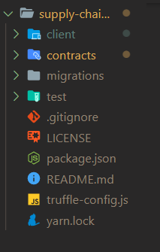
Code
The project contains 2 main components.
The contracts folder contains the smart contracts which define the main logic of the application.
The client folder contains code which defines how the information is presented to the user.

Slide 19
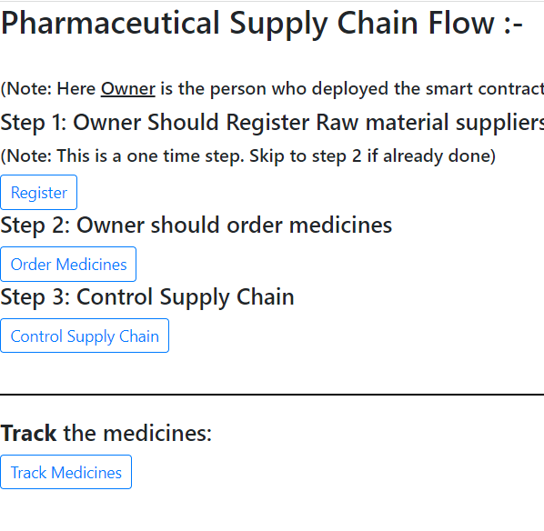
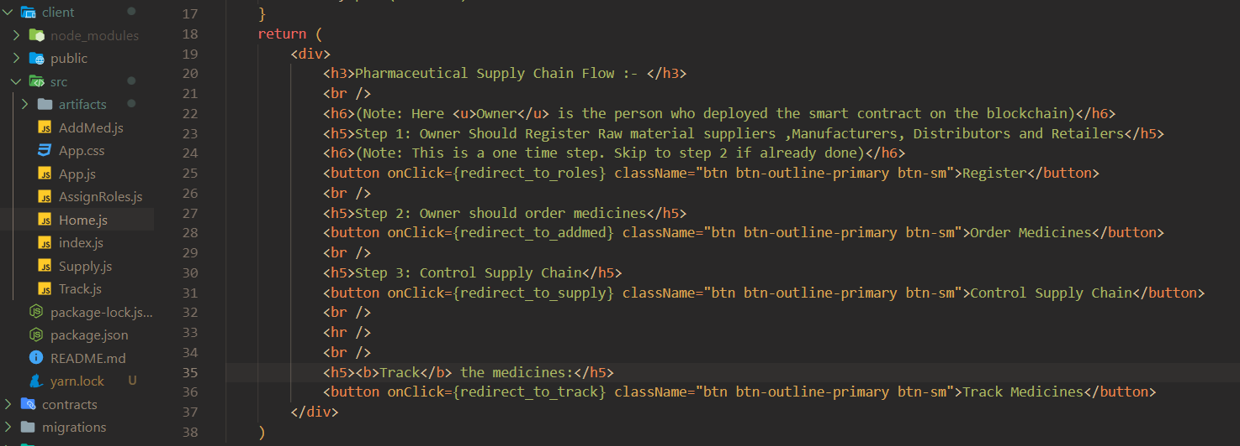
Code
In React, the various components of the visible part are defined in separate files and then combined together.
Let us consider the example of “Order Medicines” functionality which redirects to the Addmed.js file.

Slide 20
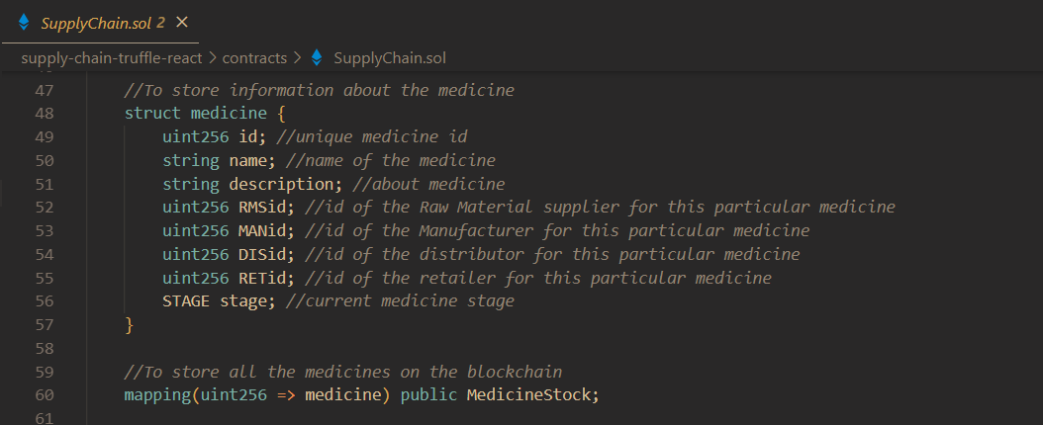
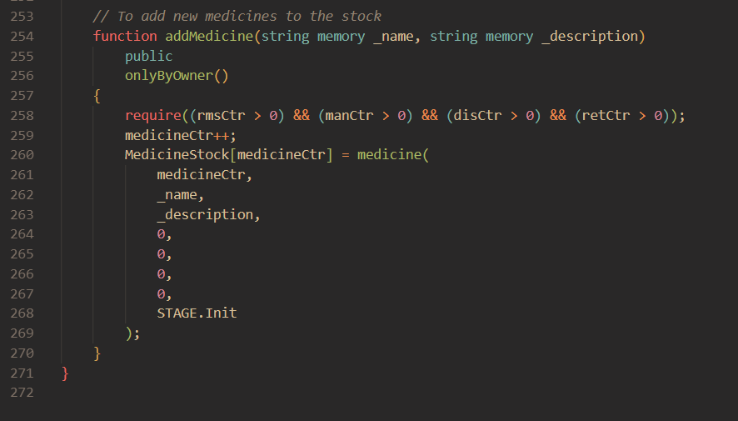
Code
The smart contracts are defined in a file.
In this, medicine is defined as an object with various parameters such as name, description, id etc.
A function addMedicine is created which takes the required values from the user and stores them in an array of medicines

Slide 21
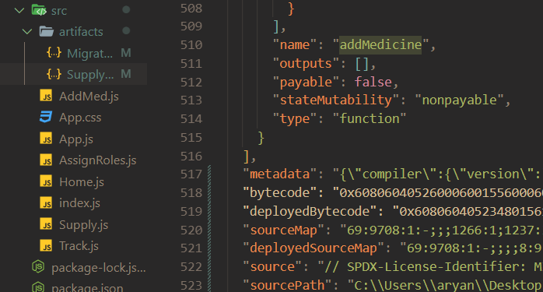
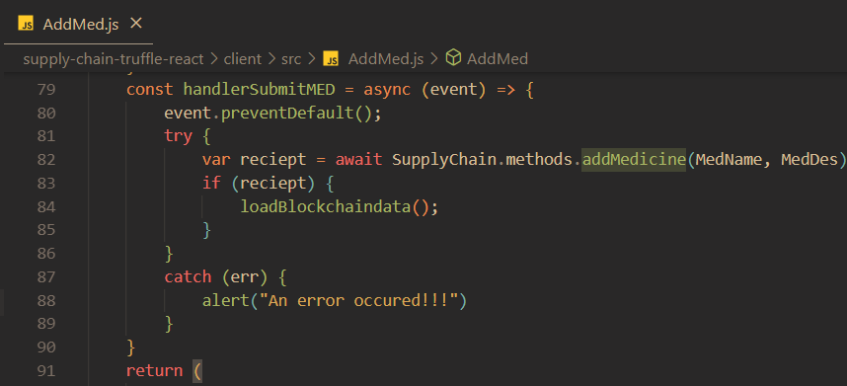
Code
The contracts are compiled into artifacts by truffle.
An artifact is a JSON bundle that contains a lot of useful information related to a contract like the ABI, the contract bytecode, the deployment details, compiler version etc.
This can then be used to access functions and data in the JS files.

Slide 22
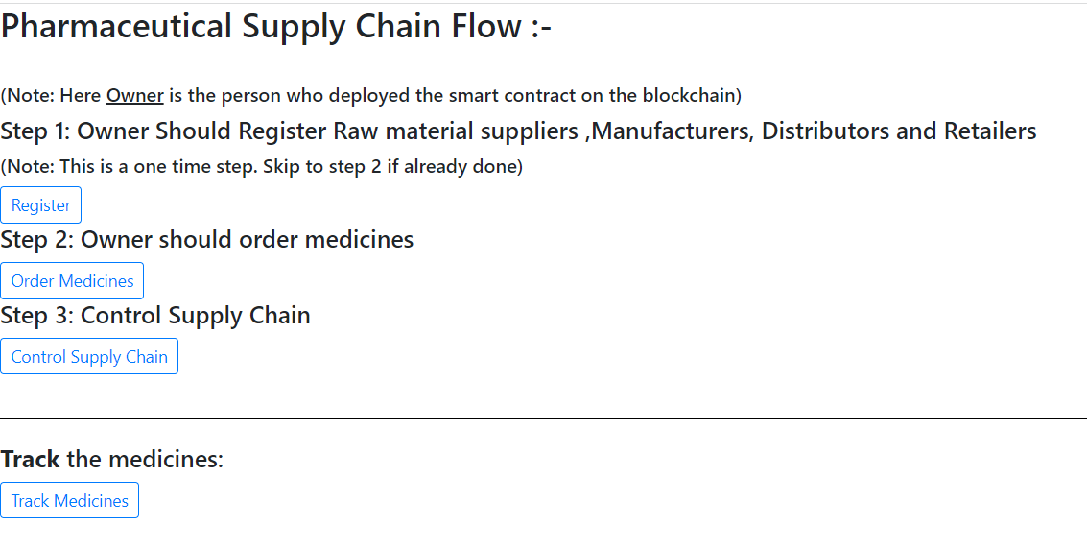
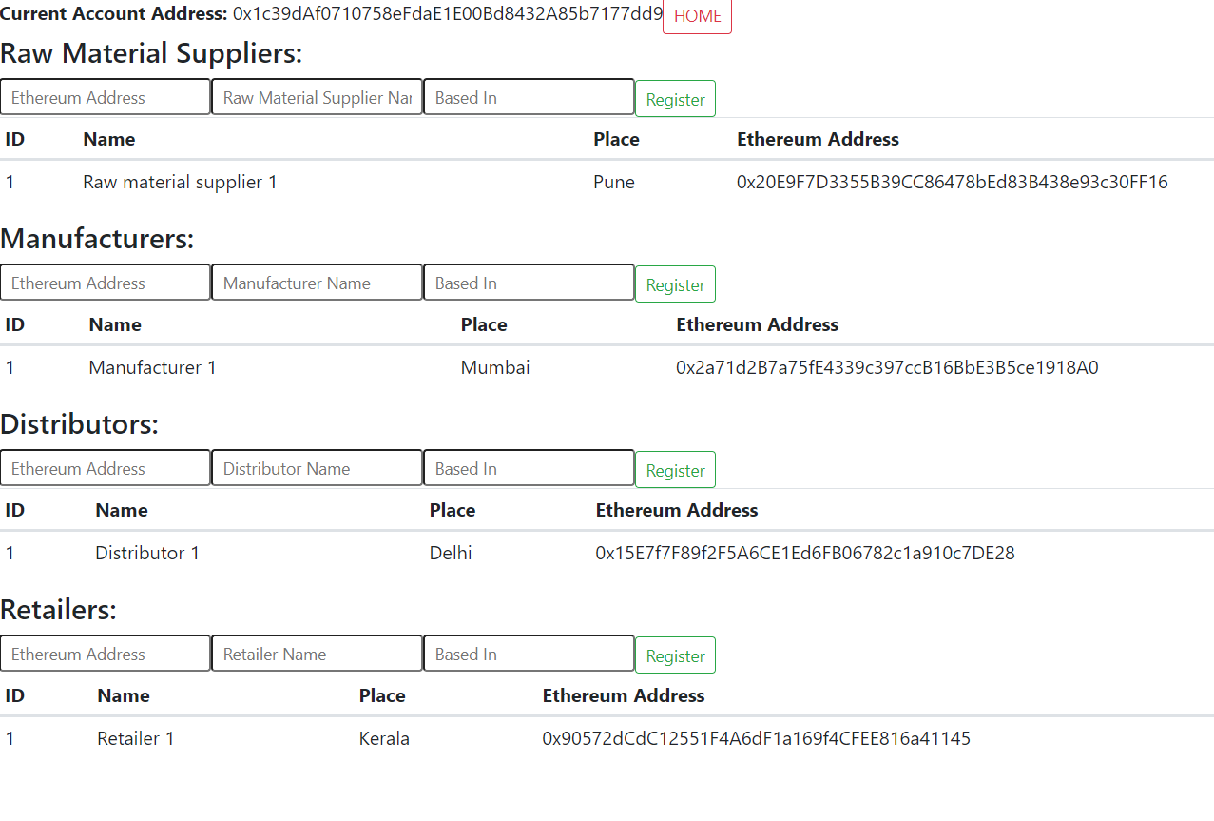
Demo
Home page
Register Members

Slide 23
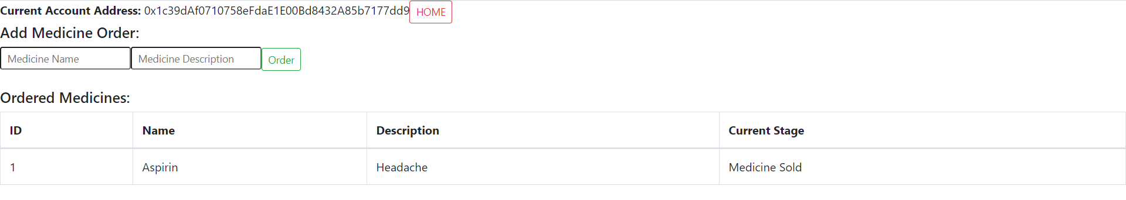
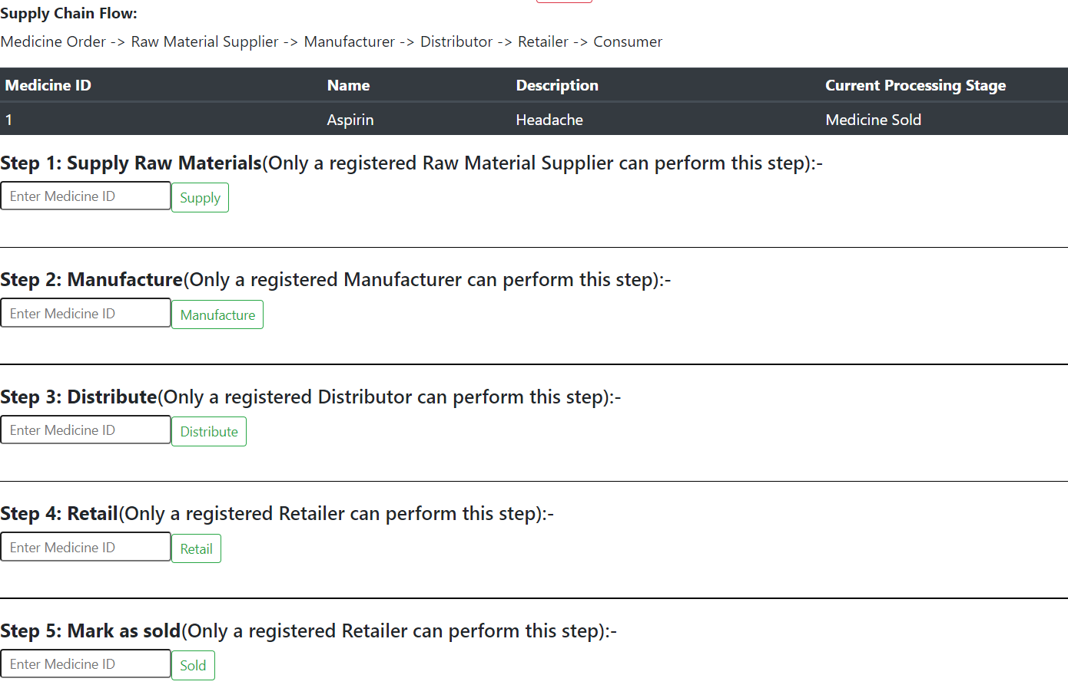
Demo
Order medicines
Control supply chain

Slide 24
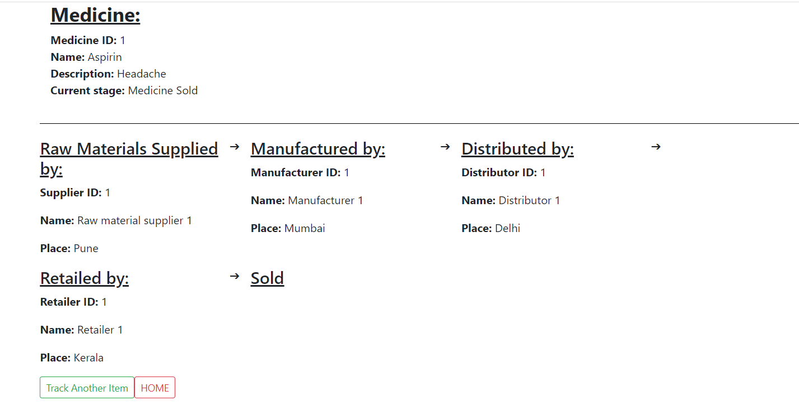
Demo
Tracking order

Slide 25
Advantages
Completely transparent, which allows tracking of orders.
Allows collection of data which can be analysed to identify bottlenecks and suggest improvements.
In case of an emergency, a drug recall can be implemented using the data available.
Functionality of users is clearly defined and identified using their crypto accounts.
Since it is a web app, it can be accessed from anywhere easily.

Slide 26
Disadvantages/Future scope
Some Privacy is sacrificed for more data availability.
Does not utilize machine learning for a recommendation system based on the data generated.
All data is stored on the blockchain.

Slide 27
Conclusion
A use case of blockchain was explored.
Identified various merits and demerits of using blockchain technology.
In the future, centralized and decentralized technologies will go hand in hand.

Slide 28
References
R. W. Ahmad, K. Salah, R. Jayaraman, I. Yaqoob, M. Omar and S. Ellahham, "Blockchain-Based Forward Supply Chain and Waste Management for COVID-19 Medical Equipment and Supplies," in IEEE Access, vol. 9, pp. 44905-44927, 2021, doi: 10.1109/ACCESS.2021.3066503.
T. Bocek, B. B. Rodrigues, T. Strasser and B. Stiller, "Blockchains everywhere - a use-case of blockchains in the pharma supply-chain," 2017 IFIP/IEEE Symposium on Integrated Network and Service Management (IM), 2017, pp. 772-777, doi: 10.23919/INM.2017.7987376.
Zoughalian K, Marchang J, Ghita B. A Blockchain Secured Pharmaceutical Distribution System to Fight Counterfeiting. Int J Environ Res Public Health. 2022 Mar 30;19(7):4091. doi: 10.3390/ijerph19074091. PMID: 35409774; PMCID: PMC8998750
A. Musamih et al., "A Blockchain-Based Approach for Drug Traceability in Healthcare Supply Chain," in IEEE Access, vol. 9, pp. 9728-9743, 2021, doi: 10.1109/ACCESS.2021.3049920.
Abbas, Khizar & Muhammad, Afaq & Ahmed Khan, Talha & Song, Wang-Cheol. (2020). A Blockchain and Machine Learning-Based Drug Supply Chain Management and Recommendation System for Smart Pharmaceutical Industry. Electronics. 9. 852. 10.3390/electronics9050852.
Reda, Moulouki & Kanga, Dominique & Fatima, Taif & Azouazi, Mohamed. (2020). Blockchain in health supply chain management: State of art challenges and opportunities. Procedia Computer Science. 175. 706-709. 10.1016/j.procs.2020.07.104.
Y. Raj and S. B, "Study on Supply Chain Management using Blockchain Technology," 2021 6th International Conference on Inventive Computation Technologies (ICICT), 2021, pp. 1243-1247, doi: 10.1109/ICICT50816.2021.9358768.
Sahoo, Saumyaranjan & Kumar, Satish & Sivarajah, Uthayasankar & Lim, Weng Marc & Westland, J. & Kumar, Ashwani. (2022). Blockchain for Sustainable Supply Chain Management: Trends and Ways Forward. Electronic Commerce Research. 10.1007/s10660-022-09569-1.
Lingayat, Vishwesh & Pardikar, Isha & Yewalekar, Shubham & Khachane, Shyamal & Pande, Sachin. (2021). Securing Pharmaceutical Supply Chain using Blockchain Technology. ITM Web of Conferences. 37. 01013. 10.1051/itmconf/20213701013.

