Slide 1
Unit- 5

Slide 2
Sequential search (Linear Search)
It works by comparing the value to be searched with every element of the array one by one in a sequence until a match is found.
Linear search is mostly used to search an unordered list of elements (array in which data elements are not sorted).
For example, if an array A[] is declared and initialized as,
int A[] = {10, 8, 2, 7, 3, 4, 9, 1, 6, 5};

Slide 3
Cont.
The value to be searched is VAL = 7, then searching means to find whether the value ‘7’ is present in the array or not.
If yes, then it returns the position of its occurrence. Here, POS = 3 (index starting from 0).

Slide 4
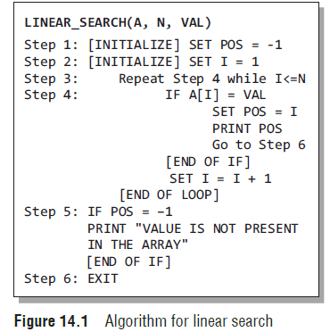
Cont.

Slide 5
Step by Step - Example
(The below figure is contain animation. Please put slideshow option)

Slide 6
Cont.
Video Link
https://www.youtube.com/watch?v=iwo5WAldDks

Slide 7
Binary Search
Binary search is a searching algorithm that works efficiently with a sorted list.
Now, let us consider how this mechanism is applied to search for a value in a sorted array.
Consider an array A[] that is declared and initialized as
int A[] = {0, 1, 2, 3, 4, 5, 6, 7, 8, 9, 10};
and the value to be searched is VAL = 9. The algorithm will proceed in the following manner.

Slide 8
Cont.
BEG = 0, END = 10, MID = (0 + 10)/2 = 5
Now, VAL = 9 and A[MID] = A[5] = 5
A[5] is less than VAL, therefore, we now search for the value in the second half of the array. So,
we change the values of BEG and MID.
Now, BEG = MID + 1 = 6, END = 10, MID = (6 + 10)/2 =16/2 = 8
VAL = 9 and A[MID] = A[8] = 8
A[8] is less than VAL, therefore, we now search for the value in the second half of the segment.
So, again we change the values of BEG and MID.

Slide 9
Cont.
Now, BEG = MID + 1 = 9, END = 10, MID = (9 + 10)/2 = 9
Now, VAL = 9 and A[MID] = 9.
In this algorithm, we see that BEG and END are the beginning and ending positions of the segment that we are looking to search for the element.
MID is calculated as (BEG + END)/2. Initially, BEG = lower_bound and END = upper_bound.
The algorithm will terminate when A[MID] = VAL.
When the
algorithm ends, we will set POS = MID.

Slide 10
Cont.
POS is the position at which the value is present in the array.
However, if VAL is not equal to A[MID], then the values of BEG, END, and MID will be changed depending on whether VAL is smaller or greater than A[MID].
(a) If VAL < A[MID], then VAL will be present in the left segment of the array. So, the value of END will be changed as END = MID – 1.
(b) If VAL > A[MID], then VAL will be present in the right segment of the array. So, the value of BEG will be changed as BEG = MID + 1.

Slide 11
Cont.
Finally, if VAL is not present in the array, then eventually, END will be less than BEG. When this
happens, the algorithm will terminate and the search will be unsuccessful.

Slide 12
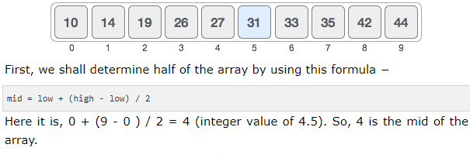
Example - Step by Step

Slide 13
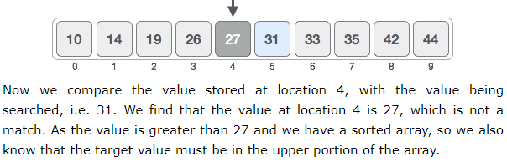
Cont.

Slide 14
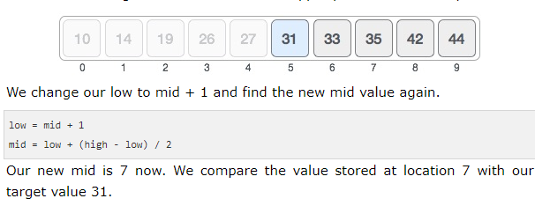
Cont.

Slide 15
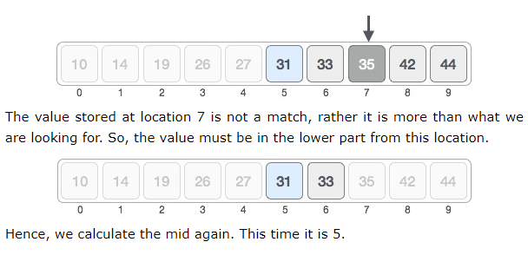
Cont.

Slide 16
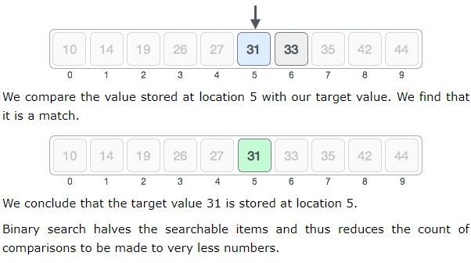
Cont.

Slide 17
Cont.
Video Link
https://www.youtube.com/watch?v=4y-vnflMWQ0

