Slide 1
School of Computing Science and Engineering
Course Code: BTCS9401
Course Name: Data Science
UNIT -1
Faculty Name: Mr. S. Prakash
Program Name: B.Tech

Slide 2
COURSE OBJECTIVE
Understand concepts of data science.
Understand popular tools of data analysis.
Learn data science in python.
Apply different visualization Techniques on datasets.
Implement learning techniques in data science.

Slide 3
Statistics for Data Science
Statistics is one of the popularly known disciplines that is mainly focused on data collection, data organization, data analysis, data interpretation, and data visualization.
Earlier, statistics was practiced by statisticians, economists, business owners to calculate and represent relevant data in their field.

Slide 4
Statistics for Data Science
Basic Terminologies in Statistics:
To become a master in the statistical program we should be familiar with certain terminologies. They are:
Population: A population is the set of resources from where we can collect data
Sample: A Sample is nothing but a subset of the Population which is used for sampling of data and in inferential statistics to predict the outcome.

Slide 5
Statistics for Data Science
Statistics is one of the popularly known disciplines that is mainly focused on data collection, data organization, data analysis, data interpretation, and data visualization.
Earlier, statistics was practiced by statisticians, economists, business owners to calculate and represent relevant data in their field.

Slide 6
Statistics for Data Science
Variable: A Variable can be a number, a characteristic, or a quantity that can be counted. It can be also called a data point.
Probability Distribution: A probability distribution is a mathematical concept that primarily gives the probabilities of occurrence of different possible outcomes generally for an experiment conducted by statisticians.
Statistical Parameter: Statistical or population parameter is basically a quantity that helps in indexing a family of probability distributions like the mean, median, or mode of a population.

Slide 7
Statistics for Data Science
Types of Statistics Concepts:
Descriptive Statistics -Descriptive statistics is a concept that allows us to analyze and summarize data and organize the same in the form of numbers graph, bar plots, histogram, pie chart, etc. Descriptive statistics is simply a process to describe our existing data. It transforms the raw observations into some meaningful data that can be further interpreted and used. Concepts like standard deviation, central tendency are widely used around the world when it comes to learning descriptive statistics.

Slide 8
Statistics for Data Science
Types of Statistics Concepts:
Inferential Statistics – Inferential statistics on the other hand is an important concept that deals with drawing conclusions based on small samples collected from the entire population. For example, during an election poll, people will often want to predict the exit poll results so they will conduct a survey in various parts of state or country and record their opinion. Based on the information they have collected they tend to draw conclusions and make inferences to predict results for the entire population.

Slide 9
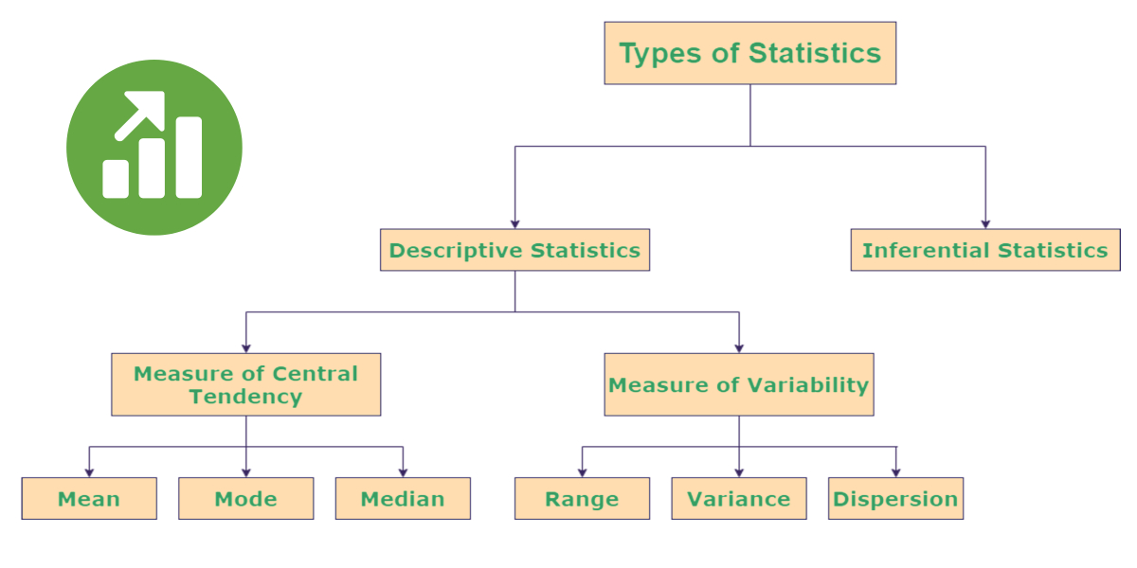
Statistics for Data Science

Slide 10
Statistics for Data Science
1. Descriptive Statistics
It is used to describe the basic features of data that provide a summary of the given data set which can either represent the entire population or a sample of the population. It is derived from calculations that include:
Mean: It is the central value which is commonly known as arithmetic average.
Mode: It refers to the value that appears most often in a data set.
Median: It is the middle value of the ordered set that divides it in exactly half.

Slide 11
Statistics for Data Science
2. Variability
Variability includes the following parameters:
Standard Deviation: It is a statistic that calculates the dispersion of a data set as compared to its mean.
Variance: It refers to a statistical measure of the spread between the numbers in a data set. In general terms, it means the difference from the mean. A large variance indicates that numbers are far apart from the mean or average value. Small variance indicates that the numbers are closer to the average values. Zero variance indicates that the values are identical to the given set.

Slide 12
Statistics for Data Science
Range: This is defined as the difference between the largest and smallest value of a dataset.
Percentile: It refers to the measure used in statistics that indicates the value below which the given percentage of observation in the dataset falls.
Quartile: It is defined as the value that divides the data points into quarters.
Interquartile Range: It measures the middle half of your data. In general terms, it is the middle 50% of the dataset.

Slide 13
Statistics for Data Science
3. . Correlation
It is one of the major statistical techniques that measure the relationship between two variables. The correlation coefficient indicates the strength of the linear relationship between two variables.
A correlation coefficient that is more than zero indicates a positive relationship.
A correlation coefficient that is less than zero indicates a negative relationship.
Correlation coefficient zero indicates that there is no relationship between the two variables.

Slide 14
Statistics for Data Science
4. Probability Distribution
It specifies the likelihood of all possible events. In simple terms, an event refers to the result of an experiment like tossing a coin. Events are of two types dependent and independent.
Independent event:
The event is said to be an Independent event when it is not affected by the earlier events. For example, tossing a coin, let us consider a coin is tossed the first outcome is head when the coin is tossed again the outcome may be head or tail. But this is entirely independent of the first trial.

Slide 15
Statistics for Data Science
Dependent event:
The event is said to be dependent when the occurrence of the event is dependent on the earlier events. For example when a ball is drawn from a bag that contains red and blue balls. If the first ball drawn is red, then the second ball may be red or blue; this depends on the first trial.
The probability of independent events is calculated by simply multiplying the probability of each event and for a dependent event is calculated by conditional probability.

Slide 16
Statistics for Data Science
5. Regression
It is a method that is used to determine the relationship between one or more independent variables and a dependent variable. Regression is mainly of two types:
Linear regression: It is used to fit the regression model that explains the relationship between a numeric predictor variable and one or more predictor variables.
Logistic regression: It is used to fit a regression model that explains the relationship between the binary response variable and one or more predictor variables.

Slide 17
Statistics for Data Science
6. Normal Distribution
Normal is used to define the probability density function for a continuous random variable in a system. The standard normal distribution has two parameters – mean and standard deviation that are discussed above. When the distribution of random variables is unknown, the normal distribution is used. The central limit theorem justifies why normal distribution is used in such cases.

Slide 18
Statistics for Data Science
7. Bias
In statistical terms, it means when a model is representative of a complete population. This needs to be minimized to get the desired outcome.
The three most common types of bias are:
Selection bias: It is a phenomenon of selecting a group of data for statistical analysis, the selection in such a way that data is not randomized resulting in the data being unrepresentative of the whole population.
Confirmation bias: It occurs when the person performing the statistical analysis has some predefined assumption.
Time interval bias: It is caused intentionally by specifying a certain time range to favor a particular outcome.

Slide 19
Galgotias University
THANK YOU
THANK YOU

