Slide 1
School of Computing Science and Engineering
Course Code: BTCS9401
Course Name: Data Science
UNIT -1
Faculty Name: Mr. S. Prakash
Program Name: B.Tech

Slide 2
COURSE OBJECTIVE
Understand concepts of data science.
Understand popular tools of data analysis.
Learn data science in python.
Apply different visualization Techniques on datasets.
Implement learning techniques in data science.

Slide 3
Data Science Tools
1. Algorithms.io.
This tool is a machine-learning (ML) resource that takes raw data and shapes it into real-time insights and actionable events, particularly in the context of machine-learning.
Advantages:
It’s on a cloud platform, so it has all the SaaS advantages of scalability, security, and infrastructure
Makes machine learning simple and accessible to developers and companies

Slide 4
Data Science Tools
2. Apache Hadoop
This open-source framework creates simple programming models and distributes extensive data set processing across thousands of computer clusters. Hadoop works equally well for research and production purposes. Hadoop is perfect for high-level computations.
Advantages:
Open-source
Highly scalable
It has many modules available
Failures are handled at the application layer

Slide 5
Data Science Tools
3. Apache Spark
Also called “Spark,” this is an all-powerful analytics engine and has the distinction of being the most used data science tool. It is known for offering lightning-fast cluster computing. Spark accesses varied data sources such as Cassandra, HDFS, HBase, and S3. It can also easily handle large datasets.
Advantages:
Over 80 high-level operators simplify the process of parallel app building
Can be used interactively from the Scale, Python, and R shells
Advanced DAG execution engine supports in-memory computing and acyclic data flow

Slide 6
Data Science Tools
4.BigML
This tool is another top-rated data science resource that provides users with a fully interactable, cloud-based GUI environment, ideal for processing ML algorithms. You can create a free or premium account depending on your needs, and the web interface is easy to use.
Advantages:
An affordable resource for building complex machine learning solutions
Takes predictive data patterns and turns them into intelligent, practical applications usable by anyone
It can run in the cloud or on-premises

Slide 7
Data Science Tools
5. D3.js
D3.js is an open-source JavaScript library that lets you make interactive visualizations on your web browser. It emphasizes web standards to take full advantage of all of the features of modern browsers, without being bogged down with a proprietary framework.
Advantages:
D3.js is based on the very popular JavaScript
Ideal for client-side Internet of Things (IoT) interactions
Useful for creating interactive visualizations

Slide 8
Data Science Tools
6. Data Robot
This tool is described as an advanced platform for automated machine learning. Data scientists, executives, IT professionals, and software engineers use it to help them build better quality predictive models, and do it faster.
Advantages:
With just a single click or line of code, you can train, test, and compare many different models
It features Python SDK and APIs
It comes with a simple model deployment process

Slide 9
Data Science Tools
8. Excel
Yes, even this ubiquitous old database workhorse gets some attention here, too! Originally developed by Microsoft for spreadsheet calculations, it has gained widespread use as a tool for data processing, visualization, and sophisticated calculations.
Advantages:
You can sort and filter your data with one click
Advanced Filtering function lets you filter data based on your favorite criteria
Well-known and found everywhere

Slide 10
Data Science Tools
9. Java
Java is the classic object-oriented programming language that’s been around for years. It’s simple, architecture-neutral, secure, platform-independent, and object-oriented.
Advantages:
Suitable for large science projects if used with Java 8 with Lambdas
Java has an extensive suite of tools and libraries that are perfect for machine learning and data science
Easy to understand

Slide 11
Data Science Tools
10. MySQL
Another familiar tool that enjoys widespread popularity, MySQL is one of the most popular open-source databases available today. It’s ideal for accessing data from databases.
Advantages:
Users can easily store and access data in a structured manner
Works with programming languages like Java
It’s an open-source relational database management system

Slide 12
Data Science Tools
11. NLTK
Short for Natural Language Toolkit, this open-source tool works with human language data and is a well-liked Python program builder. NLTK is ideal for rookie data scientists and students.
Advantages:
Comes with a suite of text processing libraries
Offers over 50 easy-to-use interfaces
It has an active discussion forum that provides a wealth of new information

Slide 13
Data Science Tools
12. Rapid Miner
This data science tool is a unified platform that incorporates data prep, machine learning, and model deployment for making data science processes easy and fast. It enjoys heavy use in the manufacturing, telecommunication, utility, and banking industries.
Advantages:
All of the resources are located on one platform
GUI is based on a block-diagram process, simplifying these blocks into a plug-and-play environment
Uses a visual workflow designer to model machine learning algorithms

Slide 14
Data Science Tools
13. SAS
This data science tool is designed especially for statistical operations. It is a closed-source proprietary software tool that specializes in handling and analyzing massive amounts of data for large organizations. It’s well-supported by its company and very reliable. Still, it’s a case of getting what you pay for because SAS is expensive and best suited for large companies and organizations.
Advantages:
Numerous analytics functions covering everything from social media to automated forecasting to location data
It features interactive dashboards and reports, letting the user go straight from reporting to analysis
Contains advanced data visualization techniques such as auto charting to present compelling results and data

Slide 15
Data Science Tools
14. NLTK
Natural Language Processing has emerged as the most popular field in Data Science. It deals with the development of statistical models that help computers understand human language.
These statistical models are part of Machine Learning and through several of its algorithms, are able to assist computers in understanding natural language. Python language comes with a collection of libraries called Natural Language Toolkit (NLTK) developed for this particular purpose only.

Slide 16
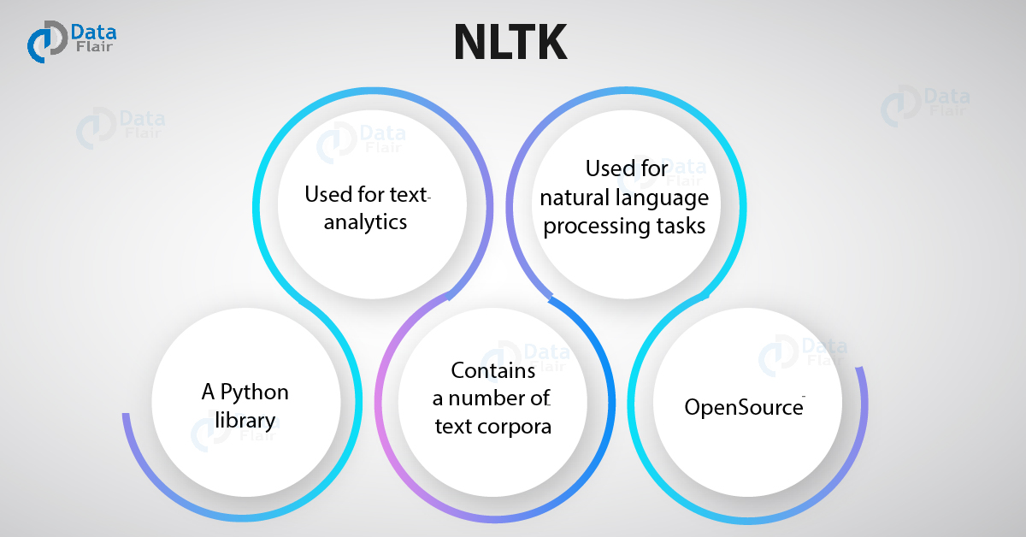
Data Science Tools

Slide 17
Data Science Tools
15. TensorFlow
TensorFlow has become a standard tool for Machine Learning. It is widely used for advanced machine learning algorithms like Deep Learning. Developers named TensorFlow after Tensors which are multidimensional arrays.
It is an open-source and ever-evolving toolkit which is known for its performance and high computational abilities. TensorFlow can run on both CPUs and GPUs and has recently emerged on more powerful TPU platforms.
This gives it an unprecedented edge in terms of the processing power of advanced machine learning algorithms.

Slide 18
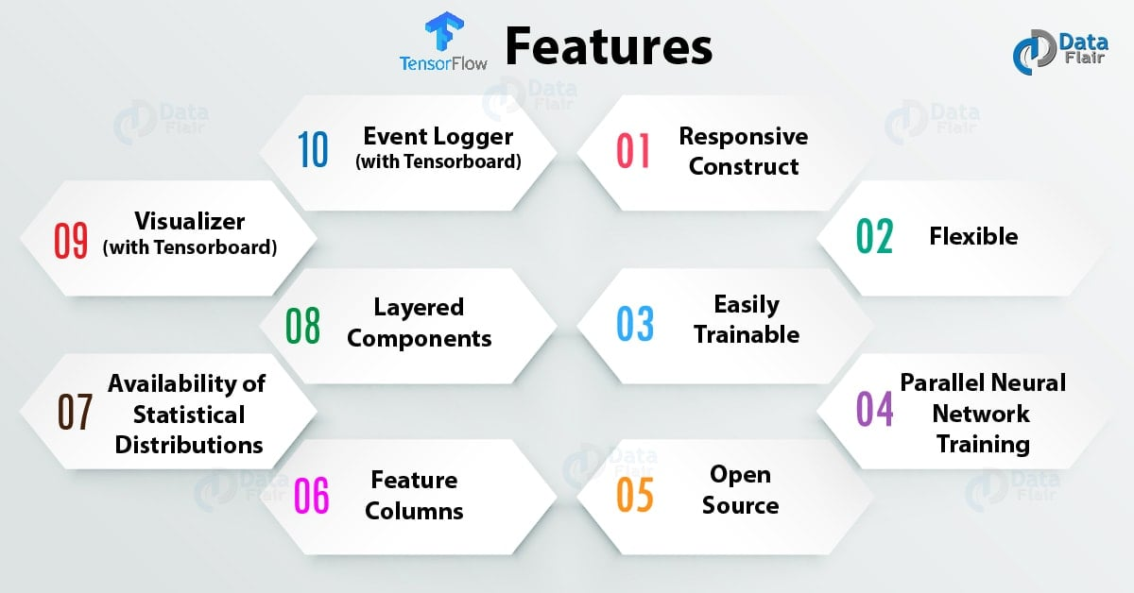
Data Science Tools
13. TensorFlow

Slide 19
Data Science Tools
16. Weka
Weka or Waikato Environment for Knowledge Analysis is a machine learning software written in Java. It is a collection of various Machine Learning algorithms for data mining. Weka consists of various machine learning tools like classification, clustering, regression, visualization and data preparation.
It is an open-source GUI software that allows easier implementation of machine learning algorithms through an interactable platform.

Slide 20
Data Science Tools
17. TensorFlow
TensorFlow has become a standard tool for Machine Learning. It is widely used for advanced machine learning algorithms like Deep Learning. Developers named TensorFlow after Tensors which are multidimensional arrays.
It is an open-source and ever-evolving toolkit which is known for its performance and high computational abilities. TensorFlow can run on both CPUs and GPUs and has recently emerged on more powerful TPU platforms.

Slide 21
Data Science Tools
17. TensorFlow
TensorFlow has become a standard tool for Machine Learning. It is widely used for advanced machine learning algorithms like Deep Learning. Developers named TensorFlow after Tensors which are multidimensional arrays.
It is an open-source and ever-evolving toolkit which is known for its performance and high computational abilities. TensorFlow can run on both CPUs and GPUs and has recently emerged on more powerful TPU platforms.

Slide 22
Data Science Tools
18. Matplotlib
Matplotlib is a plotting and visualization library developed for Python. It is the most popular tool for generating graphs with the analyzed data. It is mainly used for plotting complex graphs using simple lines of code. Using this, one can generate bar plots, histograms, scatterplots etc.
Matplotlib has several essential modules. One of the most widely used modules is pyplot. It offers a MATLAB like an interface. Pyplot is also an open-source alternative to MATLAB’s graphic modules.
Matplotlib is a preferred tool for data visualizations and is used by Data Scientists over other contemporary tools.
As a matter of fact, NASA used Matplotlib for illustrating data visualizations during the landing of Phoenix Spacecraft. It is also an ideal tool for beginners in learning data visualization with Python.

Slide 23
Galgotias University
THANK YOU
THANK YOU

