Slide 1

GALGOTIAS UNIVERSITY
Plot No.2, Sector -17 A, Yamuna Expressway,
Greater Noida, Gautam Buddha Nagar, U.P., India
SCHOOL OF COMPUTING SCIENCE & ENGINEERING
CAT-3 Case Study Report File Submission
On
“Design a web page for groceries”
Course Name: Computer Workshop
Course Code:BCS01T1004
School: SCSE
Program: B. TECH Year: 1st Semester: 1
Session: 2021-2022
Submitted By: | Submitted To:
NEERAJ SINGH(21SCSE1011675) DEEPANSH BHATIA(21SCSE1011677) Arnav kumar gupta(21SCSE1011650) | Miss Indervati

Slide 2
What is a webpage?
A web page or webpage is a document, commonly written in HTML, that is viewed in an Internet browser.
A web page can be accessed by entering a URL address into a browser's address bar. A web page may contain text, graphics, and hyperlinks to other web pages and files.
A web page is often used to provide information to viewers, including pictures or videos to help illustrate important topics.
A web page may also be used as a method to sell products or services to viewers. Multiple web pages make up a website, like our Computer Hope website

Slide 3
Web site
A website is a collection of linked web pages that share a unique domain name. Each web page of a given website provides explicit links—most of the time in the form of clickable portion of text—that allow the user to move from one page of the website to another.
To access a website, type its domain name in your browser address bar, and the browser will display the website's main web page, or homepage.
Web server
A web server is a computer hosting one or more websites. "Hosting" means that all the web pages and their supporting files are available on that computer. The web server will send any web page from the website it is hosting to any user's browser, per user request.
Don't confuse websites and web servers. For example, if you hear someone say, "My website is not responding", it actually means that the web server is not responding and therefore the website is not available. More importantly, since a web server can host multiple websites, the term web server is never used to designate a website, as it could cause great confusion. In our previous example, if we said, "My web server is not responding", it means that multiple websites on that web server are not available.

Slide 4
Advantages of Online Grocery Shopping
Buy in Bulk with Ease
Cut Gas and Parking Costs
Browse on Your Time
Avoid the Line and Shop in the Comfort of your Home
Avoid Making Multiple Trips

Slide 5
Disadvantages of online shopping.
Frauds in online shopping. Fraud in online shopping is the biggest disadvantage of online shopping.
Delay in the delivery.
You can't touch the product
You cannot bargain.
Hidden costs and shipping charges.
Lack of interaction.
Returning the product.

Slide 6
file:///F:/website/first.html

Slide 7
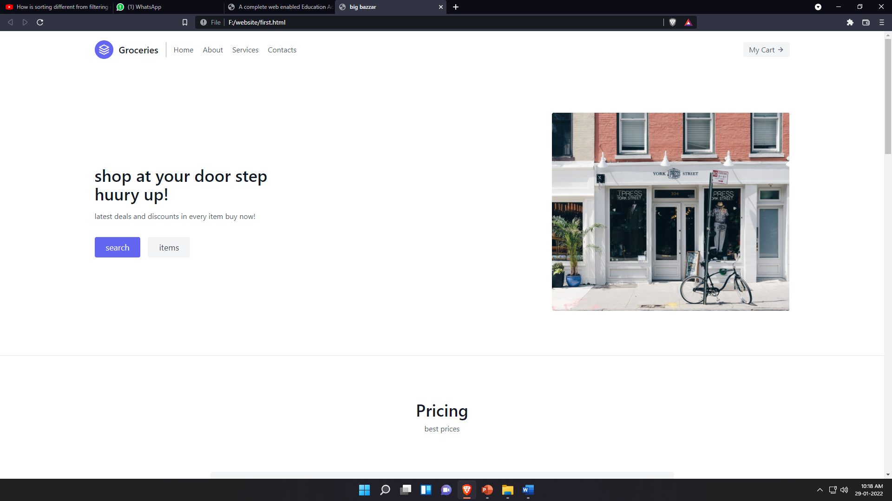

Slide 8
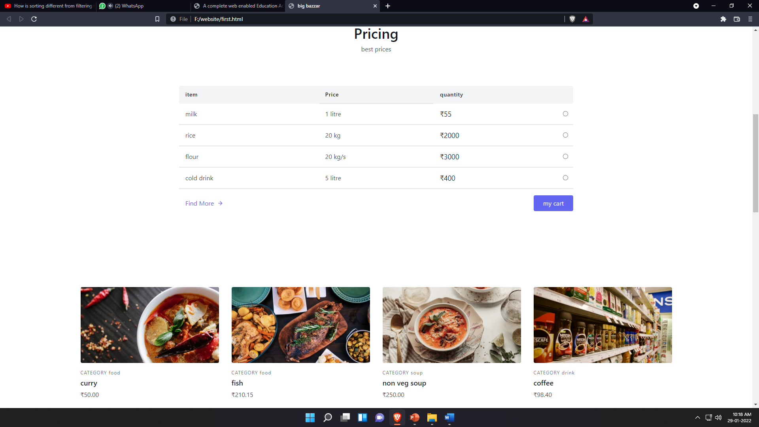

Slide 9
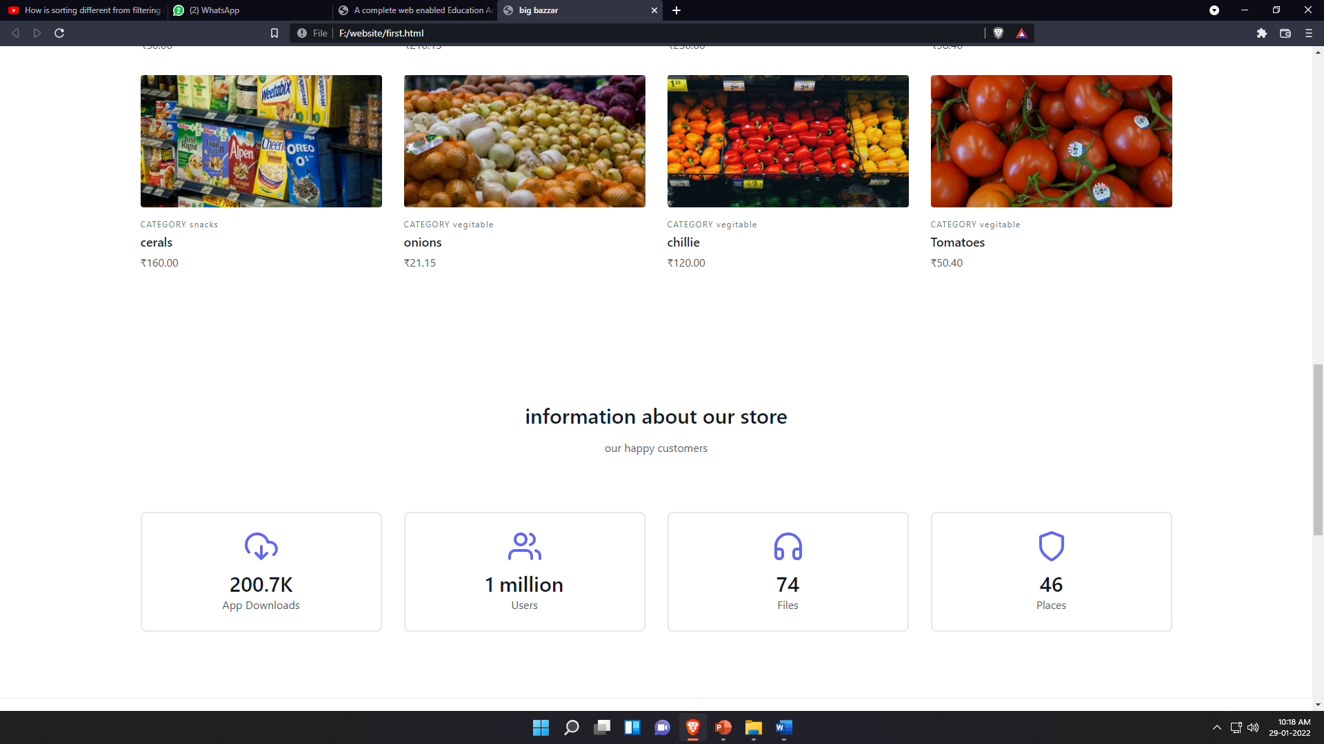

Slide 10
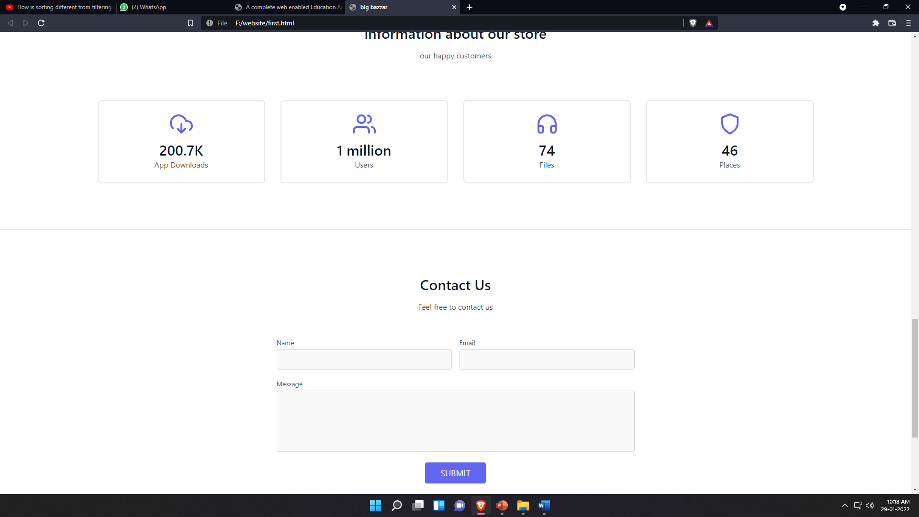

Slide 11
