Slide 1
School of Computing Science and Engineering
Course Code:
Course Name: Computer Graphics
Subject Code:
Subject Name: Computer Graphics
Faculty Name:
Program Name: B.Tech

Slide 2
School of Computing Science and Engineering
Course Code: BCSE2370
Course Name: Data Communication and Networking
COURSE OUTCOMES
On completion of the course, the student will be able to,
CO1. Understands the principles and techniques of computer graphics, e.g., the graphics pipeline, Line drawing algorithms and circle generation.
CO2. Apply the relevant mathematics to facilitate computer graphics, e.g., 2D and 3D rotations using both vector algebra, geometrical transformations
CO3. Analyze the concept of projections using homogeneous co-ordinations and curves & surfaces.
CO4. Develop of computer games, information visualization, and business applications with computer graphics concepts.
Faculty Name:
Program Name: B.Tech

Slide 3
School of Computing Science and Engineering
Course Code: BCSE2370
Course Name: Data Communication and Networking
Unit 1
Introduction Concepts
Faculty Name:
Program Name: B.Tech

Slide 4
Topics to be covered
Points and lines
Line drawing algorithms(DDA)
Bresenhem’s Line Drawing algorithm
Midpoint circle generating algorithm.
Revision
Basic transformation

Slide 5
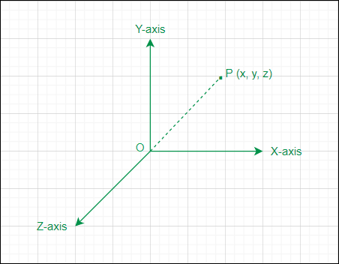
Points and lines
A Point in three-dimensional geometry is defined as a location in 3D space that is uniquely defined by an ordered triplet (x, y, z) where x, y, & z are the distances of the point from the X-axis, Y-axis, and Z-axis respectively.
Points is a location of space this is denoted by the dot symbol (.)
In computer graphics point is a pixel present on the device screen , point is a starting point of any element.

Slide 6
Points and lines
A Line in three-dimensional geometry is defined as a set of points in 3D that extends infinitely in both directions and is represented by L : (x – x1) / l = (y – y1) / m = (z – z1) / n; here (x, y, z) are the position coordinates of any variable point lying on the line, (x1, y1, z1) are the position coordinates of a point P lying on the line, and l, m, & n are the direction ratios (DRs).
In 3D a line is also formed by the intersection of two non-parallel planes.

Slide 7
Points and lines
Line is a collection of points drawing is accomplished by calculating intermediate positions along the line path between two specified endpoint positions.
An output device is then directed to fill in these positions between the endpoints. For analog devices, such as a vector pen plotter or a random-scan display, a straight line can be drawn smoothly from one endpoint to the other.
Digital devices display a straight line segment by plotting discrete points between the two endpoints. Discrete coordinate positions along the line path are calculated from the equation of the line.

Slide 8
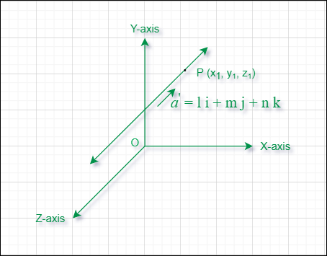
Introduction

Slide 9
Introduction
A Plane in three-dimensional (3D) geometry can be considered as a surface such that the line segment joining any two points on the surface lies completely on it.
The general form of a plane in 3D is a first-degree equation in x, y, z i.e. (a x + b y + c z + d = 0) where (x, y, z) represents the coordinates of a variable point on the plane.

Slide 10
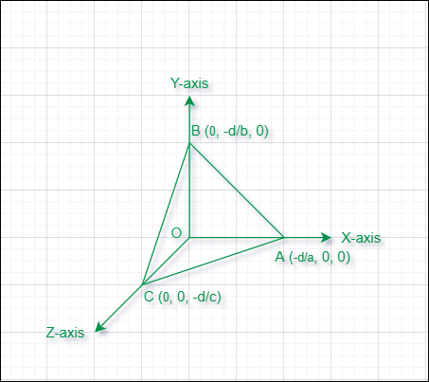
Introduction

Slide 11
Introduction
A Plane in three-dimensional (3D) geometry can be considered as a surface such that the line segment joining any two points on the surface lies completely on it.
The general form of a plane in 3D is a first-degree equation in x, y, z i.e. (a x + b y + c z + d = 0) where (x, y, z) represents the coordinates of a variable point on the plane.
slope-intercept equation for a straight line is
y=mx+c
Where m slope , c as the y intercept

Slide 12
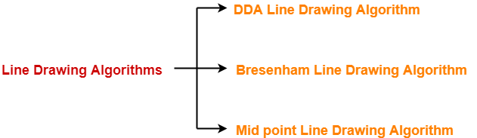
Line Drawing Algorithms
In computer graphics, popular algorithms used to generate lines are,
Digital Differential Analyzer (DDA) Line Drawing Algorithm
Bresenham’s Line Drawing Algorithm
Mid Point Line Drawing Algorithm

Slide 13
1. DDA Algorithm
DDA Algorithm is the simplest line drawing algorithm.
Given the starting and ending coordinates of a line, DDA Algorithm attempts to generate the points between the starting and ending coordinates.

Slide 14
1. DDA Algorithm
// calculate dx , dy
dx = X1 – X0; dy = Y1 – Y0;
// Depending upon absolute value of dx & dy // choose number of steps to put pixel as
// steps = abs(dx) > abs(dy) ? abs(dx) : abs(dy) steps = abs(dx) > abs(dy) ? abs(dx) : abs(dy);
// calculate increment in x & y for each steps
Xinc = dx / (float) steps; Yinc = dy / (float) steps;
// Put pixel for each step
X = X0; Y = Y0;
for (int i = 0; i <= steps; i++) { putpixel (round(X),round(Y),WHITE); X += Xinc; Y += Yinc; }

Slide 15
1. DDA Algorithm Advantages
The advantages of DDA Algorithm are-
It is a simple algorithm.
It is easy to implement.
It avoids using the multiplication operation which is costly in terms of time complexity.

Slide 16
1. DDA Algorithm Disadvantages
The disadvantages of DDA Algorithm are-
There is an extra overhead of using round off( ) function.
Using round off( ) function increases time complexity of the algorithm.
Resulted lines are not smooth because of round off( ) function.
The points generated by this algorithm are not accurate.
Web Reference: https://www.youtube.com/watch?v=W5P8GlaEOSI&feature=youtu.be

Slide 17
2. Bresenham’s Line Generation Algorithm
Given the coordinate of two points A(x1, y1) and B(x2, y2). The task is to find all the intermediate points required for drawing line AB on the computer screen of pixels. Note that every pixel has integer coordinates.
Examples:
Input : A(0,0), B(4,4)
Output : (0,0), (1,1), (2,2), (3,3), (4,4)
Input : A(0,0), B(4,2)
Output : (0,0), (1,0), (2,1), (3,1), (4,2)

Slide 18
2. Bresenham’s Line Generation Algorithm
Below are some assumptions to keep the algorithm simple.
We draw lines from left to right.
x1 < x2 and y1< y2
Slope of the line is between 0 and 1. We draw a line from lower left to upper right.

Slide 19
2. Bresenham’s Line Generation Algorithm
The above algorithm works, but it is slow. The idea of Bresenham’s algorithm is to avoid floating point multiplication and addition to compute mx + c, and then compute the round value of (mx + c) in every step. In Bresenham’s algorithm, we move across the x-axis in unit intervals.
We always increase x by 1, and we choose about next y, whether we need to go to y+1 or remain on y. In other words, from any position (Xk, Yk) we need to choose between (Xk + 1, Yk) and (Xk + 1, Yk + 1).

Slide 20
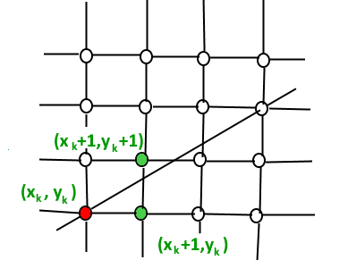
2. Bresenham’s Line Generation Algorithm

Slide 21
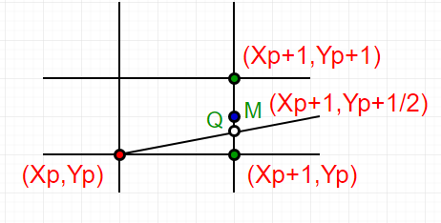
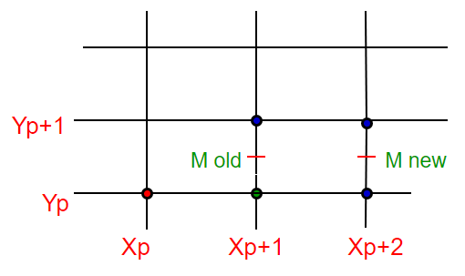
3. Mid-Point Line Generation Algorithm
Given coordinate of two points A(x1, y1) and B(x2, y2) such that x1 < x2 and y1 < y2. The task to find all the intermediate points required for drawing line AB on the computer screen of pixels. Note that every pixel has integer coordinates.

Slide 22
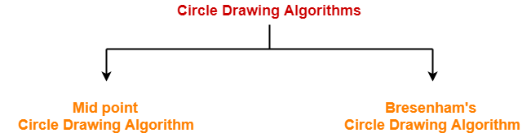
Circle Generation Algorithm
In computer graphics, popular algorithms used to generate circle are-
Mid Point Circle Drawing Algorithm
Bresenham Circle Drawing Algorithm

Slide 23
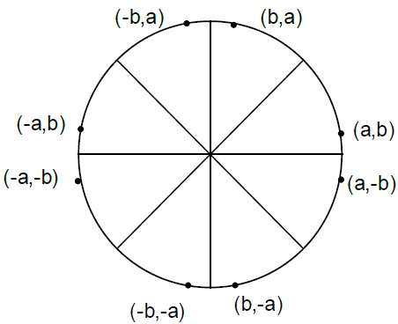
Circle Generation Algorithm
Drawing a circle on the screen is a little complex than drawing a line. There are two popular algorithms for generating a circle − Bresenham’s Algorithm and Midpoint Circle Algorithm. These algorithms are based on the idea of determining the subsequent points required to draw the circle. Let us discuss the algorithms in detail −
The equation of circle is X²+Y²=r²,
where r is radius.

Slide 24
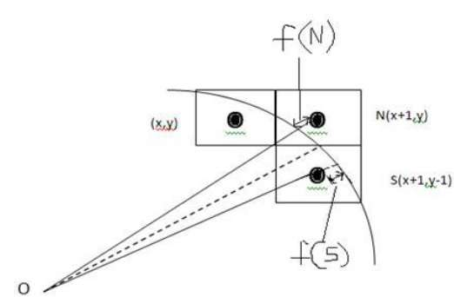
Circle Generation Algorithm
Bresenham’s Algorithm
We cannot display a continuous arc on the raster display. Instead, we have to choose the nearest pixel position to complete the arc.
From the following illustration, you can see that we have put the pixel at X,Y
location and now need to decide where to put the next pixel − at N X+1,Y or at S X+1,Y−1

Slide 25
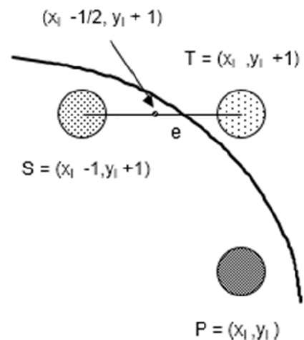
Circle Generation Algorithm
Mid Point Algorithm
Input radius r and circle center (xc,yc)
and obtain the first point on the circumference of the circle centered on the origin as
(x0, y0) = (0, r)

Slide 26
Advantages of Mid Point Circle Drawing Algorithm
The advantages of Mid Point Circle Drawing Algorithm are-
It is a powerful and efficient algorithm.
The entire algorithm is based on the simple equation of circle X2 + Y2 = R2.
It is easy to implement from the programmer’s perspective.
This algorithm is used to generate curves on raster displays.

Slide 27
Disadvantages of Mid Point Circle Drawing Algorithm
The disadvantages of Mid Point Circle Drawing Algorithm are-
Accuracy of the generating points is an issue in this algorithm.
The circle generated by this algorithm is not smooth.
This algorithm is time consuming.

Slide 28
Basic transformation
Computer Graphics provide the facility of viewing object from different angles. The architect can study building from different angles i.e.
Front Evaluation
Side elevation
Top plan

Slide 29
Basic transformation
A Cartographer can change the size of charts and topographical maps. So if graphics images are coded as numbers, the numbers can be stored in memory. These numbers are modified by mathematical operations called as Transformation.
The purpose of using computers for drawing is to provide facility to user to view the object from different angles, enlarging or reducing the scale or shape of object called as Transformation.

Slide 30
Basic transformation
Two essential aspects of transformation are given below:
Each transformation is a single entity. It can be denoted by a unique name or symbol.
It is possible to combine two transformations, after connecting a single transformation is obtained, e.g., A is a transformation for translation. The B transformation performs scaling. The combination of two is C=AB. So C is obtained by concatenation property.

Slide 31
Basic transformation
There are two complementary points of view for describing object transformation.
Geometric Transformation: The object itself is transformed relative to the coordinate system or background. The mathematical statement of this viewpoint is defined by geometric transformations applied to each point of the object.
Coordinate Transformation: The object is held stationary while the coordinate system is transformed relative to the object. This effect is attained through the application of coordinate transformations.

Slide 32
Basic transformation
Types of Transformations:
Translation
Scaling
Rotating
Reflection
Shearing

Slide 33
Text and References Books
Computer Graphics C Version – Donald Hearn and M Pauline Baker, Pearson Education.
Computer Graphics – Amrendra N Sinha and Arun D Udai, TMH Publications
Computer Graphics: A Programming Approach – Steven Harrington, TMH Publications
Procedural Elements of Computer Graphics – Rogers, McGraw Hill

Slide 34
GALGOTIAS UNIVERSITY
THANK YOU

