Slide 1
What is Data Science?
An area that manages, manipulates, extracts, and interprets knowledge from tremendous amount of data
Data science (DS) is a multidisciplinary field of study with goal to address the challenges in big data
Data science principles apply to all data – big and small

Slide 2
What is Data Science?
Theories and techniques from many fields and disciplines are used to investigate and analyze a large amount of data to help decision makers in many industries such as science, engineering, economics, politics, finance, and education
Computer Science
Pattern recognition, visualization, data warehousing, High performance computing, Databases, AI
Mathematics
Mathematical Modeling
Statistics
Statistical and Stochastic modeling, Probability.

Slide 3
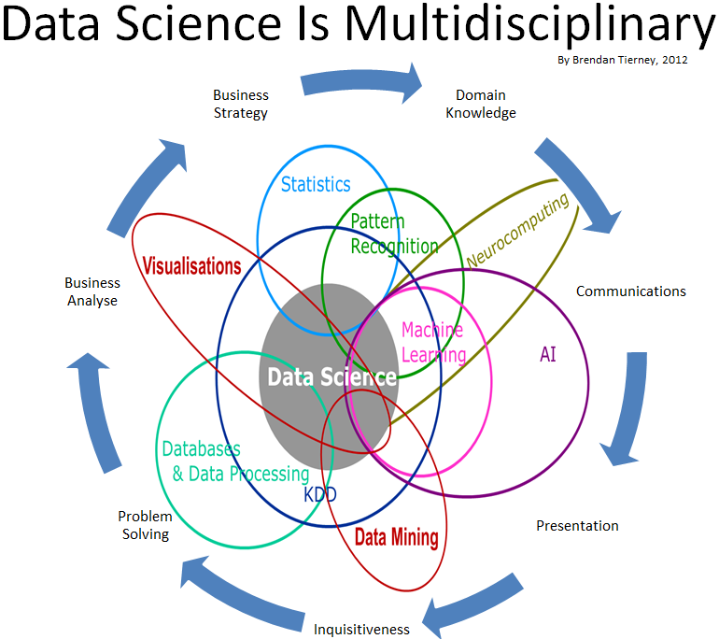
Data Science

Slide 4
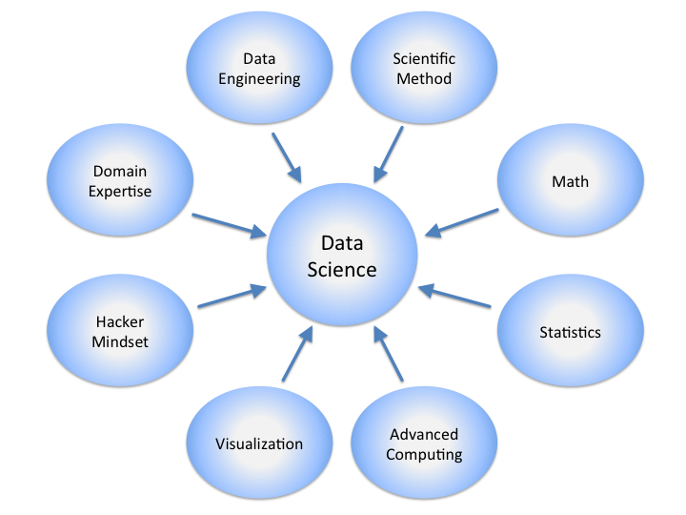
Data Science

Slide 5
Real Life Examples
Companies learn your secrets, shopping patterns, and preferences
For example, can we know if a woman is pregnant, even if she doesn’t want us to know? Target case study
Data Science and election (2008, 2012)
1 million people installed the Obama Facebook app that gave access to info on “friends”

Slide 6

Data Scientists
Data Scientist
The Sexiest Job of the 21st Century
They find stories, extract knowledge. They are not reporters

Slide 7

Data Scientists
Data scientists are the key to realizing the opportunities presented by big data. They bring structure to it, find compelling patterns in it, and advise executives on the implications for products, processes, and decisions

Slide 8
What do Data Scientists do?
National Security
Cyber Security
Business Analytics
Engineering
Healthcare
And more ….

Slide 9
Concentration in Data Science
Mathematics and Applied Mathematics
Applied Statistics/Data Analysis
Solid Programming Skills (R, Python, Julia, SQL)
Data Mining
Data Base Storage and Management
Machine Learning and discovery

