Slide 1

CAT-III
BCSE2361
DATA STRUCTURES & ALGORITHMS
Prepared by:
NEERAJ SINGH : 21SCSE1011675
NITIN KUMAR : 21SCSE1011671
RADHESHYAM : 21SCSE1011633
Semester: III Section:6
Session 2022-2023
SUBMITTED TO: Dr. Arvind Dagur Sir
1

Slide 2
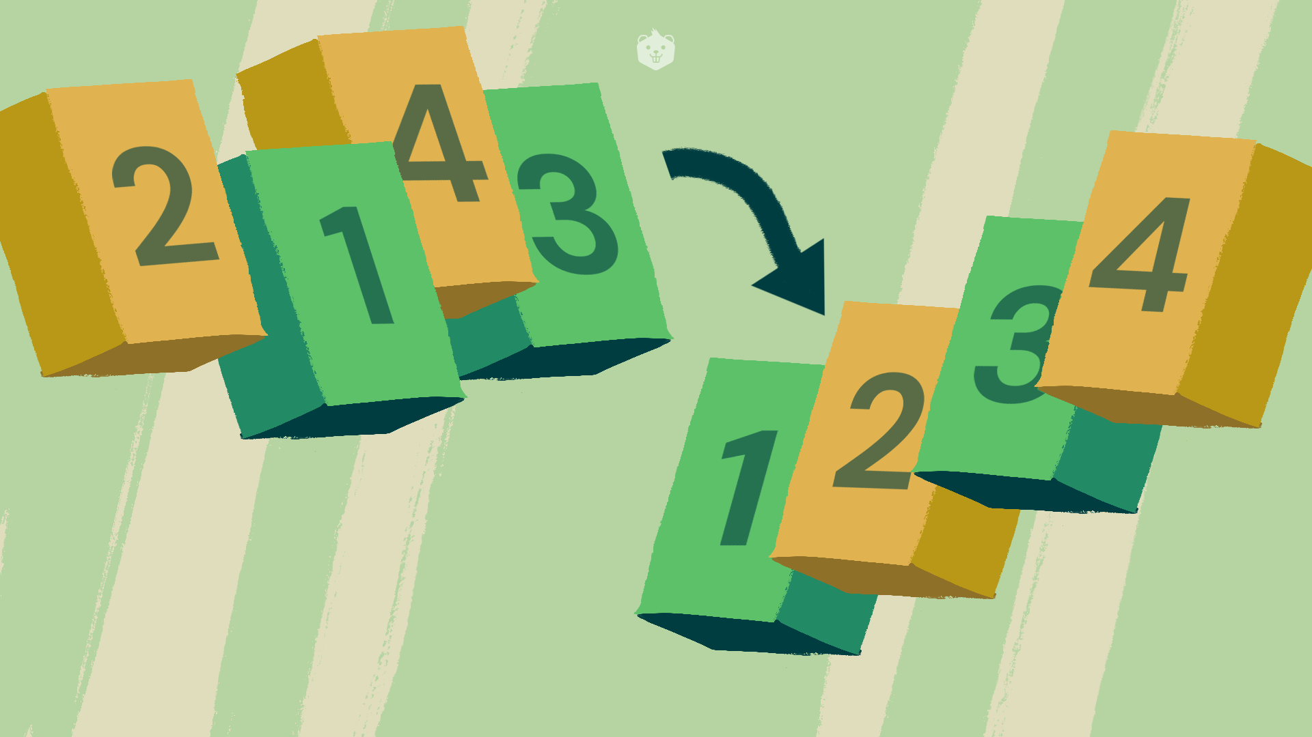
CAT-III
TOPIC
Cartesian Tree Sorting
2

Slide 3
School of Computing Science & Engineering
Course Code : BCSE2361 Course Name: DATA STRUCTURES & ALGORITHMS
Cartesian Tree Sorting
Cartesian Sort is an Adaptive Sorting as it sorts the data faster if data is partially sorted
It needs two data structures: a Cartesian tree and a priority queue.
The algorithm here uses min-heap Cartesian tree to give a sorted sequence.
We can also use max-heap Cartesian tree but that will give a sorted sequence in non-increasing order.
For example consider the array {5, 10, 40, 30, 28}.
The input data is partially sorted too as only one swap between “40” and “28” results in a completely sorted order.

Slide 4
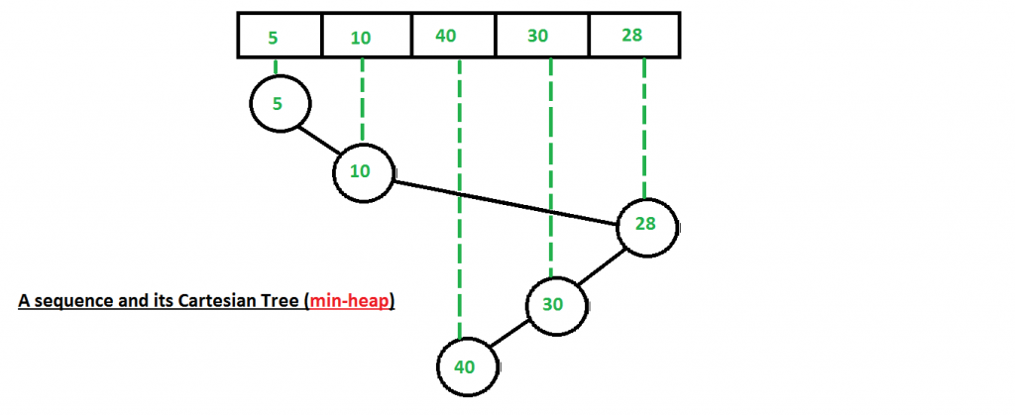
School of Computing Science & Engineering
Course Code : BCSE2361 Course Name: DATA STRUCTURES & ALGORITHMS
STEPS USED FOR SORTING
Step 1 : Build a (min-heap) Cartesian Tree from the given input sequence.

Slide 5
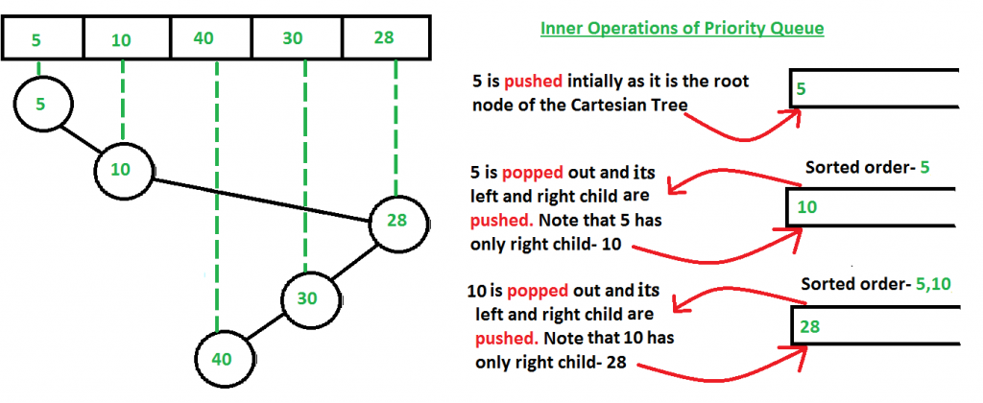
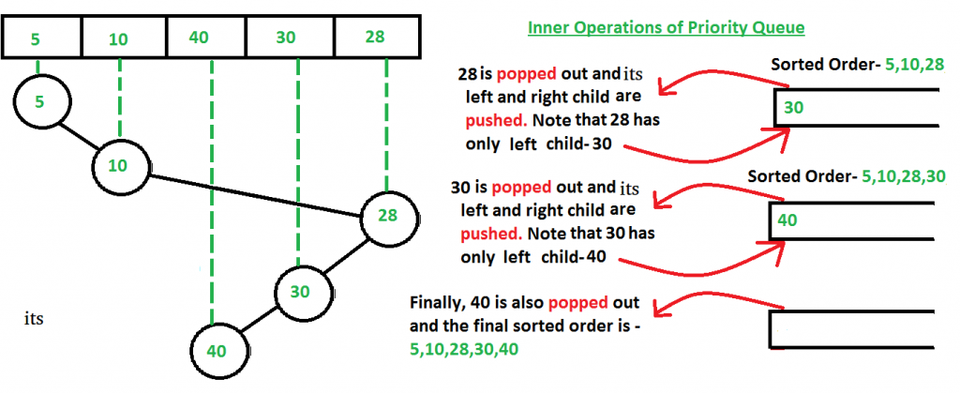
School of Computing Science & Engineering
Course Code : BCSE2361 Course Name: DATA STRUCTURES & ALGORITHMS
Step 2 : Starting from the root of the built Cartesian Tree, we push the nodes in a priority queue. Then we pop the node at the top of the priority queue and push the children of the popped node in the priority queue in a pre-order manner.
Pop the node at the top of the priority queue and add it to a list.
Push left child of the popped node first (if present).
Push right child of the popped node next (if present).

Slide 6
School of Computing Science & Engineering
Course Code : BCSE2361 Course Name: DATA STRUCTURES & ALGORITHMS
APPROACH
Construct a Cartesian tree for given sequence.
Create a priority queue, at first having only the root of Cartesian tree.
Pop the minimum value x from the priority queue
Add x to the output sequence
Push the left child of x from Cartesian tree into priority queue.
Push the right child of x from Cartesian tree into priority queue.
If priority queue is not empty, again go to step 3.

Slide 7
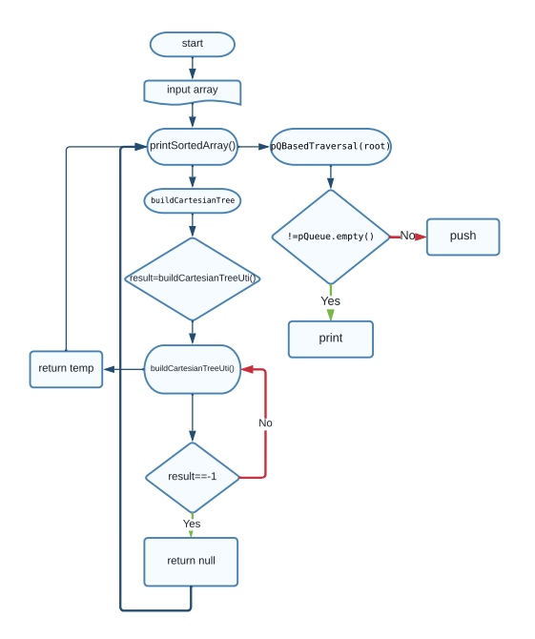
School of Computing Science & Engineering
Course Code : BCSE2361 Course Name: DATA STRUCTURES & ALGORITHMS
FLOWCHART

Slide 8
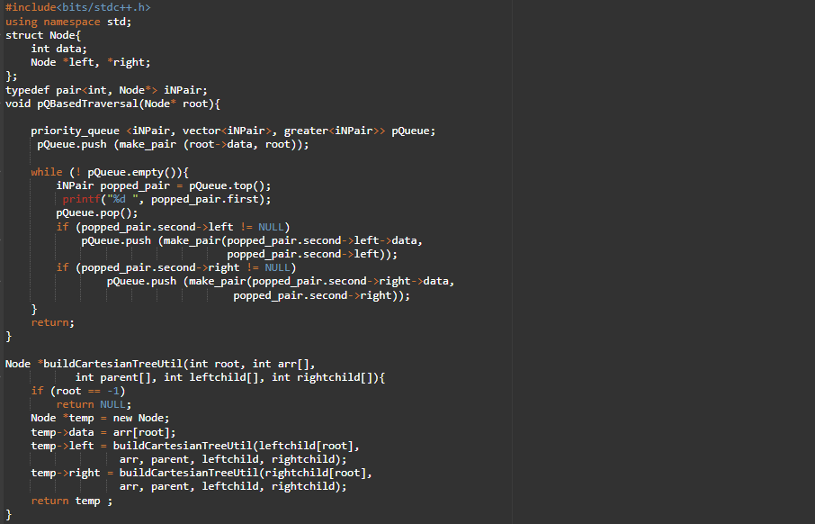
School of Computing Science & Engineering
Course Code : BCSE2361 Course Name: DATA STRUCTURES & ALGORITHMS
IMPLEMENTATION

Slide 9
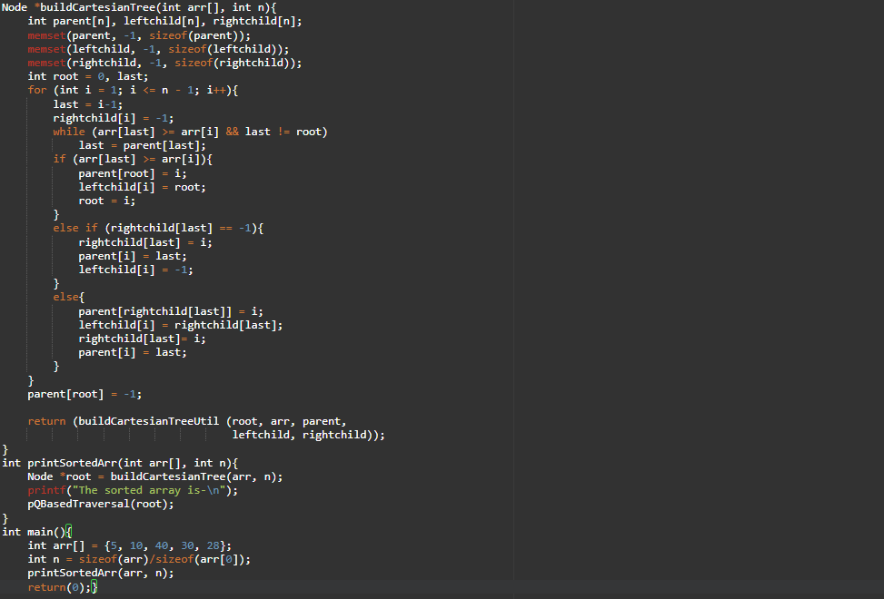
School of Computing Science & Engineering
Course Code : BCSE2361 Course Name: DATA STRUCTURES & ALGORITHMS

Slide 10
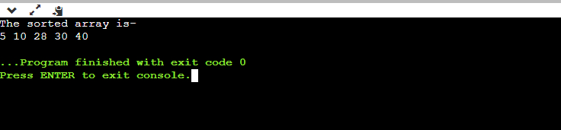
School of Computing Science & Engineering
Course Code : BCSE2361 Course Name: DATA STRUCTURES & ALGORITHMS
OUTPUT

Slide 11
School of Computing Science & Engineering
Course Code : BCSE2361 Course Name: DATA STRUCTURES & ALGORITHMS
Time Complexity:
O(n) best-case behaviour (when the input data is partially sorted),
O(n log n) worst-case behavior (when the input data is not partially sorted)
Auxiliary Space :
We use a priority queue and a Cartesian tree data structure. Now, at any moment of time the size of the priority queue doesn’t exceeds the size of the input array, as we are constantly pushing and popping the nodes. Hence we are using O(n) auxiliary space.

Slide 12
School of Computing Science & Engineering
Course Code : BCSE2361 Course Name: DATA STRUCTURES & ALGORITHMS
References
[1] Cartesian Tree Sorting- https://www.geeksforgeeks.org/cartesian-tree-sorting/

Slide 13
School of Computing Science & Engineering
Course Code : BCSE2361 Course Name: DATA STRUCTURES & ALGORITHMS
THANK YOU

