Slide 1



3140702
Operating System
Unit – 5
Deadlock
Subject Faculty: Prof. Aanchal Phutela
Computer Engineering
aanchal.phutela@marwadieducation.edu.in

Slide 2
Disclaimer
It is hereby declared that the production of the said content is meant for non-commercial, scholastic and research purposes only.
We admit that some of the content or the images provided in this channel's videos may be obtained through the routine Google image searches and few of them may be under copyright protection. Such usage is completely inadvertent.
It is quite possible that we overlooked to give full scholarly credit to the Copyright Owners. We believe that the non-commercial, only-for-educational use of the material may allow the video in question fall under fair use of such content. However we honor the copyright holder's rights and the video shall be deleted from our channel in case of any such claim received by us or reported to us.

Slide 3
Topics to be covered
Deadlock and its Principles
Four Necessary Conditions of Deadlock
Deadlock Prevention
Resource Allocation Graph (RAG)
Deadlock Avoidance - Banker’s algorithm
Deadlock Detection & Recovery.

Slide 4
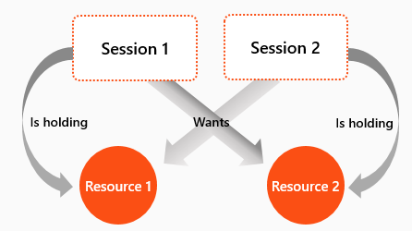
What is Deadlock?

Slide 5
Definition of Deadlock
A deadlock consists of a set of blocked processes, each holding a resource and waiting to acquire a resource held by another process in the set.
For Example:
two processes each want to record a scanned document on a CD.
process 1 requests for scanner & gets it
process 2 requests for CD writer & gets it
process 1 requests CD writer but is blocked
process 2 requests scanner but is blocked.
At this point both processes are blocked and will remain so forever,
This situation is called a deadlock

Slide 6
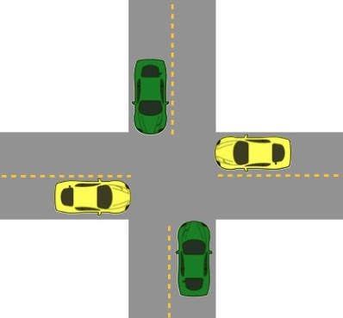
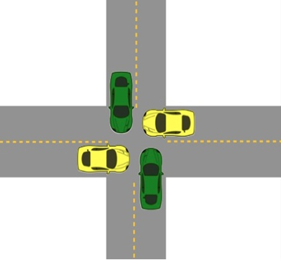
Deadlock
The processes are the cars.
The resources are the spaces occupied by the cars
Deadlock possible
Deadlock occurred

Slide 7
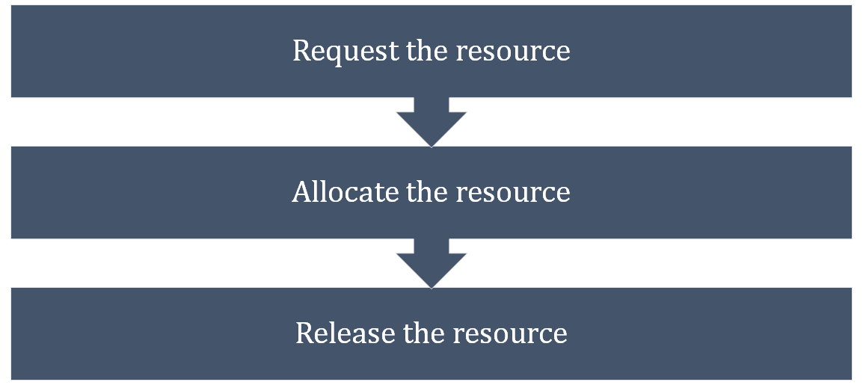
Sequence of events to use a Resource

Slide 8
Necessary Conditions for Deadlock
Mutual exclusion:
At least one resource type in the system which can be used in non-shareable mode (i.e. one at a time) for example printer.
Because many resource can be shared by more than one process at a time (e.g., Memory location).
Hold and Wait:
Processes are allowed to request for new resources without releasing the resources they are currently holding.
No pre-emption:
A resource can be released only voluntarily by the process holding it after that process has completed its task.

Slide 9
Necessary Conditions for Deadlock
Circular wait:
Two or more processes must form a circular chain in which each process is waiting for a resource that is held by the next member of the chain.
All four of these conditions must hold simultaneously in a system for a deadlock to occur.

Slide 10
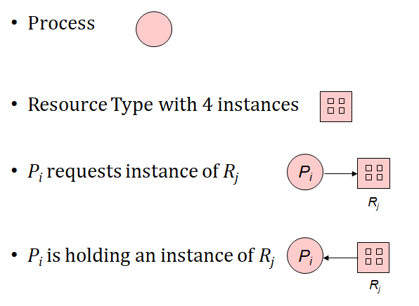
Deadlock Modeling
For Deadlock modeling a directed graph, called Resource Allocation Graph (RAG) is used.
Notation used for representation of RAG -

Slide 11
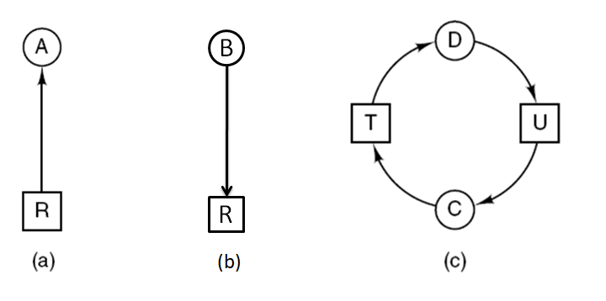
Construction of Resource Allocation Graph
B
R
(b)
Figure : Resource allocation graphs
(a) Holding a resource. (b) Requesting a resource. (c) Deadlock.

Slide 12
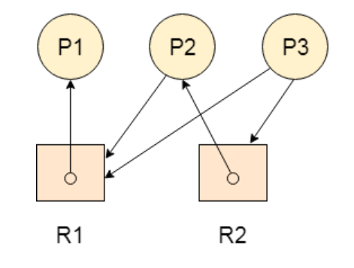
Resource Allocation Graph
Problem-1 : Find the system is in a deadlock state or not?

Slide 13
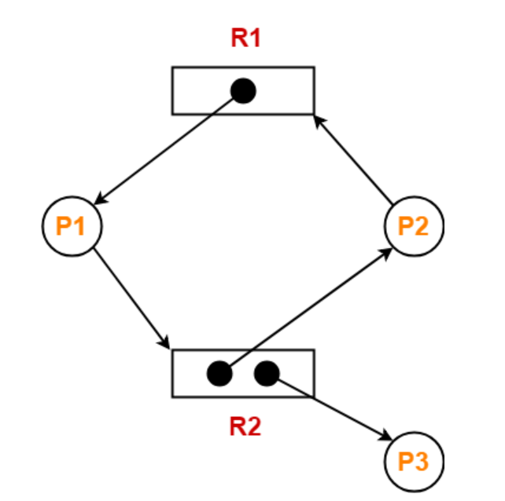
Resource Allocation Graph
Problem-2 : Find the system is in a deadlock state or not?

Slide 14
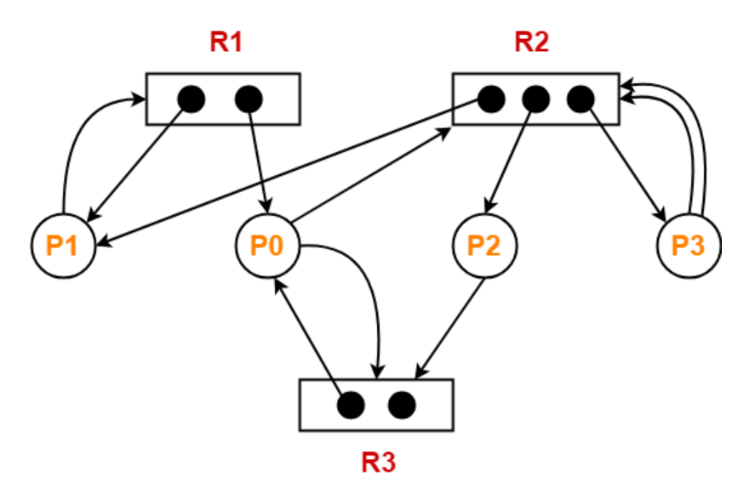
Resource Allocation Graph
Problem-3 : Find the system is in a deadlock state or not?

Slide 15
Handling Deadlocks In DOS
Handling of deadlocks in distributed systems is more complex than in centralized systems.
Because the resources, the processes, and other relevant information are scattered on different nodes of the system.
Strategies to handle deadlocks:
Prevention – constraints are imposed on the way in which processes request resources in order to prevent deadlocks.
Avoidance – resources are carefully allocated to avoid deadlocks.
Detection and recovery – deadlocks are allowed to occur and a detection algorithm is used to detect them. After deadlock is detected it is resolved by certain means.
Ignore – do nothing, just ignore the problem.

Slide 16
Deadlock Prevention
Deadlock can be prevented by violating the one of the four conditions that leads to deadlock.
Attacking the Mutual Exclusion Condition
Attacking the Hold and Wait Condition
Attacking the No Preemption Condition
Attacking the Circular Wait Condition

Slide 17
Violation of Mutual Exclusion Condition
No deadlock if each resource can be assigned to more than one process.
This can violate the hardware properties of a resource.
We can not assign some resources to more than one process at a time such as printer.
Not feasible

Slide 18
Violation of Hold and Wait Condition
Conservative Approach : Process is allowed to start execution if and only if it has acquired all the resources (less efficient, not implementable, easy, deadlock independence)
A process is allowed to run if all resources it needed is available. Otherwise nothing will be allocated and it will just wait.
Problem with this strategy is that a process may not know required resources at start of run.
Resource will not be used optimally.
It may cause starvation of a process that needs may resources.

Slide 19
Violation of Hold and Wait Condition
2. Do not Hold: A process will acquire all desired resources but before making any fresh request it must release all the resources that it currently hold (efficient, implementable)
3. Wait Timeout: We place a maximum time up to which a process can wait after which process and release all the holding resources.

Slide 20
Violation of No Preemption Condition
Forcefully Pre-emption: We allow a process to forcefully pre-empt the resource by other processes
For example - When a process request for a resource that is currently not available, all the resources held by the process are taken away from it and process is blocked.
This method may be used by high priority process or system process.
The process which are in waiting state must be selected as a victim instead of process in the running state.

Slide 21
Violation of Circular Wait Condition
To provide a global numbering of all the resources.
Processes can request resources whenever they want to, but all requests must be made in increasing or decreasing order.
A process need not acquire them all at once.
Circular wait is prevented if a process holding resource n cannot wait for resource m, if m > n.
1.Printer, 2.Scanner, 3.Plotter, 4.Tape drive, 5.CD ROM
A process may request 1st a CD ROM drive, then tape drive. But it may not request 1st a plotter, then a Tape drive.
Resource graph can never have cycle.
P1 – R1, R2, R4, R43, R56
P1 – R1, R4, R2 NOT POSSIBLE

Slide 22
Deadlock Avoidance
In most systems, however, resources are requested one at a time. The system must be able to decide whether granting a resource is safe or not and only make the allocation when it is safe.
Safe and Unsafe state
A state is said to be safe if it is not deadlocked and there is some scheduling order in which every process can run to completion if all of them suddenly request their maximum number of resources immediately.

Slide 23
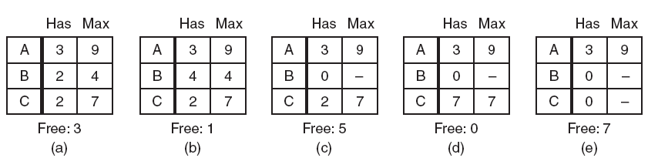
Safe State
A total of 10 instance of the resource exist, so with 7 resources already allocated, there are 3 still free.
Figure : Demonstration that the state in (a) is safe.

Slide 24
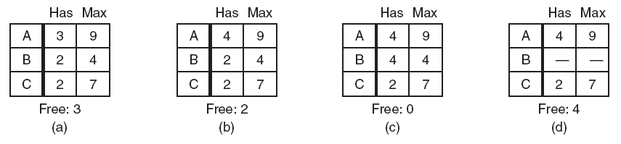
Unsafe State
Figure : Demonstration that the state in (b) is not safe.
Thus from the safe state system can guarantee that all process will finish and from unsafe state no such guarantee can be given.

Slide 25
The Banker’s Algorithm for a Single Resource
It is modeled on the way a small-town banker might deal with a group of customers to whom he has granted lines of credit.
What the algorithm does is check to see if granting the request leads to an unsafe state.
If it does, the request is denied.
If granting the request leads to a safe state, it is carried out.

Slide 26
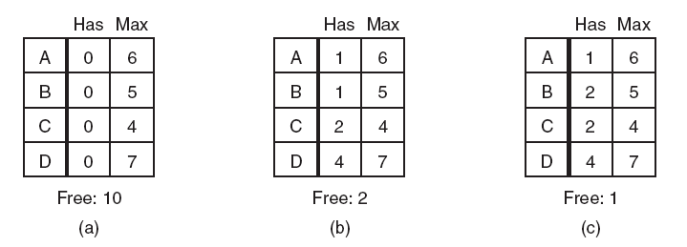
The Banker’s Algorithm for a Single Resource
Figure : Three resource allocation states:
The banker’s algorithm considers each request as it occurs, and see if granting it leads to a safe state. If it does, the request is granted; otherwise, it is postponed until later. To see if a state is safe, the banker checks to see if he has enough resources to satisfy some customer. If so, those loans are assumed to be repaid.

Slide 27
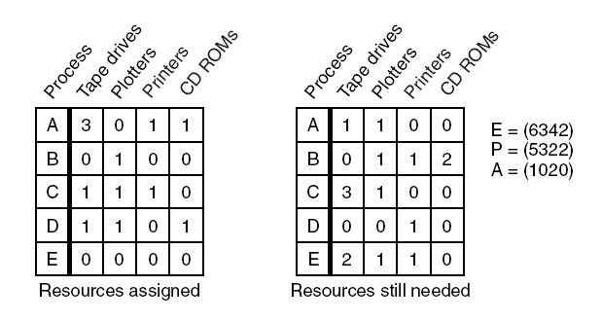
The Banker’s Algorithm for Multiple Resources
Figure : The banker’s algorithm with multiple resources. {Max (7,5,5,5) Allocated (5,3,2,2) avail=max-allocated (1,1,3,3) A=(3,0,1,1)+(1,1,3,3)}

Slide 28
The Banker’s Algorithm for Multiple Resources
Algorithm for checking to see if a state is safe:
Look for row, R, whose unmet resource needs all ≤ A. If no such row exists, system will eventually deadlock since no process can run to completion
Assume process of row chosen requests all resources it needs and finishes. Mark process as terminated, add all its resources to the A vector.
Repeat steps 1 and 2 until either all processes marked terminated (initial state was safe) or no process left whose resource needs can be met (there is a deadlock).
If the order of execution is: D,A,B,C and E then safe state(no Deadlock)
If D request 1 CDROM then it leads to unsafe state(deadlock)

Slide 29
The Banker’s Algorithm for Multiple Resources
Algorithm for checking to see if a state is safe:
Look for row, R, whose unmet resource needs all ≤ A. If no such row exists, system will eventually deadlock since no process can run to completion
Assume process of row chosen requests all resources it needs and finishes. Mark process as terminated, add all its resources to the A vector.
Repeat steps 1 and 2 until either all processes marked terminated (initial state was safe) or no process left whose resource needs can be met (there is a deadlock).

Slide 30
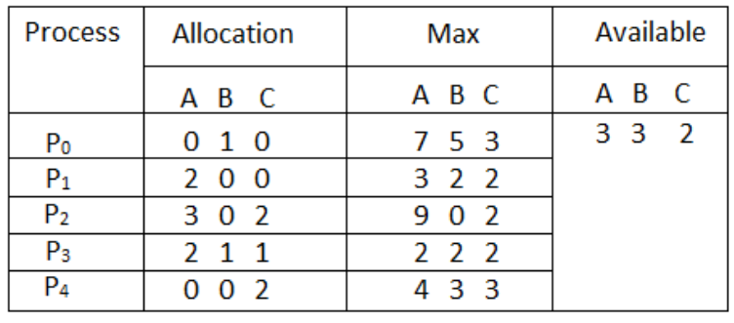
Numerical - The Banker’s Algorithm
Considering a system with five processes P0 through P4 and three resources of type A, B, C. Resource type A has 10 instances, B has 5 instances and type C has 7 instances. Find the safe sequence of the system with current allocation.

Slide 31
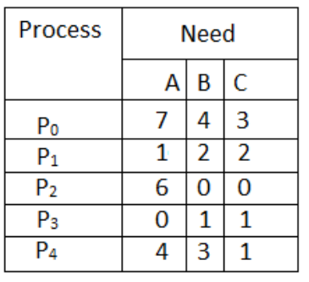

Slide 32
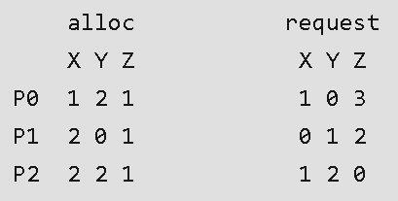
Numerical - The Banker’s Algorithm
A single processor system has three resource types X, Y and Z, which are shared by three processes. There are 5 units of each resource type. Consider the following scenario, where the column alloc denotes the number of units of each resource type allocated to each process, and the column request denotes the number of units of each resource type requested by a process in order to complete execution. Which of these processes will finish LAST? (GATE-2007 | 2-MARKS)
(A) P0 (B) P1 (C) P2 (D) None of the above, since the system is in a deadlock

Slide 33
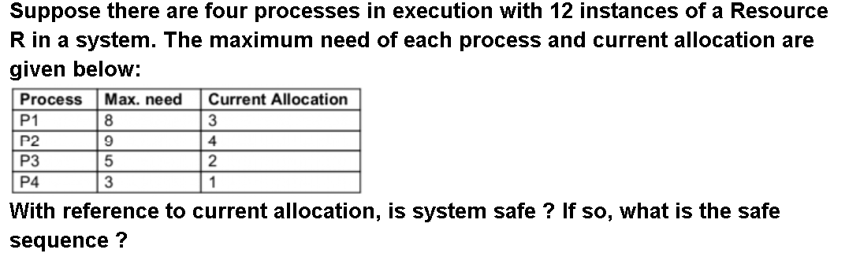
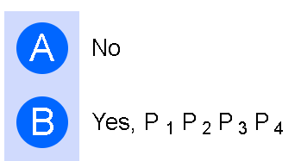
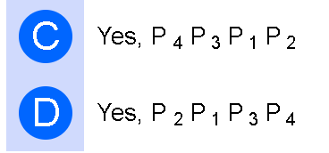
Numerical - The Banker’s Algorithm
(UGC-NET 2016 AUG)

Slide 34
Deadlock Detection
When this technique is used, the system does not attempt to prevent deadlocks from occurring.
Instead, it lets them occur, tries to detect when this happens, and then takes some action to recover after the fact.
For deadlock detection, the system must provide
An algorithm that examines the state of the system to detect whether a deadlock has occurred
And an algorithm to recover from the deadlock

Slide 35
Deadlock Detection: one Resource of each type
There are seven process, A to G, and six resources R through W
Process A hold R and wants S.
Process B holds nothing but wants T.
Process C holds nothing but wants S.
Process D holds U and wants S and T.
Process E holds T and wants V.
Process F holds W and wants S.
Process G holds V and wants U.
Is this system deadlock ? And if so which processes are involved ?

Slide 36
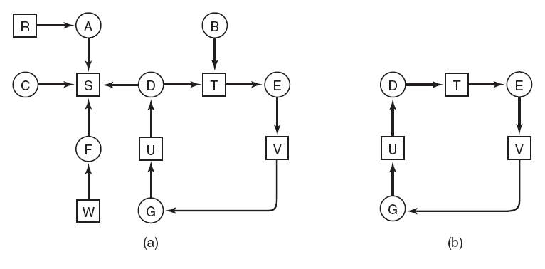
Deadlock Detection: one Resource of each type
Figure :
(a) A resource graph. (b) A cycle extracted from fig(a).

Slide 37
Deadlock Detection: one Resource of each type
Algorithm for detecting Deadlock
For each node, N in the graph, perform the following five steps with N as the starting node.
Initialize L to the empty list, designate all arcs as unmarked.
Add current node to end of L, check to see if node now appears in L two times. If it does, graph contains a cycle (listed in L), algorithm terminates.
From given node, see if any unmarked outgoing arcs. If so, go to step 5; if not, go to step 6.
Pick an unmarked outgoing arc at random and mark it. Then follow it to the new current node and go to step 3.
If this is initial node, graph does not contain any cycles, algorithm terminates. Otherwise, dead end. Remove it, go back to previous node, make that one current node, go to step 3.

Slide 39
Deadlock Detection: one Resource of each type
We start at R and initialize L to the empty list. Then we add R to the list and move to the only possibility, A, and add it to L, giving
L = [R, A].
A we go to S, giving L = [R, A, S].
Dead end.
we restart the algorithm starting at A, resetting L to the empty list. This search, too, quickly stops, so we start again at B.
From B get to D, at which time L = [B, T, E, V, G, U, D].
If we pick S we come to a dead end and backtrack to D. The second time we pick T and
update L to be [B, T, E, V, G, U, D, T], at which point we discover the cycle and stop the algorithm.

Slide 40
Deadlock Detection: Multiple Resources of Each Type
Each process is initially said to be unmarked. As the algorithm progresses, processes will be marked, indicating that they are able to complete and are thus not deadlocked. When the algorithm terminates, any unmarked processes are known to be deadlocked
Deadlock detection algorithm
Look for an unmarked process, P_{i} , for which the i-th row of R is less than or equal to A.
If such a process is found, add the i-th row of C to A, mark the process, and go back to step 1.
If no such process exists, the algorithm terminates.

Slide 41
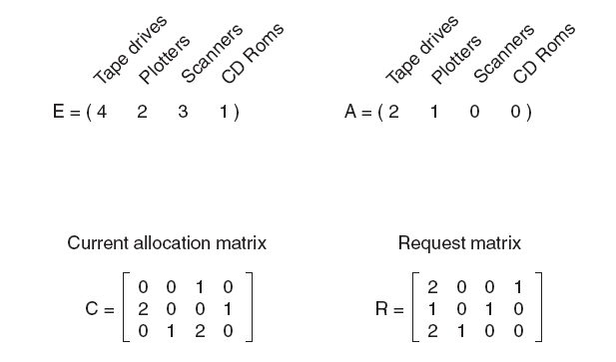
Deadlock Detection: Multiple Resources of Each Type
Three process and four classes for device are there

Slide 42
Deadlock Detection: Multiple Resources of Each Type
We will check the request matrix, process 0 request can not satisfied.
The process 1 request can not be satisfied.
Process 2 request can be satisfied so resources are granted.
Now A=(0 0 0 0)
After completion of process 2
A=(2 2 2 0)
Now we can assign resources to process 1.
After process 1 A=(4 2 2 1)
So there no dead lock.

Slide 43
Deadlock Recovery
Recovery
Recovery through preemption
Recovery through rollback
Recovery through killing processes

Slide 44
Deadlock Recovery
Recovery through preemption
In some cases, it may be possible to temporarily take a resource away from its current owner and give it to another process.
Recovering this way is frequently difficult or impossible.
Choosing the process to suspend depends largely on which ones have resources that can easily be taken back.
P₁
R₁
R₂
P₂

Slide 45
Deadlock Recovery
Recovery through killing processes
The simplest way to break a deadlock is to kill one or more processes.
Kill all the process involved in deadlock.
Kill process one by one.
After killing each process check for deadlock.
If deadlock recovered then stop killing more process.
Otherwise kill another process.

Slide 46
Deadlock Recovery
Recovery through rollback
Checkpoint a process periodically.
Check pointing a process means that its state is written to a file so that it can be restarted later.
When deadlock is detected, rollback the preempted process up to the previous safe state before it acquired that resource.

Slide 47


