Slide 1

School of Computing Science and Engineering
Program: B.Tech
Course Code: E2UC401B
Course Name: Operating system.
Presented by,
M R Sundarakumar
Assistant Professor,
SCSE

Slide 2
School of Computing Science and Engineering Course Code : E2UC401B Course Name: operating system
What is an Operating System?
A program that acts as an intermediary between a user of a computer and the computer hardware
Operating system goals:
Execute user programs and make solving user problems easier
Make the computer system convenient to use
Use the computer hardware in an efficient manner
Program Name: B.Tech

Slide 3
School of Computing Science and Engineering Course Code : E2UC401B Course Name: operating system
Computer System Structure
Computer system can be divided into four components
Hardware – provides basic computing resources
CPU, memory, I/O devices
Operating system
Controls and coordinates use of hardware among various applications and users
Application programs – define the ways in which the system resources are used to solve the computing problems of the users
Word processors, compilers, web browsers, database systems, video games
Users
People, machines, other computers
Program Name: B.Tech

Slide 4
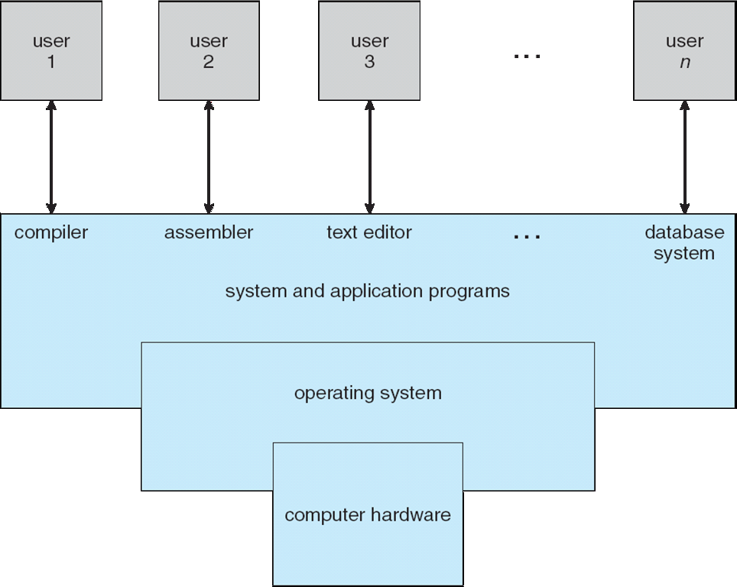
School of Computing Science and Engineering Course Code : E2UC401B Course Name: operating system
Four Components of a Computer System
Program Name: B.Tech

Slide 5
School of Computing Science and Engineering Course Code : E2UC401B Course Name: operating system
Operating System Definition
OS is a resource allocator
Manages all resources
Decides between conflicting requests for efficient and fair resource use
OS is a control program
Controls execution of programs to prevent errors and improper use of the computer
Program Name: B.Tech

Slide 6
School of Computing Science and Engineering Course Code : E2UC401B Course Name: operating system
Operating System Definition (Cont)
No universally accepted definition
“Everything a vendor ships when you order an operating system” is good approximation
But varies wildly
“The one program running at all times on the computer” is the kernel. Everything else is either a system program (ships with the operating system) or an application program
Program Name: B.Tech

Slide 7
School of Computing Science and Engineering Course Code : E2UC401B Course Name: operating system
Computer Startup
bootstrap program is loaded at power-up or reboot
Typically stored in ROM or EPROM, generally known as firmware
Initializes all aspects of system
Loads operating system kernel and starts execution
Program Name: B.Tech

Slide 8
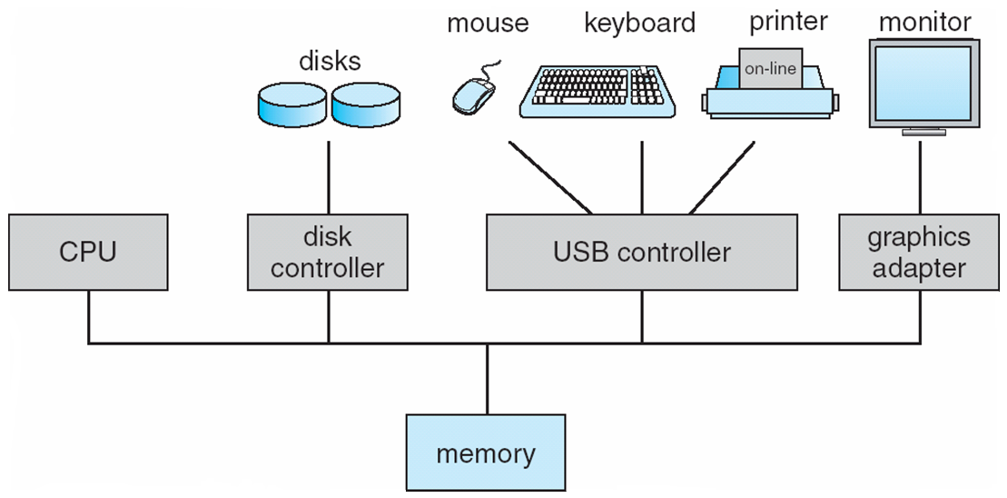
School of Computing Science and Engineering Course Code : E2UC401B Course Name: operating system
Computer System Organization
Computer-system operation
One or more CPUs, device controllers connect through common bus providing access to shared memory
Concurrent execution of CPUs and devices competing for memory cycles
Program Name: B.Tech

Slide 9
School of Computing Science and Engineering Course Code : E2UC401B Course Name: operating system
Computer-System Operation
I/O devices and the CPU can execute concurrently
Each device controller is in charge of a particular device type
Each device controller has a local buffer
CPU moves data from/to main memory to/from local buffers
I/O is from the device to local buffer of controller
Device controller informs CPU that it has finished its operation by causing an interrupt
Program Name: B.Tech

Slide 10
School of Computing Science and Engineering Course Code : E2UC401B Course Name: operating system
Common Functions of Interrupts
Interrupt transfers control to the interrupt service routine generally, through the interrupt vector, which contains the addresses of all the service routines
Interrupt architecture must save the address of the interrupted instruction
Incoming interrupts are disabled while another interrupt is being processed to prevent a lost interrupt
A trap is a software-generated interrupt caused either by an error or a user request
An operating system is interrupt driven
Program Name: B.Tech

Slide 11
School of Computing Science and Engineering Course Code : E2UC401B Course Name: operating system
Storage Structure
Main memory – only large storage media that the CPU can access directly
Secondary storage – extension of main memory that provides large nonvolatile storage capacity
Magnetic disks – rigid metal or glass platters covered with magnetic recording material
Disk surface is logically divided into tracks, which are subdivided into sectors
The disk controller determines the logical interaction between the device and the computer
Program Name: B.Tech

Slide 12
School of Computing Science and Engineering Course Code : E2UC401B Course Name: operating system
Storage Hierarchy
Storage systems organized in hierarchy
Speed
Cost
Volatility
Caching – copying information into faster storage system; main memory can be viewed as a last cache for secondary storage
Program Name: B.Tech

Slide 13
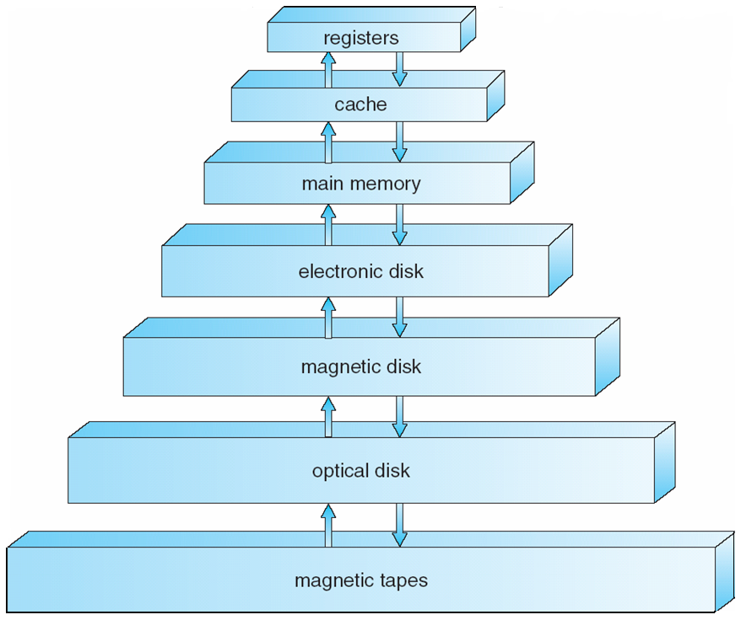
School of Computing Science and Engineering Course Code : E2UC401B Course Name: operating system
Storage-Device Hierarchy
Program Name: B.Tech

Slide 14
School of Computing Science and Engineering Course Code : E2UC401B Course Name: operating system
Computer-System Operation
I/O devices and the CPU can execute concurrently
Each device controller is in charge of a particular device type
Each device controller has a local buffer
CPU moves data from/to main memory to/from local buffers
I/O is from the device to local buffer of controller
Device controller informs CPU that it has finished its operation by causing an interrupt
Program Name: B.Tech

Slide 15
School of Computing Science and Engineering Course Code : E2UC401B Course Name: operating system
Caching
Important principle, performed at many levels in a computer (in hardware, operating system, software)
Information in use copied from slower to faster storage temporarily
Faster storage (cache) checked first to determine if information is there
If it is, information used directly from the cache (fast)
If not, data copied to cache and used there
Cache smaller than storage being cached
Cache management important design problem
Cache size and replacement policy
Program Name: B.Tech

Slide 16
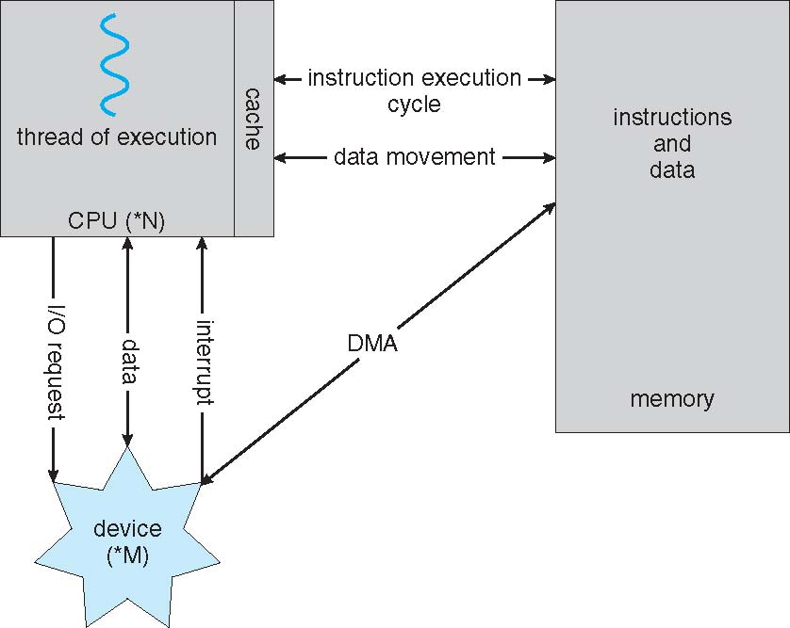
School of Computing Science and Engineering Course Code : E2UC401B Course Name: operating system
How a Modern Computer Works
Program Name: B.Tech

Slide 17
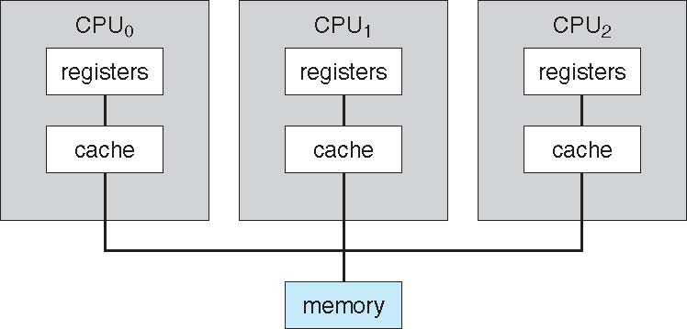
School of Computing Science and Engineering Course Code : E2UC401B Course Name: operating system
Symmetric Multiprocessing Architecture
Program Name: B.Tech

Slide 18
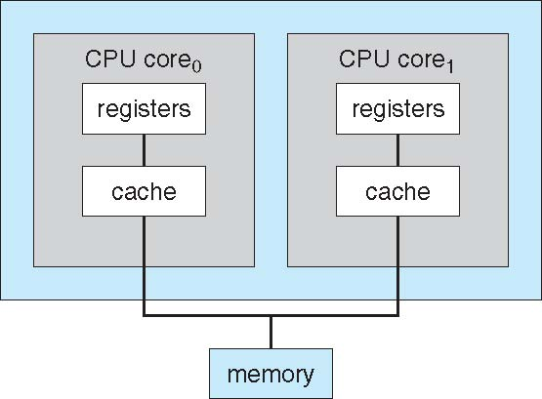
School of Computing Science and Engineering Course Code : E2UC401B Course Name: operating system
A Dual-Core Design
Program Name: B.Tech

Slide 19
School of Computing Science and Engineering Course Code : E2UC401B Course Name: operating system
Clustered Systems
Like multiprocessor systems, but multiple systems working together
Usually sharing storage via a storage-area network (SAN)
Provides a high-availability service which survives failures
Asymmetric clustering has one machine in hot-standby mode
Symmetric clustering has multiple nodes running applications, monitoring each other
Some clusters are for high-performance computing (HPC)
Applications must be written to use parallelization
Program Name: B.Tech

Slide 20
School of Computing Science and Engineering Course Code : E2UC401B Course Name: operating system
Operating System Structure
Multiprogramming needed for efficiency
Single user cannot keep CPU and I/O devices busy at all times
Multiprogramming organizes jobs (code and data) so CPU always has one to execute
A subset of total jobs in system is kept in memory
One job selected and run via job scheduling
When it has to wait (for I/O for example), OS switches to another job
Timesharing (multitasking) is logical extension in which CPU switches jobs so frequently that users can interact with each job while it is running, creating interactive computing
Response time should be < 1 second
Each user has at least one program executing in memory process
If several jobs ready to run at the same time  CPU scheduling
If processes don’t fit in memory, swapping moves them in and out to run
Virtual memory allows execution of processes not completely in memory
Program Name: B.Tech

Slide 21
School of Computing Science and Engineering Course Code : E2UC401B Course Name: operating system
Operating-System Operations
Interrupt driven by hardware
Software error or request creates exception or trap
Division by zero, request for operating system service
Other process problems include infinite loop, processes modifying each other or the operating system
Dual-mode operation allows OS to protect itself and other system components
User mode and kernel mode
Mode bit provided by hardware
Provides ability to distinguish when system is running user code or kernel code
Some instructions designated as privileged, only executable in kernel mode
System call changes mode to kernel, return from call resets it to user
Program Name: B.Tech

Slide 22
School of Computing Science and Engineering Course Code : E2UC401B Course Name: operating system
Process Management
A process is a program in execution. It is a unit of work within the system. Program is a passive entity, process is an active entity.
Process needs resources to accomplish its task
CPU, memory, I/O, files
Initialization data
Process termination requires reclaim of any reusable resources
Single-threaded process has one program counter specifying location of next instruction to execute
Process executes instructions sequentially, one at a time, until completion
Multi-threaded process has one program counter per thread
Typically system has many processes, some user, some operating system running concurrently on one or more CPUs
Concurrency by multiplexing the CPUs among the processes / threads
Program Name: B.Tech

Slide 23
School of Computing Science and Engineering Course Code : E2UC401B Course Name: operating system
Process Management Activities
The operating system is responsible for the following activities in connection with process management:
Creating and deleting both user and system processes
Suspending and resuming processes
Providing mechanisms for process synchronization
Providing mechanisms for process communication
Providing mechanisms for deadlock handling
Program Name: B.Tech

Slide 24
School of Computing Science and Engineering Course Code : E2UC401B Course Name: operating system
Memory Management
All data in memory before and after processing
All instructions in memory in order to execute
Memory management determines what is in memory when
Optimizing CPU utilization and computer response to users
Memory management activities
Keeping track of which parts of memory are currently being used and by whom
Deciding which processes (or parts thereof) and data to move into and out of memory
Allocating and deallocating memory space as needed
Program Name: B.Tech

Slide 25
School of Computing Science and Engineering Course Code : E2UC401B Course Name: operating system
Storage Management
OS provides uniform, logical view of information storage
Abstracts physical properties to logical storage unit - file
Each medium is controlled by device (i.e., disk drive, tape drive)
Varying properties include access speed, capacity, data-transfer rate, access method (sequential or random)
File-System management
Files usually organized into directories
Access control on most systems to determine who can access what
OS activities include
Creating and deleting files and directories
Primitives to manipulate files and dirs
Mapping files onto secondary storage
Backup files onto stable (non-volatile) storage media
Program Name: B.Tech

Slide 26
School of Computing Science and Engineering Course Code : E2UC401B Course Name: operating system
Mass-Storage Management
Usually disks used to store data that does not fit in main memory or data that must be kept for a “long” period of time
Proper management is of central importance
Entire speed of computer operation hinges on disk subsystem and its algorithms
OS activities
Free-space management
Storage allocation
Disk scheduling
Some storage need not be fast
Tertiary storage includes optical storage, magnetic tape
Still must be managed
Varies between WORM (write-once, read-many-times) and RW (read-write)
Program Name: B.Tech

Slide 27
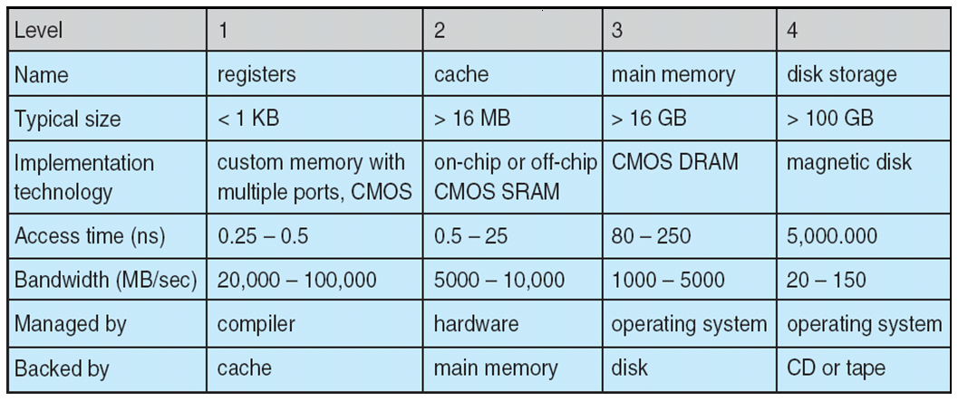
School of Computing Science and Engineering Course Code : E2UC401B Course Name: operating system
Performance of Various Levels of Storage
Movement between levels of storage hierarchy can be explicit or implicit
Program Name: B.Tech

Slide 28
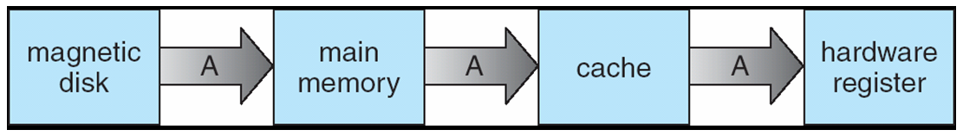
School of Computing Science and Engineering Course Code : E2UC401B Course Name: operating system
Migration of Integer A from Disk to Register
Multitasking environments must be careful to use most recent value, no matter where it is stored in the storage hierarchy
Multiprocessor environment must provide cache coherency in hardware such that all CPUs have the most recent value in their cache
Distributed environment situation even more complex
Several copies of a datum can exist
Various solutions covered in Chapter 17
Program Name: B.Tech

Slide 29
School of Computing Science and Engineering Course Code : E2UC401B Course Name: operating system
Open-Source Operating Systems
Operating systems made available in source-code format rather than just binary closed-source
Counter to the copy protection and Digital Rights Management (DRM) movement
Started by Free Software Foundation (FSF), which has “copyleft” GNU Public License (GPL)
Examples include GNU/Linux, BSD UNIX (including core of Mac OS X), and Sun Solaris
Program Name: B.Tech

