Slide 1


Minor Project
Title: Automatic memory management for c language
Presented by: Aryan Dhaked, 500105243
Sankalp Awasthi, 500101735
Sarthak Kaushal, 500105680
Aakash rana, 500106627
Guided by: Assistant professor Mr. Rajib Banarjee

Slide 2
Content
Abstract
Introduction
Literature Review
Problem Statement
Objective
Methodology
Pert Chart
Conclusion
9. References

Slide 3
1. Abstract
Develop automatic garbage collector for C language
Improve memory management and programmer efficiency
Use reference counting and mark-and-sweep algorithms
Reduce memory leaks, improve code reliability
Enhance programmer productivity

Slide 4
2. Introduction
Memory management in C is difficult and can cause errors.
Automatic garbage collection (AGC) can help.
AGC will identify and reclaim unused memory.
AGC will prevent errors and improve C program reliability.

Slide 5
3.Literature Review
Reference Counting:
Tracks references, reclaims when zero.
Efficient for small objects, but can have cycles.
Mark and Sweep:
Marks reachable objects, collects unmarked.
Suitable for large heap, but can cause pauses.
Hybrid Approaches:
Combine reference counting and mark and sweep.
Reduce overhead, balance performance.
Challenges:
Performance overhead.
Determinism issues.
Integration complexity.
Real-time limitations.
Existing AGCs:
Boehm-Demers-Weiser (BDW).
Explicitly-Kept Garbage Collector (EKGC).
Garbage Collection for C (GCC).
Each has unique features and trade-offs.

Slide 6
4. Problem Statement
Manual memory management in C is error-prone and time-consuming.
Memory leaks and segmentation faults are common issues.
Improving programmer productivity and code reliability is essential.
Automatic garbage collection can address these problems.

Slide 7
Error-Prone and Time-Consuming
Memory leaks: One of the most common issues is memory leaks, where allocated memory is not properly deallocated, leading to a gradual depletion of available memory over time.
Segmentation faults: These occur when a program attempts to access memory outside of its allocated bounds, often caused by incorrect memory management, such as accessing an array element beyond its index.
Double free and use after free: These errors can arise when memory is accidentally freed multiple times or used after it has been freed, leading to unpredictable behavior and potential crashes.
Manual overhead: Programmers must carefully allocate and deallocate memory, which can be time-consuming and error-prone, especially in complex applications.

Slide 8
Impact on Programmer Productivity and Code Reliability
Reduced productivity: The constant need to manage memory can significantly reduce programmer productivity, as it requires careful attention and can be a frequent source of debugging.
Increased risk of bugs: Memory-related errors can be difficult to detect and can lead to subtle bugs that are hard to reproduce.
Lower code reliability: The presence of memory leaks and other memory-related issues can compromise the overall reliability and stability of a C program.

Slide 9
The Solution: Automatic Garbage Collection
Automatic garbage collection can alleviate many of these problems by automatically managing memory allocation and deallocation. Garbage collectors can identify unused memory and reclaim it, preventing memory leaks and reducing the risk of memory-related errors. This can lead to:
Improved programmer productivity: Programmers can focus more on writing the core logic of their applications without worrying about memory management.
Enhanced code reliability: By eliminating many common memory-related errors, garbage collection can improve the overall reliability and stability of C programs.
Reduced debugging time: The need for debugging memory-related issues is significantly reduced, saving developers time and effort.

Slide 10
5. Objectives
Develop an automatic garbage collector for the C language.
Improve memory management efficiency and reduce the risk of memory leaks.
Enhance programmer productivity by eliminating manual memory allocation and deallocation.
Improve code reliability and stability by preventing memory-related errors.
Provide a convenient and safe way to handle memory management in C programs.

Slide 11
Benefits:
Less work for programmers: You won't have to manually keep track of memory and worry about freeing it when you're done.
Fewer mistakes: This can help prevent errors that happen when programmers forget to free memory.
Faster programs: A good garbage collector can sometimes make your programs run faster.
How it works:
Track memory usage: The system will keep an eye on how memory is used.
Identify unused memory: It will figure out which parts of memory are no longer needed.
Free unused memory: The system will reclaim this memory so it can be used again later.
Challenges:
C's manual memory management: C doesn't have a built-in garbage collector, so you'll need to create one from scratch.
Performance: The garbage collector shouldn't slow down your programs too much.
Complexity: Implementing a garbage collector can be complex.

Slide 12
6.Methodology
Study existing garbage collection techniques.
Select appropriate algorithm.
Implement data structures and integrate into C.
Test and evaluate performance.
Optimize for efficiency.
Integrate into compiler or runtime.

Slide 13
1. Research Existing Techniques:
Mark-and-Sweep: One of the most common methods. It marks reachable objects and then sweeps through memory, freeing unmarked ones.
Reference Counting: Keeps track of the number of references to an object. When the count reaches zero, the object is considered garbage.
Generational Collection: Divides memory into generations based on object age. Young objects are collected more frequently, while older ones are less likely to be garbage.
2. Select Appropriate Algorithm:
Factors to consider: Application characteristics (e.g., object lifetimes, memory usage), language features, and performance requirements.
Trade-offs: Mark-and-sweep is generally efficient for large heaps but can cause pauses during collection. Reference counting is simple but can suffer from cycles. Generational collection provides a balance between performance and efficiency.
3. Implement Data Structures:
Object headers: Store metadata about objects, such as their size, age, and reference count (if applicable).
Free list: A linked list of available memory blocks.
Root set: A set of objects that are always reachable, such as global variables and stack frames.
4. Integrate into C:
Modify memory allocation and deallocation: Use the garbage collector's functions instead of malloc and free.
Handle root set updates: Ensure that the garbage collector is aware of any changes to the root set.

Slide 14
5. Test and Evaluate:
Use a variety of workloads: Test the garbage collector with different types of applications to identify potential issues.
Measure performance metrics: Monitor memory usage, collection frequency, and pause times.
6. Optimize for Efficiency:
Tune collection frequency: Adjust the frequency of garbage collection based on application needs.
Optimize mark-and-sweep: Use techniques like bitmap marking or incremental marking to reduce pauses.
Consider generational collection: If appropriate, optimize the generational structure and collection policies.
7. Integrate into Compiler or Runtime:
Modify the compiler: Integrate the garbage collector into the compiler's memory management routines.
Create a runtime library: Provide a library that can be linked to applications to enable garbage collection.

Slide 15
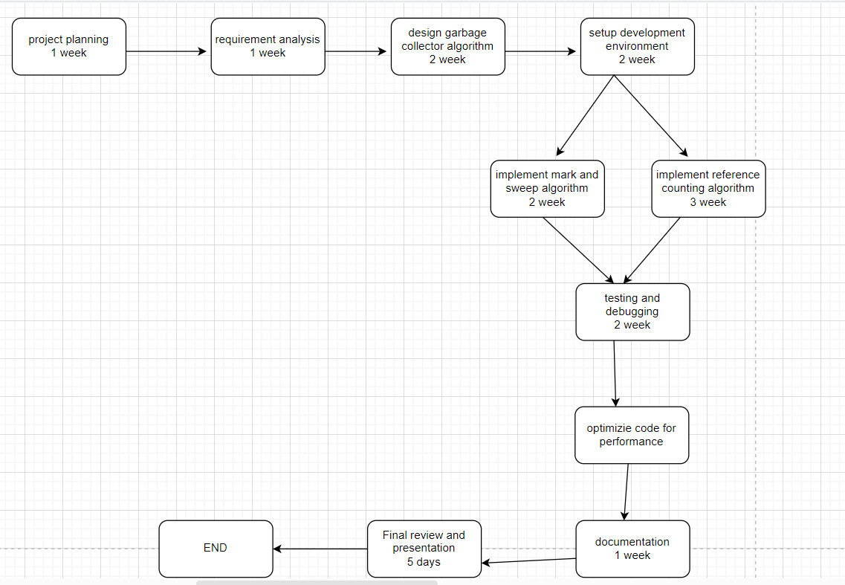
7. PERT Chart

Slide 16
8. Conclusion
Developed automatic garbage collector for C.
Addresses manual memory management challenges.
Identifies and reclaims unused memory.
Reduces memory leaks and improves code reliability.
Demonstrates feasibility and benefits of garbage collection in C.
Enhances programmer productivity and application quality.

Slide 17
9. References
Boehm, H.-J., Weiser, M., & Demers, A. (1991). A garbage
collector for C.
Wilson, R. (1994). A simple portable garbage collector.
Barz, G., & Boehm, H.-J. (2000). A generational garbage collector for C.
Paul, W. (2003). Garbage collection for C: A practical approach.

Slide 18
Thank You

