Slide 1
Excel Reassessment
By: Aryan Mittal

Slide 2
Q1
Insights: 8% of the total orders were returned.
We can see that approximately 23k of profit got shattered in returning .
Order Return | Orders | Sum of Sales | Sum of Profit
No | 92.00% | 2,117k | 263k
Yes | 8.00% | 181k | 23k
Grand Total | 100.00% | 2,297k | 286k
Formula Used:XLOOKUP has been used for labelling the ORDER id which got return.
==XLOOKUP(B3,Returns!B:B,Returns!A:A,”NO”,0)

Slide 3
Q2
Insights:Same Day has the fastest delivery time and Standard Class had the slowest delivery time .
Ship Mode | Average of Diff between ship date and order date
First Class | 2.18
Same Day | 0.04
Second Class | 3.24
Standard Class | 5.01
Formula Used:=DATEDIF(C2,D2,"D") for extracting the difference between order date and shipping date in days .

Slide 4
Q3
Segments | Count of Order ID | Sum of Sales | Sum of Profit
Consumer | 5k | 1,161k | 134k
Corporate | 3k | 706k | 92k
Home Office | 2k | 430k | 60k
Grand Total | 10k | 2,297k | 286k
Insights:Consumer segment is the most valuable segment with the highest sales and high profitability.
Formula Used:

Slide 5
Q4
Insights:As you can see, based on total sales ,technology category got top with the subcategory Phones has the highest sales .
In furniture category, Chairs got top with highest sales.
In Office Supplies category, Storage has the highest sales.
Category | Sub-Category | Sum of Sales | Average of Profit
Technology | Phones | 330k | 50.07
 | Machines | 189k | 29.43
 | Accessories | 167k | 54.11
 | Copiers | 150k | 817.91
Technology Total |  | 836k | 78.75
Furniture | Chairs | 328k | 43.10
 | Tables | 207k | -55.57
 | Bookcases | 115k | -15.23
 | Furnishings | 92k | 13.65
Furniture Total |  | 742k | 8.70
Office Supplies | Storage | 224k | 25.15
 | Binders | 203k | 19.84
 | Appliances | 108k | 38.92
 | Paper | 78k | 24.86
 | Supplies | 47k | -6.26
 | Art | 27k | 8.20
 | Envelopes | 16k | 27.42
 | Labels | 12k | 15.24
 | Fasteners | 3k | 4.38
Office Supplies Total |  | 719k | 20.33
Grand Total |  | 2,297k | 28.66
Formula Used:

Slide 6
Q5
Insights:WEST is the highest sales region, SOUTH is the lowest sales region.
WEST has the highest sales and profit , we can see that in WESTERN region , there is more exposer of superstore to the customers.
Region | Sum of Sales | Sum of Profit
West | 725k | 108k
East | 679k | 92k
Central | 501k | 40k
South | 392k | 47k
Grand Total | 2,297k | 286k
Formula Used:

Slide 7
Q6
Insights: Surprisingly we can see here that with 0 discount rate , sales has been increased and profit also
With 80% discount, less profit recorded .
There is not even more than 1% of correlation between discount rate and qty sold
There is negative correlation between discount rate and profit.
Discount Rates | Sum of Sales | Sum of Profit | Sum of Quantity
0 | 1087908.47 | 320987.60 | 18267
0.2 | 764594.37 | 90337.31 | 13660
0.4 | 116417.78 | -23057.05 | 786
0.3 | 103226.66 | -10369.28 | 849
0.5 | 58918.54 | -20506.43 | 241
0.1 | 54369.35 | 9029.18 | 373
0.7 | 40620.28 | -40075.36 | 1660
0.15 | 27558.52 | 1418.99 | 198
0.8 | 16963.76 | -30539.04 | 1188
0.32 | 14493.46 | -2391.14 | 105
0.6 | 6644.70 | -5944.66 | 501
0.45 | 5484.97 | -2493.11 | 45
Formula Used:=CORREL(Orders!T:T,Orders!S:S) [Correlation between dicount rate and qty sold]
=CORREL(Orders!T:T,Orders!U:U) [Correlation between dicount rate and profit]

Slide 8
Q7
Insights:West got more exposed to the business and somewhat we achieved the saturation level .
South region is still remaining for capturing the market.
Region | Count of City | Count of Customer ID | Sum of Sales | Sum of Profit
Central | 2323 | 2323 | 501k | 40k
East | 2848 | 2848 | 679k | 92k
South | 1620 | 1620 | 392k | 47k
West | 3203 | 3203 | 725k | 108k
Grand Total | 9994 | 9994 | 2,297k | 286k
Formula Used:

Slide 9
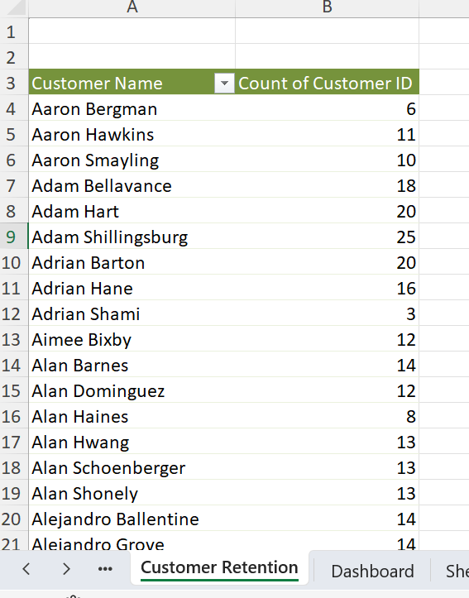
Q8
Insights:Customer retention rate is very good , merely about 126%.
Formula Used:total number of orders placed/ total_customers * 100

Slide 10
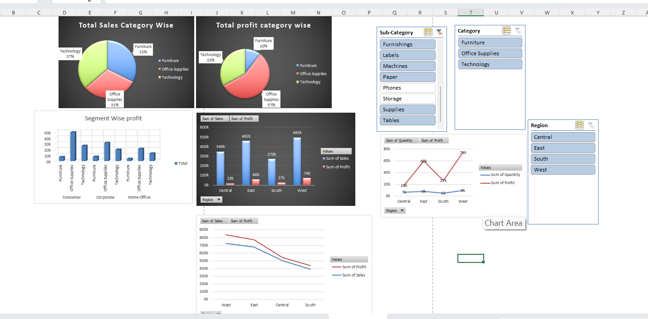
Q9
Insights:
We want to extract the profit, sales and qty metrices according to the segments, product category, sub category and region wise .

