Slide 1
(ITA16-Cricket Management System)
Department of Information Technology
SE Mini Project
Semester: IV
Group Members:
Aryan Sawant – 21101A0008
Shivraj paWAR – 21101A0017
Vishal devkate – 21101A0019
Vishal Mourya – 21101a0024
Under the guidance of
(Prof.Rasika ransing)
AY 2022-23

Slide 2
Outline
Abstract
Introduction
Motivation
Objectives
Problem Statement
Literature Survey
Technology Stack (Hardware/Software)
Implementation
Results and Discussions
Conclusion and Future Scope
References
Project Achievements

Slide 3

ABSTRACT
Cricket Management System is a project which aims in developing a computerized system to maintain all the daily records of Cricket This project has many features which are generally not available in normal Cricket management systems like facility of user login and a facility of admin login. It has a facility of admin login through which the admin can monitor the whole system. It has also a facility where user after logging in their accounts can see list of player details, team details, date and time of each match and coach details. The admin after logging into his account. Admin’s account can able to add or remove team details, match details, coach details, umpire details.

Slide 4
INTRODUCTION
A Cricket management is a project that manages and stores players information electronically according to player's needs. The system helps both players and admin to keep a constant track of all the players available in the team. It allows the admin to track team records.
The project titled “CRICKET WORLD CUP DATABASE MANAGEMENT SYSTEM” is a comprehensive system which provide all the information about World cup. This project deals with the scheduling matches,, updating their results ,disqualifying a player or a team and adding ,updating ,deleting of data related to worldcup by an authorized person.

Slide 5
MOTIVATION
In India there are many people including our project team who are very interested in Cricket than anything else. Cricket World Cup is the tournament for which Cricket fans are very much excited. Therefore we decided to create a GUI where anyone can get any information they
want about world cup. To make the life of the one who maintains data we also decided to implement features like scheduling matches etc. It would be really helping both Cricket fans and also the team which maintains the data.

Slide 6
OBJECTIVES AND PROBLEM STATEMENT
This project aims to design and implement the database to maintain the data related to Cricket World Cup.
The objectives of our project of Cricket World Cup database management system are:
Systematic storage of all the data and try to avoid the redundancy
Using the basic concepts of database management system
To thoroughly study the concepts and applications of database systems while implementing
Properly making use of the database design concepts to implement the system
Using structured query language for implementation

Slide 7
LITERATURE SURVEY
A Cricket Management System is a tool which a library using the old way to manage it in any institution can use and increase their work efficiency. The old method of searching for a team and providing the same to the player through manual work is a real hassle and hinders fast report generation. This software provides a central database maintained for every important record such as player history, match history and the happenings in the team and is organized systematically. This system is helpful for any institution or organization such as engineering, legal, medical, schools, colleges, corporate houses, research centres and many more. There are many papers published and researches done in this area and we have learned the idea for a library system. Some of the paper works and their ideas are as follows:

Slide 8
Any team who want to participate in the tournament should register their team’s name, members name, phone number, email to the server, and then the user can login with the username and password in the login form and can view the tournament details. The website details are monitored by administrator and the match allotment is allotted by admin. Admin will able to track records of players, teams. Admin will also track records match and coach details.
Online Cricket Management System, is a software developed in python focusing on the basic operations of a teams including adding player details, adding team details, adding coach details, adding match details updating any data of players performed for a team.
Enhanced Cricket Management System has been designed to overcome the problem of existing system to provide the feasible solution to the user. It has some features which makes it different from normal Cricket management system like it consists of three modules:
Admin module, Player module.
It is developed to manage the daily activities of a team in an efficient way.

Slide 9
TECHNOLOGY STACK (HARDWARE/SOFTWARE)
HARDWARE REQUIREMENTS :
Intel core i5 2nd generation is used as a processor because it is fast than other processors an provide reliable and stable and we can run our pc for long-time. By using this processor, we can keep on developing our project without any worries.
Ram 1 GB is used as it will provide fast reading and writing capabilities and will in turn support in processing

Slide 10

SOFTWARE TOOLS USED :
Details of Software:
SQLite browser: -
It is a tool that lets you view the data that is stored in an SQLite Database. Depending on the format and type of data in the database it may or may not be readable by a human. This is generally used for debugging or other development task where the developer needs to read the data that has been stored but does not have a built-in system to access it through the program.

Slide 11

2) Visual Studio Code: -
Microsoft Visual Studio is Microsoft’s big and comprehensive IDE/compiler/debugger package for C# and C++ development that has been around for many years and is available for Windows and macOS (but not for Linux). And, here’s the confusing bit: Visual Studio Code has very little to do with Microsoft Visual Studio. (Though, I would guess that they use a lot of common code under the hood.)
Visual Studio Code is an offering of its own, open source, not commercialized (for the time being at least), and based on Electron. It doesn’t use the Atom editor component though, like many other development tools built with Electron. Instead, it uses a separate editor component that is also used in Microsoft’s Azure DevOps product. This is not something you need to worry about, or even know, when working with Code, of course.

Slide 12

3) QT Designer: -
Qt Designer is a graphical user interface (GUI) design tool that comes with the Qt framework. It allows developers to create and edit GUI interfaces visually, without needing to write any code. Qt Designer makes it easy to create professional-looking and user-friendly interfaces for desktop applications.
With Qt Designer, developers can create GUI interfaces by dragging and dropping widgets onto a canvas, and then setting their properties and connecting them to signals and slots. It provides a wide range of built-in widgets and layouts, including buttons, labels, text boxes, check boxes, radio buttons, and many others.
Qt Designer also includes a preview feature, allowing developers to see how the GUI will look and behave before running the application. It also includes features for managing resources such as images and icons, and for creating custom widgets and plug-ins.
One of the benefits of Qt Designer is that it generates code automatically based on the design created by the developer. This code can then be integrated into the application's main codebase, saving time and effort in developing the user interface.
Overall, Qt Designer is a powerful and user-friendly tool for creating GUI interfaces for desktop applications. It simplifies the process of designing and coding user interfaces, making it easier and faster to create professional-looking and user-friendly applications.

Slide 13
4) PyQT5 Module: -
PyQt5 is a Python binding of the cross-platform GUI toolkit Qt. PyQt5 allows developers to create desktop
applications with Python and Qt graphical user interfaces.
PyQt5 is a comprehensive set of Python bindings for Qt 5. It is implemented as a set of Python modules that wrap the
original Qt C++ classes, making it easy to use Qt from Python.
Some of the key features of PyQt5 include:
- Support for a wide range of platforms including Windows, Linux, and macOS
- Full support for Qt's extensive set of widgets and tools
- Compatibility with both Python 2 and Python 3
- Easy integration with other Python libraries and tools
- A large community of developers and users who contribute to its ongoing development and support
Overall, PyQt5 is a powerful and versatile tool for creating desktop applications with Python and Qt. It provides a rich set of features
and tools for building modern, cross-platform user interfaces that are both intuitive and visually appealing.

Slide 14
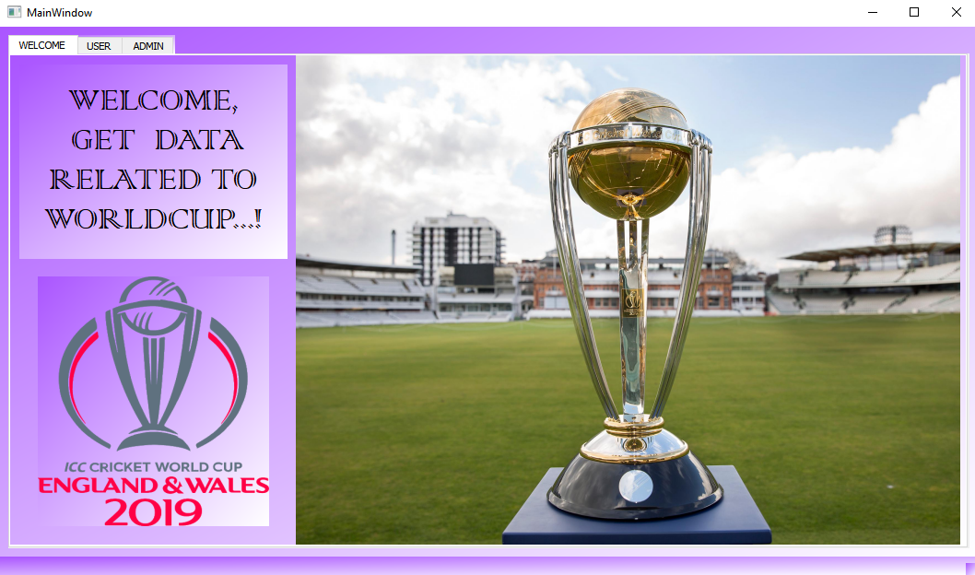
IMPLEMENTATION

Slide 15
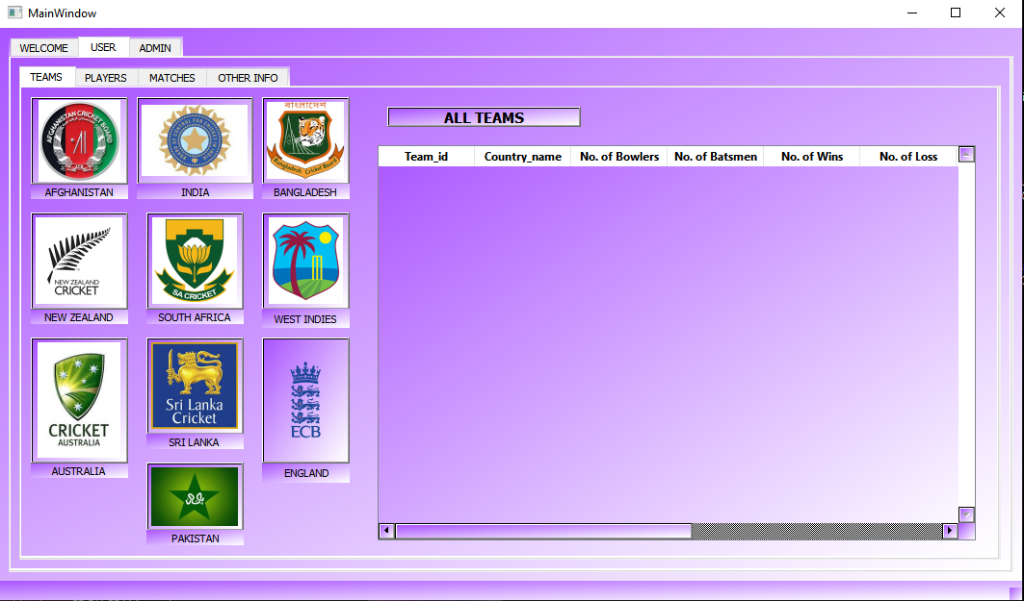
1.USER Open Teams tab If you are a normal user you can get all details about Worldcup in the USER tab.

Slide 16
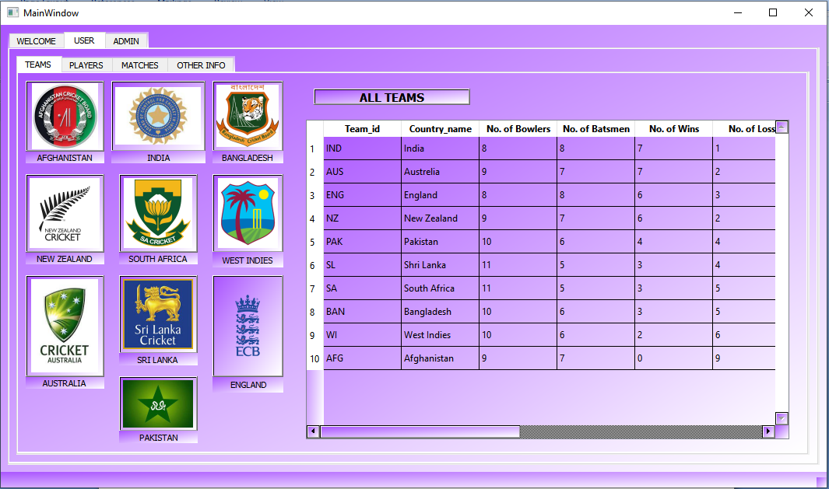
You can click on each team icon to get that particular team details. You can click on All teams to get info of all teams.

Slide 17
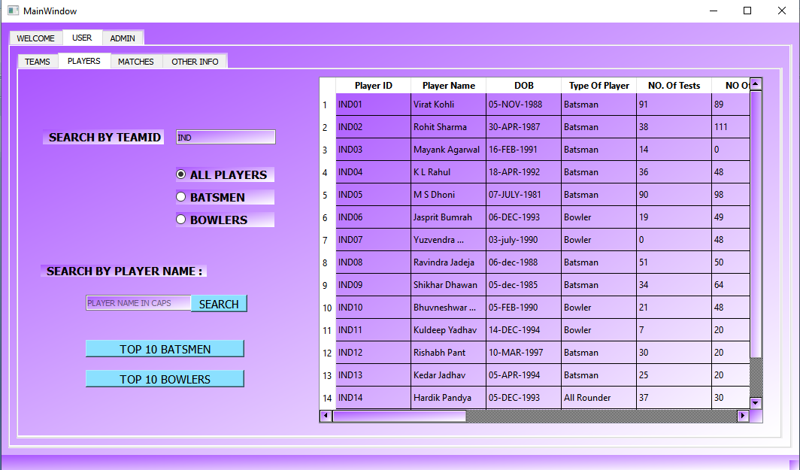
Open Player tab In player tab you can enter team Id and get all players by clicking All players, Batsmen and Bowlers of a particular team

Slide 18
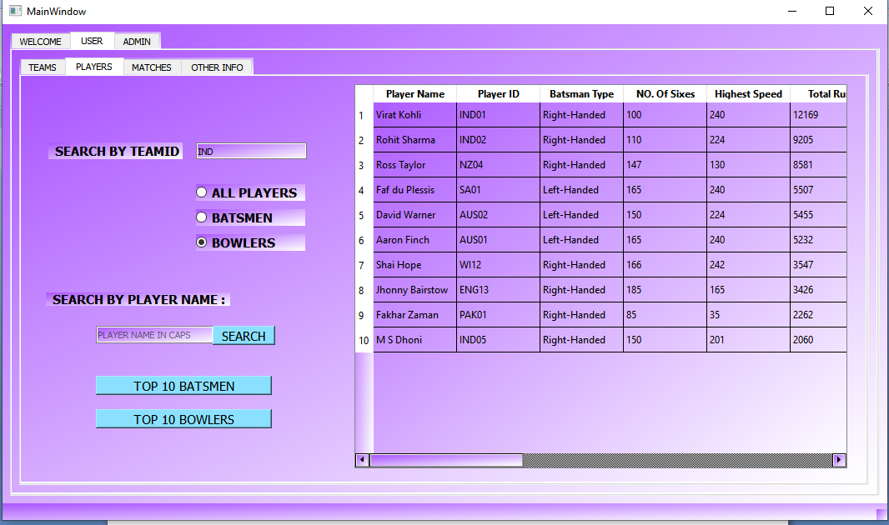
Get Top 10 batsmen of the tournament by clicking top 10 batsmen button.

Slide 19
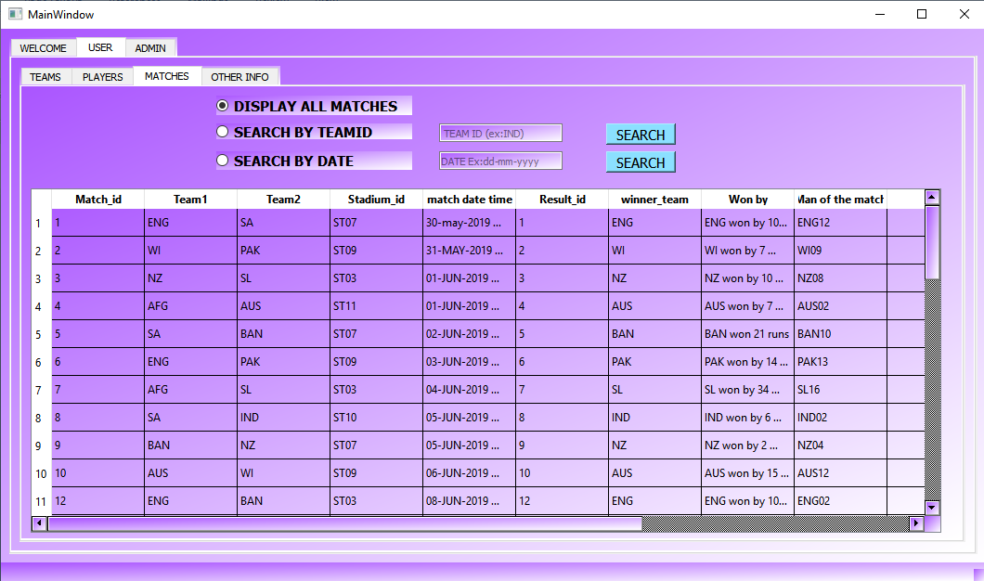
1.1 : open Matches tab Get info of all matches by clicking display all matches.

Slide 20
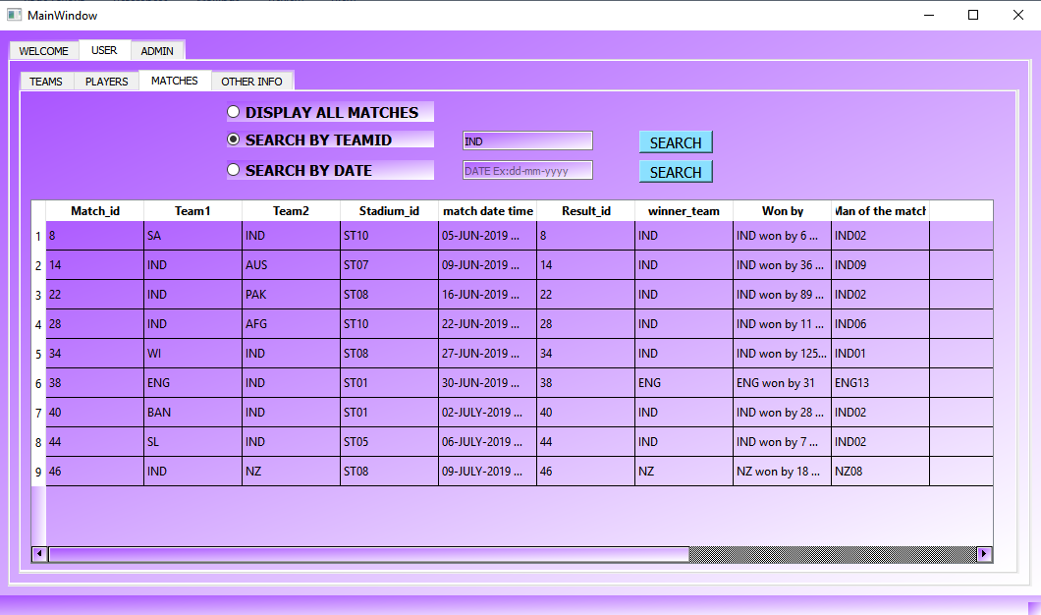
Search your favorite team to check the information of matches and its result.

Slide 21
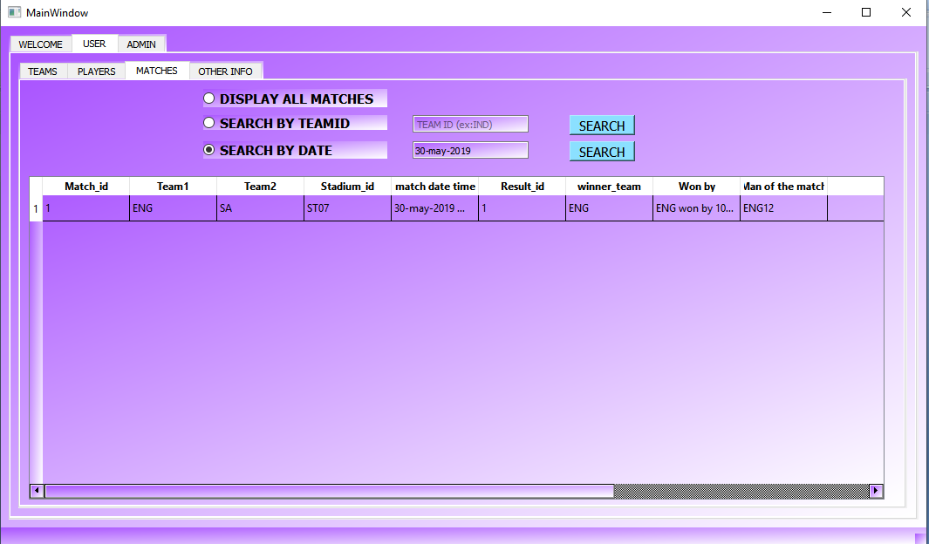
Get match details of a specific date.

Slide 22
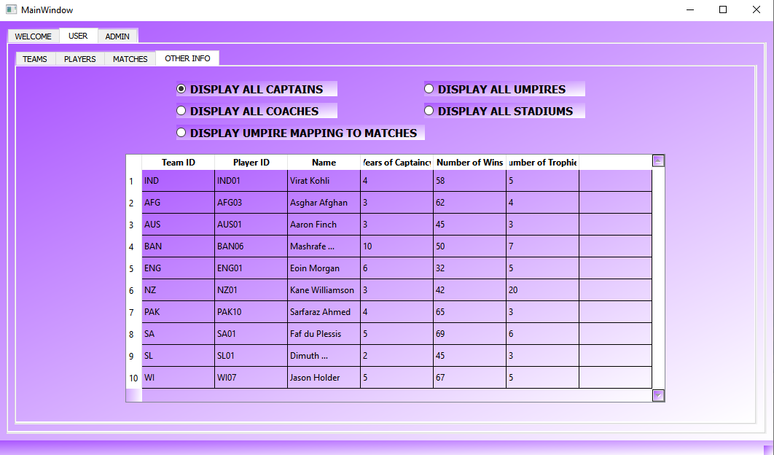
Open Other Info tab click Display all captains ,all coaches, umpire mapping to matches, all umpires, all stadiums to get respective information.

Slide 23
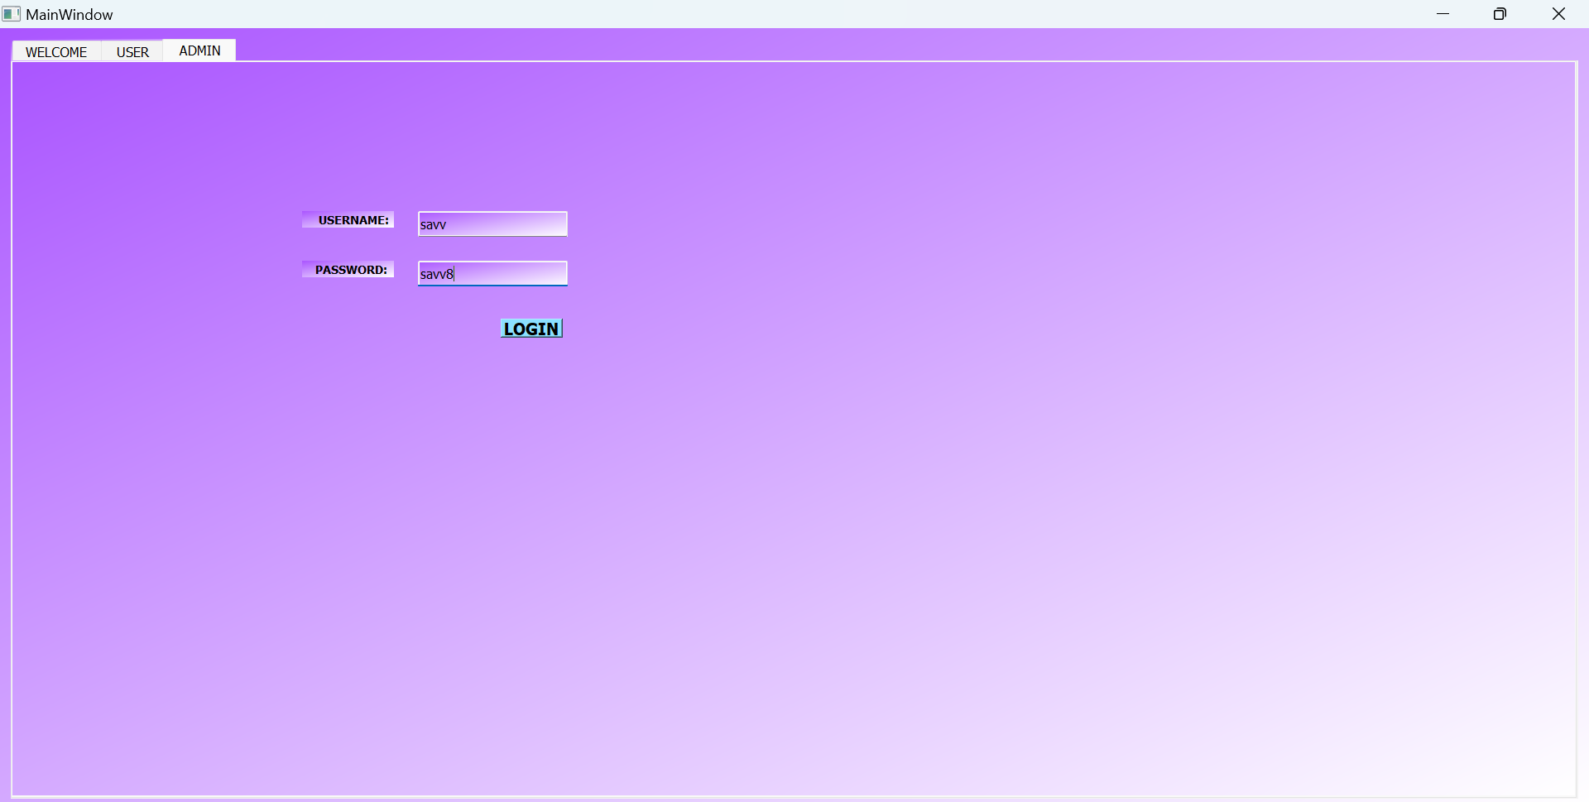
2.ADMIN If you are admin enter your username(savv) and password( savv8) and click Login. Another window will open where all the admin activities can be done.

Slide 24
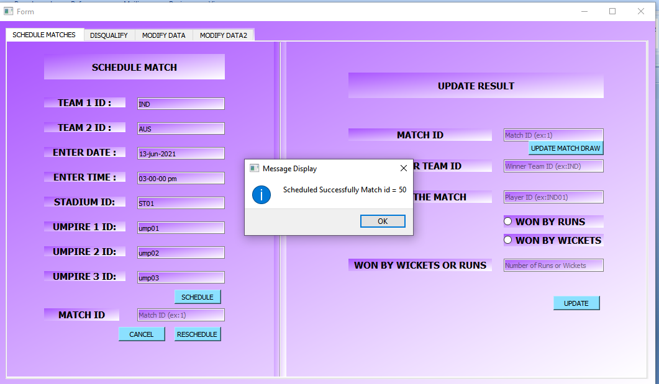
Go to SCHEDULE MATCHES tab To schedule a match enter Team ids of both teams ,the date and time of match ,it’s venue(stadium) and 3 umpires who will umpire the matches Then click schedule. A confirmation message is displayed with match number Click ok.

Slide 25
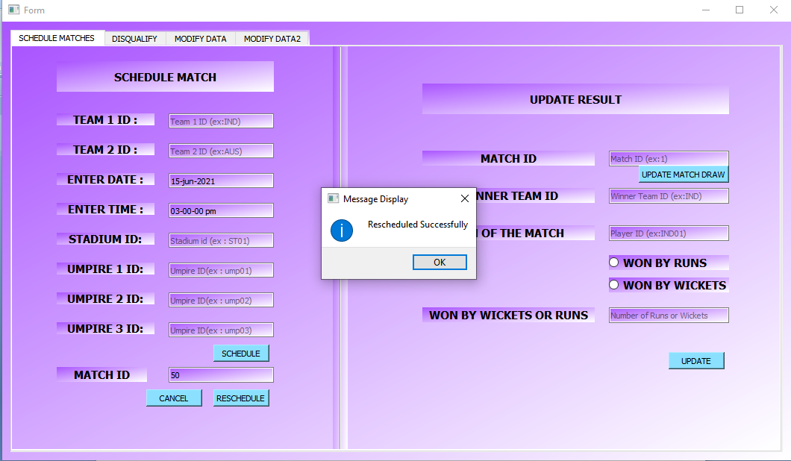
To reschedule a match enter Match ID and date and time and click reschedule.

Slide 26
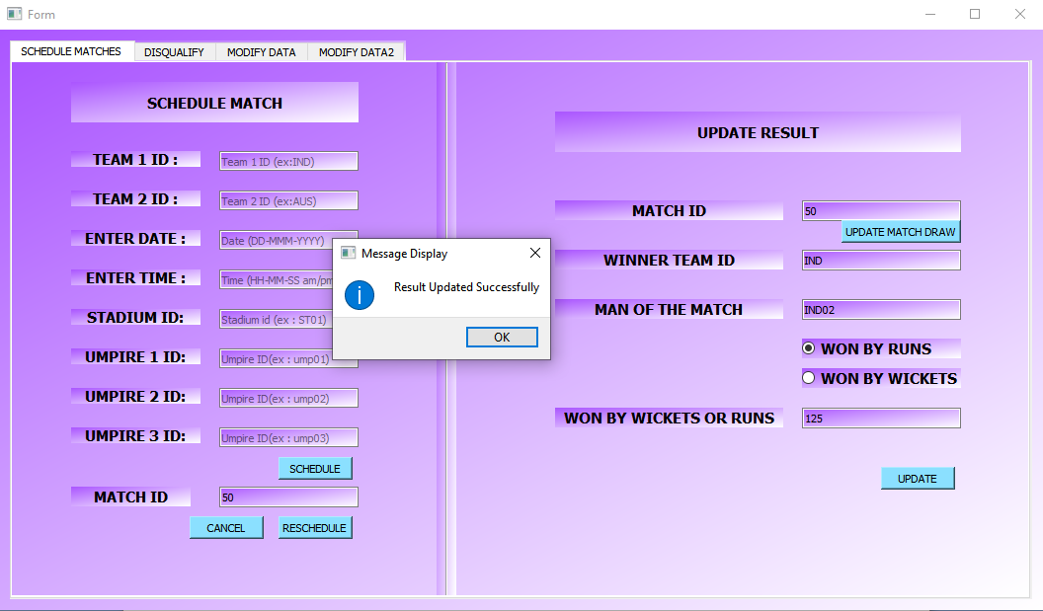
To update the result of a match enter it’s match ID if it is draw click on update match draw button. Otherwise enter winner team ID . Select whether they won match by wickets or runs select respective button. Enter number of wickets or runs in Won by wickets or runs. Click update. The result will be updated.

Slide 27
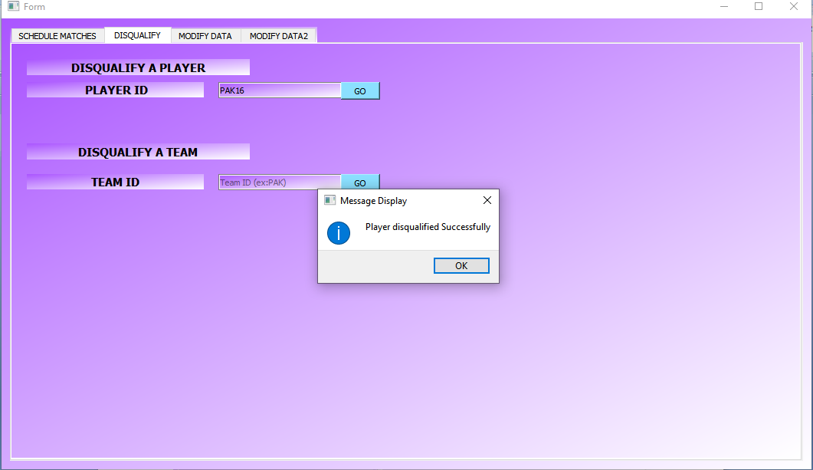
Go to DISQUALIFY tab Enter Player ID and click Go (that player will be disqualified).

Slide 28
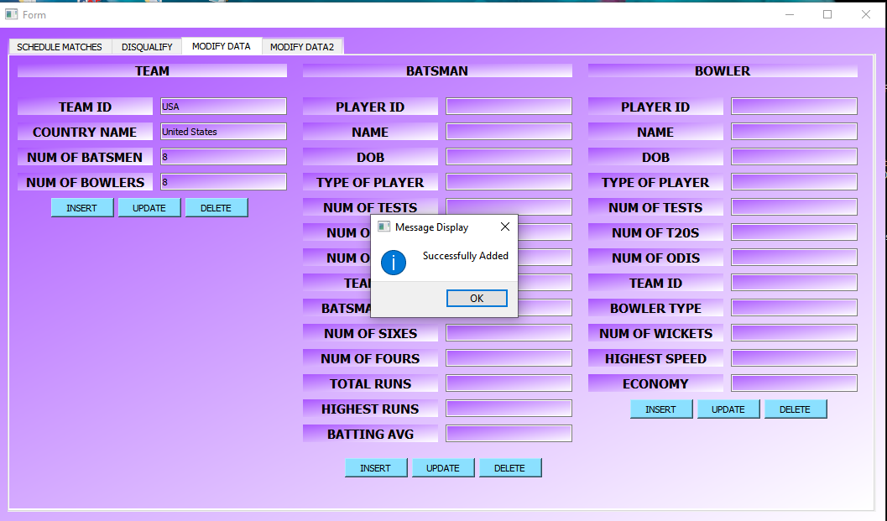
To add to, update or delete data from database. Enter the new values of new record to be added and click insert. A message box will be displayerd and your data will be saved. Like this batsmen, bowlers data can also be added modified or deleted.

Slide 29
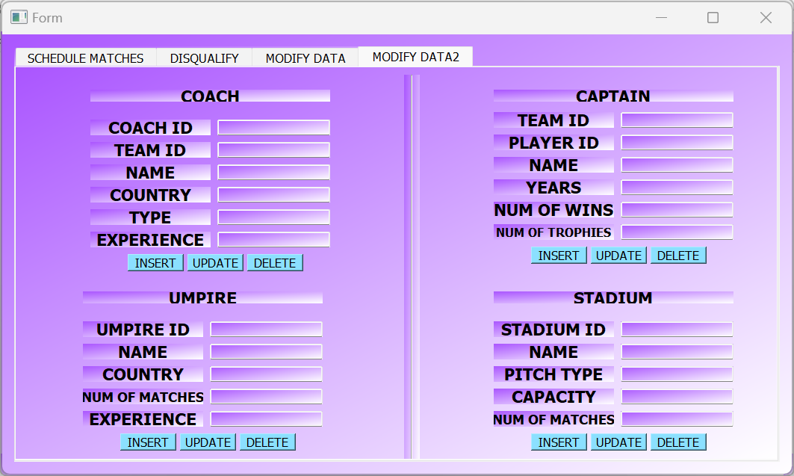
Go to MODIFY DATA2 tab Here captains, stadiums, coaches, umpire data can be added modified or deleted like same way you have done to team data.

Slide 30
RESULTS AND DISCUSSIONS
Results:
The performance of individual players and the team as a whole during matches, including runs scored, wickets taken, etc.
The analysis of player and team performance over time, such as trends in batting and bowling averages, and win-loss records.
Insights into the impact of factors such as weather conditions, pitch conditions, and opposition strength on performance.
The effectiveness of various game strategies, such as batting order and bowling tactics.
Discussions:
Suggestions for improving player and team performance based on the data collected and analyzed by the system.
The identification of areas of strength and weakness for individual players and the team as a whole, and recommendations for addressing them.
Evaluations of the effectiveness of various coaching and training techniques, and suggestions for improving these techniques.
Discussions on how the system can be improved to better support the management of the team, and how it can be integrated with other systems to create a comprehensive management solution.
Overall, the results and discussions of a cricket management system can provide valuable insights into player and team performance, helping coaches and managers make informed decisions about strategy, training, and player selection.

Slide 31
CONCLUSION AND FUTURE SCOPE
In conclusion, a Cricket management system is an essential tool for teams, coaches, and fans to manage and analyze Cricket data effectively. It provides various features such as player statistics, live score updates, injury tracking, analytics and data visualization, scheduling and tournament management, and social media integration, to enhance the overall experience of the game. As the sport of Cricket continues to evolve, the need for advanced technology in managing and analyzing data will increase, and Cricket management systems will play a critical role in providing insights and strategic decision-making for teams and coaches. Ultimately, the success of a Cricket management system depends on its ability to accurately and efficiently provide relevant information to its users, and as such, its development should be continuously improved and updated to meet the needs of the sport’s stakeholders.

Slide 32
There are several potential areas for future work and improvement in a Cricket management system. Here are some possible suggestions:
Enhanced player statistics: Currently, most Cricket management systems provide basic player statistics, such as batting average and bowling average. In the future, these systems could be improved by providing more advanced statistics, such as strike rates, economy rates, and more detailed fielding data.
Live score updates: While many Cricket management systems provide live score updates, there is still room for improvement in terms of accuracy and speed. Systems could be improved to provide faster and more reliable updates, perhaps by integrating with live streaming services or using advanced data processing techniques.
Player injury tracking: Injuries are a common occurrence in Cricket, and it is important for team management to keep track of which players are injured and when they are likely to return to play. Future Cricket management systems could provide more advanced injury tracking and management features, such as automated alerts when a player's injury status changes.
Analytics and data visualization: Cricket generates a vast amount of data, and it can be difficult to make sense of all this information without the help of advanced analytics and data visualization tools. Future Cricket management systems could provide more powerful analytics and visualization features, such as heat maps and advanced predictive modeling.

Slide 33
Integration with social media: Social media has become a major part of the modern Cricket experience, and future Cricket management systems could be improved by integrating with social media platforms to provide real-time updates and analysis of social media activity related to Cricket.
Improved scheduling and tournament management: Scheduling and managing Cricket tournaments can be a complex and time-consuming task. Future Cricket management systems could provide more advanced scheduling and tournament management features, such as automated fixture generation and real-time tracking of scores and standings.
Mobile app integration: Many Cricket fans follow the game on their mobile devices, and future Cricket management systems could be improved by providing more advanced mobile app integration features, such as push notifications for live score updates and mobile-friendly data visualization tools.
Overall, there is significant potential for future work and improvement in Cricket management systems, and these systems will play an increasingly important role in the future of the sport.

Slide 34
REFERENCES
Razzaq, S., Sadiq, A., & Akbar, F. (2021). Development of a GUI based Cricket Management System using Python. In 2021 2nd International Conference on Computing, Mathematics and Engineering Technologies (iCoMET) (pp. 35-40). IEEE.

Slide 35
PROJECT ACHIEVEMENTS
Improved Player and Team Performance: One of the main goals of a cricket management system is to improve the performance of individual players and the team as a whole. The system can help analyze player and team performance over time, identify areas of strength and weakness, and provide recommendations for addressing them.
Better Decision Making: By providing coaches and managers with detailed performance data, a cricket management system can help them make better decisions about game strategy, player selection, and training techniques.
Increased Efficiency: A well-designed cricket management system can help automate many time-consuming tasks, such as data entry and analysis, freeing up coaches and managers to focus on other aspects of their job.
Enhanced Communication: A cricket management system can facilitate better communication between coaches, players, and management. Coaches can use the system to provide feedback to players, and managers can use it to share performance data with team owners and other stakeholders.
Competitive Advantage: By providing insights into player and team performance that are not available to competitors, a cricket management system can provide a competitive advantage for the team.

Slide 36
THANK YOU

