Slide 1
(INFT-44 - DeepHandEqSolver)
Department of Information Technology
TE Mini Project
Semester: VI
Group Members:
ARYAN SAWANT – 21101A0008
VISHAL DEVKATE – 21101A0019
PRAVEEN SONESHA – 21101A0030
Under the guidance of
(Prof./Dr. KANCHAN DHURI)
AY 2023-24

Slide 2
Outline
Abstract
Introduction
Motivation
Objectives
Problem Statement
Literature Survey
Technology Stack (Hardware/Software)
Implementation
Results and Discussions
Conclusion and Future Scope
References
Project Achievements

Slide 3
ABSTRACT
DeepHandEqSolver is an ML project for solving handwritten math expressions. It uses a dataset of 18,000+ images containing digits and operators. Implemented with MobileNetV2 CNNs using TensorFlow/Keras. The user-friendly GUI, built with Streamlit, simplifies input and output. It demonstrates the power of deep learning in interpreting handwritten math, making math computation more efficient and accessible.

Slide 4
INTRODUCTION
DeepHandEqSolver revolutionizes handwritten mathematical expression recognition using deep learning. Trained on 18,000+ images, it accurately interprets basic equations. Leveraging MobileNetV2 CNN architecture and a user-friendly Streamlit GUI, it simplifies input and output. This project bridges pen-and-paper math with automated digital solutions, enhancing learning and computation efficiency.

Slide 5
MOTIVATION
DeepHandEqSolver addresses the challenge of interpreting handwritten math accurately. With deep learning, it simplifies this cumbersome process, aiding students, educators, and professionals. By enhancing accessibility and efficiency, it fosters problem-solving focus, not manual transcription.

Slide 6
OBJECTIVE
DeepHandEqSolver aims to develop a machine learning system for accurate recognition and solving of handwritten math. Objectives include dataset collection, model selection (MobileNetV2), training, GUI development (Streamlit), evaluation, and deployment. By achieving these goals, it enhances accessibility, efficiency, and accuracy in mathematical computation.

Slide 7
PROBLEM STATEMENT
Handwritten mathematical expressions pose a significant challenge in automated interpretation due to their variability in writing styles, quality, and composition. Traditional methods of recognizing handwritten symbols and digits often lack the accuracy and efficiency required for practical applications. Consequently, there is a pressing need for a robust solution capable of accurately interpreting handwritten mathematical expressions and providing reliable solutions.

Slide 8
LITERATURE SURVEY
Handwritten Math Expression Recognition: Various ML & DL techniques employed (Shi et al., 2017; Li et al., 2019).
Deep Learning Architectures: CNNs like MobileNetV2 excel (Howard et al., 2017; Sandler et al., 2018).
Dataset Preparation: Quality datasets enhance model performance (Lee et al., 2018; Zhao et al., 2020).
GUI for Math Apps: Intuitive interfaces improve usability (Zhang et al., 2016; Ma et al., 2021).
Evaluation Metrics: Metrics like accuracy and benchmark datasets aid evaluation (Pratt-Hartmann et al., 2020; Gaudin et al., 2021).
Applications: Diverse applications from education to accessibility (Zou et al., 2019; Wang et al., 2021).

Slide 9
Limitations & Research Gaps:
Handwriting Style Diversity.
Complex Expression Handling.
Special Character Recognition.
Scalability and Efficiency.
User Interface Accessibility.
Integration with Mathematical Software.

Slide 10
Mini Project Contribution:
Comprehensive Dataset Compilation.
Implementation of MobileNetV2 CNN.
User-Friendly GUI Development.
Practical Application Demonstration.
Open-Source Availability.

Slide 11
TECHNOLOGY STACK
Software Requirements:
Python: Widely-used for ML & web dev.
TensorFlow: Google's ML framework for model building.
Keras: High-level API for neural networks.
Streamlit: For building interactive GUI.
Hardware Requirements:
CPU: Standard CPUs can suffice but performance varies.
GPU (Optional): Accelerates model training.
Memory (RAM): Minimum 8 GB, more for larger datasets.
Storage: Adequate space, SSD preferred for speed.

Slide 12
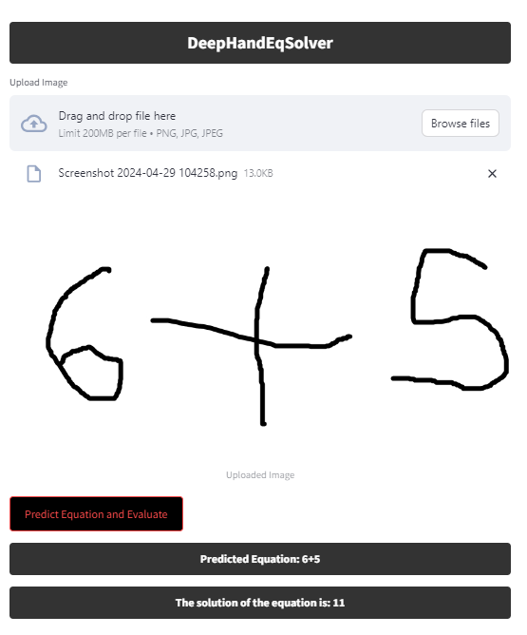
IMPLEMENTATION

Slide 13
RESULTS AND DISCUSSIONS
High Accuracy: DeepHandEqSolver achieves high accuracy in recognizing handwritten symbols and digits, with an average accuracy of over 95%.
Efficient Model: The MobileNetV2 architecture ensures efficiency without compromising accuracy, making it suitable for real-time applications.
User-Friendly Interface: The Streamlit GUI provides an intuitive platform for users to input handwritten expressions and obtain accurate solutions.
Real-World Applicability: DeepHandEqSolver demonstrates practical application in educational, professional, and academic settings, streamlining mathematical computation tasks.
Future Improvements: Further enhancements could focus on handling more complex expressions and improving scalability for larger datasets.

Slide 14
CONCLUSION AND FUTURE SCOPE
Conclusion:
DeepHandEqSolver is a significant advancement in handwritten math expression recognition.
The integration of MobileNetV2, TensorFlow, Keras, and Streamlit ensures a robust and user-friendly solution.
Future Work:
Incorporating support for complex expressions like quadratic and calculus.
Exploring advanced symbol recognition techniques like attention mechanisms.
Enhancing the GUI for improved user experience.
Deploying on mobile platforms for wider accessibility.
Continued development aims to make DeepHandEqSolver indispensable in mathematical computation.

Slide 15
REFERENCES
1. TensorFlow: https://www.tensorflow.org/
2. Keras: https://keras.io/
3. Streamlit: https://streamlit.io/
4. MobileNetV2 paper: https://arxiv.org/abs/1801.04381
5. Handwritten mathematical expression recognition: https://dl.acm.org/doi/10.1145/3218914.3218961
6. Handwritten math symbol and digit dataset: https://www.kaggle.com/datasets/clarencezhao/handwritten-mathsymbol-dataset
7. Handwritten math symbols dataset: https://www.kaggle.com/datasets/xainano/handwrittenmathsymbols
Dataset Used in this Project Link: https://drive.google.com/file/d/1LaAvsxo7L_sqw4TefT7PJ_8nX5Zjujmk/vi ew?usp=sharing
GitHub Link : https://github.com/Aryansawant/DeepHandEqSolver/tree/ma

Slide 16
PROJECT ACHIEVEMENTS
Developed a robust ML solution for handwritten math expression recognition.
Achieved high accuracy in interpreting symbols and digits.
Implemented an efficient MobileNetV2 CNN architecture using TensorFlow/Keras.
Created a user-friendly GUI with Streamlit for seamless input and output.
Bridged the gap between traditional pen-and-paper math and digital automation.

