Slide 1
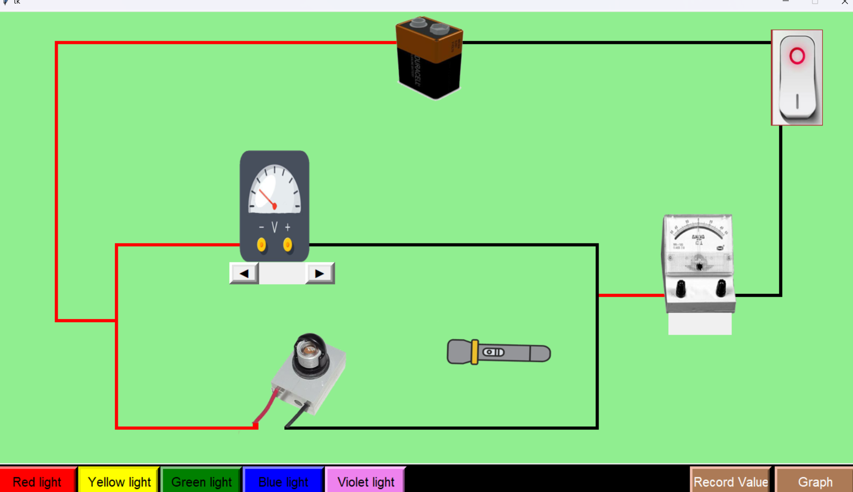
Working
Battery
Voltmeter
Power Switch
Galvanometer
P.E. Cell
Light Source

Slide 2
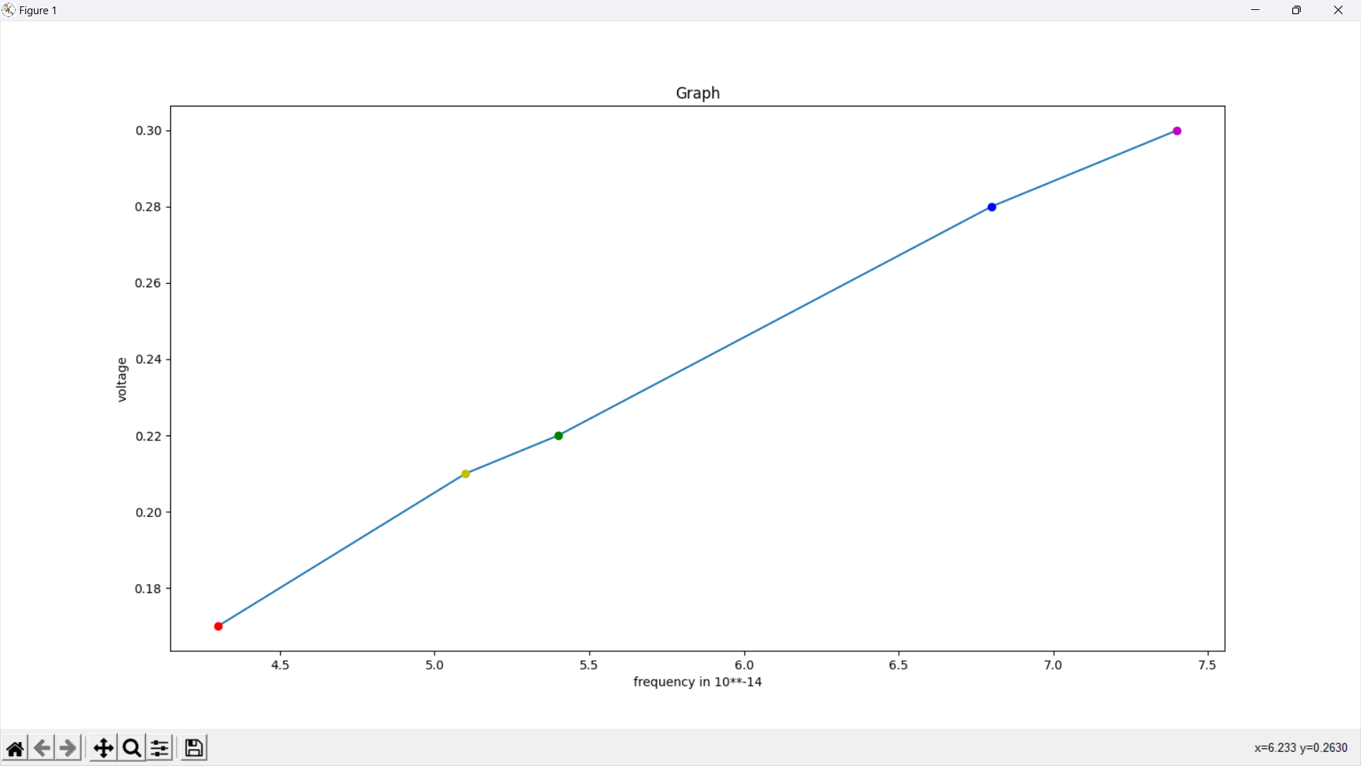
Graph

Slide 3
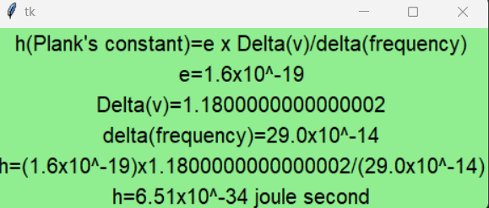
Plank’s Constant Value Calculation

