Slide 1
CAPSTONE PROJECT Emojification with deep learning
Presented By-
Student Name: Aryan Namdev
College Name: School of Information Technology, RGPV
Department: Computer Science & Engineering
Email ID: namdevaryan044@gmail.com
AICTE Student ID: stu6438e2bd40bd81681449661

Slide 2
OUTLINE
Problem Statement
Proposed System/Solution
System Development Approach (Technology Used)
Algorithm & Deployment
Result (Output Image)
Conclusion
Future Scope
References

Slide 3
Problem Statement
Emojis or avatars are ways to indicate nonverbal cues. These cues have become an essential part of online chatting, product review, brand emotion, and many more. It also lead to increasing data science research dedicated to emoji-driven storytelling. How can we detect human emotions from images?

Slide 4
Proposed Solution
With advancements in computer vision and deep learning, it is now possible to detect human emotions from images. In this deep learning project, we will classify human facial expressions to filter and map corresponding emojis or avatars. We will build a deep learning model to classify facial expressions from the images. Then we will map the classified emotion to an emoji or an avatar.

Slide 5
System Approach
We will be using the CNN (Convolutional Neural Network) of deep learning to express the emotions using appropriate emojis or avatars. For execution and implementation of this project, we will be using Python (version 3.12) for making the machine learning model as well as making the graphical user interface (GUI). The following are the resources used to make our deep learning CNN model:
System Requirements: We used a notebook laptop with following specifications-
Processor: Intel(R) Core(TM) i5-8350U CPU @ 1.70GHz 1.90 GHz
Installed RAM: 8.00 GB (7.85 GB usable)
System type: 64-bit operating system, x64-based processor

Slide 6
System Approach
Library required to build the model: We used the following python libraries to make this project-
NumPy- for numerical computing
Pandas- for operations on data frame
OpenCV (CV2)- for image processing
Keras- interface for artificial neural networks
Tkinter- for Graphical user interface
OS Module- for directory manipulation

Slide 7
Algorithm & Deployment
A brief breakdown of all the steps and processes describing the model development are outlined below-
Algorithm Selection: We used a Convolutional Neural Network (CNN) to classify facial expressions and map them to appropriate emojis. CNNs are well-suited for image classification tasks due to their ability to capture spatial hierarchies in visual data, making them ideal for facial expression recognition.
Data Input: The model was trained on images of human faces, labeled with emotion categories such as happy, sad, angry, and surprised. We have trained our model on the FER2013 dataset.
Training Process: The data was split into training and validation sets. Techniques like data augmentation, dropout, and batch normalization were applied to improve generalization.
Prediction Process: Once trained, the CNN takes a live or static facial image as input, processes it through the network, and outputs a predicted emotion class. This class is then mapped to a corresponding emoji to visually represent the detected emotion.

Slide 8
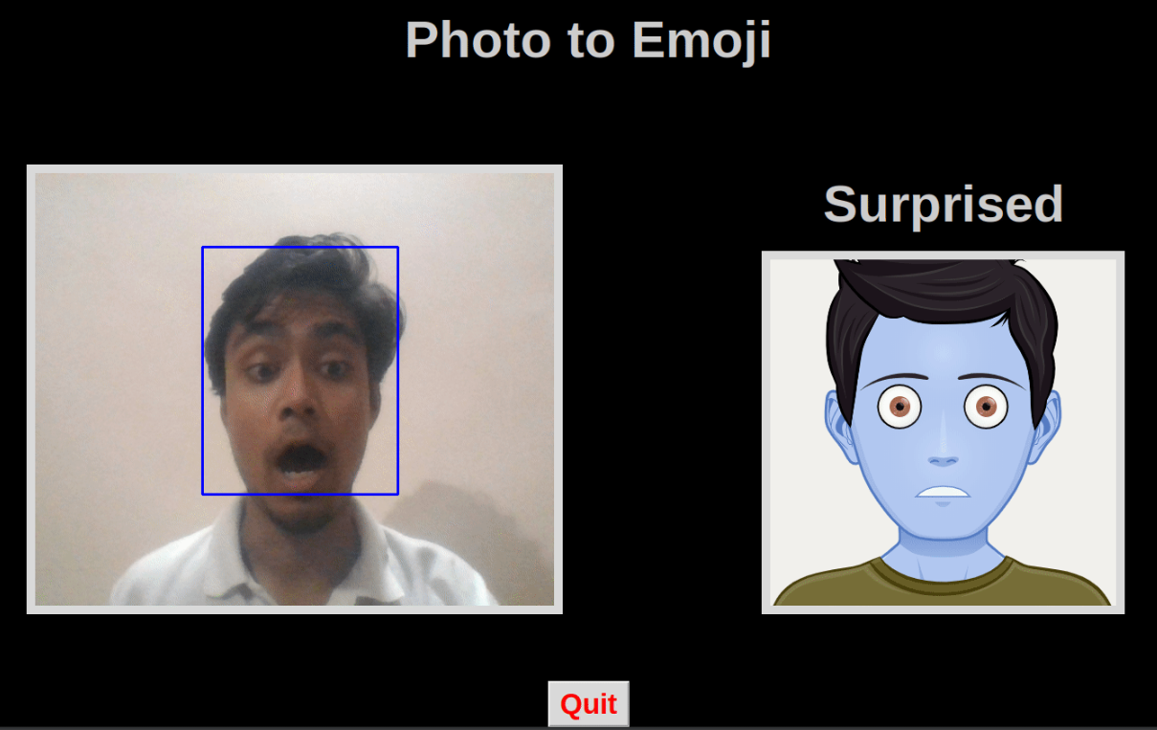
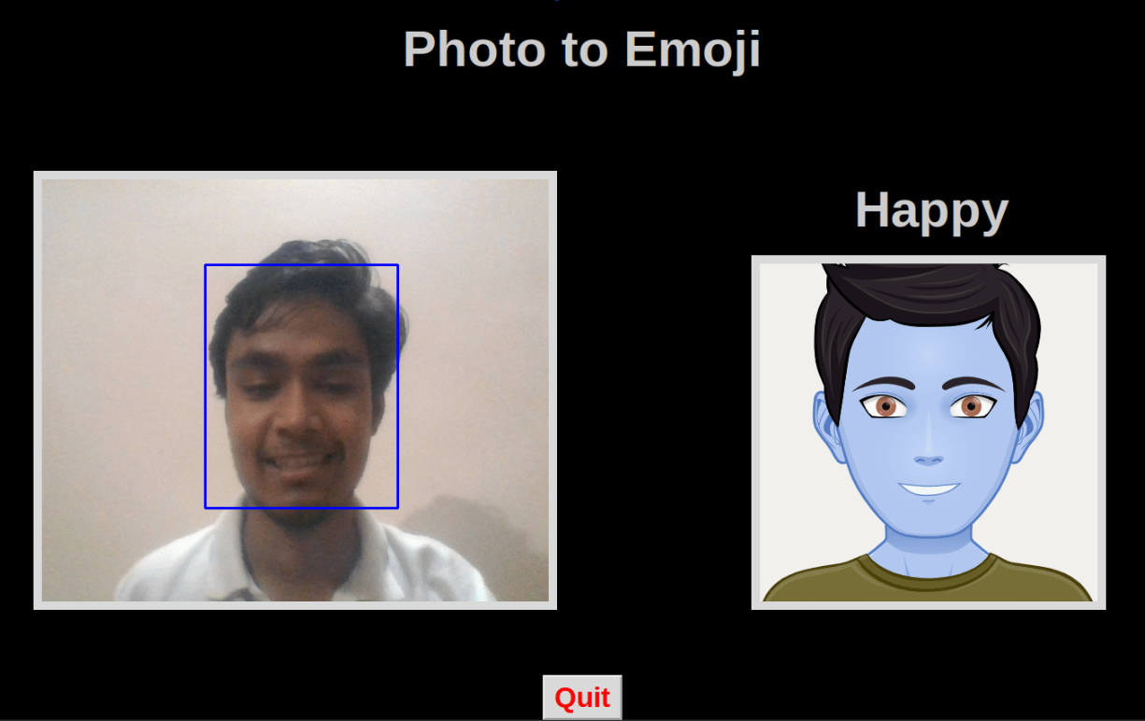
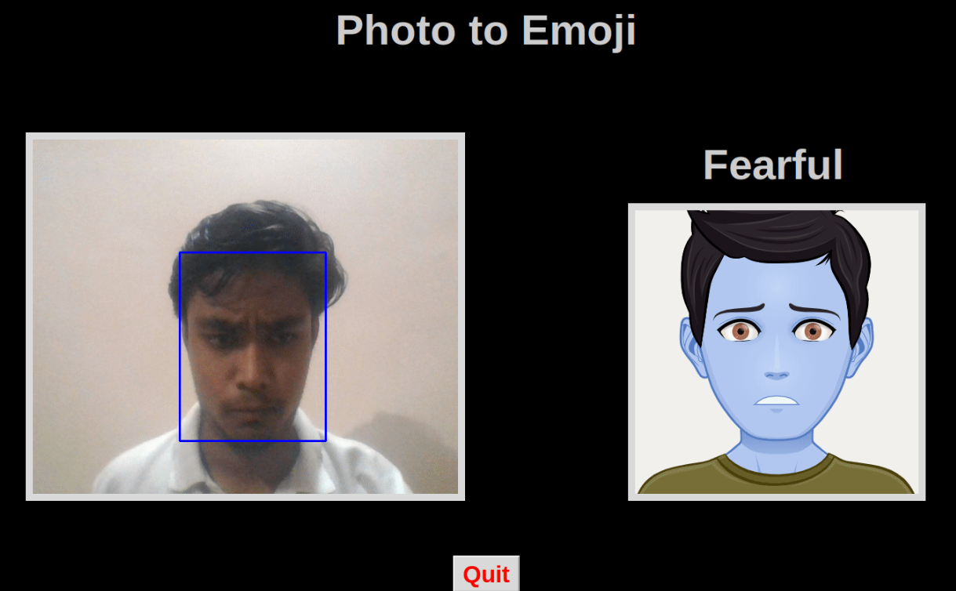
Result
The CNN-based model accurately classified facial expressions and mapped them to appropriate emojis in real time. It performed well on the validation dataset, showing strong accuracy in detecting core emotions such as happiness, sadness, fearful, and surprise. The system provided a smooth and responsive user experience, effectively demonstrating the feasibility of using deep learning for real-time emotion-to-emoji translation.

Slide 9
Conclusion
The project successfully demonstrated the effectiveness of using a Convolutional Neural Network (CNN) for real-time facial expression recognition and emoji generation. The system achieved good accuracy in identifying basic emotions and offered an engaging user experience through instant emoji feedback. This confirms the suitability of deep learning for emotion-based interaction systems.
However, the implementation faced challenges such as limited expression variety in the dataset, difficulty in handling low-light or occluded faces, and real-time performance bottlenecks on lower-end hardware. Future improvements could include expanding the dataset to cover more diverse facial expressions, optimizing the model for faster inference, and enhancing robustness to environmental variations. These enhancements can help make the system more scalable and applicable to real-world scenarios.

Slide 10
Future scope
The project can be extended to recognize a broader range of complex or subtle emotions and support multiple face detection in group scenarios. Integration with platforms such as video conferencing tools, chat applications, or educational software can enhance user interaction. Future improvements may include the use of transfer learning with pre-trained models, support for different lighting conditions and ethnicities, and deployment on mobile devices for wider accessibility

Slide 11
References
The data consists of 48x48 pixel grayscale images of faces. The task is to categorize each face based on the emotion shown in the facial expression into one of seven categories (0=Angry, 1=Disgust, 2=Fear, 3=Happy, 4=Sad, 5=Surprise, 6=Neutral). The training set consists of 28,709 examples and the public test set consists of 3,589 examples.
Data Set Link: https://www.kaggle.com/datasets/msambare/fer2013
GitHub Link: https://github.com/Aryan0044/Emojify/tree/emojis

Slide 12
Thank you

