Slide 1
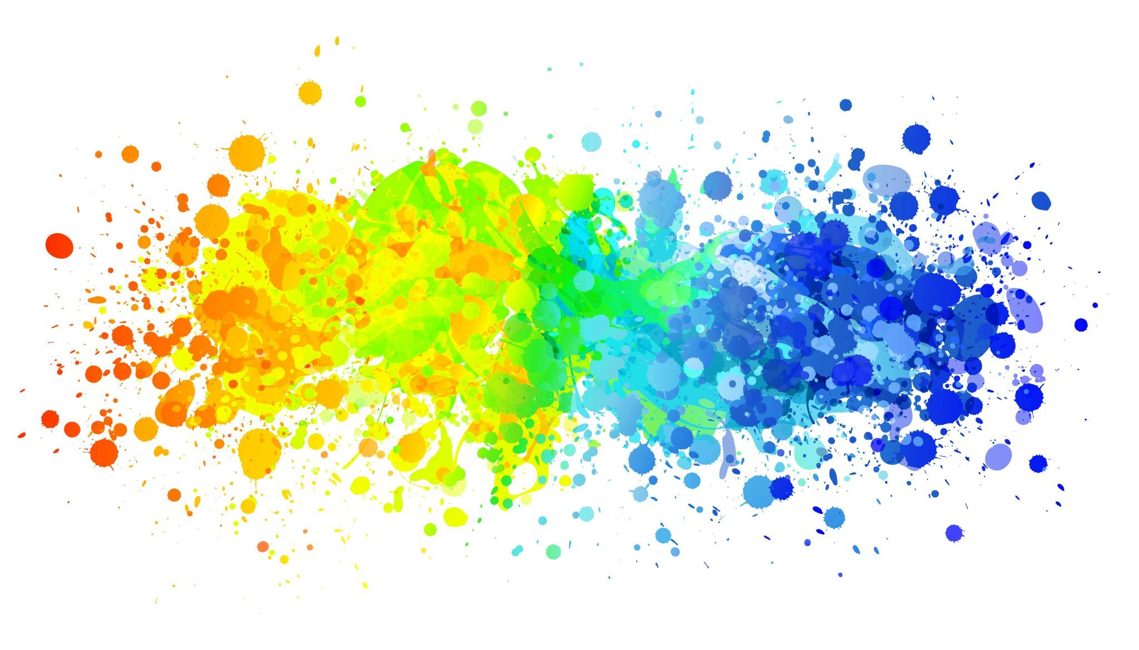
Musify-Music Composition using A.I.
Made By
Aryan Chordia

Slide 2
Music Composition
Musical composition is the process of making or forming a piece of music by combining the parts, or elements of music
Parameters such as pitch ,interval , notes ,chords are used for composing short piece of music.

Slide 3
Description of the project
Music + Deep Learning = Automatic Music Generation Model
Uses a variant of Recurrent Neural Networks called LSTM (Long - Short Term Memory)
Platform : Visual Studio Code
Coding Language : Python
Libraries used Tensorflow,Music21, Keras,NumPy,Sklearn, tqdm
Captures music produced by the piano instrument.

Slide 4

Important Definitions
Note : This is a sound produced by a single key.
Chord : The combination of two or more notes is called a chord.
Recurrent Neural Networks : A recurrent neural network is class of artificial neural networks that make use of sequential information. They are called recurrent because they perform the same function for every single element of the sequence.
LSTM
LSTM are a type of Recurrent Neural Networks that can efficiently learn via descent gradient.
Useful to solve problems when the network has to remember data for long time.
Applications : Music and Text Generation.

Slide 5

libraries
Music 21
Music 21 is a python toolkit for computer aided musicology
The toolkit provides a simple interface to acquire the musical notation of MIDI files. Additionally , it allows us to create Note and Chord objects so that we can make our own MIDI files easily.
Keras
It is a high level neural networks API that simplifies interactions with Tensor FLow.
Tensor Flow
Tensor Flow is a free and open source software library for machine learning and artificial intelligence.
It is mainly used for training and testing models and and inference of deep neural networks.
Numpy
Numpy is a python library mainly used for working with arrays.
Tqdm
It is a library in python used for creating progress bars or progress meters.

Slide 6

Project Files
Midi Files: This is the folder containing various MIDI files of different composers used in the project.
code.ipynb : This files contains the main code of the project used for training and testing the model.
MOD: This directory contains optimizer, metrics, and weights of our trained model.
AI_composed_music.mid: This is our music generated file containing the predicted notes of the model.

Slide 7

STEPS FOR DEVELOPING CODE

Slide 8

Step 1 Importing all the libraries.
Import all the important libraries required for the project.
Step 2 Reading the MIDI file
The MIDI file dataset has to be read using Music21 library.
Mozart and Schubert composed files have been used .
For this project , the files have that contain sequential streams of Piano data has only been worked on.
Piano stream from the MIDI file contains many data like Keys, Time Signature , Chord ,Note ,etc.
We required only notes and chords to generate music.

Slide 9
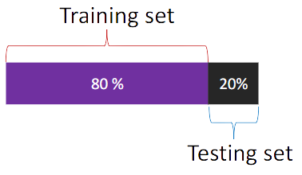
Step 3 Exploring the Data Set
This is done to check the number of unique notes and and their distribution.
50 is used as a threshold frequency and only those notes whose frequency is more than 50 have been considered.
Step 4 Input and output sequences for model
Input and output sequences for our model are created.
A timestep of 50 has been used . So , if we traverse 50 notes of our input sequence then the 51st note will be output for that sequence.
Step 5 Training and Testing sets
Array for our model is reshaped and the data is split into 80:20 ratio.

Slide 10
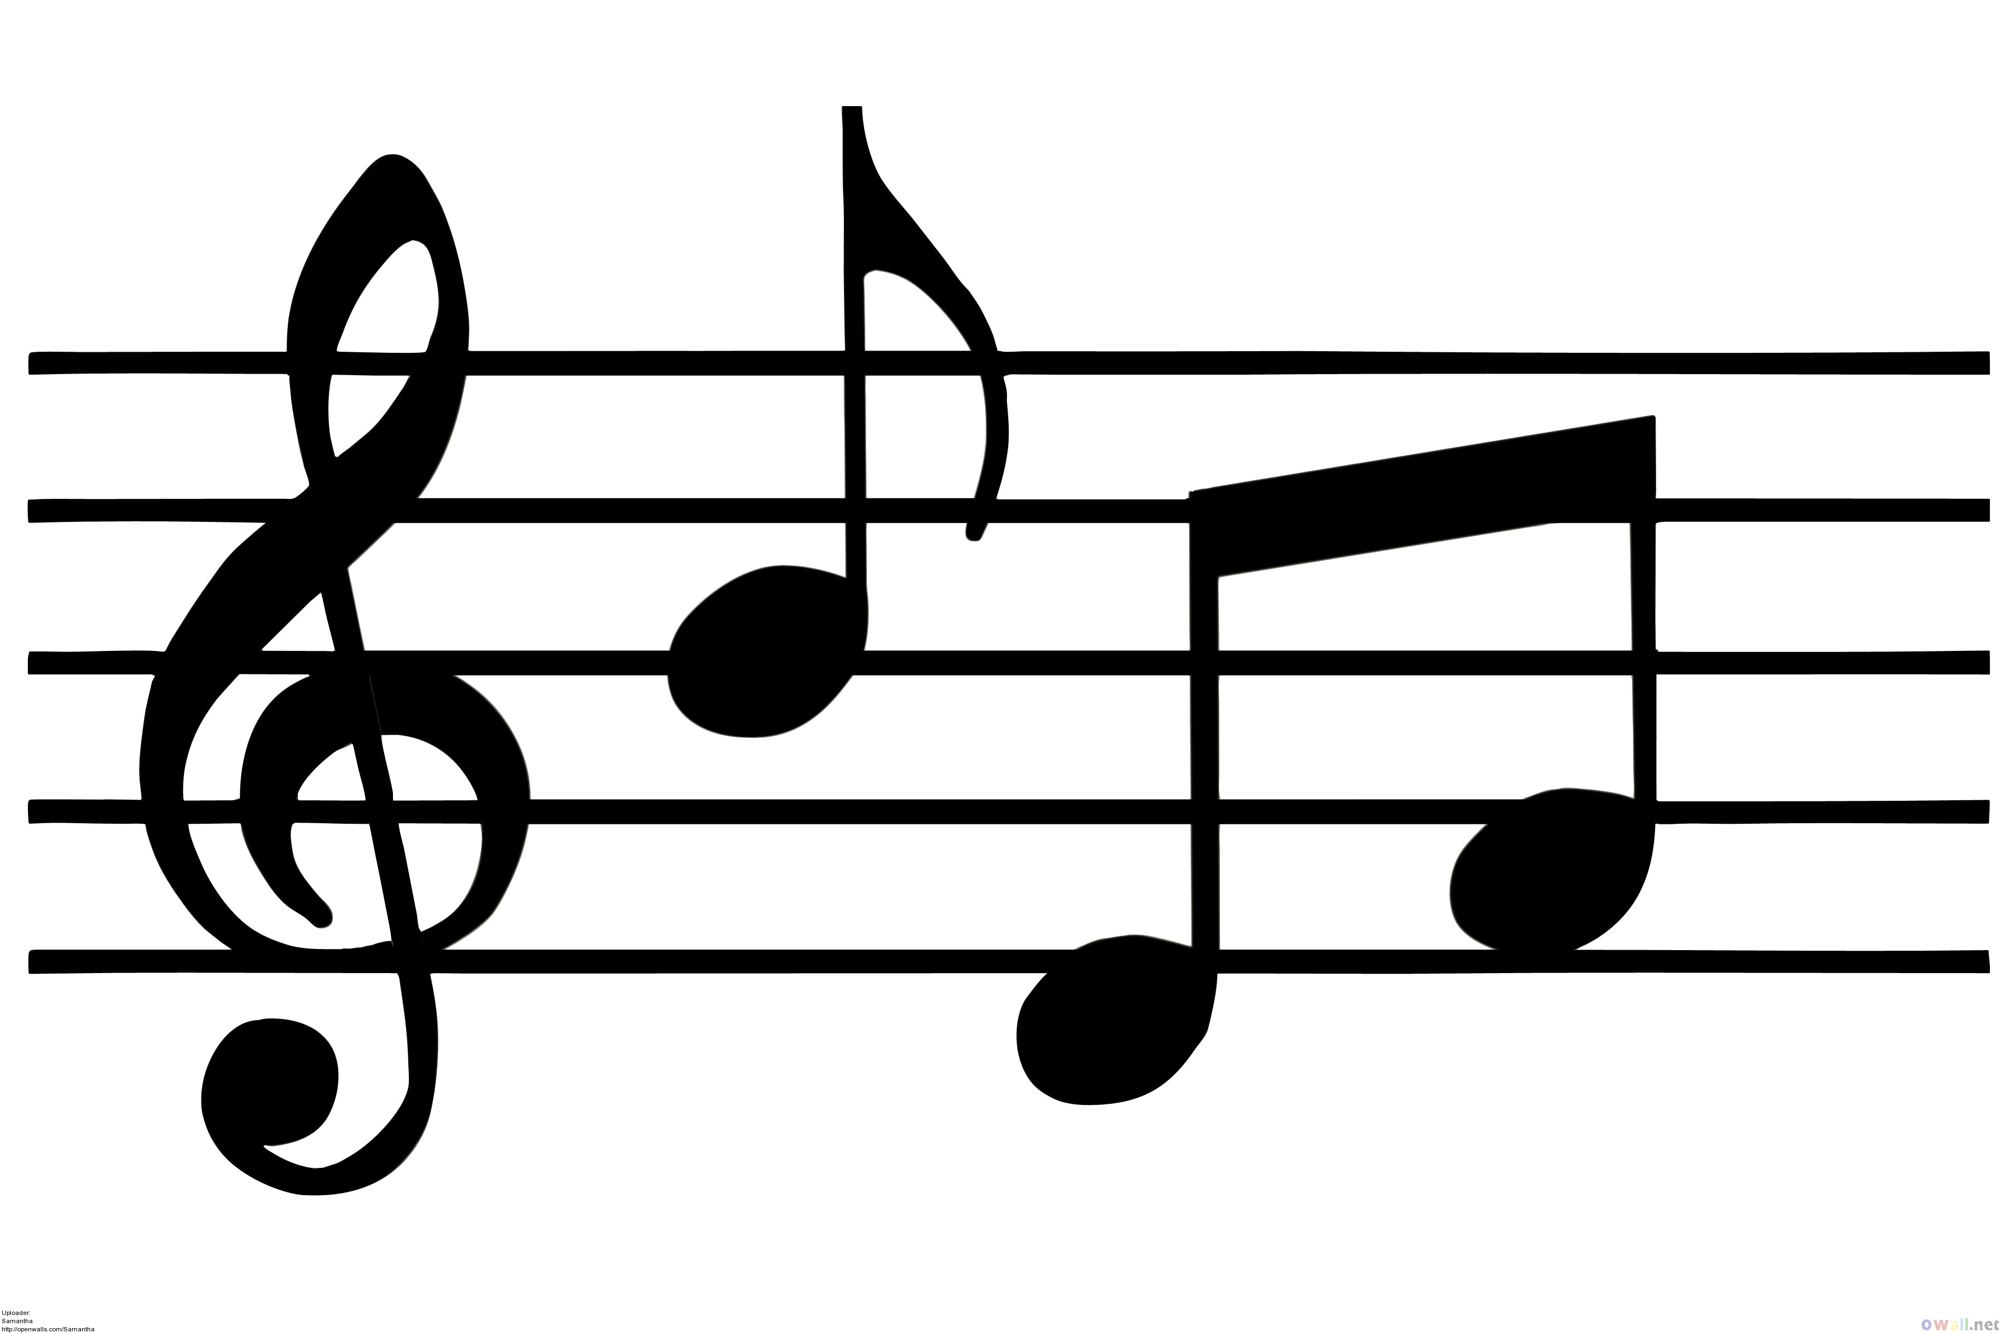
Step 6 Building the Model
2 stacked LSTM layers with a dropout rate of 0.2 are used .
A fully connected Dense layer has been used for output.
Step 7 Training the Model
After building the model , it is trained on the input and output data.
For this 'Adam Optimizer ' is used on batch size of 128 and a total of 30 epochs.
After Training, model is saved for prediction.
Step 8 Inference Phase and Saving the File
Using the trained model, the notes will be predicted and the predicted output notes are saved in a MIDI file.

Slide 11
Key Takeaways from the project
Good introduction to the world of Machine Learning and Deep Learning.
Application of Deep Learning in Music Composition
Learning several libraries and packages including Tensor Flow , Numpy , Pandas etc

Slide 12

Thank you

