Slide 1
IBM HACKATHON PROJECT
FitnessBuddy AI AGENT
Presented By: Aryan Arora
College Name & Department :Manipal University Jaipur, Computer Science Department

Slide 2
OUTLINE
Problem Statement
Technology used
Wow factor
End users
Result
Conclusion
Git-hub Link
Future scope
IBM Certifications

Slide 3
PROBLEM STATEMENT
In today’s fast-paced world, many individuals struggle to maintain a healthy lifestyle due to:
Lack of personalized fitness and nutrition guidance
Rigid schedules and time constraints
High costs of gym memberships and coaching
Inconsistent motivation and poor habit-building
Traditional solutions fail to adapt to personal routines, goals, and accessibility needs. There is a growing demand for a 24/7, intelligent, and user-friendly fitness companion that delivers real-time support.

Slide 4
TECHNOLOGY USED
IBM cloud lite services
Natural Language Processing (NLP) Retrieval Augmented Generation (RAG) IBM Granite model

Slide 5
IBM CLOUD SERVICES USED
IBM Cloud Watsonx AI Studio
IBM Cloud Watsonx AI runtime
IBM Cloud Agent Lab
IBM Granite foundation model

Slide 6

WOW FACTORS
24/7 Personalized Fitness Assistant
Available anytime, anywhere—adapts to the user’s schedule and lifestyle without the need for expensive equipment or subscriptions.
AI-Generated Workouts & Meals
Uses IBM Granite to dynamically recommend workouts and healthy meals based on user input like duration, fitness level, or goals.
No Equipment? No Problem!
Tailors routines that can be done at home with zero or minimal equipment.
Motivational & Habit-Building Coach
Sends reminders, motivational quotes, and tracks habits—making it more than just a workout planner.
Powered by IBM Cloud
Fully built using IBM Watsonx, Granite, and Cloud Lite—scalable, smart, and secure.

Slide 7
END USERS
Academic Researchers
Research Institutions and Universities
Industry R&D Teams
Educators

Slide 8
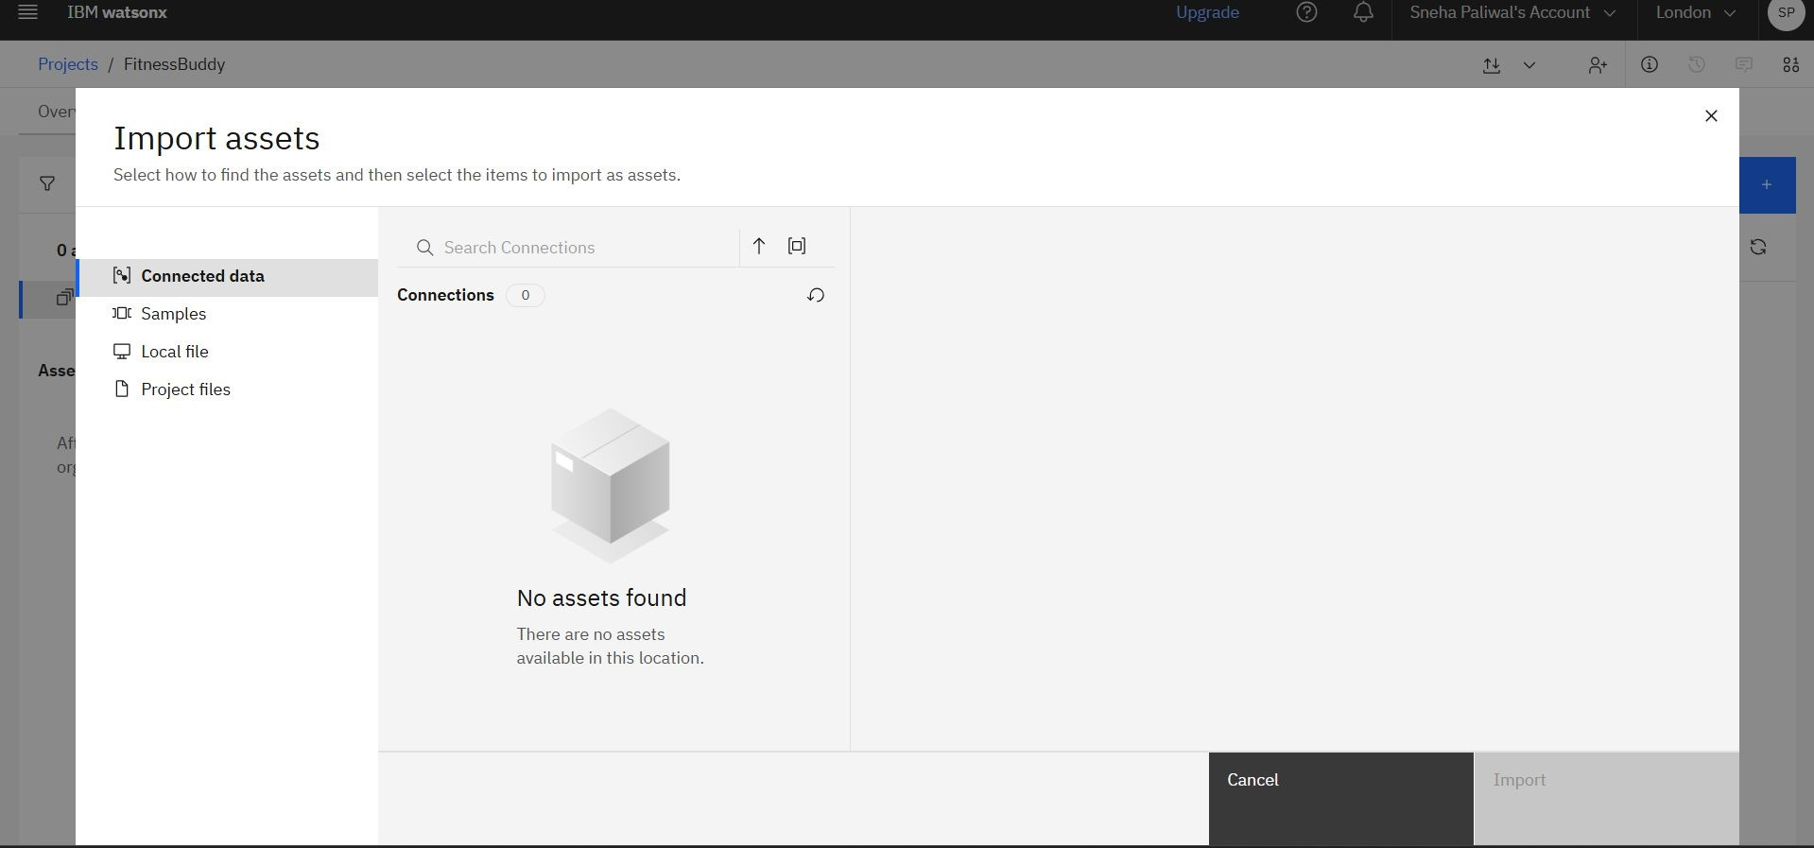
RESULTS

Slide 9
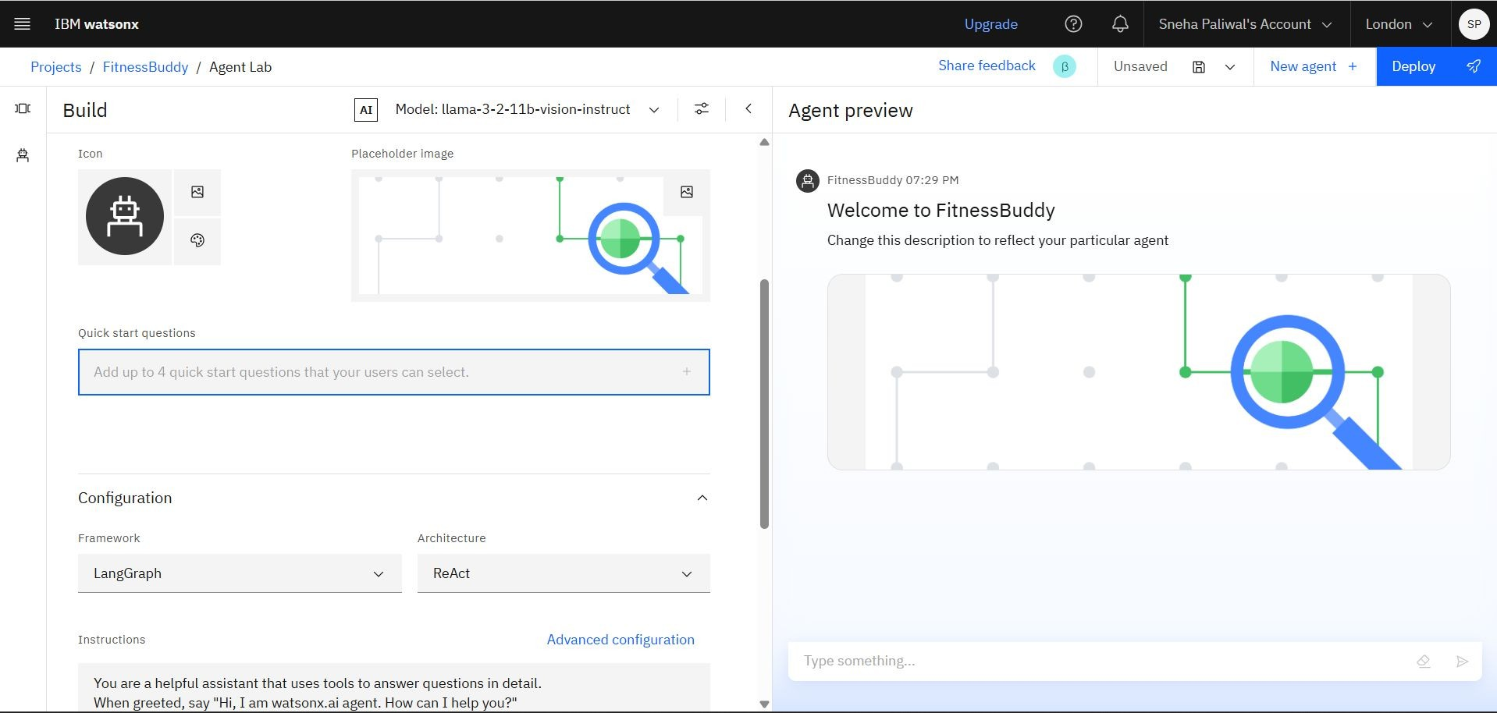
RESULTS

Slide 10
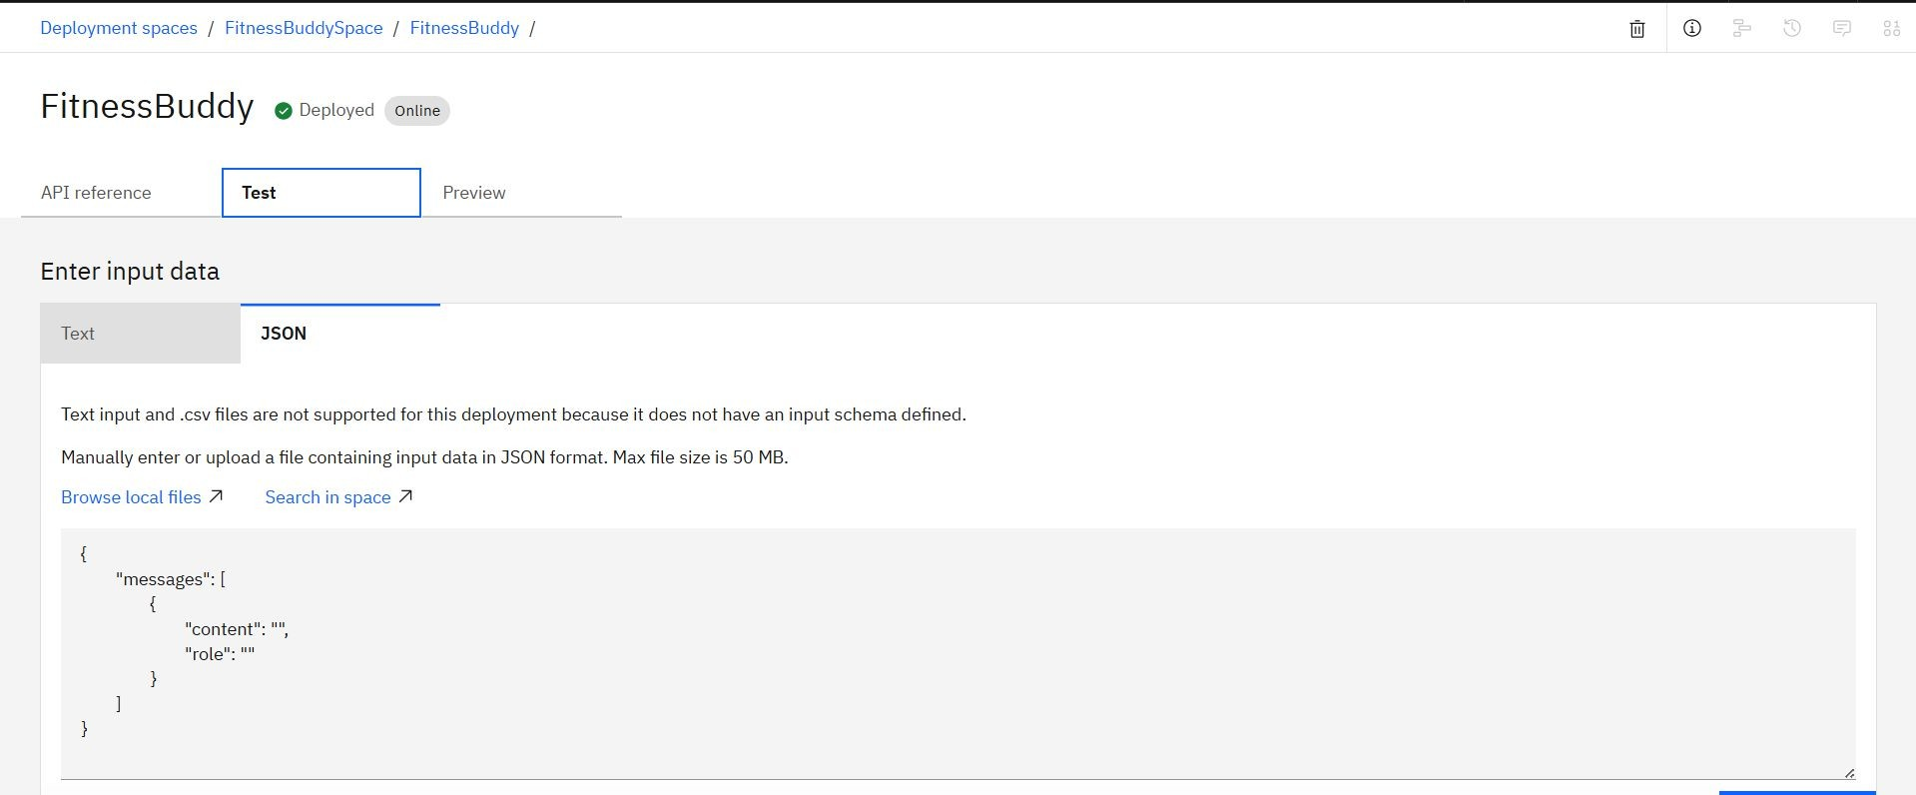
RESULTS

Slide 11
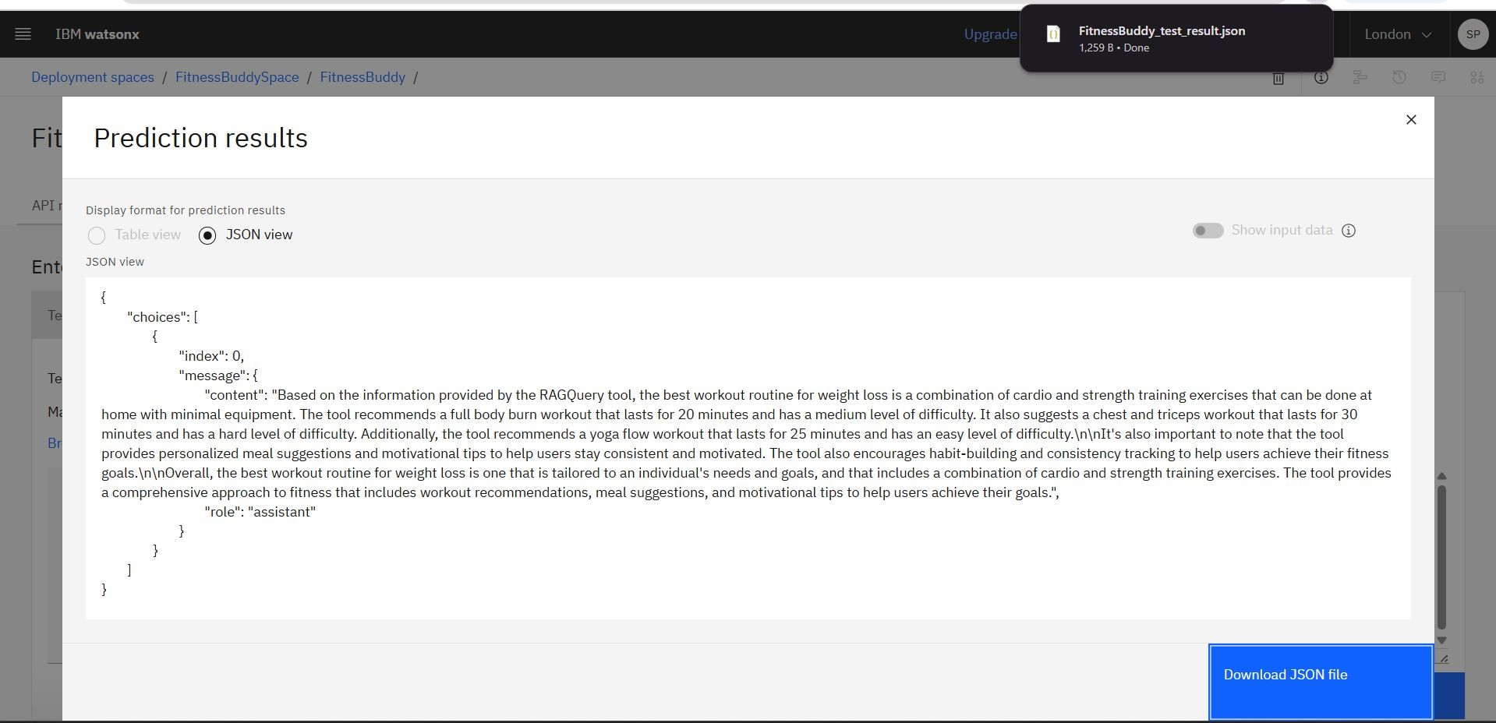
RESULTS

Slide 12

CONCLUSION
FitnessBuddy is an intelligent, AI-powered virtual assistant that helps users stay fit, eat better, and stay motivated—anytime, anywhere.
Built using IBM Watsonx and Granite Foundation Models, it offers personalized guidance without the cost or rigidity of traditional fitness solutions.
It empowers users by:
Recommending smart workouts and meal plans
Encouraging habit-building and wellness consistency
Making health accessible to beginners and busy individuals alike
◼

Slide 13
GITHUB LINK
https://github.com/Aryan021/Fitness-Buddy

Slide 14

FUTURE SCOPE
Voice Assistant Integration
Enable hands-free interaction via voice commands (e.g., “Start my 10-minute workout”).
Wearable Device Support
Integrate with smartwatches and fitness bands for live tracking of steps, heart rate, calories, etc.
Progress Analytics Dashboard
Provide visual reports of weekly goals, habits, nutrition, and workout consistency.
Mental Wellness & Meditation Support
Add AI-generated meditation routines, breathing exercises, and mood tracking.
Community & Challenges
Enable users to participate in fitness challenges and share progress with friends or groups.
Multilingual & Regional Customization
Support content in multiple Indian languages and meal plans tailored to regional diets.

Slide 15
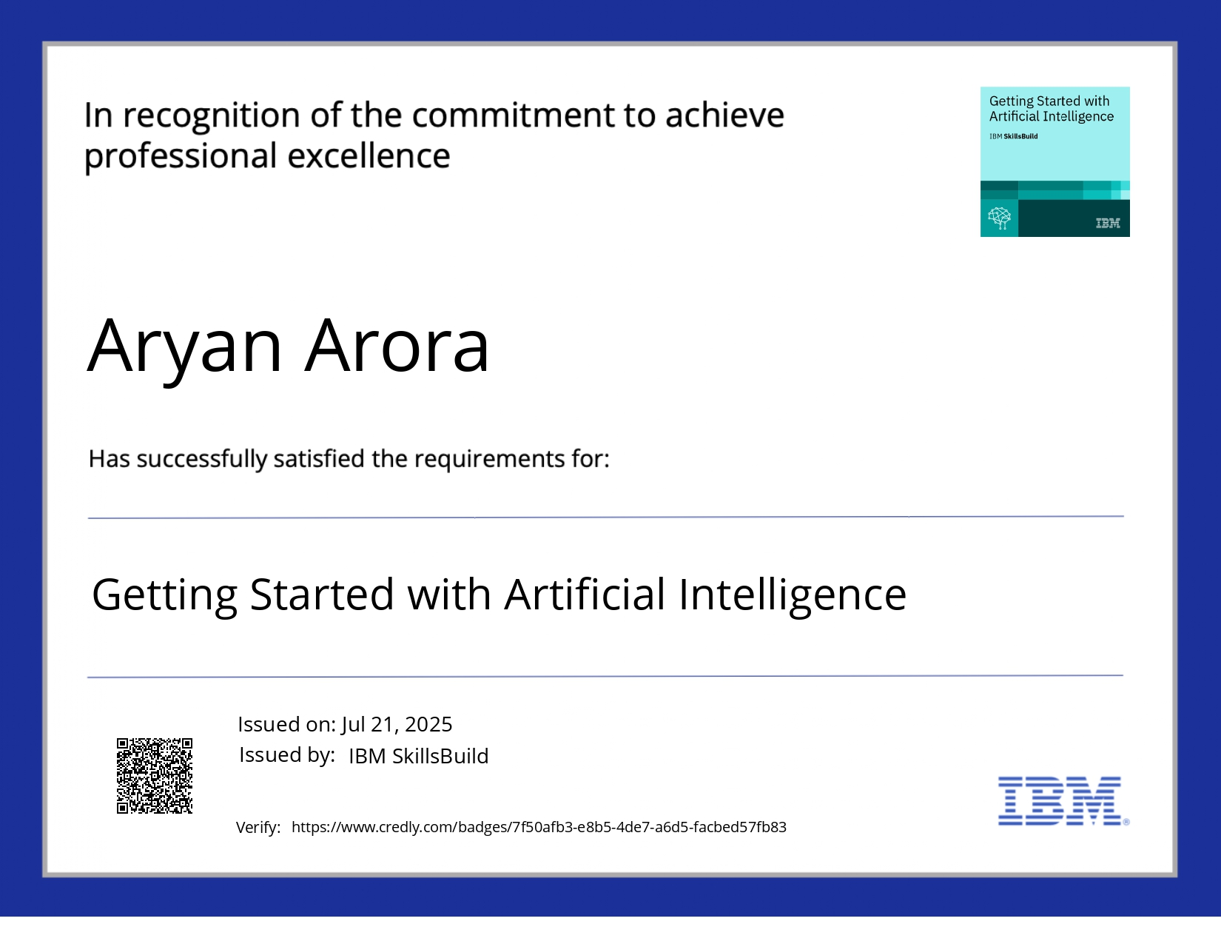
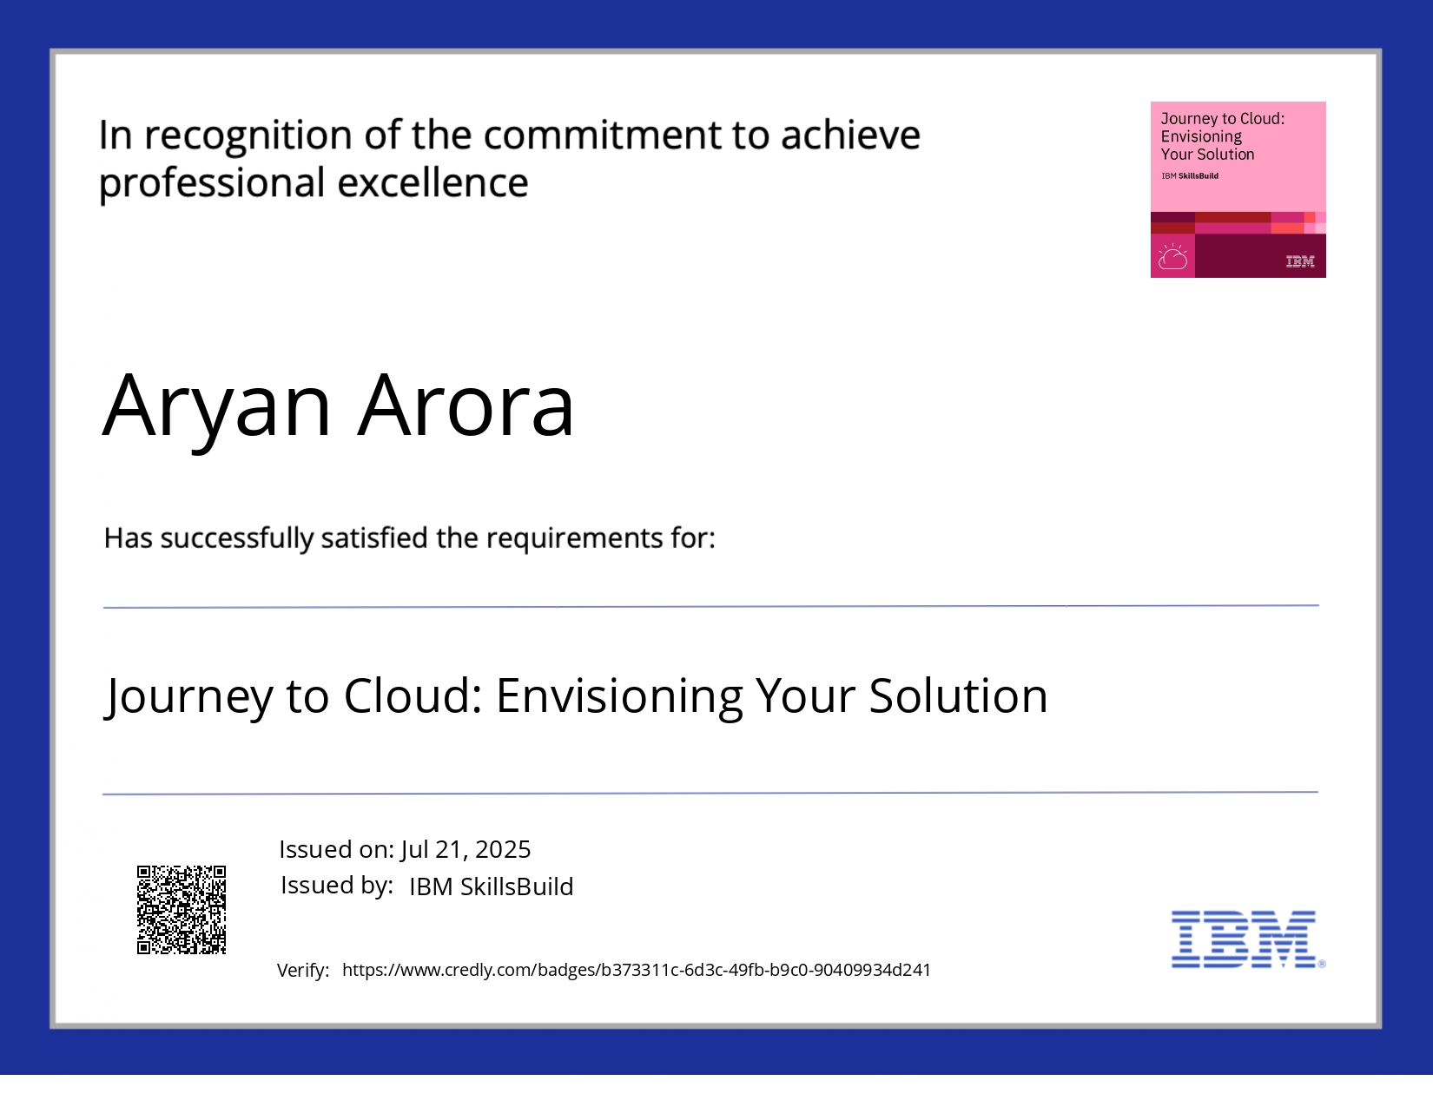
IBM CERTIFICATIONS
◼

Slide 16
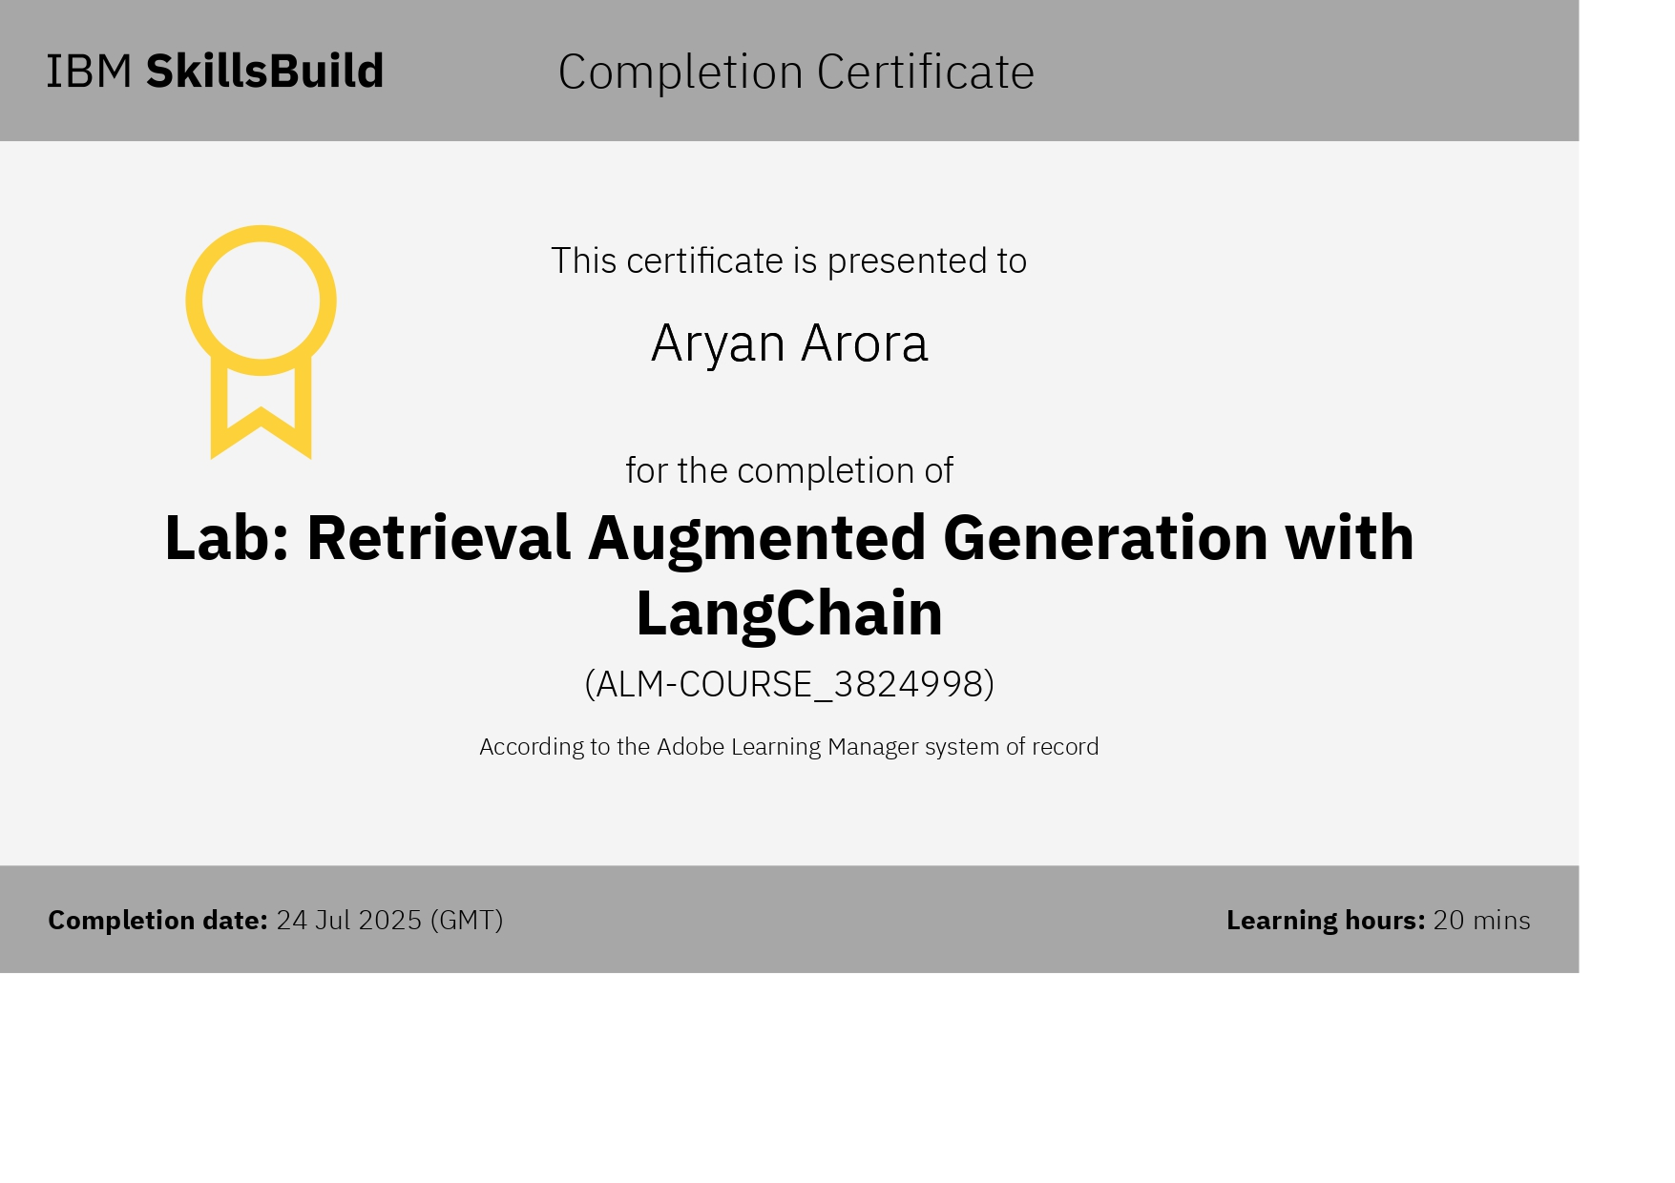

Slide 17
THANK YOU

