Slide 1
Project Presentation of Industry Oriented Hands on Experience (22CS422)
On
JOB LISTING PORTAL Aryan
2211981100
Supervised By
Dr. Monika Aggarwal
Department of Computer Science and Engineering,
Chitkara University, Punjab

Slide 2
Introduction
The Job Listing Portal is a full-stack web application designed to bridge the gap between job seekers and employers by providing a centralized and efficient hiring platform. In today’s digital era, job searching and recruitment processes are often scattered across multiple platforms, making it time-consuming and inefficient for both candidates and recruiters.
This project aims to simplify the entire recruitment process by offering a single platform where job seekers can easily search for jobs, apply online, and track their applications, while employers can post job openings, manage applicants, and streamline the hiring process.
The system is developed using modern web technologies with a user-friendly interface, secure authentication, and real-time data handling. It ensures better accessibility, faster communication, and improved user experience for all stakeholders.
2

Slide 3
Advantages of the System
It simplifies the job search process by providing all listings in one place
Employers can quickly reach a large number of candidates
Saves time compared to traditional hiring methods
Provides real-time updates and notifications
Improves communication between recruiter and applicant
Easy profile management for users
Secure authentication system ensures data safety

Slide 4
Technology Stack
Backend: Node.js, Express.js
Database: MongoDB
Authentication: JWT
API Testing: Postman
Frontend: React.js, Tailwind CSS

Slide 5
Project Abstract
The Hire Hub project represents a sophisticated response to the evolving challenges of the modern recruitment landscape. Built upon the robust and scalable MERN stack, the platform is designed to function as a seamless bridge between ambitious talent and forward-thinking organizations. At its core, the application leverages MongoDB for its flexible document-based storage, allowing for the efficient management of diverse job listings and user profiles. The backend is powered by Node.js and Express.js, providing a high-performance environment that handles complex routing and business logic with minimal latency. On the client side, the application utilizes React.js through the Vite build tool, ensuring a lightning-fast user experience characterized by interactive components and smooth transitions.
The architectural integrity of Hire Hub is maintained through a strict separation of concerns, where the backend focuses on data integrity and security while the frontend prioritizes user engagement and aesthetic excellence. Security is a paramount feature of the system, implemented through JSON Web Tokens (JWT) for session management and Bcrypt.js for the encryption of sensitive user data.

Slide 6
Objectives
Build a secure job portal system
Separate roles: Admin, Employer, Job Seeker
Prevent fake job postings
Provide easy job search and application system
Key Features:
For Job Seekers: Profile management, Job search with filters, Easy apply, Application tracking, and Real-time notifications.
For Employers: Job posting (CRUD), Candidate management, Resume viewing, and Dashboard analytics.
Security: Admin verification system, Protected routes, and JWT-based session management.

Slide 7
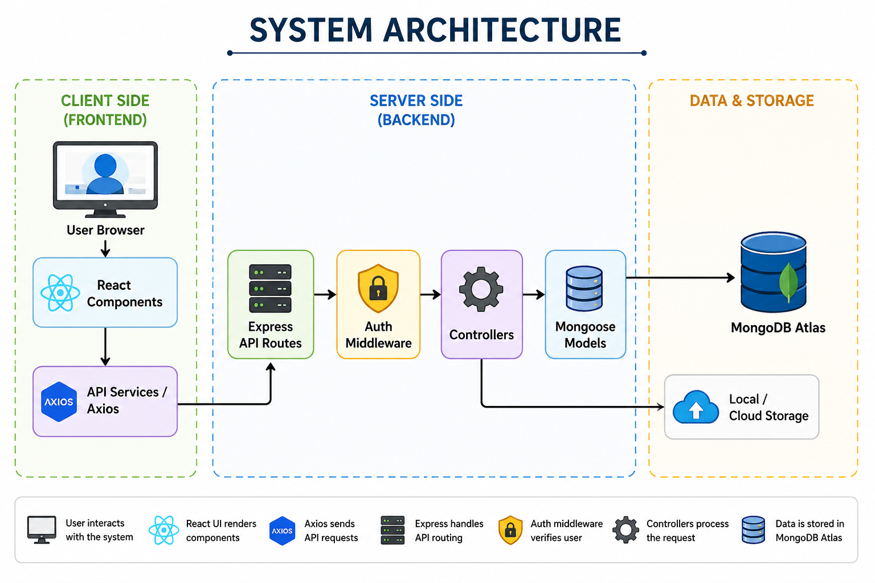
System Architecture

Slide 8
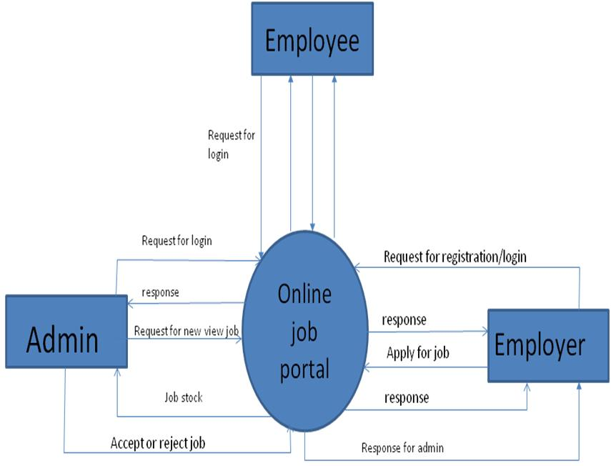
Data Flow Diagram

Slide 9
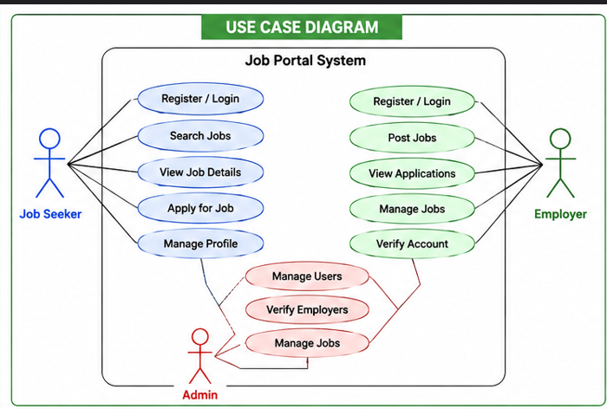
Use Case Diagram

Slide 10
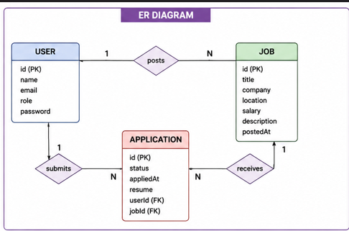
ER DIAGRAM

Slide 11
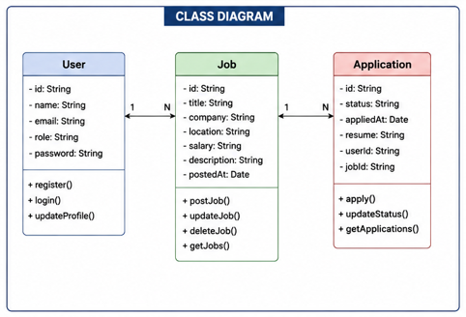
Class Diagram

Slide 12
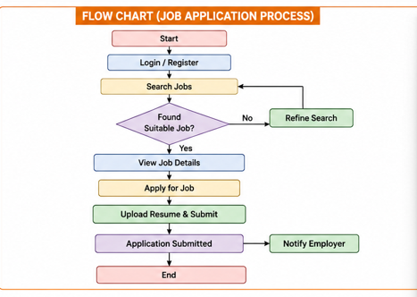
Flow chart diagram

Slide 13
Future Scope
AI Integration: Automated resume parsing and smart-matching algorithms.
Real-time Communication: Built-in video interviews (WebRTC) and instant chat (Socket.io).
Blockchain Verification: Secure verification of educational and work credentials.
Mobile Support: Dedicated React Native apps for iOS and Android.
Global Scaling: Multi-language support and regional edge computing.

Slide 14
Thank You
14

