Slide 1
NATIONAL INSTITUTE OF TECHNOLOGY WARANGAL
Biometric Security — Course Project
Contactless-to-Contact Fingerprint Recognition
Cross-Modal Relational Alignment (CMRA) with Risk-Controlled Abstention
A reproducible study on the HKPolyU Contactless 2D to Contact-based 2D database
Aryan Desai · Naman Sinha · Saurabh Bharrdwaj · Sayan Das
November 2026
Notes:
Title. The final system is CMRA: one shared embedding trained with identity-balanced batches, ArcFace and two cross-modal consistency losses. The VerifNet-style Siamese branch and score fusion are now baselines only.

Slide 2
Why contactless-to-contact is still hard
MOTIVATION
Contactless capture removes the sensor, but not the legacy contact database.
Cross-modal gap: illumination, pose, perspective, ridge scale and sensor noise change together.
VerifNet-style systems still rely on a Siamese branch plus fixed 90/10 score fusion.
The strongest 2025–26 methods need transformers, external data or synthetic augmentation.
Biometric security is decided at low FAR, where calibration and abstention matter.
Hygiene + access
touchless capture, remote onboarding
Interoperability
match phone photos to legacy prints
Security
operate at FAR = 1% and 0.1%
Goal: one embedding that aligns cross-modal identity structure — not another fusion layer.
Biometric Security · Course Project · CMRA
2 / 13
Notes:
Set up the problem: the sensor disappears but interoperability does not. Emphasise the low-FAR regime, because that is where a biometric system is judged.

Slide 3
Data and evaluation protocol
HKPolyU CL2CB
336
5,952
101
10,728
fingers, 2 sessions
paired images (2 modalities)
held-out test identities
test pairs
Every finger: 6 contactless + 6 contact impressions per session; 160 fingers return in session 2.
Split by finger: 201 train / 34 validation / 101 test — no identity appears twice.
Primary test: 10,728 pairs (5,364 genuine, 5,364 impostor); all genuine pairs are same-session.
Supplementary cross-session test: 48 test fingers in both sessions, 3,456 genuine + 3,456 impostor pairs.
Metrics: EER, TAR@FAR = 1% and 0.1%; 95% CI from 500 identity-cluster bootstrap resamples.
Model selection uses validation only; the test set is scored once after freezing.
Biometric Security · Course Project · CMRA
3 / 13
Notes:
Stress the identity-disjoint split and that the primary genuine pairs are same-session. The cross-session study is supplementary because only 48 test fingers have a second session.

Slide 4
Related work: five papers, one gap
LITERATURE
Paper | Core idea | Reported result
Lin & Kumar (TIP 2018) | Traditional ridge and minutiae features + COTS matcher | Contactless-to-contact baseline on HKPolyU
Tan & Kumar MANet (TIFS 2021) | Minutiae-guided attention CNN | Contactless-to-contactless identification
VerifNet (TBIOM 2025) | Scattering + Siamese + minutiae, fixed 90/10 | 2.5% EER, IITI-CFD; CL2CL only
Ridgeformer (ICIP 2025) | ViT + multi-stage contrastive, 4 training sets | 2.83% EER, HKPolyU
Kaplesh et al. (EAAI 2025) | Systematic review of end-to-end pipelines | Domain shift and preprocessing remain open
Common thread: representation, calibration and quality are entangled; fusion weights are usually fixed.
Gap: no reproducible identity-disjoint CL2CB baseline built around a genuinely different training objective.
State of the art is 2–4% EER — but with external data, transformers or synthetic pipelines.
Biometric Security · Course Project · CMRA
4 / 13
Notes:
The point is not the leaderboard. The strong numbers come from settings we cannot reproduce on a CPU. VerifNet is the closest lightweight idea, but it is evaluated contactless-to-contactless and keeps a fixed fusion.

Slide 5
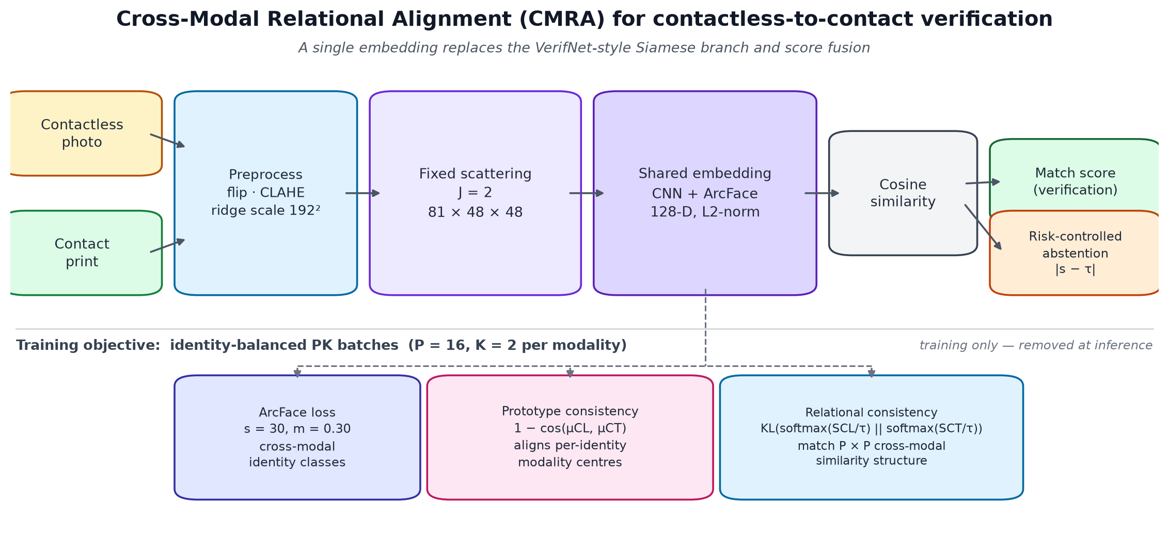
Proposed pipeline: CMRA
METHOD
One shared embedding; the Siamese branch and score fusion are removed from the proposed system.
Biometric Security · Course Project · CMRA
5 / 13
Notes:
Walk left to right. Both modalities pass through the same front-end and embedding. The two consistency losses are used only for training; at inference only cosine similarity and the optional abstention remain.

Slide 6
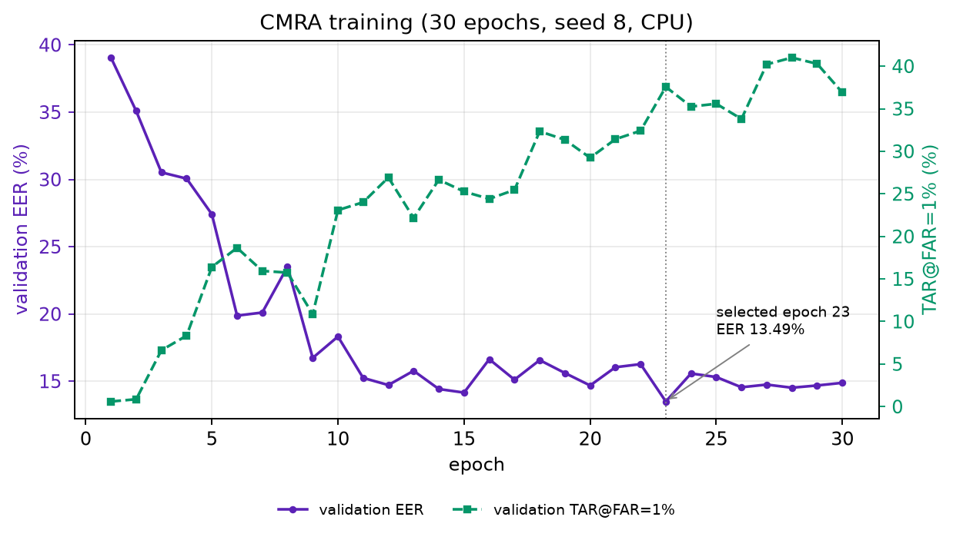
A CPU-cheap front-end, one shared embedding
METHOD
Fixed 2-D scattering transform (J = 2, 81 × 48 × 48) replaces learned early filters.
Three conv blocks → 128-D L2-normalised embedding; about 0.13M parameters.
ArcFace: scale 30, margin 0.30; both modalities share one identity class.
30 epochs, AdamW, ±2-cell translation, label smoothing 0.05.
Checkpoint at epoch 23: validation EER 13.49%, test EER 16.06% (seed 8).
Trained from scratch on 201 identities — no external data.
Biometric Security · Course Project · CMRA
6 / 13
Notes:
The representation is deliberately cheap: a fixed scattering transform plus a small CNN. The training curve shows validation EER and TAR@1% moving in the right direction; the test checkpoint is frozen.

Slide 7
Identity-balanced PK batches + ArcFace
METHOD
P = 16
K = 2 + 2
ArcFace supervision
L_arc = −log( e^{s·cos(θ_y + m)} / Σ_j e^{s·cos(θ_j)} )
identities per batch
contactless + contact per identity
64
64
s = 30, m = 0.30; label smoothing 0.05.
θ_y is the angle between the embedding and its class weight.
Contactless and contact images of the same finger share the label y.
This replaces pairwise contrastive training with identity-level supervision.
images per training step
steps per epoch
Sampled by identity, not by pair: every step contains both modalities of the same fingers.
Random crop ±2 cells; the identity split is never violated.
A shared class label lets ArcFace learn the cross-modal identity structure directly.
Identity-level supervision, not pairwise contrastive loss.
Biometric Security · Course Project · CMRA
7 / 13
Notes:
The PK sampler is the structural change. Because every batch contains both modalities of the same identity, the consistency losses below have a meaningful cross-modal signal.

Slide 8
Two cross-modal consistency losses
METHOD
Prototype consistency
Relational consistency
L_proto = (1/P) Σ_i [ 1 − cos(μ_i^CL, μ_i^CT) ]
L_rel = ½ KL(p_CT ‖ p_CL) + ½ KL(p_CL ‖ p_CT)
Pulls the mean embedding of each identity across the two modalities together.
p = softmax(S / τ); aligns who-is-close-to-whom across modalities.
L = L_arc + λ_proto·L_proto + λ_rel·L_rel with λ_proto = λ_rel = 0.5, τ = 0.1
Prototype loss aligns modality centres; relational loss aligns the full P × P similarity structure.
Temperature τ = 0.1 keeps the KL term numerically meaningful — a raw Gram MSE was negligible (~0.001).
At seed 7, relational-only (17.74% EER) is the strongest single addition, ahead of prototype-only (18.23%).
The network is trained on the cross-modal relation, not only on identity labels.
Biometric Security · Course Project · CMRA
8 / 13
Notes:
This is the new part. ArcFace alone gives identity separation; the two consistency terms force the two modalities to agree on identity centres and on relative similarity structure.

Slide 9
Ablation: where the gain comes from
RESULTS
Method | EER | TAR@1% | TAR@0.1%
ISE (v1 single embedding) | 19.56 | 28.24 | 4.05
CMRA ArcFace + PK only | 19.41 | 24.33 | 4.34
CMRA + prototype | 18.23 | 27.44 | 5.87
CMRA + relational | 17.74 | 28.93 | 6.99
CMRA full (prototype + relational) | 16.80 | 29.55 | 7.20
ArcFace + PK alone (19.41%) is already at the ISE level (19.56%).
Each consistency term helps; full CMRA reaches 16.80% EER.
v1 best fusion is 18.16% EER, but 32.94% TAR@1% — still stronger in the low-FAR tail.
Four seeds span 16.06–20.15%; report mean ± spread, not one cherry-picked seed.
Percentages; 10,728 test pairs, 101 identities, seed 7.
Single embedding, no score fusion — and a lower EER than the v1 fusion pipeline.
Biometric Security · Course Project · CMRA
9 / 13
Notes:
Lead with the ablation. ArcFace + PK is a control; the consistency terms are the actual contribution. Be explicit that v1 fusion still wins TAR@1% and TAR@0.1%.

Slide 10
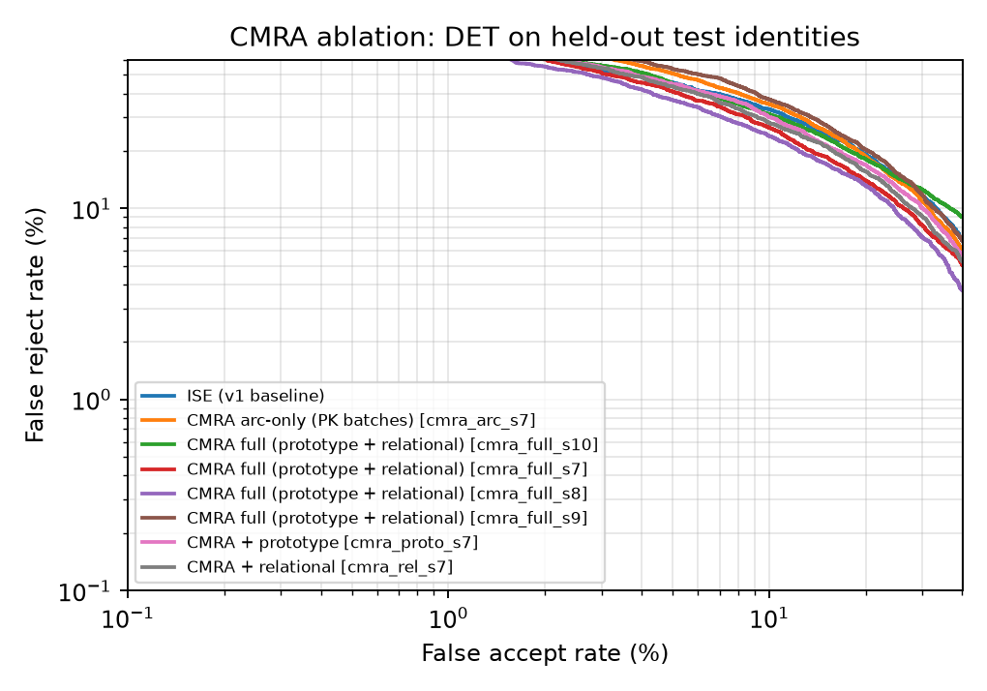
DET curves across the operating range
RESULTS
CMRA full has the lowest EER of the ablation.
ArcFace-only and ISE overlap; the consistency losses separate them.
The low-FAR tail is close: v1 fusion keeps a small advantage at TAR@1% and 0.1%.
DET uses log–log axes, so the tail is visible rather than hidden by the EER point.
Honest claim: comparable-or-better accuracy with a simpler, genuinely new pipeline.
Biometric Security · Course Project · CMRA
10 / 13
Notes:
The DET plot is the fair way to show this result. CMRA wins at EER and remains competitive in the tail, but the v1 fusion tail is still slightly better.

Slide 11
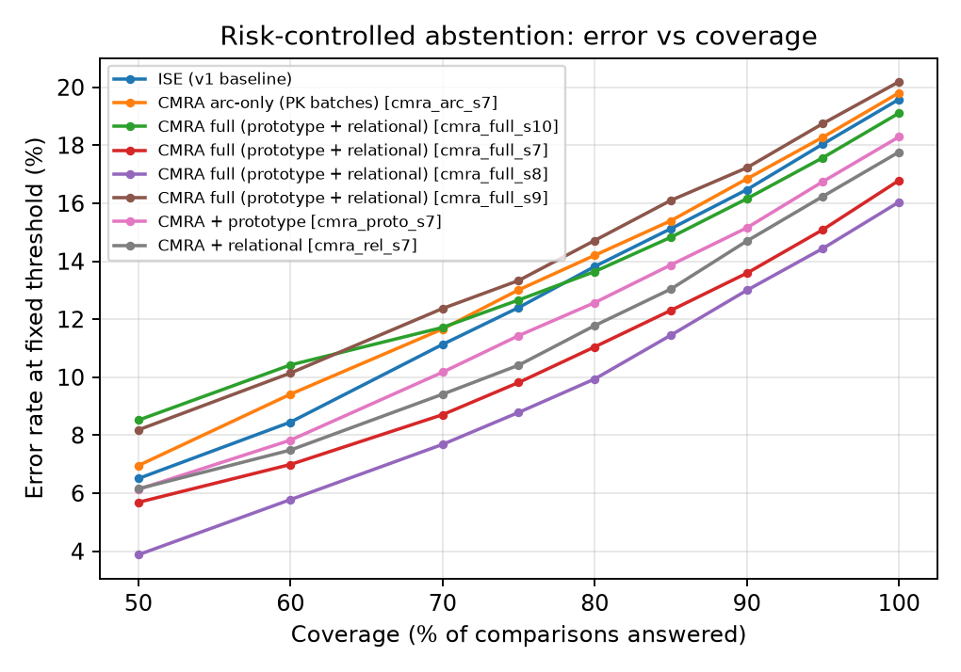
Risk-controlled abstention
RESULTS
Coverage | Error rate
100% | 16.04
90% | 13.00
80% | 9.94
70% | 7.68
50% | 3.88
Rank by confidence |s − τ| and reject the least confident pairs.
AURC 0.056 vs 0.084 for ISE.
At 50% coverage the error falls to 3.9% — a security-facing capability absent from v1 and the compared literature.
Biometric Security · Course Project · CMRA
11 / 13
Notes:
This is the deployment story: when the system is unsure, it can ask for another capture instead of accepting a risky comparison. Coverage 50% means half of the pairs are auto-decided.

Slide 12
Does it survive a session gap?
SUPPLEMENTARY
Method | Cross EER | Cross TAR@1% | Same EER | Same TAR@1%
CMRA seed 8 (proposed) | 14.89 | 32.81 | 15.79 | 25.64
v1 quality-aware fusion | 18.50 | 27.66 | 16.26 | 30.35
ISE (v1 baseline) | 18.89 | 31.57 | 17.43 | 28.36
Minutiae | 37.66 | 9.90 | 37.72 | 6.86
CMRA beats v1 fusion by 3.6 points cross-session.
Cross-session EER is actually lower than same-session here.
The gain is not a same-session artefact.
48 test identities present in both sessions; 3,456 genuine and 3,456 impostor cross-session pairs.
Biometric Security · Course Project · CMRA
12 / 13
Notes:
Caveat first: only 48 identities, and the genuine pairs are constructed differently. It is evidence of robustness, not a full cross-session benchmark.

Slide 13
Conclusion
WRAP-UP
16.80% EER · 29.55% TAR@1% · 3.9% error at 50% coverage
What worked
Honest limits
Next
Cross-modal relational alignment.
Single embedding, no score fusion.
CPU-only: 30 epochs, 0.13M parameters.
Honest identity-disjoint protocol.
Seed variance: 16.06–20.15%.
v1 fusion still better at TAR@1%/0.1%.
Cross-session study covers 48 identities.
No state-of-the-art claim.
Joint minutiae + identity learning.
Learned pair-reliability model.
Synthetic multi-pose data.
OpenVINO / NPU deployment.
A genuinely different training objective — relational alignment — not another fusion of the VerifNet score.
Biometric Security · Course Project · CMRA
13 / 13
Notes:
Close on the methodological point: CMRA changes how the embedding is trained, not just how scores are combined. Leave time for questions about seed variance and the low-FAR tail.

