Slide 1

PROJECT TITLE : SECURE DATA HIDING IN IMAGES USING STEGANOGRAPHY
SECURE THE DATA TO PREVENT HACKERS
Presented By: Aryan Raj
College Name & Department : Vellore Institute of Technology A.P & SCOPE

Slide 2
OUTLINE
Problem Statement
Technology used
Wow factor
End users
Result
Conclusion
Git-hub Link
Future scope

Slide 3
Problem Statement
With the increasing need for secure communication, traditional encryption methods can raise suspicion when intercepted. This project focuses on steganography, a technique for hiding secret messages within images without noticeable changes. The goal is to develop a system that securely embeds and retrieves text from images using a passcode, ensuring confidentiality and preventing unauthorized access.

Slide 4
Technology used
For make the project this are the following libraries , platforms are used:
cv2 module
Os and string module
Vs code (for write the program)
16 GB RAM, 512 GB hard disk
Intel core ultra 7
Github

Slide 5
Wow factors
For the more security purpose I add additional feature is that in the process of decryption; With password you have to also give the length of the secret message to know the encrypted message.

Slide 6
End users
Cybersecurity Professionals – To securely exchange confidential data without raising suspicion.
Government & Military Agencies – For covert communication and classified information transfer.
Journalists & Activists – To protect sensitive information in regions with restricted freedom of speech.
Business Organizations – To securely transmit proprietary or financial data.
General Users – For personal data protection and secure message exchange.

Slide 7
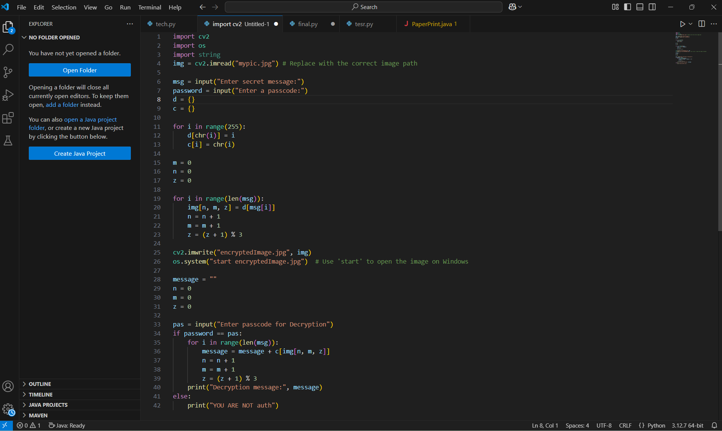
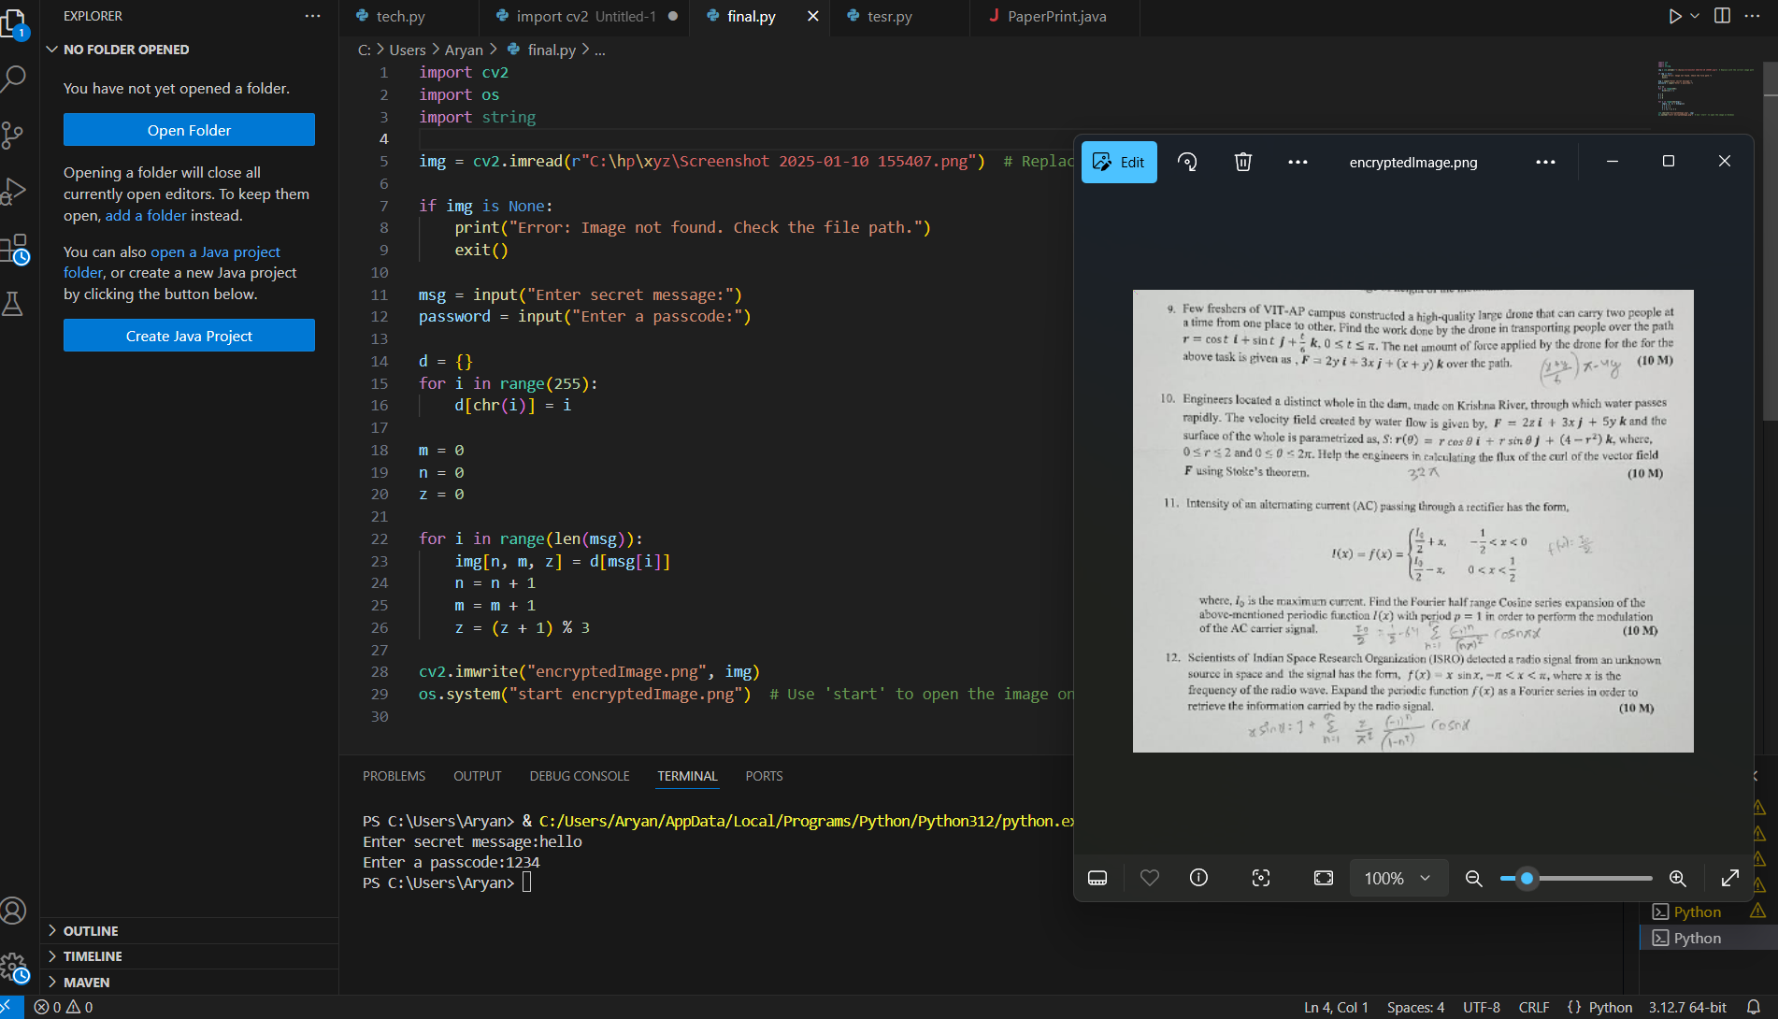
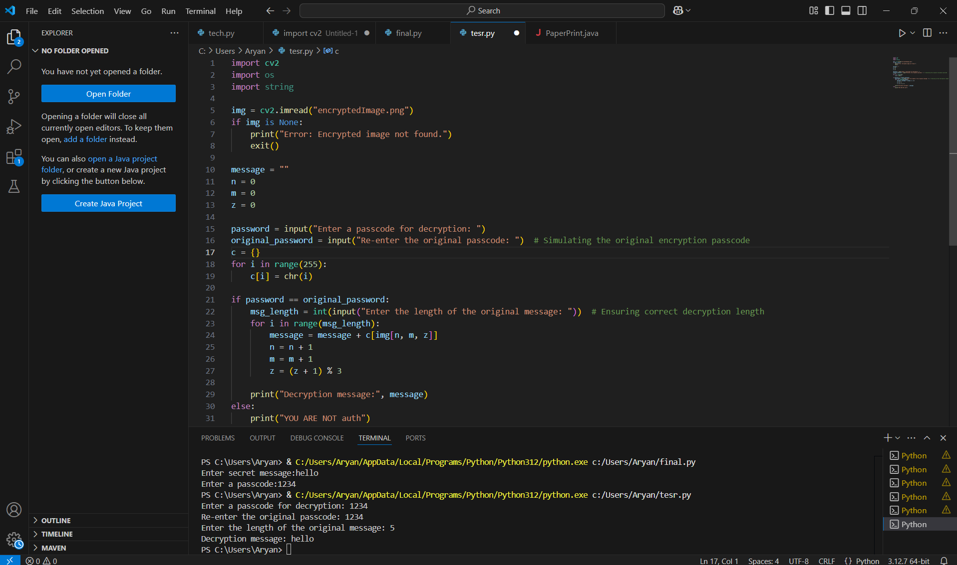
Results

Slide 8
Conclusion
This project successfully implements image-based steganography to securely hide and retrieve secret messages within digital images. By embedding the message at the pixel level and requiring a passcode for decryption, the system ensures confidentiality and unauthorized access prevention. The method maintains the visual integrity of the image while providing a covert and reliable means of secure communication. This approach can be effectively used in cybersecurity, covert communication, and data protection, making it a valuable tool for secure information exchange.

Slide 9
GitHub Link
https://github.com/Aryan0819/Image-StegoSecure.git

Slide 10
THANK YOU

