Slide 1
Explainable Machine Learning for Chronic Kidney Disease Prediction
SHAP-based feature attribution on the UCI CKD dataset
Vedank Singh | Reg. No. 240962043
B.Tech. CSE (AI & ML), V Semester, Section B
Guides: Dr. Narendra V G (Professor) and Ms Vibha (Assistant Professor - Senior Scale)
School of Computer Engineering, Manipal Institute of Technology | Academic Year 2026–27
Notes:
Introduce the project: an explainable pipeline that predicts CKD from routine clinical data and shows why each prediction was made. Mention it is an educational prototype, not a diagnostic tool.

Slide 2
Why CKD prediction needs explanations
788 million
Objectives
1
Acquire, clean and preprocess the UCI CKD data without leakage: missing values, encoding, scaling, class imbalance
adults had CKD in 2023 (age-standardised prevalence 14.2%), GBD 2023 Study
Often silent early
Routine blood and urine tests can flag likely CKD before symptoms appear.
2
Tune and compare Logistic Regression, SVM, Random Forest and XGBoost on accuracy, precision, recall, F1 and ROC-AUC
Black boxes are hard to trust
A clinician needs to see why a model flags a patient. SHAP attributes each prediction to the inputs.
3
Explain the chosen model with SHAP, globally and per patient, and compare its key features with clinical literature
Notes:
Motivation: CKD is common and silent early. ML can screen from routine tests, but without explanations clinicians cannot judge predictions. Read the three objectives from the synopsis.

Slide 3
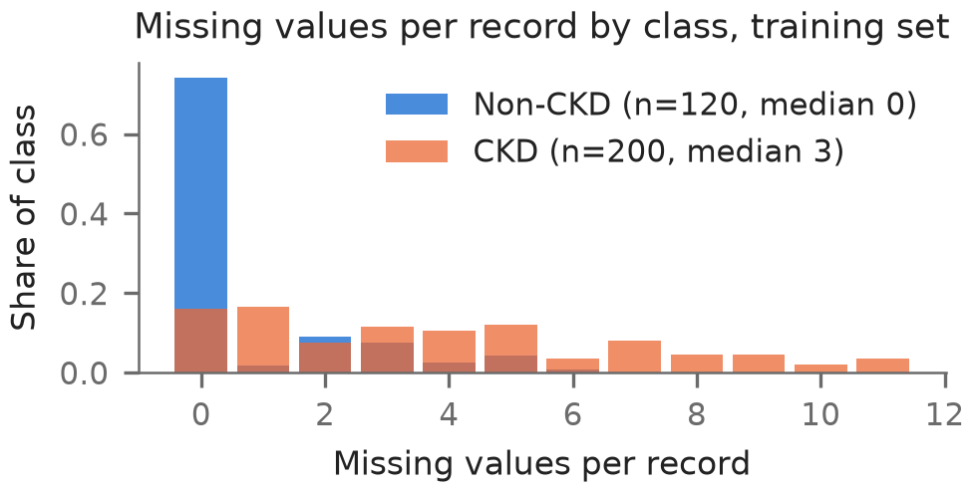
The data: 400 patients, 24 routine clinical inputs
400
250 / 150
24
10.6%
records (UCI repository, id 336)
CKD / non-CKD
inputs: 11 numeric, 3 ordinal, 10 binary
of values missing
Cleaning: nothing deleted
Official archive cached with SHA-256; matches UCI's CSV cell for cell
3 malformed lines and 16 stray tab/space cells repaired
3 impossible values set to missing (sodium 4.5; potassium 39 and 47 mEq/L)
No duplicate patient records; 80-record test set locked before tuning
In training data, CKD records miss far more values, and no non-CKD record shows any abnormal finding: the classes are unusually easy to separate (creatinine median 2.3 vs 0.9 mg/dL).
Notes:
The UCI file has formatting errors that were fixed by explicit rules, all logged. Missing values are common and strongly class-dependent, which matters later. Non-CKD records look like healthy controls.

Slide 4
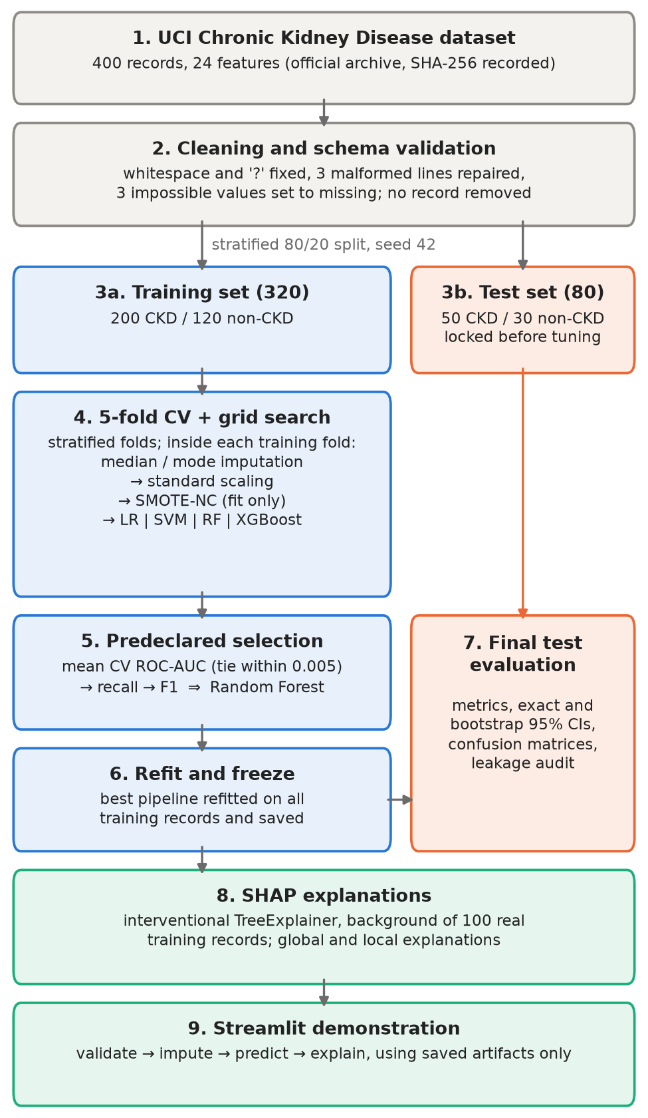
Pipeline designed so the test set stays untouched
How leakage is prevented
✓
Test set (80 records) split off and locked, with a checksum, before any tuning
✓
Imputation, scaling and SMOTE-NC are refitted inside every training fold
✓
SMOTE-NC runs only during fitting: validation and test records are never resampled
✓
The model is chosen from training-set cross-validation; the test set is used once
✓
Record ID and target are excluded from the predictors
✓
Automated audit: 11 / 11 checks passed; shuffled labels give CV ROC-AUC 0.505
Notes:
Walk down the workflow. The key point is that every learned step lives inside one pipeline that is refitted on each training fold, so nothing learned from validation or test data can leak in. SMOTE-NC creates synthetic non-CKD records only during fitting.

Slide 5
Four models, one selection rule fixed in advance
Logistic Regression
L2 penalty, C = 0.1
SVM
RBF kernel, C = 1, gamma = scale
Random Forest (selected)
300 trees, full depth, sqrt features/split
XGBoost
100 trees, depth 2, learning rate 0.05
5-fold CV (mean ± SD) | ROC-AUC | Recall | F1-score
Logistic Regression | 0.999 ± 0.001 | 0.960 ± 0.041 | 0.979 ± 0.021
SVM | 1.000 ± 0.000 | 0.985 ± 0.030 | 0.992 ± 0.016
Random Forest | 0.999 ± 0.001 | 1.000 ± 0.000 | 0.995 ± 0.006
XGBoost | 0.999 ± 0.002 | 0.985 ± 0.012 | 0.985 ± 0.012
Rule (written before any score)
Highest mean CV ROC-AUC wins
Within 0.005: tied, ranked by recall, then F1
All four tied (0.9988–1.0000): Random Forest wins on recall (1.000)
The synopsis proposed picking the best test score; selecting on training CV keeps the test estimate unbiased.
Notes:
All four were tuned by grid search with stratified 5-fold CV on the 320 training records. The selection rule was fixed in the config file before running. The synopsis said 'pick the best on the test set'; that biases the test estimate, so selection used CV only.

Slide 6
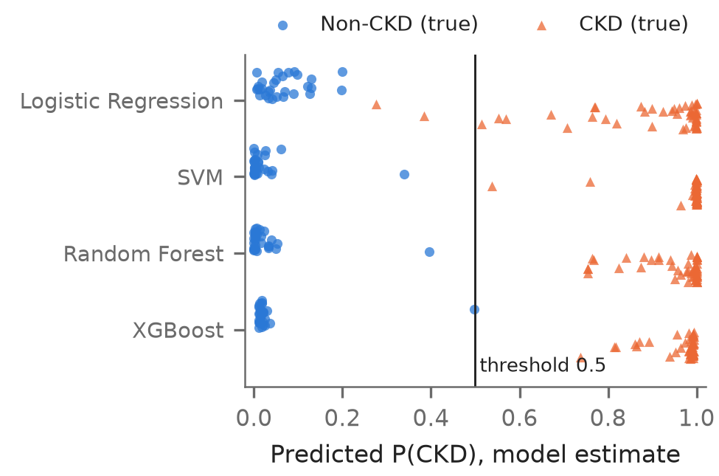
Untouched test set: near-perfect, with honest uncertainty
80 / 80
test records correct for Random Forest (also SVM and XGBoost)
0.955–1.000
exact 95% CI for Random Forest accuracy
2
CKD cases missed by Logistic Regression (no FP)
Perfect accuracy hides a near miss: non-CKD record 324 scored 0.397 (Random Forest) and 0.497 (XGBoost), just below the 0.5 threshold.
Notes:
Explain FN vs FP: a false negative is a missed CKD patient, the more harmful error. With only 80 test records, 80/80 still allows a true accuracy as low as about 95.5%. Perfect scores are not clinical validation.

Slide 7
Checks that keep the results honest
No gain
SMOTE-NC vs no resampling
0.864
Missingness alone
Same folds and settings: recall and F1 changed by at most 0.010, within one fold SD. Kept as specified, no benefit claimed.
CV ROC-AUC from which values are missing, ignoring the values: testing practice carries class signal.
0.505
Shuffled labels
0%
Abnormal findings in non-CKD
CV ROC-AUC after permuting the labels: chance level, so the pipeline has no hidden leak.
No non-CKD training record has hypertension, diabetes, anaemia or any other abnormal finding.
Notes:
These checks matter more than the headline numbers. SMOTE-NC did not help, consistent with Yang et al. 2024. Missingness is informative. Shuffled labels collapse to 0.5, showing no leakage. The data are simply very separable.

Slide 8
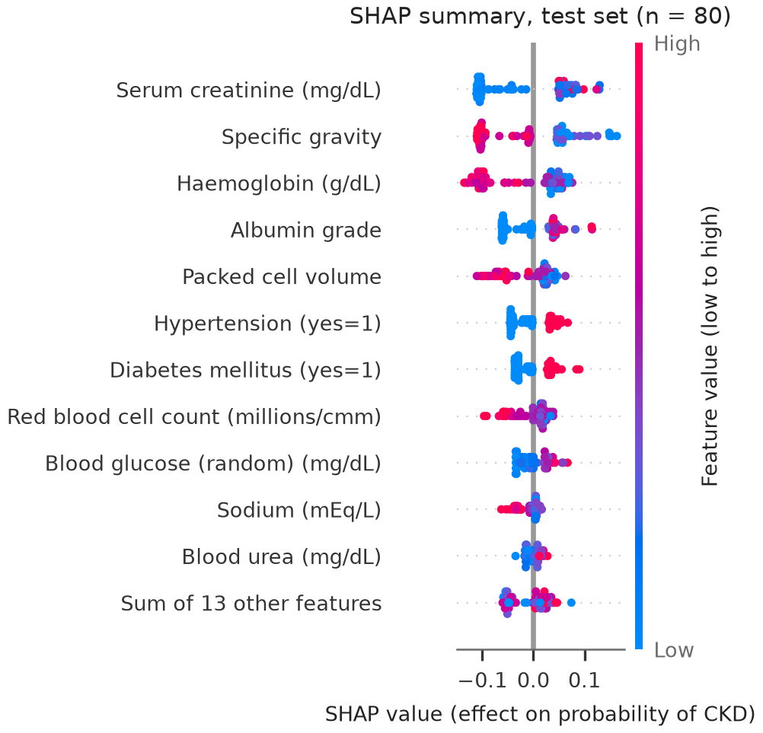
What drives the predictions: global SHAP
Creatinine: basis of eGFR, which defines CKD
Albumin: marker of kidney damage
Haemoglobin, packed cell volume: anaemia, common as CKD advances
Hypertension, diabetes: leading CKD risk factors
Specific gravity: not a diagnostic criterion; matches earlier SHAP work on this dataset
Ranking stable between test and training records (Spearman 0.995). SHAP explains the model, not the disease.
Notes:
The top five features carry about 64% of all attribution. Each dot in the beeswarm is a test patient: red means a high feature value. High creatinine and low specific gravity or haemoglobin push towards CKD. These agree with clinical knowledge, but SHAP is not causal evidence.

Slide 9
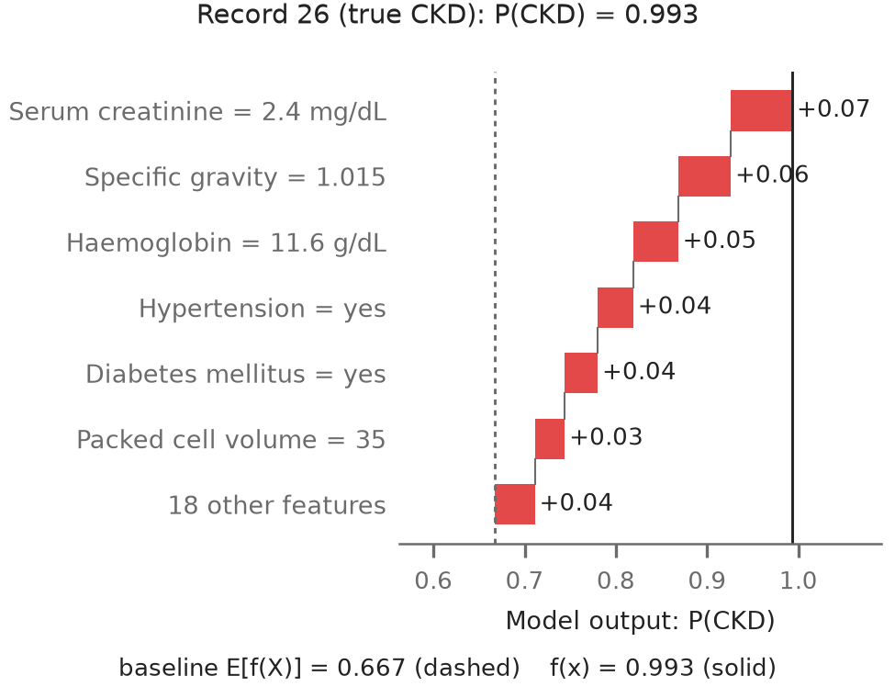
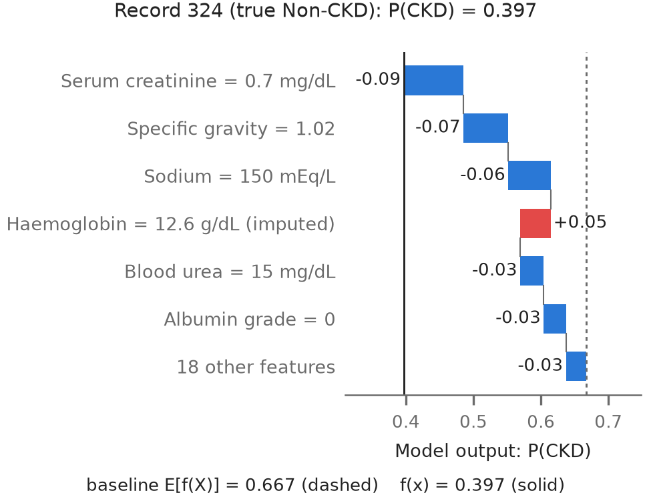
Why one patient got their prediction: local SHAP
Record 26 (true CKD), P = 0.993
High creatinine, low specific gravity and low haemoglobin push the output up from the 0.667 baseline.
Record 324 (true non-CKD), P = 0.397
Normal creatinine pushes down, but missing haemoglobin, imputed at the training median 12.6 g/dL, pushes up.
Notes:
Read a waterfall bottom to top: start at the baseline (mean prediction over 100 training records), add each feature's contribution, end at the model output. The contributions add up exactly (max error 1.8e-8). The second example shows how imputation can influence an explanation.

Slide 10
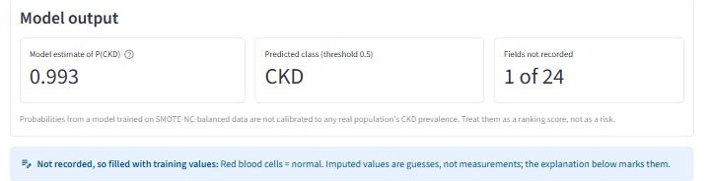
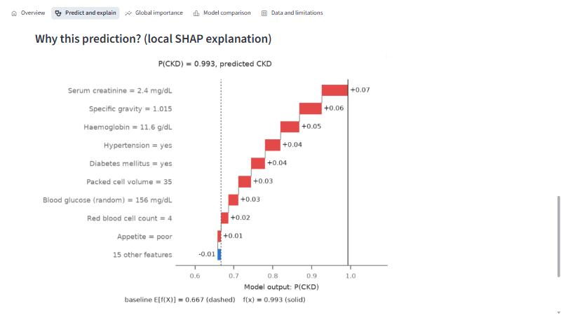
Demonstration: a local Streamlit prototype
1
Validate inputs against the schema
2
Impute blanks and list them
3
Predict P(CKD) with the saved model
4
Explain the prediction with SHAP
Screenshots from the running app (dataset record 26). It loads saved artifacts only: about 46 ms per prediction and 82 ms per explanation. Every page states that it is an educational prototype, not a diagnostic tool, with no treatment advice.
5
Check baseline + contributions = output
Notes:
Live demo: run 'streamlit run app/streamlit_app.py', load dataset record 26, press Predict and explain, show the probability, the imputed field and the waterfall, then point to the consistency check line. Screenshots are from the running app.

Slide 11
Conclusion, limitations and next steps
What we found
Limits
A reproducible, leakage-audited pipeline for four classifiers
Random Forest chosen by a predeclared CV rule; 80/80 test records correct
SHAP: creatinine, specific gravity, haemoglobin, albumin, packed cell volume
Oversampling gave no consistent benefit
400 single-centre records; healthy-looking controls
80 test records: wide confidence intervals
No eGFR or repeat tests; missingness is informative
Probabilities uncalibrated; SHAP is not causal
No external validation: not clinically validated
Next steps: external validation on larger cohorts with eGFR-based labels, calibration, explicit missingness modelling, and explanation stability across models.
Notes:
Close with the honest message: the pipeline is sound and the explanations are clinically sensible, but the dataset is too small and too easy to support clinical claims. Invite questions.

