Slide 1
CLASS IX
SUBJECT- SCIENCE (CHEMISTRY)

Slide 2
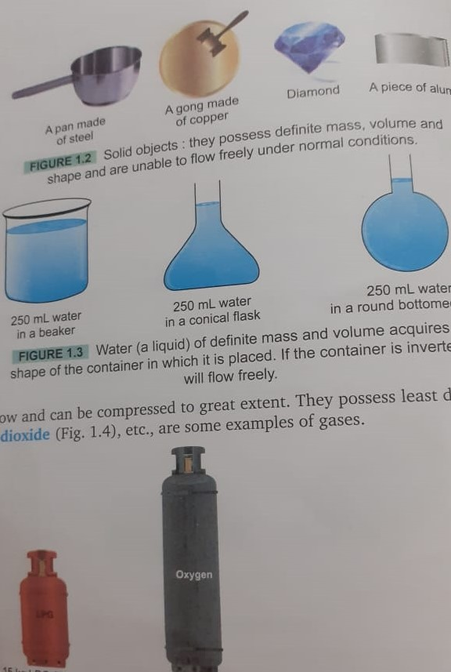
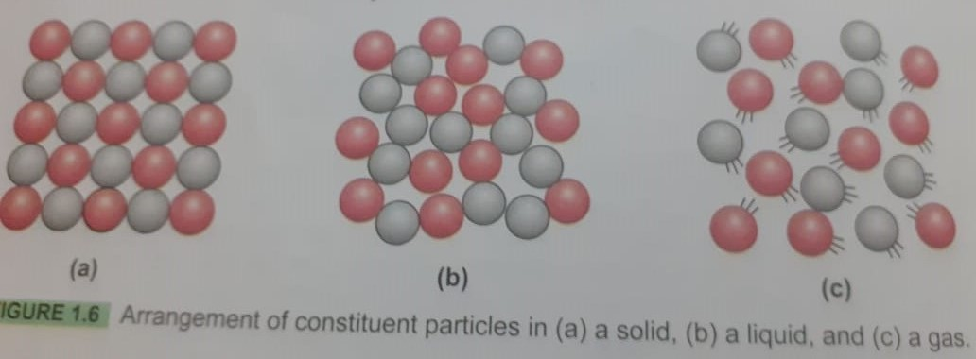
Matter in our surrounding
What matter is ?- matter anything which occupy space and have some mass.
Classification of matter
on the basis of physical properties: solid, liquid, gas.
on the basis of chemical properties: compound and mixture.
Explanation of state of matter the physical state of matter is determined mainly by two factors force of attraction and kinetic energy possessed by the constituent particles.
General characteristics of solid state: solids are rigid ,hard , unable to flow have definite volume and definite shape.
Characteristics of liquid state: liquids are less rigid possess no definite shape can flow freely.
Characteristic of gaseous state: gases are highly compressible gases possess neither definite shape nor definite volume.

Slide 3
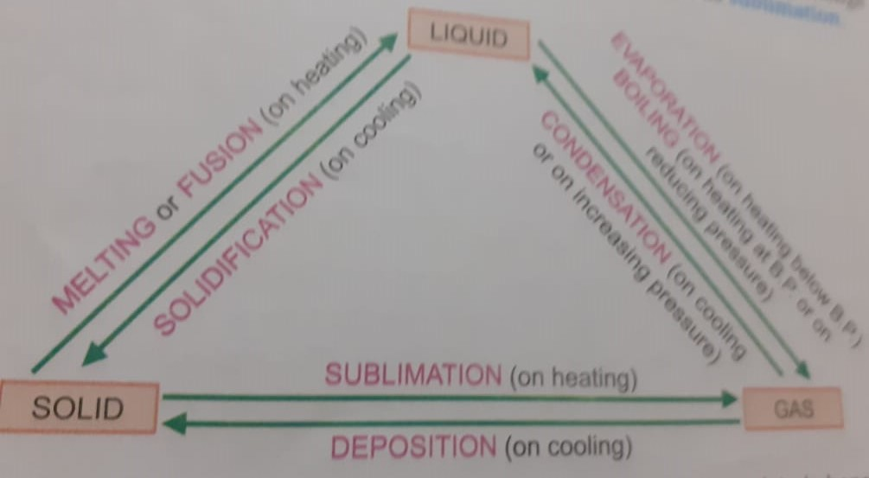
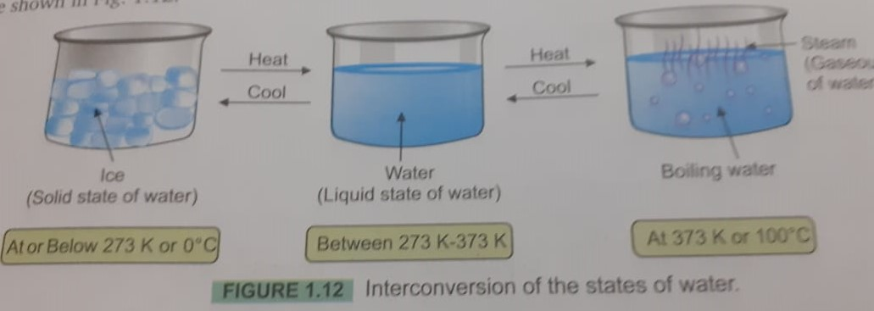
Units of temperature
Celsius scale of temperature
Kelvin scale of temperature
Temperature on Celsius scale temperature = on Kelvin scale - 273
Interconversion of state
Melting or fusion
evaporation or boiling
sublimation
Condensation
solidification

Slide 4
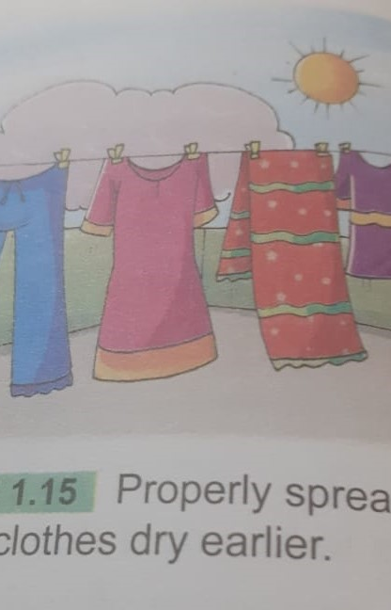
Evaporation
change of substance from liquid state to gaseous at room temperature is called evaporation or vaporization .
Factors affecting evaporation
temperature.
humidity.
surface area.
wind speed.
evaporation causes cooling due to the absorption of heat by the liquid particle

