Slide 1


ENGLISH LITERATURE CLASS - II

Slide 2
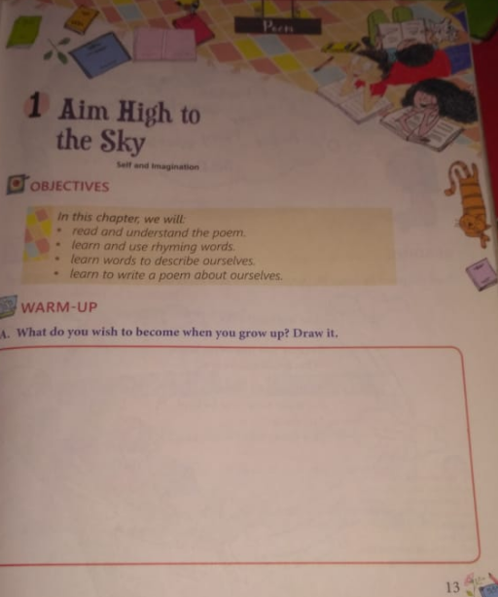
Lesson - 1

Slide 3
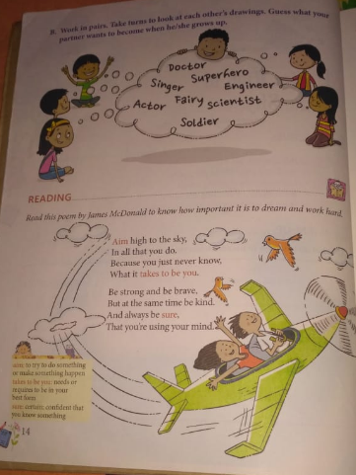

Slide 4
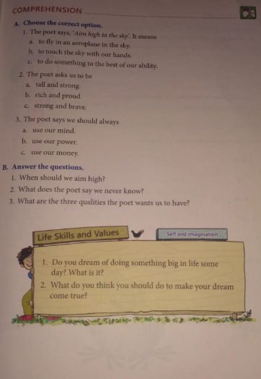

Slide 5
Question & Answers
Q1. When should we aim high?
Ans 1. We should aim high in all that we do.
Q2. What are the three qualities the poet wants us to have ?
Ans 2. The three qualities poet wants us to have are:
a. Be brave
b. Be kind
c. Be sure
Q3. What does the poet says we never know?
Ans 3. The poet said that we never know what requires to be in our best form.

Slide 6
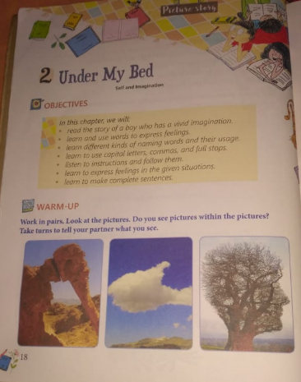
Lesson - 2

Slide 7
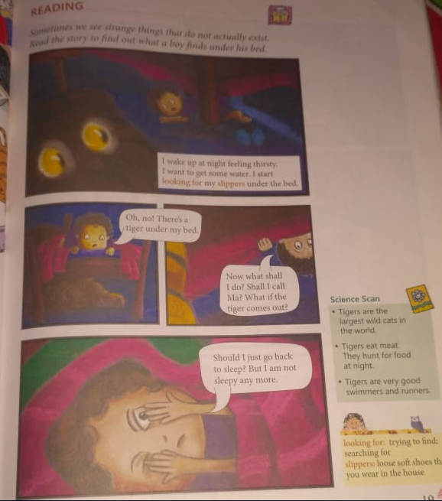

Slide 8
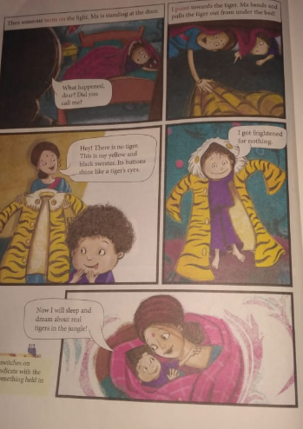

Slide 9
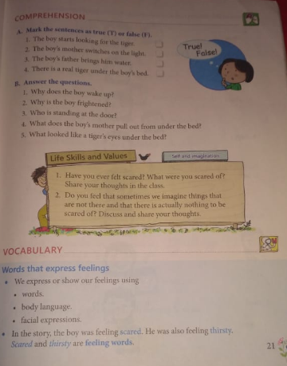

Slide 10
Word Meaning
1. looking for : trying to find
2. slippers: loose soft shoes
3. turn on: switch on
4. point: to indicate with the finger

Slide 11
Make Sentences
Make sentences of these given words:
1. Slippers
________________________________________
2. Tiger
________________________________________
3. Dream
_________________________________________
4. Thirsty
_________________________________________
5. Night
_________________________________________

Slide 12
Question & Answer
Q1. Why does the boy wake up?
Ans 1. The boy woke up at night because he was feeling thirsty.
Q2. Why does the boy frightened?
Ans 2. The boy was frightened because he thought there was a tiger under his bed.
Q3. Who was standing at the door?
Ans 3. The boy's mother was standing at the door.
Q4. What does the boy mother pull out under the bed?
Ans 4. The boys mother pulled out a yellow and black sweater under the bed.

