Slide 1


ENGLISH GRAMMAR CLASS - II

Slide 2
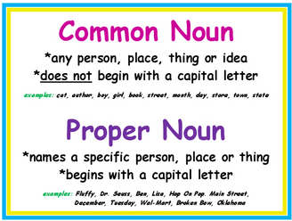
NOUNS
  Common nouns and Proper nouns

Slide 3
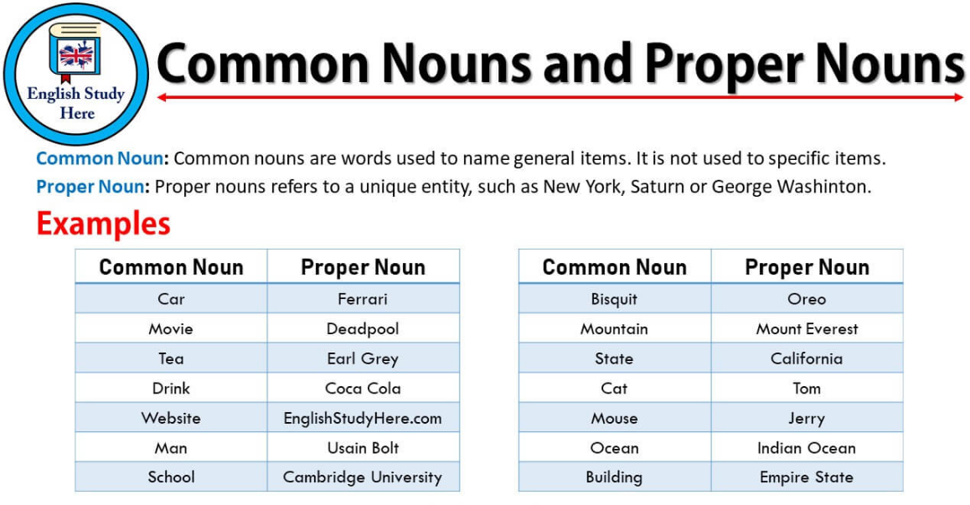

Slide 4
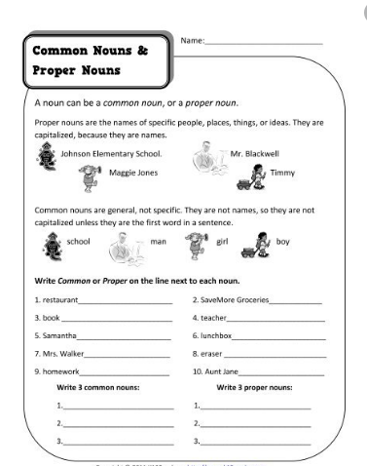

Slide 5
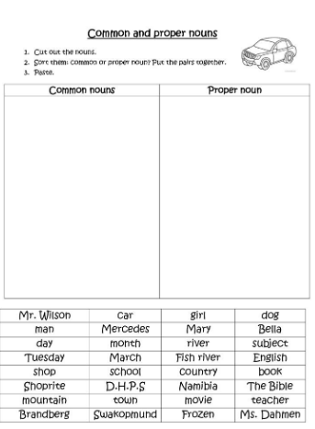

Slide 6
