Slide 1
CLASS X
SUBJECT- CHEMISTRY

Slide 2
CHEMICAL REACTION
Chemical reaction is a process in which one or more new substances are formed, its a permanent change this changes not easily reversible.
Characteristics of chemical reaction
change in state
Change in colour.
formation of precipitate.
evolution of gas.
change in temperature.

Slide 3
Chemical equation
chemical equation is a brief representation of of chemical reaction in term of chemical formula of the reactant and product.
Steps of writing chemical equation
the symbol and formulae of reactants are written on the left hand side with Plus sign between them
the symbol and formula of various product are written on the right hand side with Plus sign between them
an arrow or sign of equality is put between the reactant and product

Slide 4
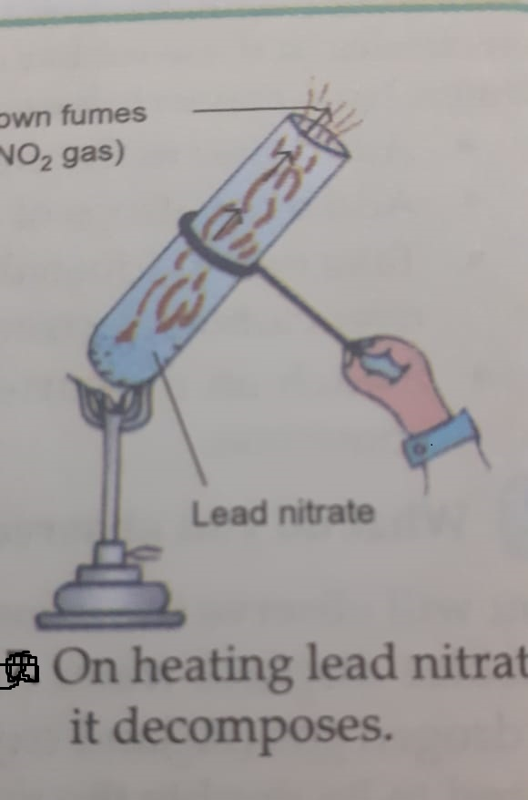
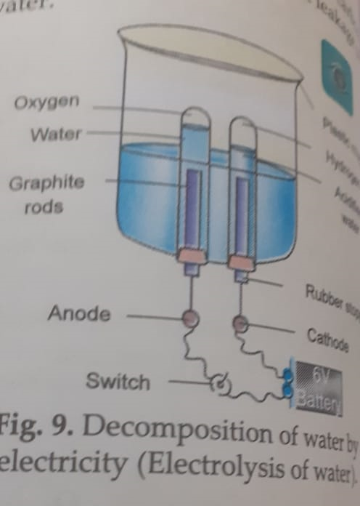
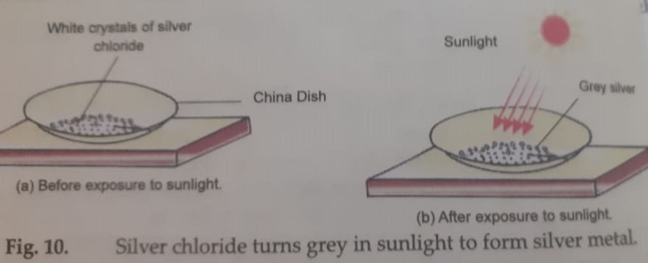
Different types of chemical reaction
combination reaction- the reaction in which two or more substance combine to form a single substance are called combination reaction example C + O2 =CO2 2H2 + O2= 2 H2O 2Mg + O2 =2 MgO
decomposition reaction- the reaction in which a compound breaks up into two or more simpler substances . it is Reverse of combination reaction for example the decomposition reaction can be brought by the action of heat light or electricity .when the decomposition reactions brought about by the action of heat are called thermal decomposition
example- 2Pb(NO3)2 =2PbO +4NO2 +O2 when the decomposition is is brought about by the passage of electricity is called e lectrolytic decomposition example to 2 H2 + O2 =2 H2O decomposition brought about by the action of light is called photochemical decomposition example 2AgCl2 =2Ag + Cl

Slide 5
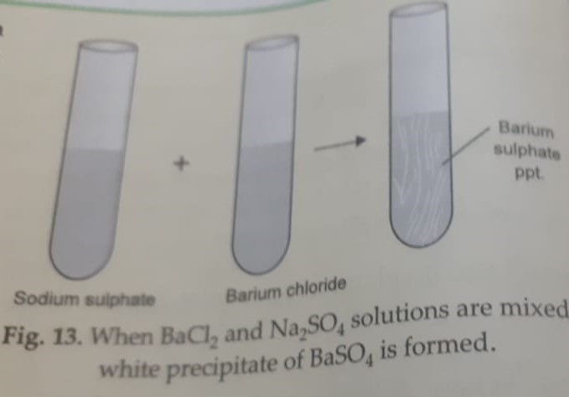
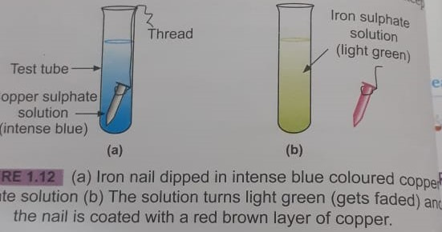
Displacement and double displacement reaction
Displacement reaction the reaction in which one element takes the place of another element in a compound.
Eg- Fe +CuSO4 =FeSO4 +Cu
Double displacement
Double displacement reaction the reaction in which two compounds react to form to other compounds by mutual exchange of atoms for example when Barium Chloride is mixed with sodium sulphate it forms Barium sulphate and sodium chloride.
Oxidation and reduction reaction oxidation is a reaction which involve addition of oxygen or removal of hydrogen . reduction reaction is in which involves the addition of hydrogen or removal of oxygen oxidising and reducing agent the substance which gets oxidized acts as reducing agent and the substance which get reduced act as oxidizing agents.

Slide 6
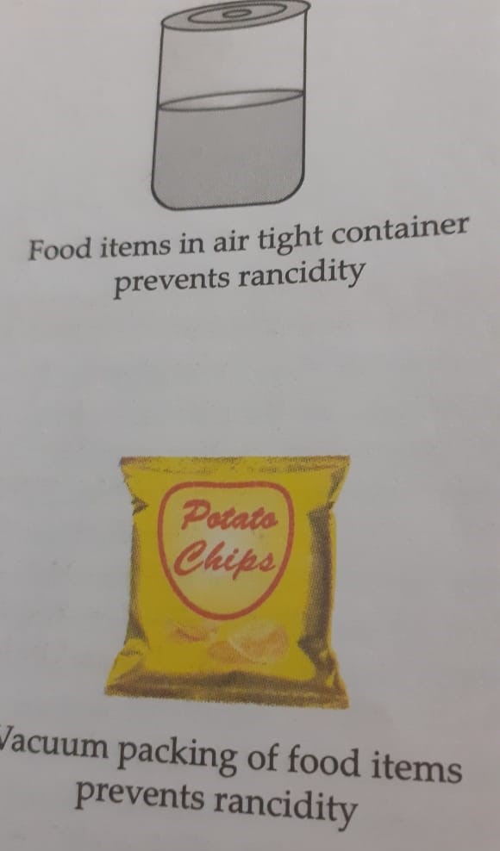
Corrosion and rancidity
Corrosion
Corrosion is a process of deterioration of the metal as a result of its reaction with air or water surrounding it Methods to prevent corrosion oiling , greasing , galvanization
rancidity
rancidity the change in odour and flavour of oily and fatty food by oxidation is called rancidity.
methods of prevent rancidity
By adding antioxidant* by keeping in airtight container.
by refrigeration of the food* by storing food away from light

