Slide 1


SCIENCE CLASS - II
JP ACADEMY

Slide 2
CHAPTER 1 : MY FAMILY AND ME

Slide 3
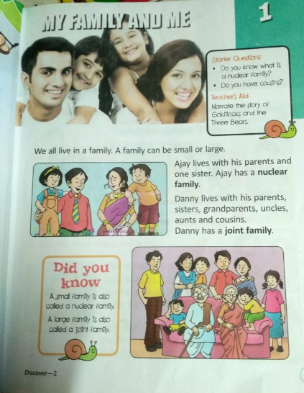

Slide 4
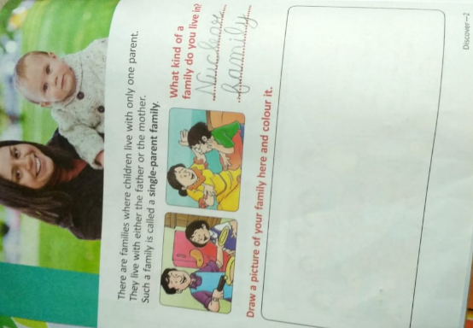

Slide 5
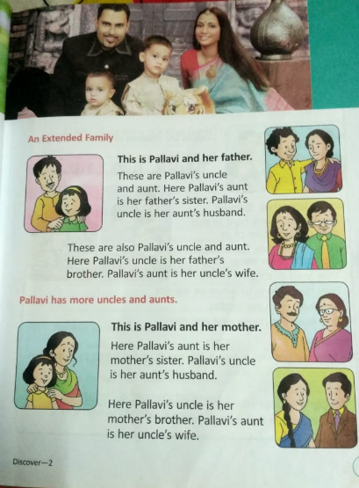

Slide 6
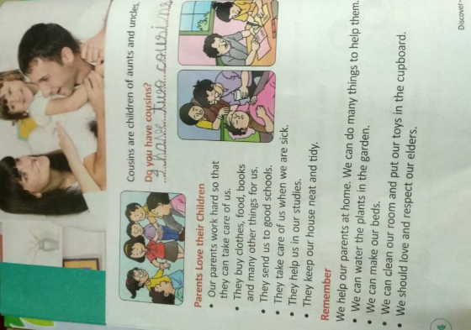

Slide 7
Exercises
1. Answer in one word:
Your uncle's children are your _Cousins .
Your father and mother are your __Parents .
Your mother's or your father's mother is your _Grandmother .
Your father's or mother's father is your _Grandfather .
Your mother's brother is your _Uncle .

Slide 8
2. Write whether these statements are True/False:
We should respect our elders. TRUE
Cousins are children of grandparents. FALSE
Parents do not take care of their children. FALSE
We can help our parents at home. TRUE
A small family is also called a joint family. FALSE

Slide 9
3. Give long answers to these questions:
Q1. Who all are there in a large family?
Ans 1. Parents, children, grandparents , uncles, aunts and cousins are there in a large family.
Q2. How can children help their parents?
Ans 2. Children can do many things to help their parents. They can do many things like -
1. Water the plants.
2. Make their bed.
3. Clean their room.

