Slide 1
Front-End Web Development
Institute Name: SSGI Bhilai
Resource Person: Learn Tech Plus
Duration: 90 hrs
Anish Kumar Verma
CSE-C , Sem -5th
Uni. Roll no. 301402219031

Slide 2
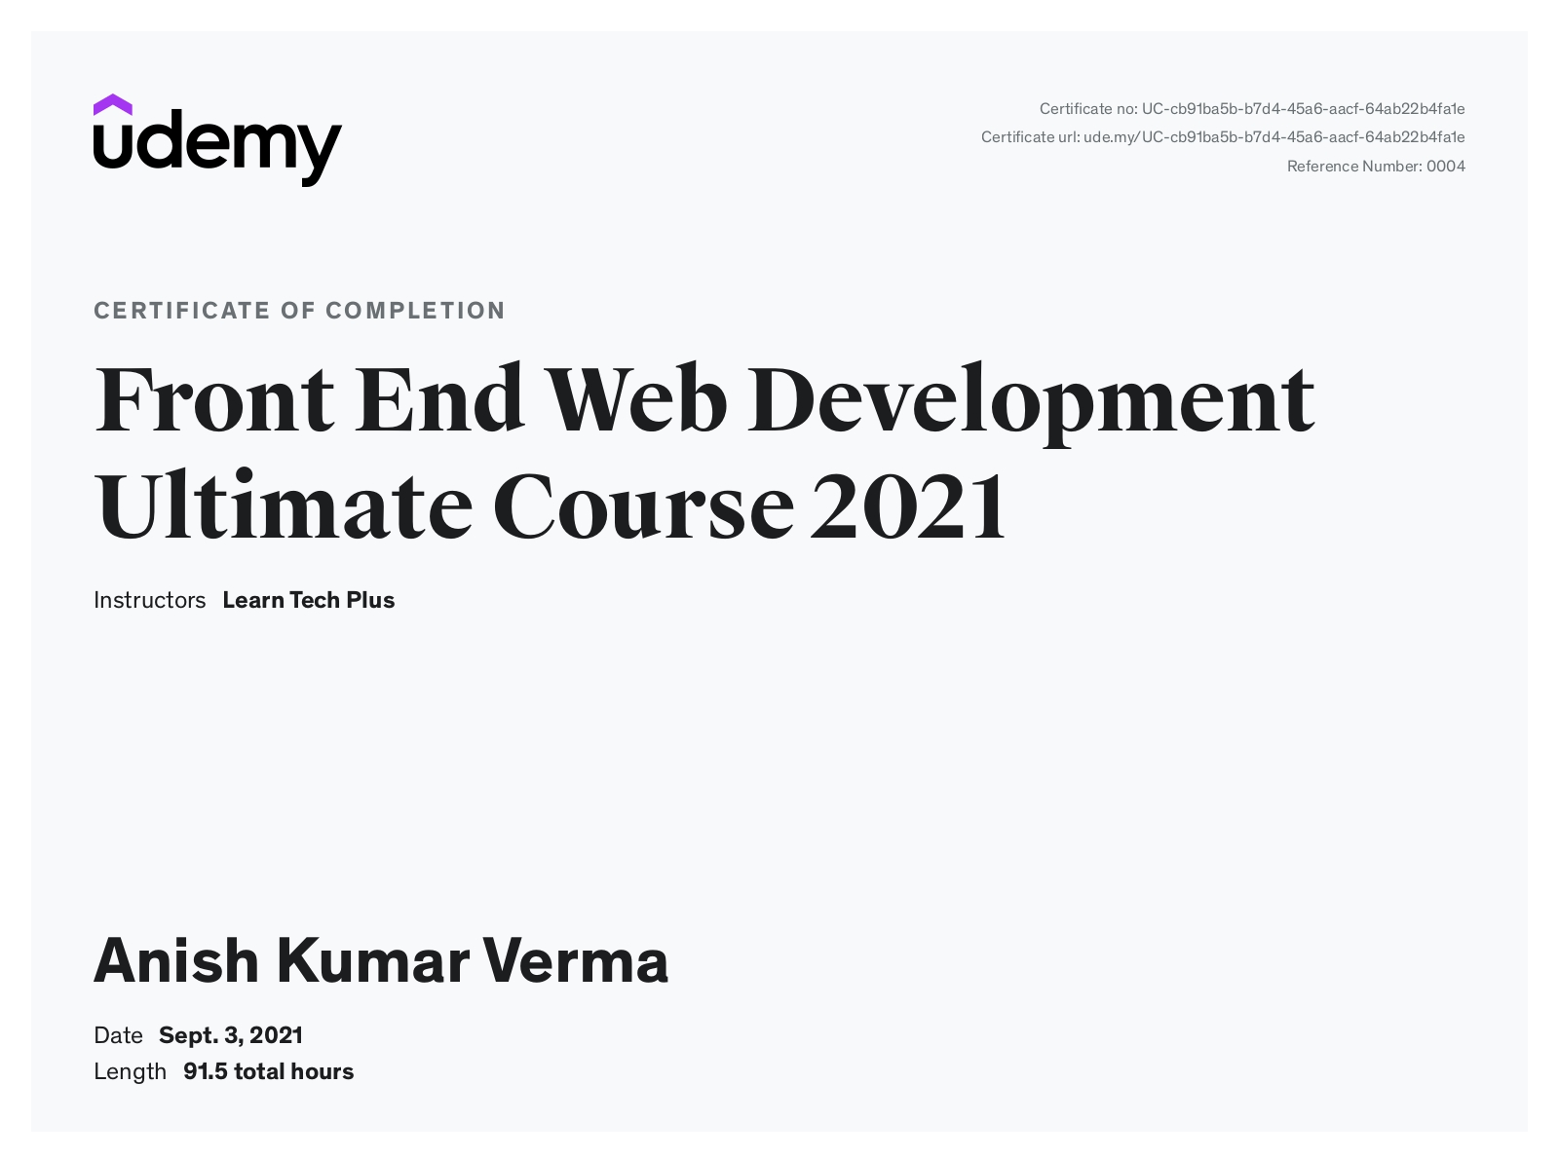
Vocational Training Certificate

Slide 3
Technology Used :
HTML – Hypertext Markup Language is the set of markup symbols or codes inserted into a file for displaying it on the internet.
HTML stands for Hyper Text Markup Language
HTML is the standard markup language for creating Web pages
HTML describes the structure of a Web page
HTML consists of a series of elements
HTML elements tell the browser how to display the content
HTML elements label pieces of content such as "this is a heading", "this is a paragraph", "this is a link", etc.

Slide 4
Technology Used :
CSS – CSS stands for Cascading Style Sheets, CSS is a style sheet language used for describing the presentation of a document written in markup language such as HTML.
CSS stands for Cascading Style Sheets
CSS describes how HTML elements are to be displayed on screen, paper, or in other media
CSS saves a lot of work. It can control the layout of multiple web pages all at once
External stylesheets are stored in CSS files

Slide 5
Project Descripton :
The Front End Web Development Ultimate Course 2021 begins with the basics.
The Course Covers everything need to know to start building websites .
It Covers HTML, CSS, JavaScript from scratch.
The Course Teaches the fundamentals of Front-End Web Development.
Use them to start creating our own websites.

Slide 6

Results and Discussions :

Slide 7
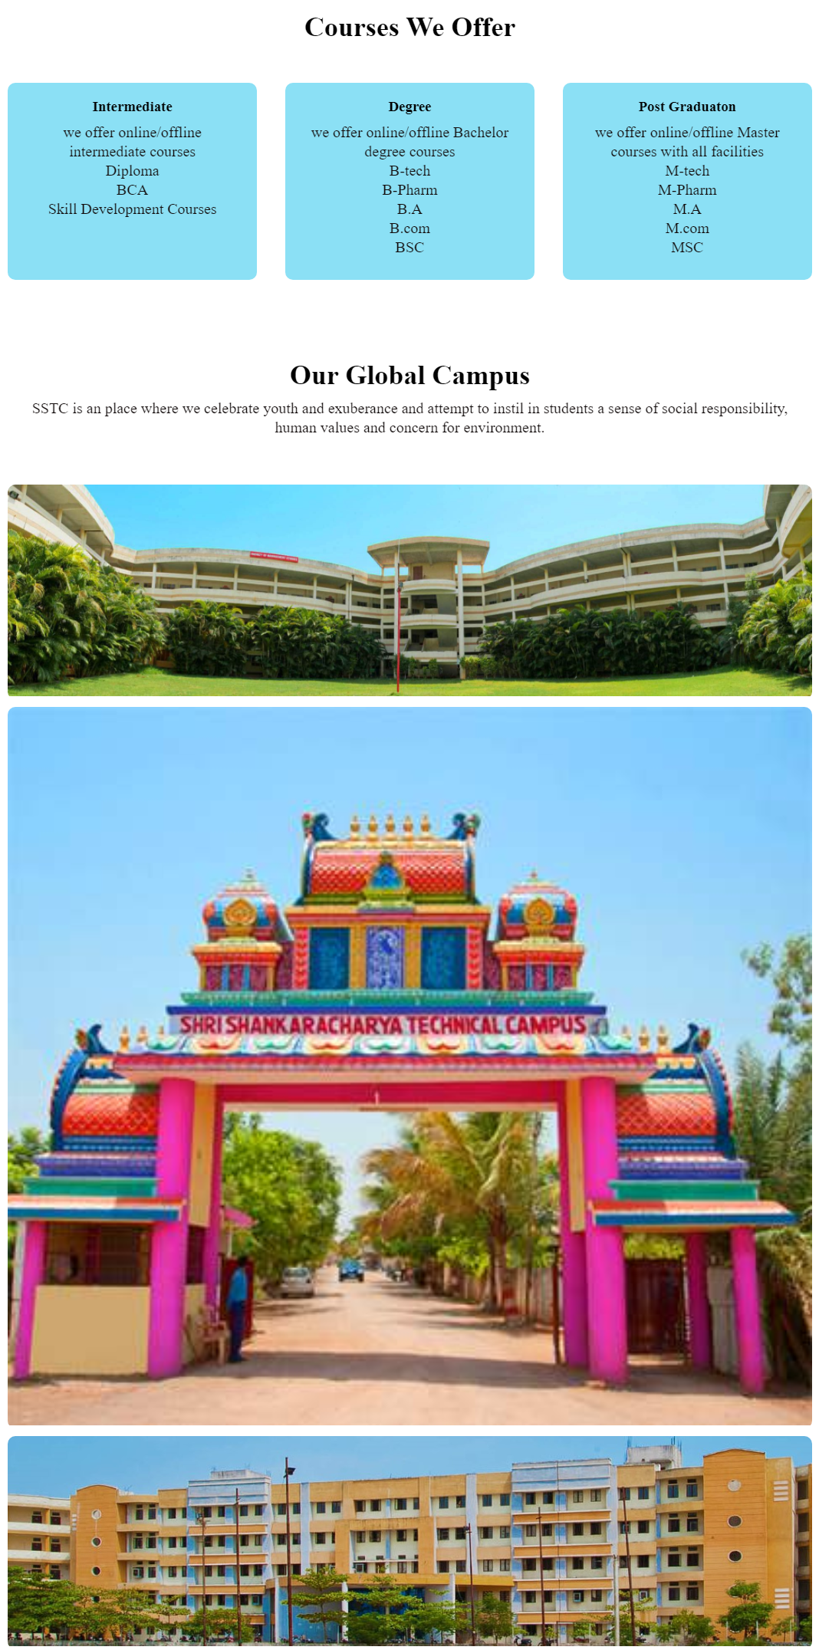
Results and Discussions :

Slide 8

Results and Discussions :
URL -
file:///C:/Users/acer/Desktop/images/index.html

Slide 9
Conclusion and Scope For Future Work :
For any business, a website matters more than anything, when it comes to reaching out to customers online. A website is the representation of the business online. These days, every business realizes the need for having a website and are putting in efforts to design and develop site.
Now almost everyone in a taken part of the society has a internet connection to access multimedia content available online.

Slide 10
Conclusion and Scope For Future Work :
Development in Technology has supported the growth of learning platform and websites are important part of it.
Whatever happens, online businesses will continue to build new websites or redesign existing ones to stay competitive and relevant. Therefore, Web developers will never run out of jobs.
Thank You

