Slide 1
PLAYTOPIA
Landing Page Walkthrough
India's First Board Game Festival
31 October 2026 | 4 PM - 10 PM | Dhruv Global School, Nande, Pune
9 Sections | Full-Page Screenshots

Slide 2

01 Hero Section

Slide 3
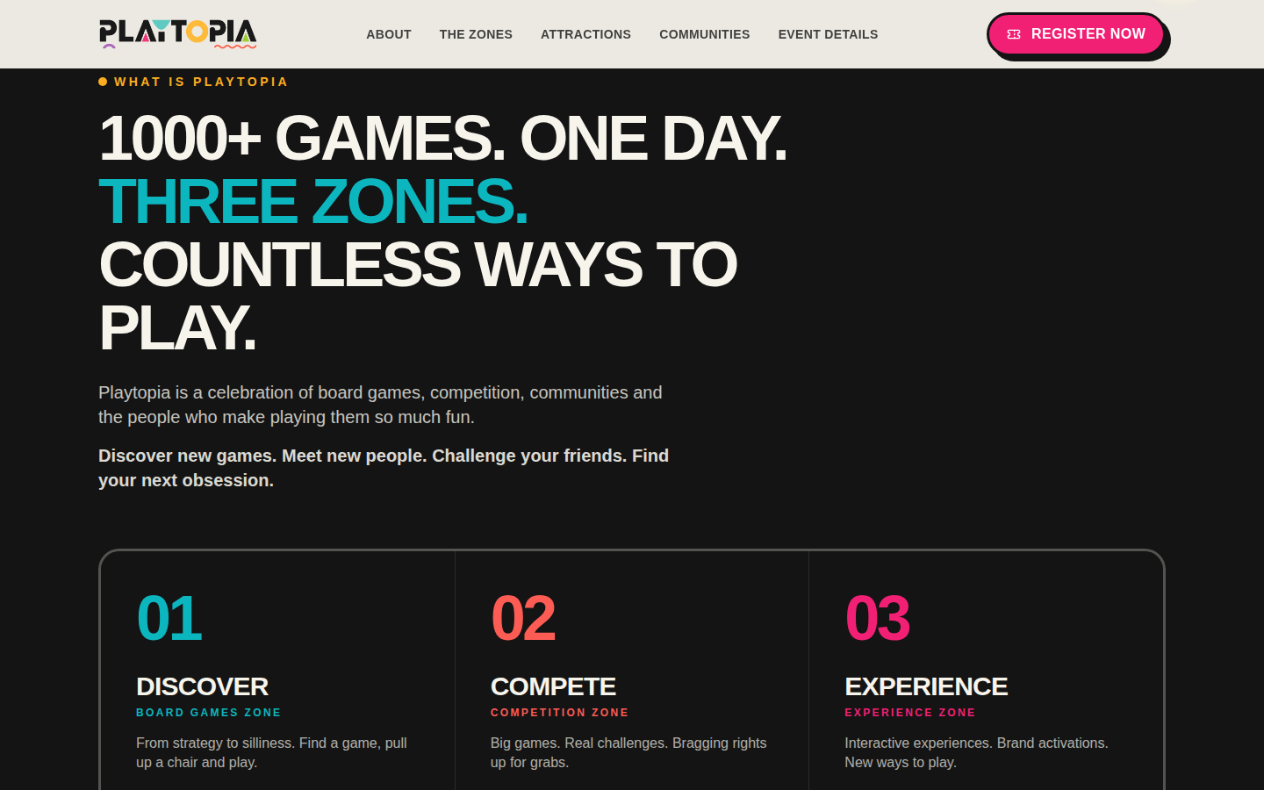
02 What Is Playtopia

Slide 4
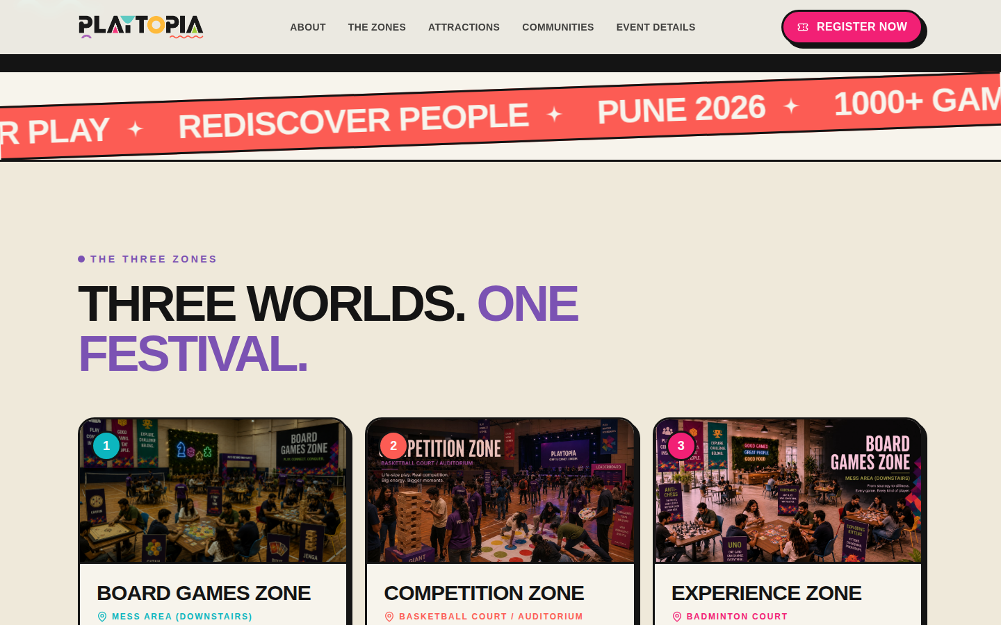
03 The Three Zones

Slide 5

04 Key Attractions — Jenga & Twister

Slide 6
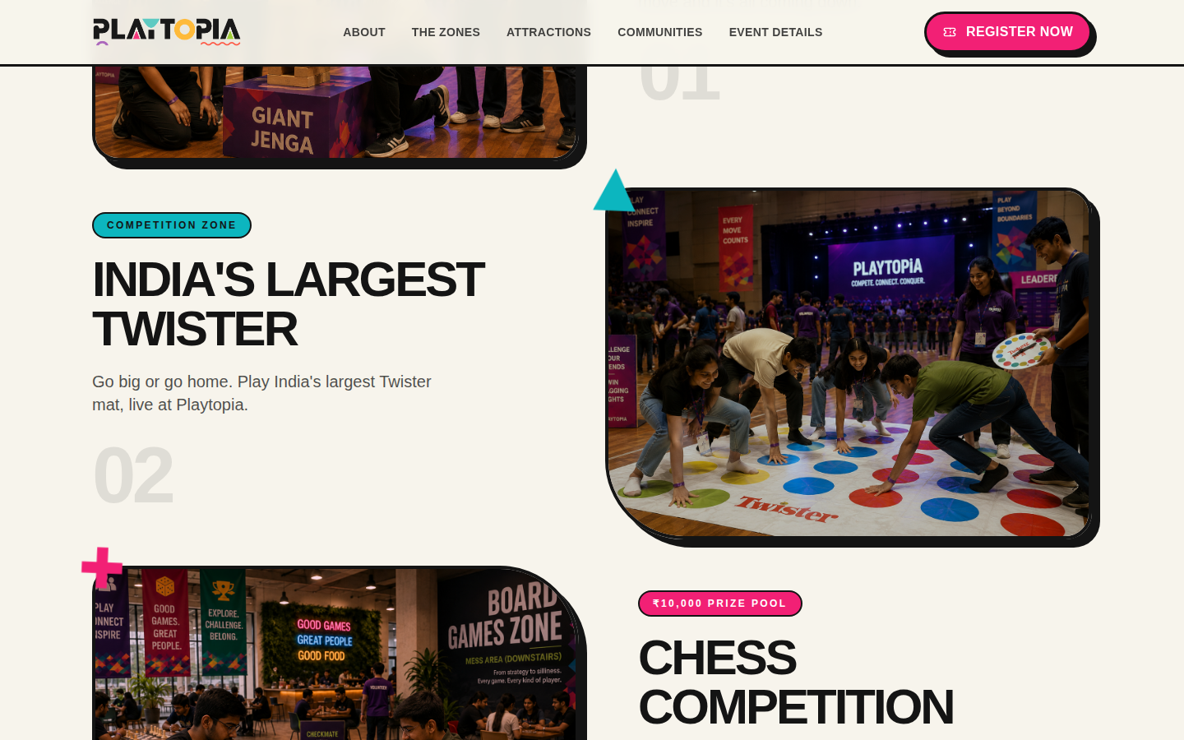
05 Key Attractions — Chess

Slide 7

06 Communities

Slide 8
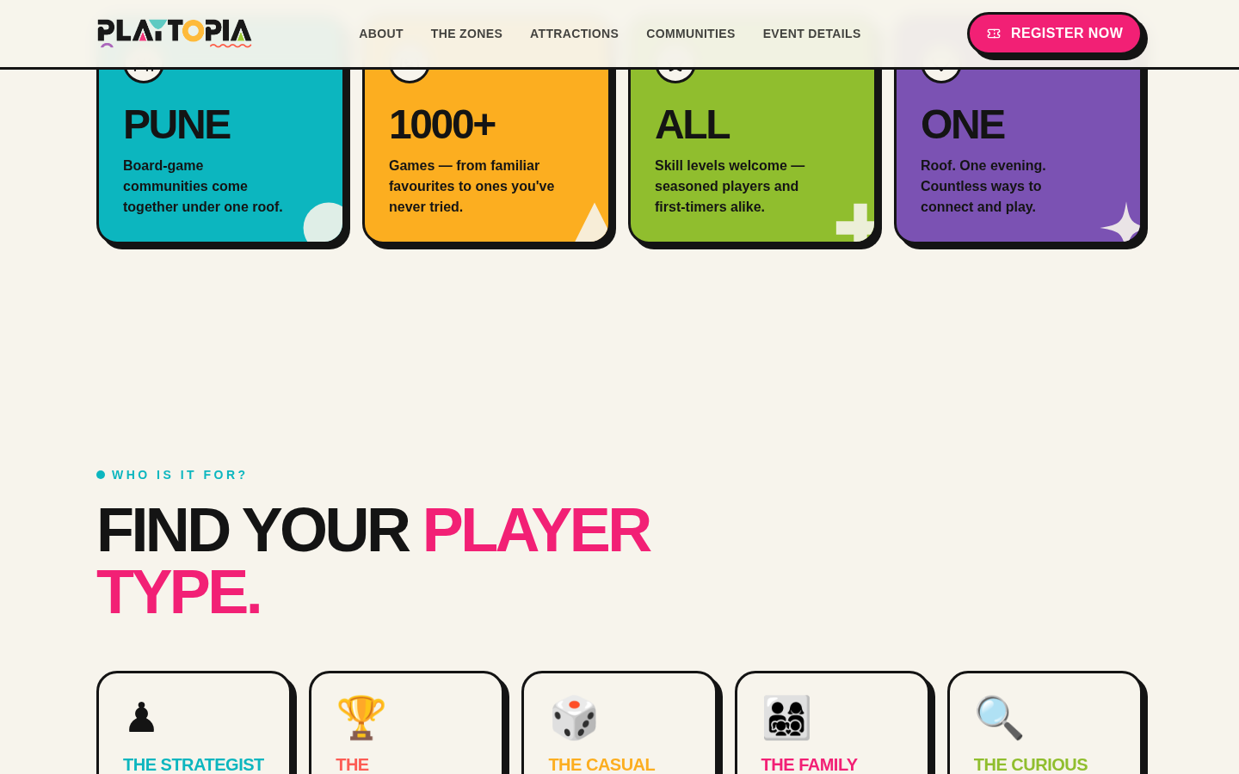
07 Who Is It For

Slide 9

08 Event Info

Slide 10

09 Final CTA & Footer

