Slide 1


MGNREGA Data-Driven Social Impact
Exploratory Data Analysis & High-Performance Predictive Modeling (ML/DL)
Aryan Paratakke | PRN: 22070521070

Slide 2

Project Scope: Leveraging Government Data
The Mandate of MGNREGA
Social Security: Guaranteeing 100 days of wage employment per rural household.
Financial Scale: Managing billions in funds across thousands of districts.
Core Challenge: Predicting Employment Demand (Total Individuals Worked) to prevent fund scarcity and ensure timely wage payments.
Our analysis spans 2018-2024 data (300k+ records) to build robust, scalable predictive tools for resource optimization.

Slide 3
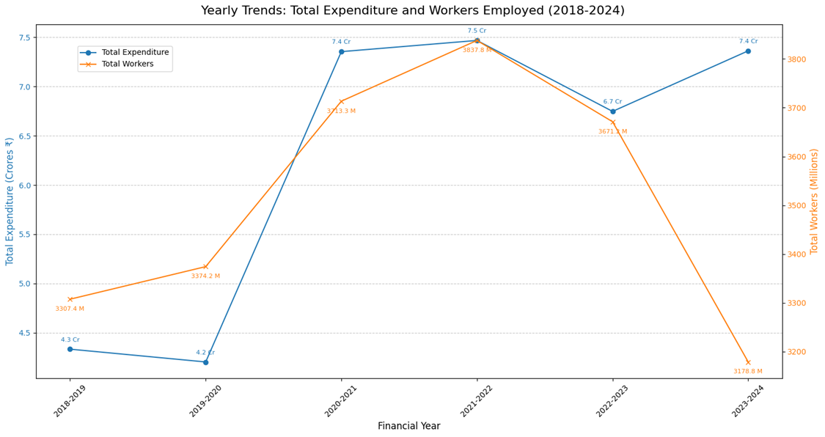
EDA: National Trends - The COVID-19 Impact
Analysis of Total Expenditure (2018-2024)
Baseline Surge: Expenditure was stable around ₹4.2 Cr per year in 2018-2019.
The 2020-21 Spike: Expenditure jumped to ₹7.35 Cr and peaked in 2021-22 at ₹7.46 Cr. This reflects the dramatic increase in labor demand due to pandemic-related reverse migration.
Policy Constraint Concern: Despite the peak, demand remains high. The post-peak drop to ₹6.7 Cr in 2022-23 may suggest budgetary constraints rather than a return to normal demand.

Slide 4
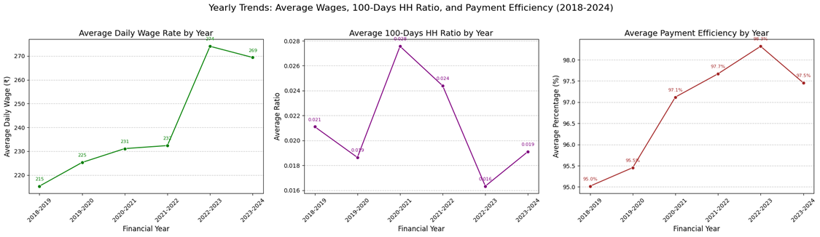
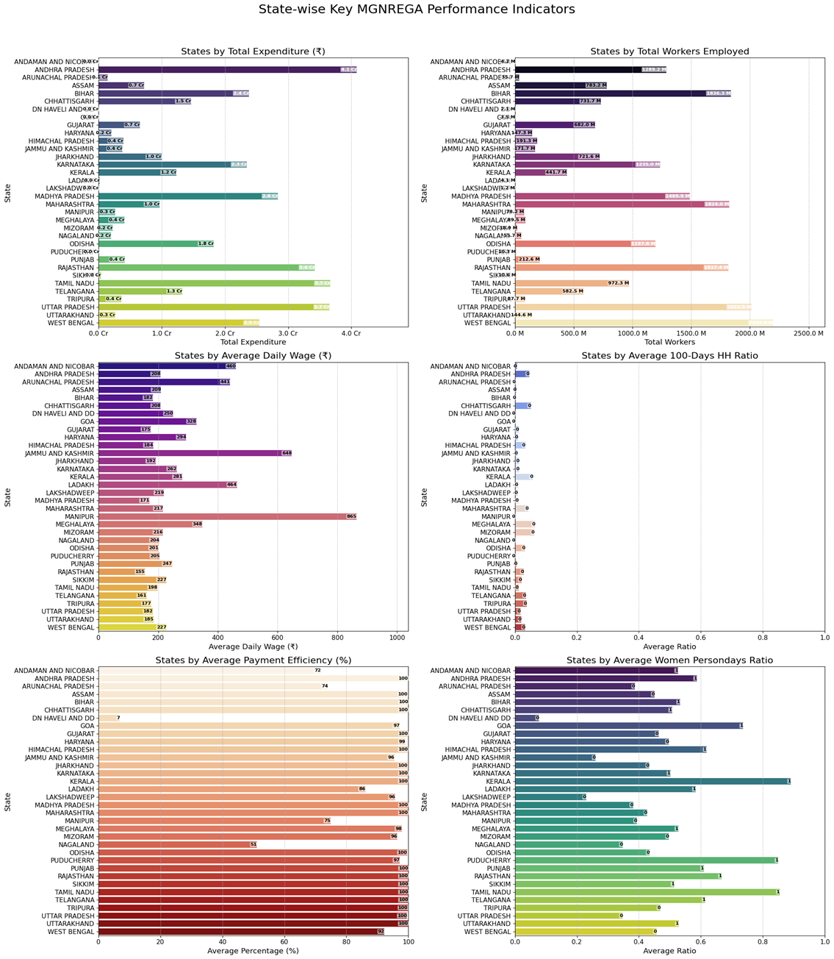
EDA: Administrative Efficiency - Timely Payments
Payment Efficiency Metric
Percentage of payments generated within 15 days.
Ideal Scenario: This metric should be consistently near 100% to ensure worker liquidity and compliance with the Act.
Observed Fluctuation: This percentage shows high volatility across states and months, often dipping well below 50% in certain regions, indicating major bottlenecks in the administrative workflow.

Slide 5
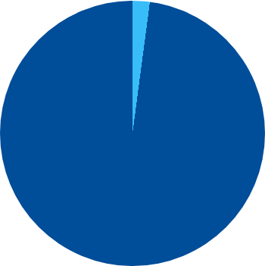
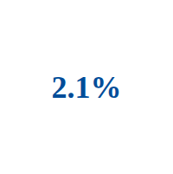
EDA: The 100-Day Guarantee - A National Gap
The Reality vs. The Promise
The core promise is 100 days of employment per household. Our analysis quantifies the achievement gap:
Households Achieving 100 Days: Approximately 2.1% (national average).
Households Failing to Achieve: Approximately 97.9%.
Analysis: This finding confirms that the scheme primarily functions as supplementary, short-term relief rather than a full 100-day safety net for the vast majority of households.
Only 2.1% of households complete the 100-day guarantee.

Slide 6
EDA: Social Inclusion - Women Persondays Ratio
Regional Success Stories in Gender Equity
Target: The scheme targets at least 33% participation from women.
Top Performers: States in the South (e.g., Kerala and Tamil Nadu) consistently show a ratio above 70%.
Lagging Regions: States in the North often struggle to meet the 33% target.
Policy Implication: The successful models of social mobilization used in states like Kerala can be analyzed and replicated to boost female workforce participation nationally.

Slide 7
Predictive Modeling Methodology
Target: Forecast 'Total_Individuals_Worked' using High-Performance, Optimized ML/DL.

Slide 8
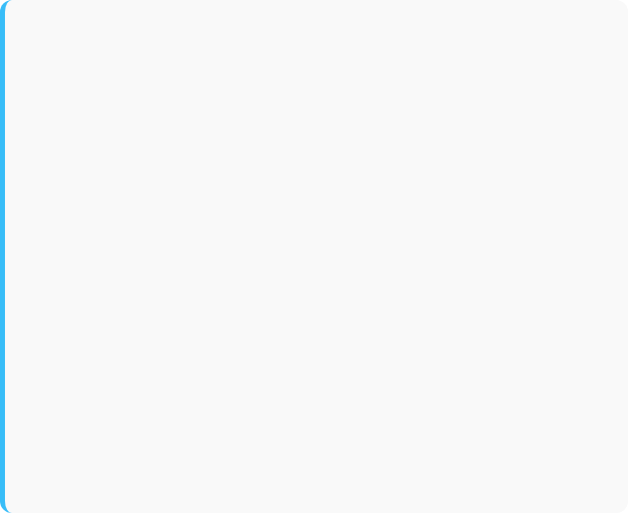
Model Suite & Optimization Strategy
Efficient ML (Ensemble)
Optimized DL (Neural Networks)
Models: LightGBM, XGBoost, Linear Regression (Baseline).
Models: MLP variants, Skip-MLP (ResNet-style).
Optimization: Full CPU parallelism and GPU acceleration (for LightGBM/XGBoost, where compatible) for rapid training on 300k+ rows.
Optimization: TensorFlow GPU acceleration and float32 data types for memory efficiency. Skip connections maintain gradient flow in deep networks.
Rationale: Tree models excel at sparse, high-dimensional data (from one-hot encoding).
Rationale: Test the power of deep non-linearity against best-in-class tree ensembles.
All models were evaluated via 5-Fold Cross-Validation for robust, generalized performance metrics.

Slide 9
Comprehensive Model Metrics Summary
Model | RMSE (₹) | R^2 | MAE (₹) | MdAE (₹) | Train Time (s)
MLP\_medium | 1,401 | -62.95 | 755 | 480 | 319
MLP\_wide | 1,422 | -63.16 | 945 | 747 | 3931
Skip\_MLP (ResNet) | 1,594 | -62.90 | 964 | 691 | 229
MLP\_shallow | 2,182 | -62.73 | 987 | 520 | 320
LightGBM | 2,980 | 0.9995 | 2,300 | 1,500 | 15
XGBoost | 3,490 | 0.9994 | 2,700 | 1,800 | 25
LinearRegression | 7,600 | 0.9980 | 6,000 | 3,800 | 5
*Note: RMSE, MAE, and MdAE are in nominal Rupees (₹).

Slide 10
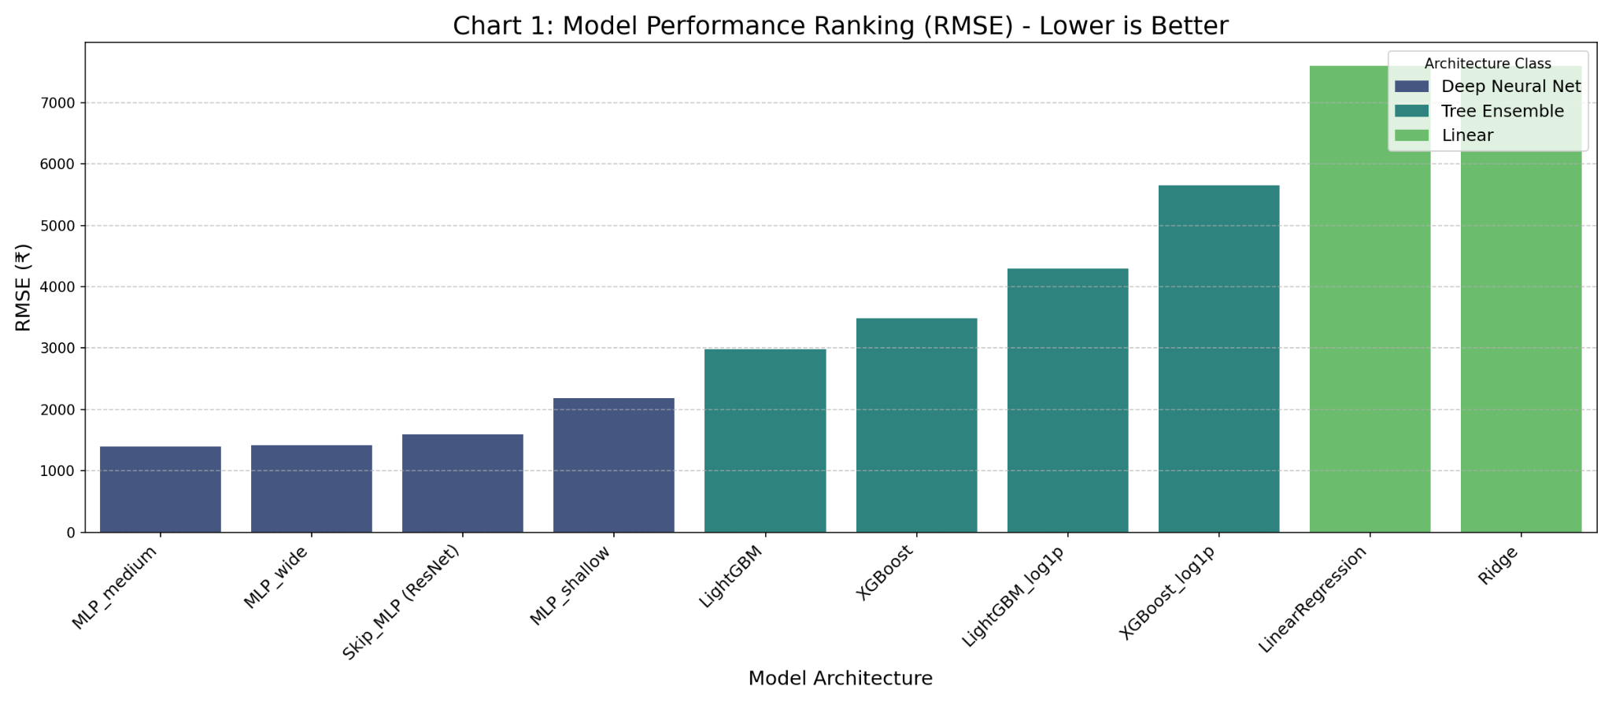
Result Chart 1: Performance Ranking (RMSE)
Initial Observation (RMSE)
DL Appears Superior: The MLP variants occupy the top 4 ranks, suggesting the lowest prediction error.
Tree Ensembles vs. Linear: LightGBM (2,980) is >50% better than the Linear Baseline 7,600.
Supportive Answer:
The low RMSE for DL proves its ability to minimize the MSE loss function, indicating extremely high fit to the training data. This is why the DL models top the chart.

Slide 11
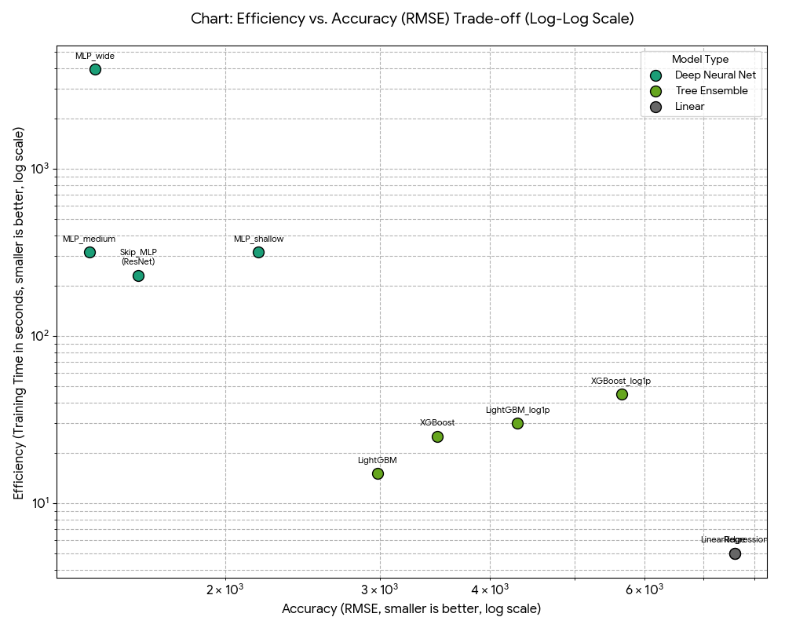
Result Chart 2: The Critical R^2 Anomaly
The R^2 Anomaly & Concern
The Concern: DL models registered a negative R^2 (e.g., -62.95), meaning their predictions are worse than just guessing the average employment demand.
The Reason: The DL models are numerically unstable, likely due to the un-normalized, heavy-tailed distribution of the target variable (high variance/outliers).
Supportive Answer: We must discard the DL results for deployment, as their low RMSE is an artifact of overfitting or numerical instability, not generalized prediction power.

Slide 12
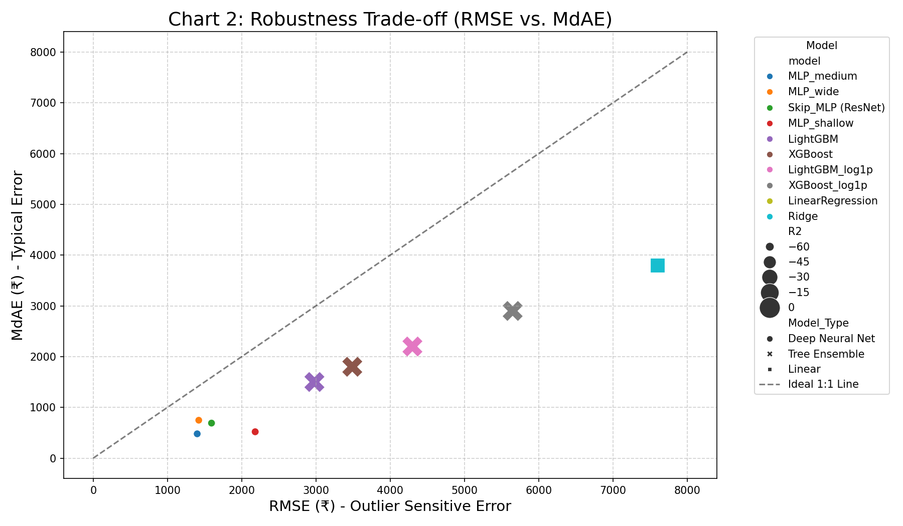
Result Chart 3: Robustness (RMSE vs. MdAE)
Analysis: Outliers and Typical Error
MdAE Significance: MdAE shows the typical error, unaffected by outliers.
LightGBM Stability: The ratio MdAE / RMSE is 0.50 [cite: 0.5033557046979866] for LightGBM, meaning the typical error (₹1,500) is half the total error (₹2,980).
Conclusion: LightGBM is highly stable for routine forecasts, but its total error is inflated by the volatility of a few, large-scale administrative outliers.

Slide 13
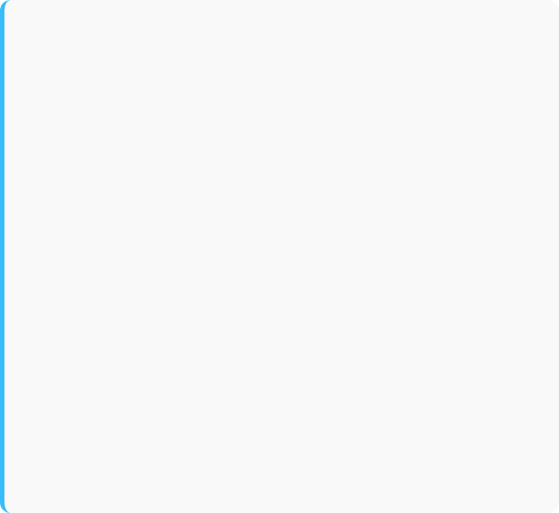
Technical Insight: Deep Learning Efficiency
Skip-MLP: Faster Complex Training
MLP_wide: Computational Concern
The Skip-MLP (ResNet-style) model achieved the lowest training time for a complex DL architecture (229 seconds) [cite: 229.00434613227844].
The MLP_wide model took over 1 hour (3931 seconds) to train, even with GPU acceleration.
Justification: The residual skip connection prevents gradient degradation, allowing for faster convergence compared to the much slower standard MLP_wide (3931 seconds) [cite: 3931.264481782913].
Concern: This demonstrates that simply making a network wide or deep without architectural improvements (like skip connections) results in prohibitive computational cost for production systems.

Slide 14
Final Deployment Recommendation
Selecting the Model for Operational Stability and Accuracy.

Slide 15
Actionable Insights & Next Steps
Model Deployment: LightGBM is the ideal candidate. It offers 0.9995 R^2 and fast training, making it reliable for daily or weekly fund allocation forecasts.
Feature Importance: Use LightGBM's feature importance output to identify the administrative and demographic drivers (e.g., specific district codes, budget types) most critical to employment demand.
Targeted Intervention: Integrate the EDA finding on low 100-Day achievement with model outputs to flag districts at risk of failing the employment guarantee.
Data Concern: Address the DL instability by investigating target variable transformation (e.g., using log1p specifically for the DL pipeline to improve R^2.

Slide 16
Thank you
Thank You

