Slide 1
MINOR PROJECT 1 / ARTIFICIAL INTELLIGENCE
AI INDUSTRY
IMPACT MAP
10 real-world applications across 5 industries
10
05
05+
AI APPLICATIONS
INDUSTRIES
AI METHOD FAMILIES
Gen AI Intern research report • 19 October 2026
KUNWAR ARYAN • AI INDUSTRY IMPACT MAP 01 / 13

Slide 2
01 / SCOPE & METHOD
Research approach
01 Map applications
02 Identify AI methods
03 Evaluate evidence
Two real-world use cases in each of five industries.
ML, deep learning, NLP, computer vision, GenAI and optimization.
Business problem, data inputs, measured impact and limitations.
Evidence rule: published studies, company-reported estimates, usage statistics and expected benefits are labelled separately. No numeric impact is invented when a source does not provide one.
AI INDUSTRY IMPACT MAP • MINOR PROJECT 1
KUNWAR ARYAN • AI INDUSTRY IMPACT MAP 02 / 13

Slide 3
02 / INDUSTRY DEEP DIVE
Healthcare
AI-assisted chest X-ray analysis
AI triage for urgent radiology scans
AI METHODS
Deep Learning / Computer Vision
BUSINESS PROBLEM
Help clinicians detect and localize abnormalities in chest X-rays.
DATA
Chest X-ray pixels; annotated images; clinical labels.
IMPACT / EVIDENCE
A published evaluation reported AUC 0.976; physicians’ AUC improved by 0.101 with AI assistance. Study result, not a guaranteed hospital-wide gain.
AI METHODS
Machine Learning / Computer Vision
BUSINESS PROBLEM
Prioritize potentially urgent scans for earlier review.
DATA
CT images; model scores; scan and report timestamps.
IMPACT / EVIDENCE
A systematic review found 67% of 33 studies measuring task time reported reductions, but pooled meta-analyses did not show significant overall effects.
Source links and full context are provided in the accompanying research report.
AI INDUSTRY IMPACT MAP • MINOR PROJECT 1
KUNWAR ARYAN • AI INDUSTRY IMPACT MAP 03 / 13

Slide 4
03 / INDUSTRY DEEP DIVE
Finance
Real-time payment fraud detection
Fraud investigation and case triage
AI METHODS
Machine Learning; GenAI-enhanced scoring
BUSINESS PROBLEM
Flag suspicious transactions while limiting unnecessary declines.
DATA
Transaction amount/time; merchant; account/device signals; fraud outcomes.
IMPACT / EVIDENCE
Mastercard reported a 20% average improvement in initial fraud-detection modelling; company-reported estimate, not a universal independent benchmark.
AI METHODS
Machine Learning / NLP
BUSINESS PROBLEM
Rank suspicious cases and summarize signals to reduce manual investigation effort.
DATA
Transaction histories; alerts; investigator notes; customer and merchant context.
IMPACT / EVIDENCE
Mastercard’s research reports 83% of surveyed organizations said AI significantly sped up investigation and resolution; survey result, not a causal experiment.
Source links and full context are provided in the accompanying research report.
AI INDUSTRY IMPACT MAP • MINOR PROJECT 1
KUNWAR ARYAN • AI INDUSTRY IMPACT MAP 04 / 13

Slide 5
04 / INDUSTRY DEEP DIVE
Retail
Personalized product recommendations
AI-generated personalized product descriptions
AI METHODS
Machine Learning / Recommender Systems
BUSINESS PROBLEM
Help customers discover relevant products and improve shopping relevance.
DATA
Clicks; searches; purchases; product metadata; customer preferences.
IMPACT / EVIDENCE
Amazon describes AI-powered personalization and recommendation improvements; the cited source does not specify a public numerical revenue lift.
AI METHODS
Generative AI / NLP
BUSINESS PROBLEM
Adapt descriptions to shopping context and highlight relevant product attributes.
DATA
Product catalog text; product attributes; search and shopping activity.
IMPACT / EVIDENCE
Potentially improves relevance and discovery; the cited source describes the capability but does not quantify a measured uplift.
Source links and full context are provided in the accompanying research report.
AI INDUSTRY IMPACT MAP • MINOR PROJECT 1
KUNWAR ARYAN • AI INDUSTRY IMPACT MAP 05 / 13

Slide 6
05 / INDUSTRY DEEP DIVE
Education
AI tutor and teaching assistant (Khanmigo)
Adaptive practice and skill recommendations
AI METHODS
Generative AI / NLP
BUSINESS PROBLEM
Provide guided explanations and help teachers draft learning materials and feedback.
DATA
Student prompts; exercise context; curriculum content; learning objectives.
IMPACT / EVIDENCE
Khan Academy reported 2.0 million Khanmigo users during school year 2024–25. Reach is not proof of causal learning gains.
AI METHODS
Machine Learning / Predictive Analytics
BUSINESS PROBLEM
Recommend practice based on learner progress and skill mastery.
DATA
Answers; attempts; time on task; skill mastery; assessment results.
IMPACT / EVIDENCE
Khan Academy reports broader platform research associating 20% learning gains with 18+ hours of practice in a school year; not attributable to GenAI alone.
Source links and full context are provided in the accompanying research report.
AI INDUSTRY IMPACT MAP • MINOR PROJECT 1
KUNWAR ARYAN • AI INDUSTRY IMPACT MAP 06 / 13

Slide 7
06 / INDUSTRY DEEP DIVE
Transportation
AI-assisted autonomous driving
Route and fleet optimization
AI METHODS
Deep Learning / Computer Vision / Sensor Fusion
BUSINESS PROBLEM
Perceive road users, lanes and traffic signals and predict motion.
DATA
Camera images; lidar/radar where used; maps; vehicle motion; labeled driving scenes.
IMPACT / EVIDENCE
Potential value includes driver assistance and consistent perception. Performance should be assessed with transparent safety metrics; no universal savings figure is claimed.
AI METHODS
Machine Learning / Operations Research
BUSINESS PROBLEM
Plan efficient routes and dispatch schedules under time, capacity and traffic constraints.
DATA
Delivery locations; road network; travel times; vehicle capacity; time windows; route outcomes.
IMPACT / EVIDENCE
Measure miles per delivery, fuel use, on-time rate and cost per stop. A verified numerical impact was not found in the selected sources.
Source links and full context are provided in the accompanying research report.
AI INDUSTRY IMPACT MAP • MINOR PROJECT 1
KUNWAR ARYAN • AI INDUSTRY IMPACT MAP 07 / 13

Slide 8
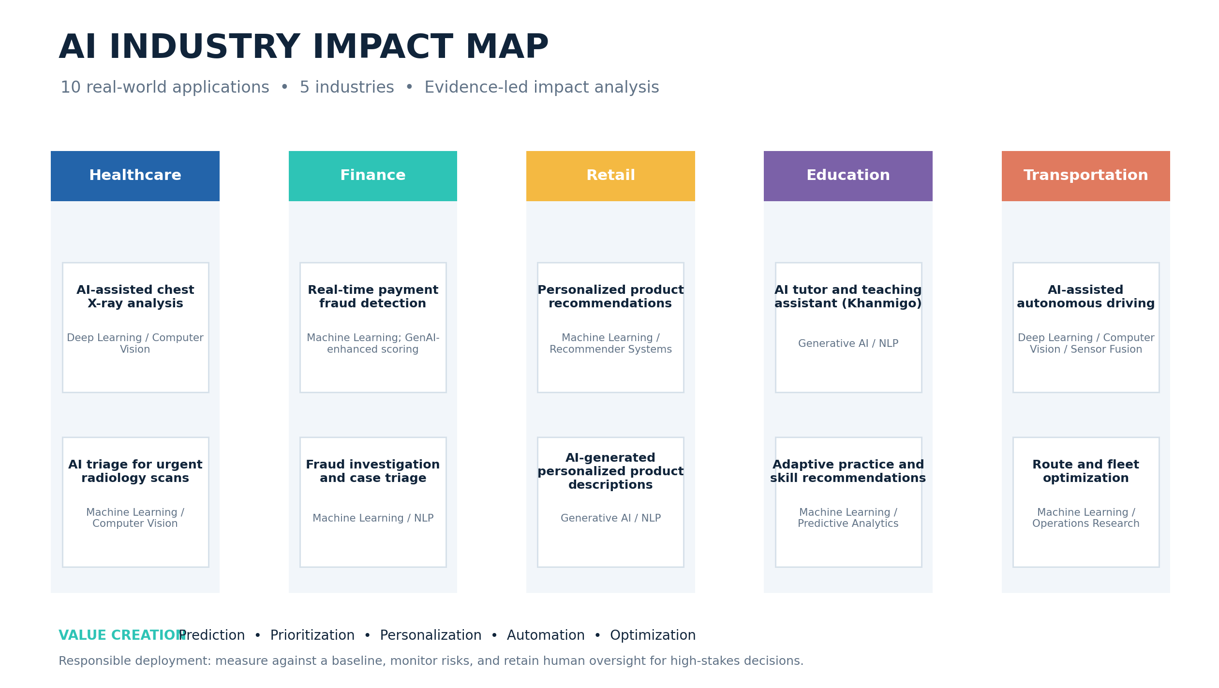
07 / OVERVIEW
The AI industry map
AI INDUSTRY IMPACT MAP • MINOR PROJECT 1
KUNWAR ARYAN • AI INDUSTRY IMPACT MAP 08 / 13

Slide 9
08 / WHAT THE CASES REVEAL
Cross-industry insights
Prediction
Personalization
Generation
Spot patterns and rank risk: imaging triage and fraud detection.
Adapt recommendations and learning practice to user context.
Support language-heavy tasks with grounding and human review.
Core lesson: AI is not a business outcome by itself. Value depends on workflow integration, data quality, adoption, and whether results improve against a credible baseline.
AI INDUSTRY IMPACT MAP • MINOR PROJECT 1
KUNWAR ARYAN • AI INDUSTRY IMPACT MAP 09 / 13

Slide 10
09 / KPI FRAMEWORK
How to measure business impact
Healthcare
Sensitivity, false negatives, turnaround time, clinician workload
Finance
Fraud loss, detection rate, false positives, investigation time
Retail
Conversion, discovery time, returns, recommendation relevance
Education
Learning gains, mastery, engagement, equity
Transportation
Cost per delivery, miles per stop, on-time rate, safety events
AI INDUSTRY IMPACT MAP • MINOR PROJECT 1
KUNWAR ARYAN • AI INDUSTRY IMPACT MAP 10 / 13

Slide 11
10 / RISK CONTROLS
Responsible AI is part of the solution
Privacy & security
Reliability
Fairness
Permission, retention, access controls
False positives, false negatives, hallucinations
Segment performance and disparate outcomes
Governance
Monitoring
Human review, accountability, audit trail
Drift, overrides, incidents and cost
AI INDUSTRY IMPACT MAP • MINOR PROJECT 1
KUNWAR ARYAN • AI INDUSTRY IMPACT MAP 11 / 13

Slide 12
11 / CONCLUSION
Start with the workflow.
Prove the impact.
• Define a clear problem and baseline.
• Run a measured pilot; compare like with like.
• Keep human accountability for high-stakes decisions.
• Monitor quality, cost, fairness and unintended effects.
Full source list and evidence notes are in the accompanying report.
KUNWAR ARYAN • AI INDUSTRY IMPACT MAP 12 / 13

Slide 13
12 / SOURCE LIST
Selected references
1. Chest X-ray deep learning evaluation (peer-reviewed)
https://pmc.ncbi.nlm.nih.gov/articles/PMC11502915/
2. Medical imaging workflow efficiency systematic review
https://pubmed.ncbi.nlm.nih.gov/39349815/
3. Mastercard — GenAI for consumer protection
https://www.mastercard.com/in/en/news-and-trends/press/2024/february/mastercard-supercharges-consumer-protection-with-gen-ai.html
4. Mastercard — AI payment fraud prevention research
https://www.mastercard.com/global/en/news-and-trends/Insights/2026/ai-is-helping-banks-save-millions-by-transforming-payment-fraud-prevention.html
5. Amazon — Generative AI for recommendations and descriptions
https://www.aboutamazon.com/news/retail/amazon-generative-ai-product-search-results-and-descriptions
6. Khan Academy — Annual Report SY24–25
https://annualreport.khanacademy.org/
7. WHO — AI and health resources
https://www.who.int/teams/digital-health-and-innovation/harnessing-artificial-intelligence-for-health
AI INDUSTRY IMPACT MAP • MINOR PROJECT 1
KUNWAR ARYAN • AI INDUSTRY IMPACT MAP 13 / 13

