Slide 1
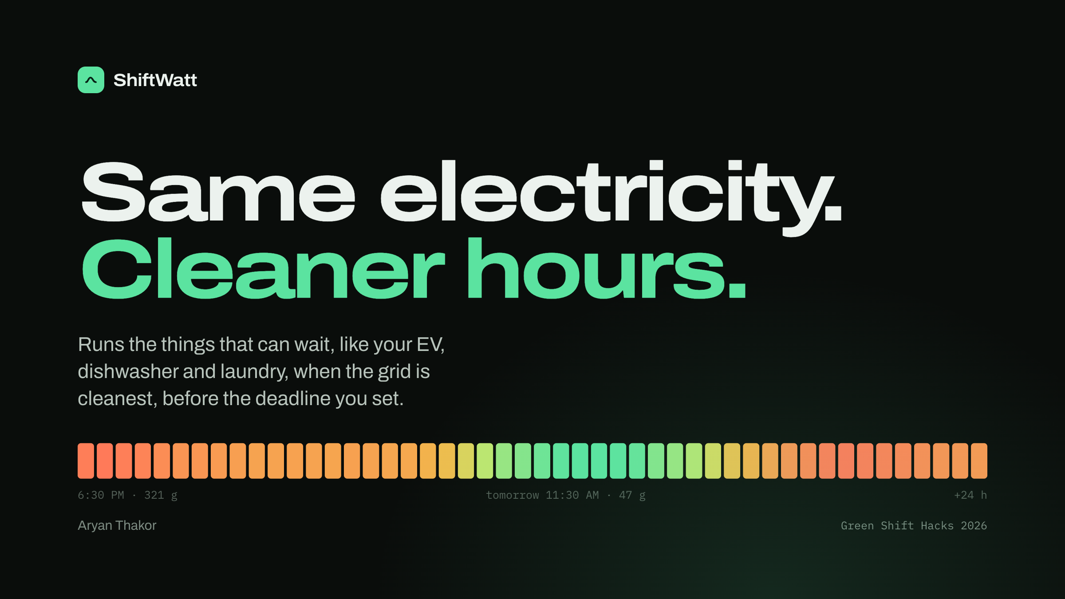
Notes:
Hi, I'm Aryan, and this is ShiftWatt. Same electricity, cleaner hours. It runs the things in your home that can wait, like charging your EV, the dishwasher and laundry, when the grid is cleanest, and always before the deadline you set.

Slide 2
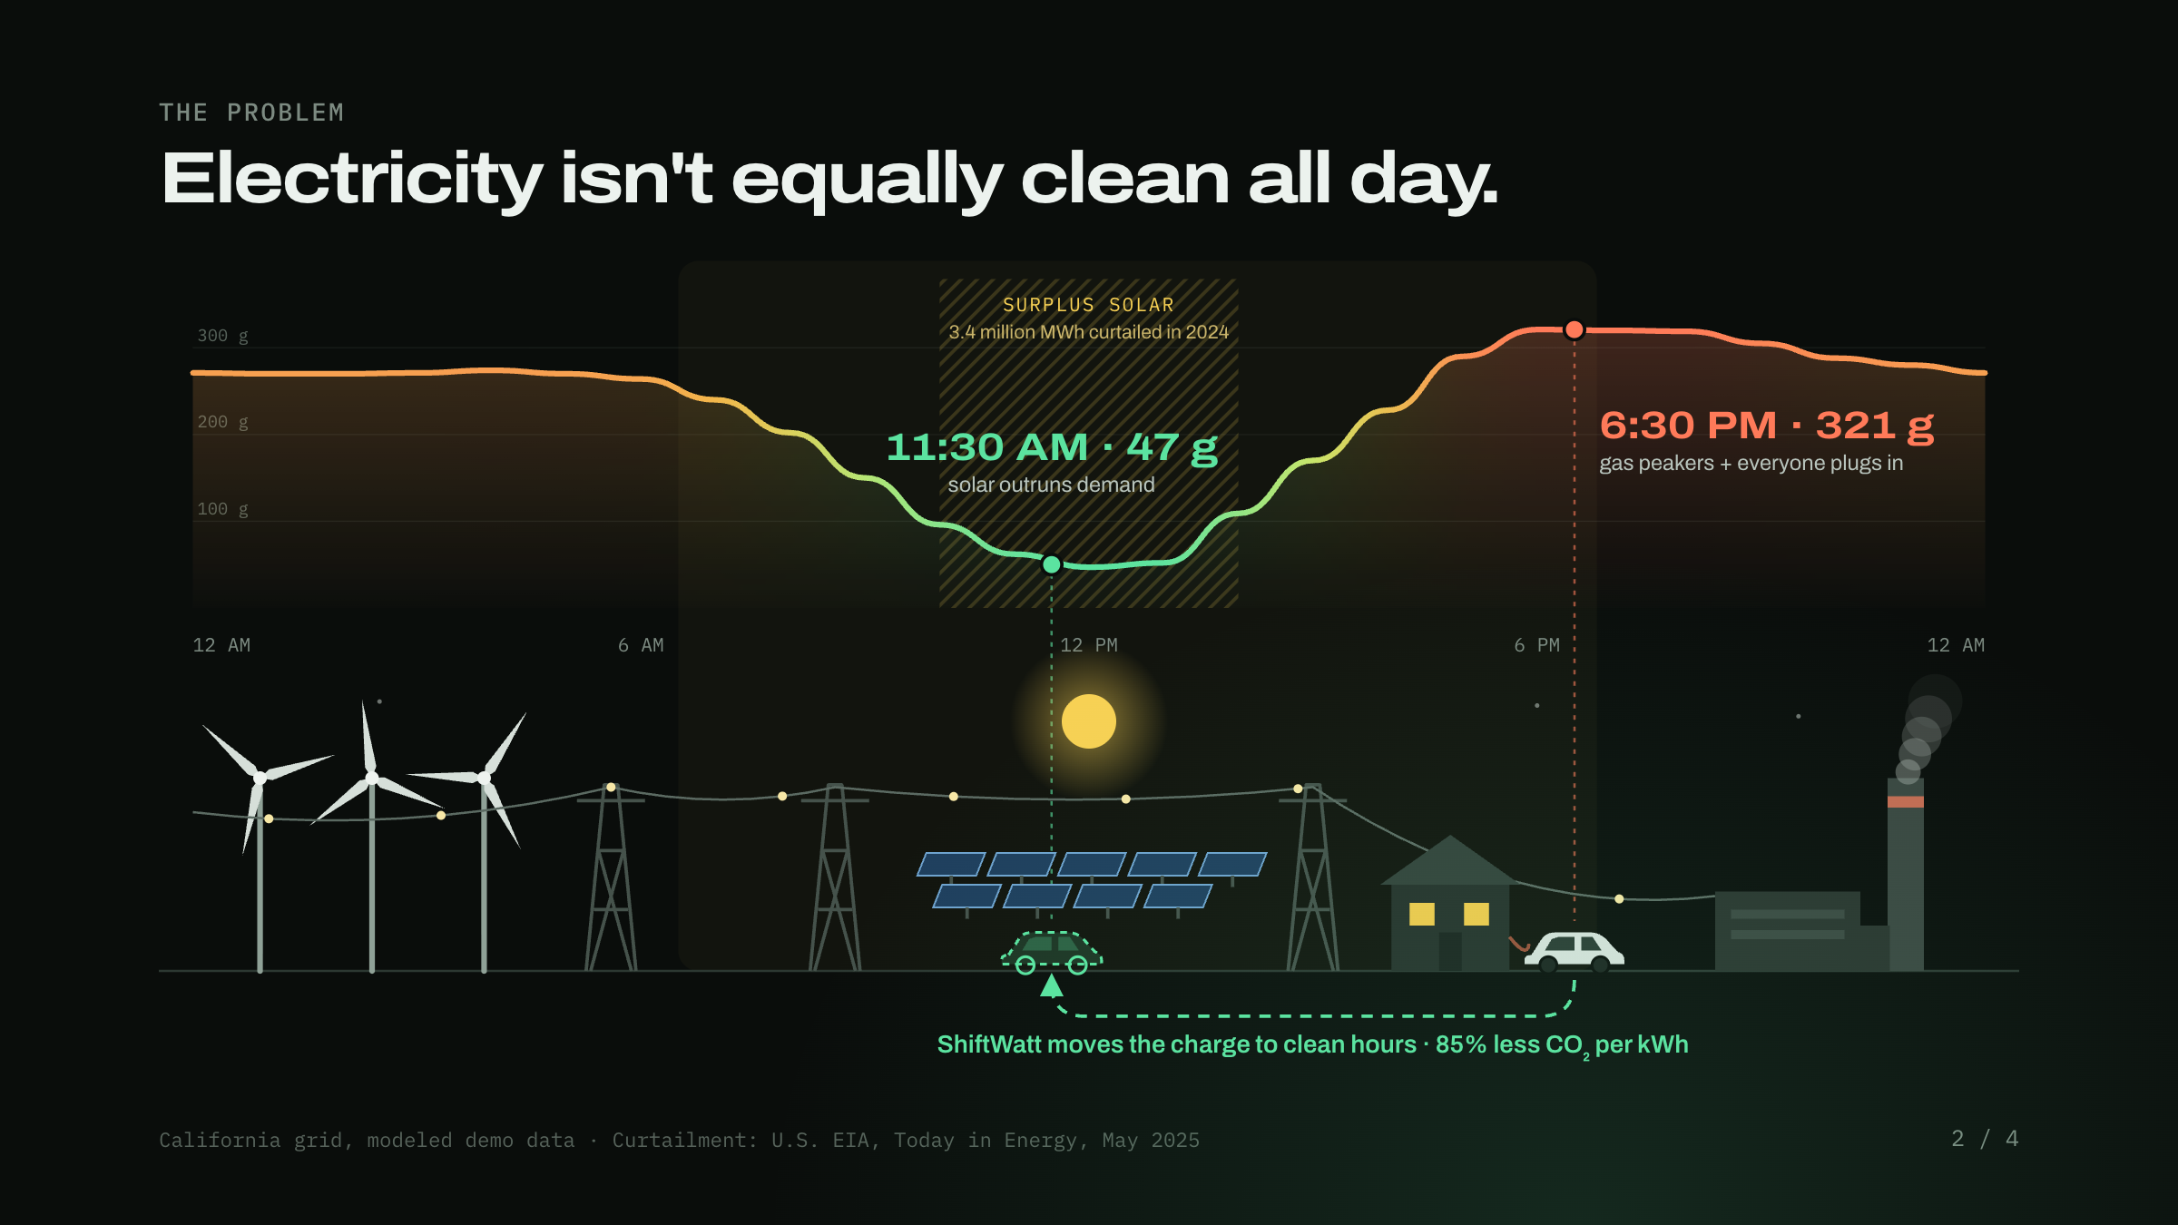
Notes:
Here's one day on the grid. At night, left, power comes from wind plus a lot of gas. Around midday the sun comes up and solar floods the grid: carbon drops to about 47 grams per kilowatt-hour. There's so much solar that California actually threw away 3.4 million megawatt-hours of it in 2024. Then at 6:30 PM, right, the sun sets, gas peaker plants fire up and carbon jumps to 321 grams. That's exactly when we get home and plug in. ShiftWatt moves that charge back to the clean hours: about 85% less CO2 per kilowatt-hour.

Slide 3
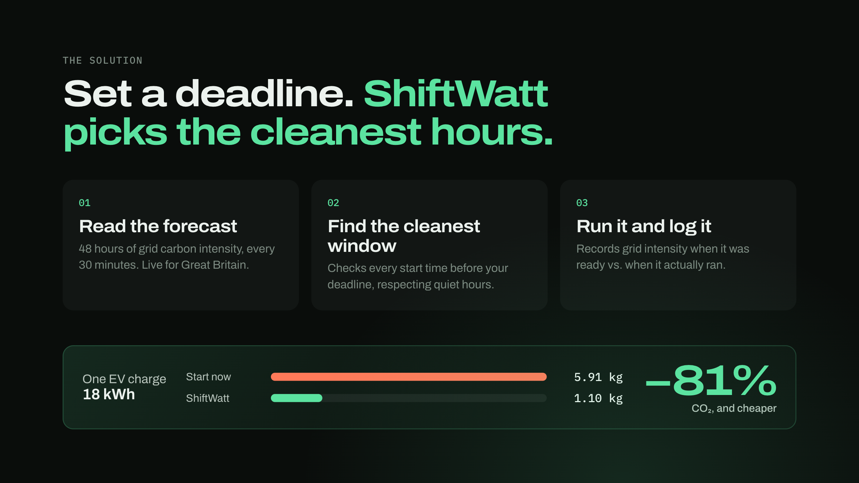
Notes:
How it works: you just set a deadline. ShiftWatt reads the 48-hour carbon forecast, which is live for Great Britain, checks every possible start time before your deadline, and runs the device in the cleanest window. Then it logs the grid intensity when the load was ready versus when it actually ran. For one EV charge: 5.91 kilos of CO2 if you start now, 1.10 with ShiftWatt. 81% cleaner, and cheaper too.

Slide 4
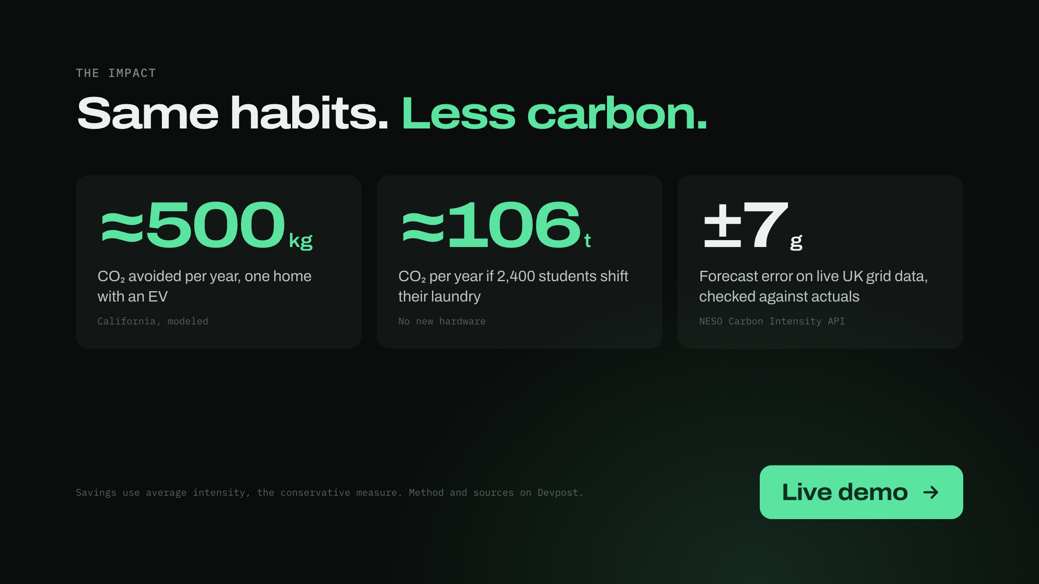
Notes:
Over a year that's about 500 kilos of CO2 for one home with an EV, and about 106 tonnes if 2,400 students shift their laundry, with no new hardware. And the forecast is real: on live UK grid data it's within about 7 grams of what actually happens. Let me show you the app.

