Slide 1


NATURAL LANGUAGE PROCESSING · PROJECT PRESENTATION
Cyberpunk 2077:
What 92,000 Steam Reviews Reveal
15 NLP methods from tokenization to Retrieval-Augmented Generation applied to real player reviews
15 methods · 92,190 reviews
PRESENTED BY
3017674 : Alister Charles
3017273 : Aryan Jadhav
SUPERVISED BY
Prof. Dr. W. Bantel
Notes:
Welcome everyone. We are Alister Charles and Aryan Jadhav, and our project applies all 15 NLP methods from the lecture to a single real-world question: Cyberpunk 2077 had one of the worst launches in gaming history in 2020, but today it sits at 'Very Positive' on Steam. We analyzed 92,000 recent English reviews to find out what players actually praise and complain about NOW. The data covers July 2024 to July 2026, i.e. the post-recovery era.

Slide 2






THE STARTING POINT
DATASET
One Question, 92,190 Reviews
Research question
Now that Cyberpunk 2077 is one of Steam's highly-rated games what do players praise, what do they still complain about, and can we answer questions about it directly from the reviews?
92,190
94.8%
24 mo
5
English reviews
via Steam API
thumbs-up rate
Jul 2024 – Jun 2026
post-recovery era
fields per review
Takeaway A post-recovery snapshot with free sentiment labels (thumbs up / down) ideal for supervised NLP.
Cyberpunk 2077 · NLP Project · Hochschule Aalen
02
Notes:
Our dataset: 92,190 English reviews with the review text, the player's thumbs up/down vote, helpfulness votes, playtime, and a timestamp five fields per review. Two things make it special. First, the data starts in July 2024, after the game was already fixed so we measure how a recovered game is received, not a redemption arc. Second, Steam's thumbs up/down gives us free labels for supervised machine learning later Method 12 needs no manual annotation. Note the strong imbalance: about 95% positive that will matter for the classifier and we will return to it.

Slide 3




DATA COLLECTION · LECTURE CH. 6
WEB CRAWLING
Web Crawling: Static CSV + Live API
→
→
→
Steam Reviews API
Scraper
Static CSV
Live fetch
appreviews/1091500
Scrapping
92,190 reviews
+500 newest / run
HOW IT WORKS
LIVE SAMPLE
Merge + deduplicate on every notebook run
Dataset is always current (last fetch: Jul 2026)
“game good. sometimes crashes and has bugs
but its worth it”
Takeaway API-based collection is the modern form of web crawling the corpus refreshes itself.
Cyberpunk 2077 · NLP Project · Hochschule Aalen
03
Notes:
Data collection is web crawling from Chapter 6. We wrote a scraper against Steam's public reviews API using cursor-based paging to collect 92,190 reviews into a CSV. On top of that, the notebook fetches the 500 newest reviews live on every run in the July 2026 run these were 95% positive and merges them in after deduplication, so the project always works with fresh data. Using an API is the modern form of web crawling: structured JSON instead of parsing HTML. The sample quote on the slide is one of the reviews fetched live three days ago it already previews the whole story: bugs exist, but the game is worth it.

Slide 4





THE BIG PICTURE
M1 – M15
One Pipeline, All 15 Methods
→
→
→
→
→
RAW TEXT
PREPROCESS
ENRICH
FEATURES
MODELS
APPLY
92,190 reviews
CSV + live API
M1 Tokenization
M2 Stop words
M3 Lemmatization
M4 Stemming A/B
M5 POS filter
M10 Levenshtein
M11 Jaccard dedup
M6 NER
M7 Patterns
M8 N-grams
M9 tf-idf
M12 LogReg
M13 Word2Vec
M14 Search
M15 RAG
Takeaway Every method feeds the next: Levenshtein fixes typos before tf-idf counts them, Word2Vec expands queries for search, and search becomes the “R” in RAG.
Cyberpunk 2077 · NLP Project · Hochschule Aalen
04
Notes:
This is the architecture of the whole project all 15 lecture methods in one connected pipeline. Raw reviews are preprocessed with seven methods, enriched with NER and pattern matching, converted to features with n-grams and tf-idf, fed into two models Logistic Regression and Word2Vec and finally power two applications: a search engine and RAG. The key design principle: methods are not isolated demos. Levenshtein runs BEFORE vectorization so typos don't split term counts; Word2Vec expands search queries; the search engine becomes the retrieval step of RAG.

Slide 5



PHASE 1 · SPACY PIPELINE
M1 · M2 · M3
Tokenize → Drop Stop Words → Lemmatize
M1 · Tokenization
ONE REVIEW THROUGH THE PIPELINE
text → tokens (“PS5”, “10/10”, emoji handled)
“The graphics are amazingly beautiful but the game constantly crashes on my PS5.”
M2 · Stop-word removal
▼
drop noise but keep “not” (negation!)
graphic amazingly beautiful game constantly crash ps
M3 · Lemmatization
crashes → crash · are → be (real words only)
14 → 7
1
“not”
tokens kept
tf-idf column per lemma
always preserved
One nlp.pipe() pass = tokens + lemmas + POS + entities · 92k reviews in minutes
Takeaway 50% smaller text, meaning intact and negation survives by design.
Cyberpunk 2077 · NLP Project · Hochschule Aalen
05
Notes:
Phase 1 is preprocessing, entirely with spaCy as taught in the lecture. Methods 1 to 3: tokenization, stop-word removal and lemmatization run in a single pipeline pass one nlp.pipe() call gives us tokens, lemmas, POS tags and entities simultaneously, and batch mode cleaned all 92,000 reviews in minutes with NER and parser disabled for speed. Two decisions worth highlighting: we keep the word 'not' although it is a stop word because 'not worth' means the opposite of 'worth' and we use lemmatization rather than stemming for the main pipeline so every output is a real dictionary word. The example shows a 14-token review compressed to 7 content words: 50% smaller, meaning intact, and 'crashes' and 'crash' now share one tf-idf column.

Slide 6



PHASE 1 · DECISIONS BACKED BY EXPERIMENTS
M4 · M5 · M10 · M11
Four Methods That Guard Data Quality
M4 · Stemming vs Lemma
M5 · POS filter
Δ 0.06 pp
5 POS
94.33% vs 94.27% we keep lemmas (readable)
NOUN · PROPN · VERB · ADJ · ADV (+ “not”)
M10 · Levenshtein fix
M11 · Jaccard dedup
832
−10,308
typos merged BEFORE tf-idf (beatiful→beautiful)
duplicates removed → 62,368 clean reviews
Takeaway Every cleaning decision was tested, not assumed A/B accuracy, edit distance, trigram similarity.
Cyberpunk 2077 · NLP Project · Hochschule Aalen
06
Notes:
Four more preprocessing methods each justified by an experiment, not by faith. Method 4: we trained the same classifier on stemmed versus lemmatized text 94.33 versus 94.27 percent accuracy, a difference of only 0.06 percentage points, so the choice barely matters and we keep lemmas because they are readable ('beauti' is not a word). Method 5: the POS filter keeps only five content-word classes plus 'not' determiners and prepositions never reach vectorization. A side insight: the top positive adjectives are 'great', 'amazing', 'immersive'; the top negative ones 'boring', 'buggy', 'bad'. Method 10: Levenshtein distance fixed 832 typos BEFORE vectorization 'beatiful' to 'beautiful' at edit distance 1 so misspellings don't split tf-idf counts. Method 11: Jaccard similarity on character trigrams removed 10,141 exact and 167 near-duplicate reviews copy-paste spam like 'sandevistan brrrr' leaving 62,368 clean reviews so review-bombs can't skew the model.

Slide 7


PHASE 1 · FROM TEXT TO STRUCTURE
M6 · M7
NER & Pattern Matching Create New Columns
M6 · NER → platform column
M7 · Matcher → category column
% positive by platform
reviews per pattern tag (4,819 tagged)
Takeaway PS5 players are the happiest (97.5%), PC the most critical (88.5%) and praise tags outnumber complaint tags ~10 : 1.
Cyberpunk 2077 · NLP Project · Hochschule Aalen
07
Notes:
Methods 6 and 7 turn free text into structured columns. NER discovers entities without any dictionary Phantom Liberty, CDPR, Johnny Silverhand, even Keanu Reeves and anchors a platform column. The left chart shows the finding: PS5 players are the happiest at 97.5% positive, PC players the most critical at 88.5% and PC is also the largest group with over 2,100 platform mentions. Pattern matching with spaCy's Matcher solves the 'one concept, many surface forms' problem: token-level rules like ADJ+bug catch 'game breaking bug' and all its variants. Nearly 5,000 reviews get a category tag WORTH_IT dominates with 2,768, while CRASH_BUG appears 249 times. These two columns power the final analysis charts later.

Slide 8
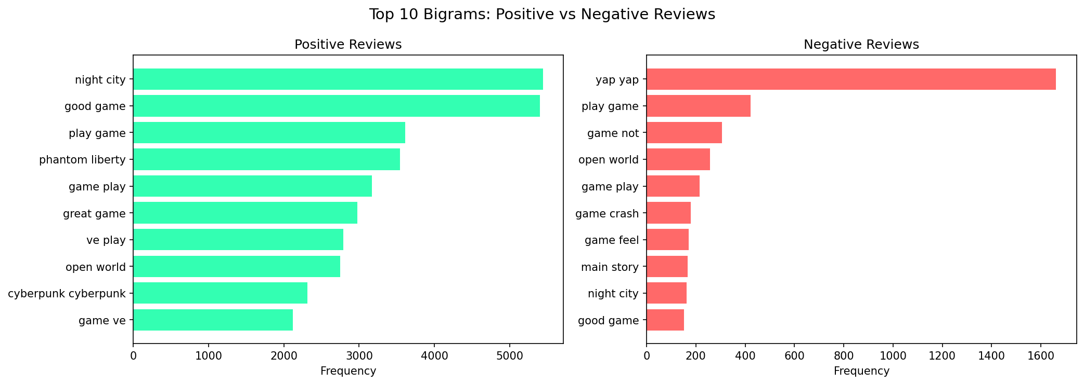

PHASE 2 · WHAT PLAYERS ACTUALLY SAY
M8
N-grams: The Phrases Behind the Votes
KEY BIGRAMS
night city
5,444×
phantom liberty
3,546×
game crash
180×
yap yap (meme)
1,662×
Takeaway With ngram_range=(1,2) bigrams become tf-idf features the model can tell “not worth” from “worth”.
Cyberpunk 2077 · NLP Project · Hochschule Aalen
08
Notes:
Method 8: n-gram analysis. Bigrams reveal what phrases actually separate positive from negative reviews. 'Night city' appears 5,444 times in positive reviews the setting is the star. Phantom Liberty, the DLC, drives a lot of praise with over 3,500 mentions. On the negative side 'game crash' still tops genuine complaints at 180 mentions, and we even caught a review meme 'yap yap', 1,662 times showing n-grams also expose spam patterns. Crucially, n-grams aren't just descriptive: our tf-idf uses ngram_range (1,2), so bigrams like 'not worth' become model features that a single-word representation could never capture.

Slide 9

PHASE 2 · TEXT BECOMES NUMBERS
M9
tf-idf: Rare = Informative
62,368 docs
TF × log(N/df)
62,368 × 8,000
→
→
cleaned reviews
the lecture formula
sparse matrix · 99.7% zero
Top positive-class terms (mean tf-idf)
Top negative-class terms (mean tf-idf)
Takeaway “not” is the 2nd-strongest negative term protecting it from stop-word removal paid off.
Cyberpunk 2077 · NLP Project · Hochschule Aalen
09
Notes:
Method 9, tf-idf, is the workhorse: it converts 62,368 cleaned reviews into an 8,000-dimensional feature matrix 99.7% sparse. The formula from the lecture: term frequency times log of N over document frequency words frequent in THIS review but rare across ALL reviews score high. That is Shannon's insight: rare events carry the most information. The charts show the strongest terms per class: 'good', 'play', 'story' for positive; 'not', 'crash', 'boring' for negative. Note that 'not' is the second-strongest negative term, which vindicates our preprocessing decision to protect it from stop-word removal. The matrix feeds an 80/20 stratified train/test split roughly 49,900 training and 12,500 test reviews for the classifier on the next slide.

Slide 10
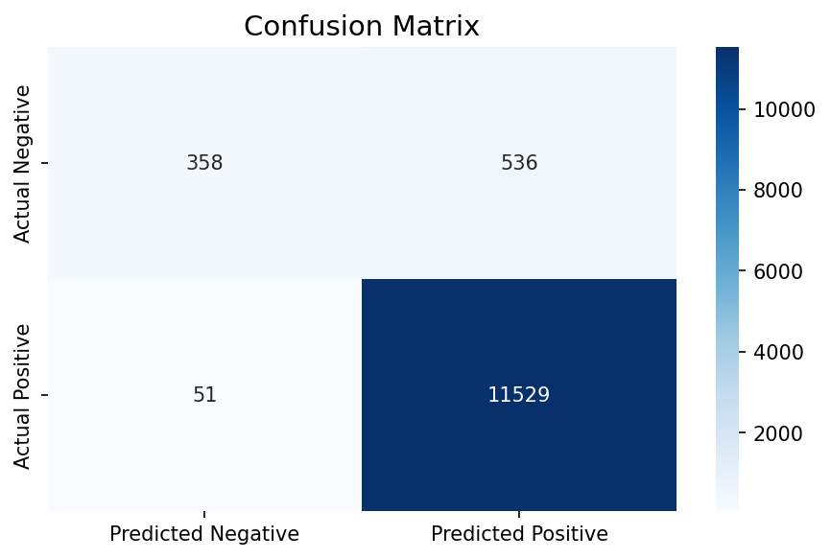
PHASE 2 · SUPERVISED MACHINE LEARNING
M12
Sentiment Classification with Logistic Regression
95.3%
WHAT THE MODEL LEARNED LOGISTIC REGRESSION COEFFICIENTS
Positive drivers ▲
Negative drivers ▼
test accuracy · 12,474 reviews
“choom” = Cyberpunk slang for friend the model learned the game's own language.
Takeaway Fully interpretable but 95/5 class imbalance caps negative recall at 0.40 (a data property, not a model failure).
Cyberpunk 2077 · NLP Project · Hochschule Aalen
10
Notes:
Method 12: supervised sentiment classification. Logistic Regression on the tf-idf vectors reaches 95.29% accuracy on 12,474 held-out reviews. The coefficients are fully interpretable that is why we chose this model: 'boring' is the strongest negative signal at minus 7.9, stronger even than 'crash', and remarkably 'choom', Cyberpunk slang for friend, is a top-5 positive predictor: the model learned the game's own vocabulary. On unseen sentences it behaves correctly: 'best RPG ever made' scores 99% positive, 'terrible buggy mess, crashes every 5 minutes' scores 94% negative. We are transparent about the weakness: negative recall is only 0.40 because 95% of labels are positive the confusion matrix shows the model over-predicting the majority class. That is a property of the data, and we discuss remedies on the final slide.

Slide 11
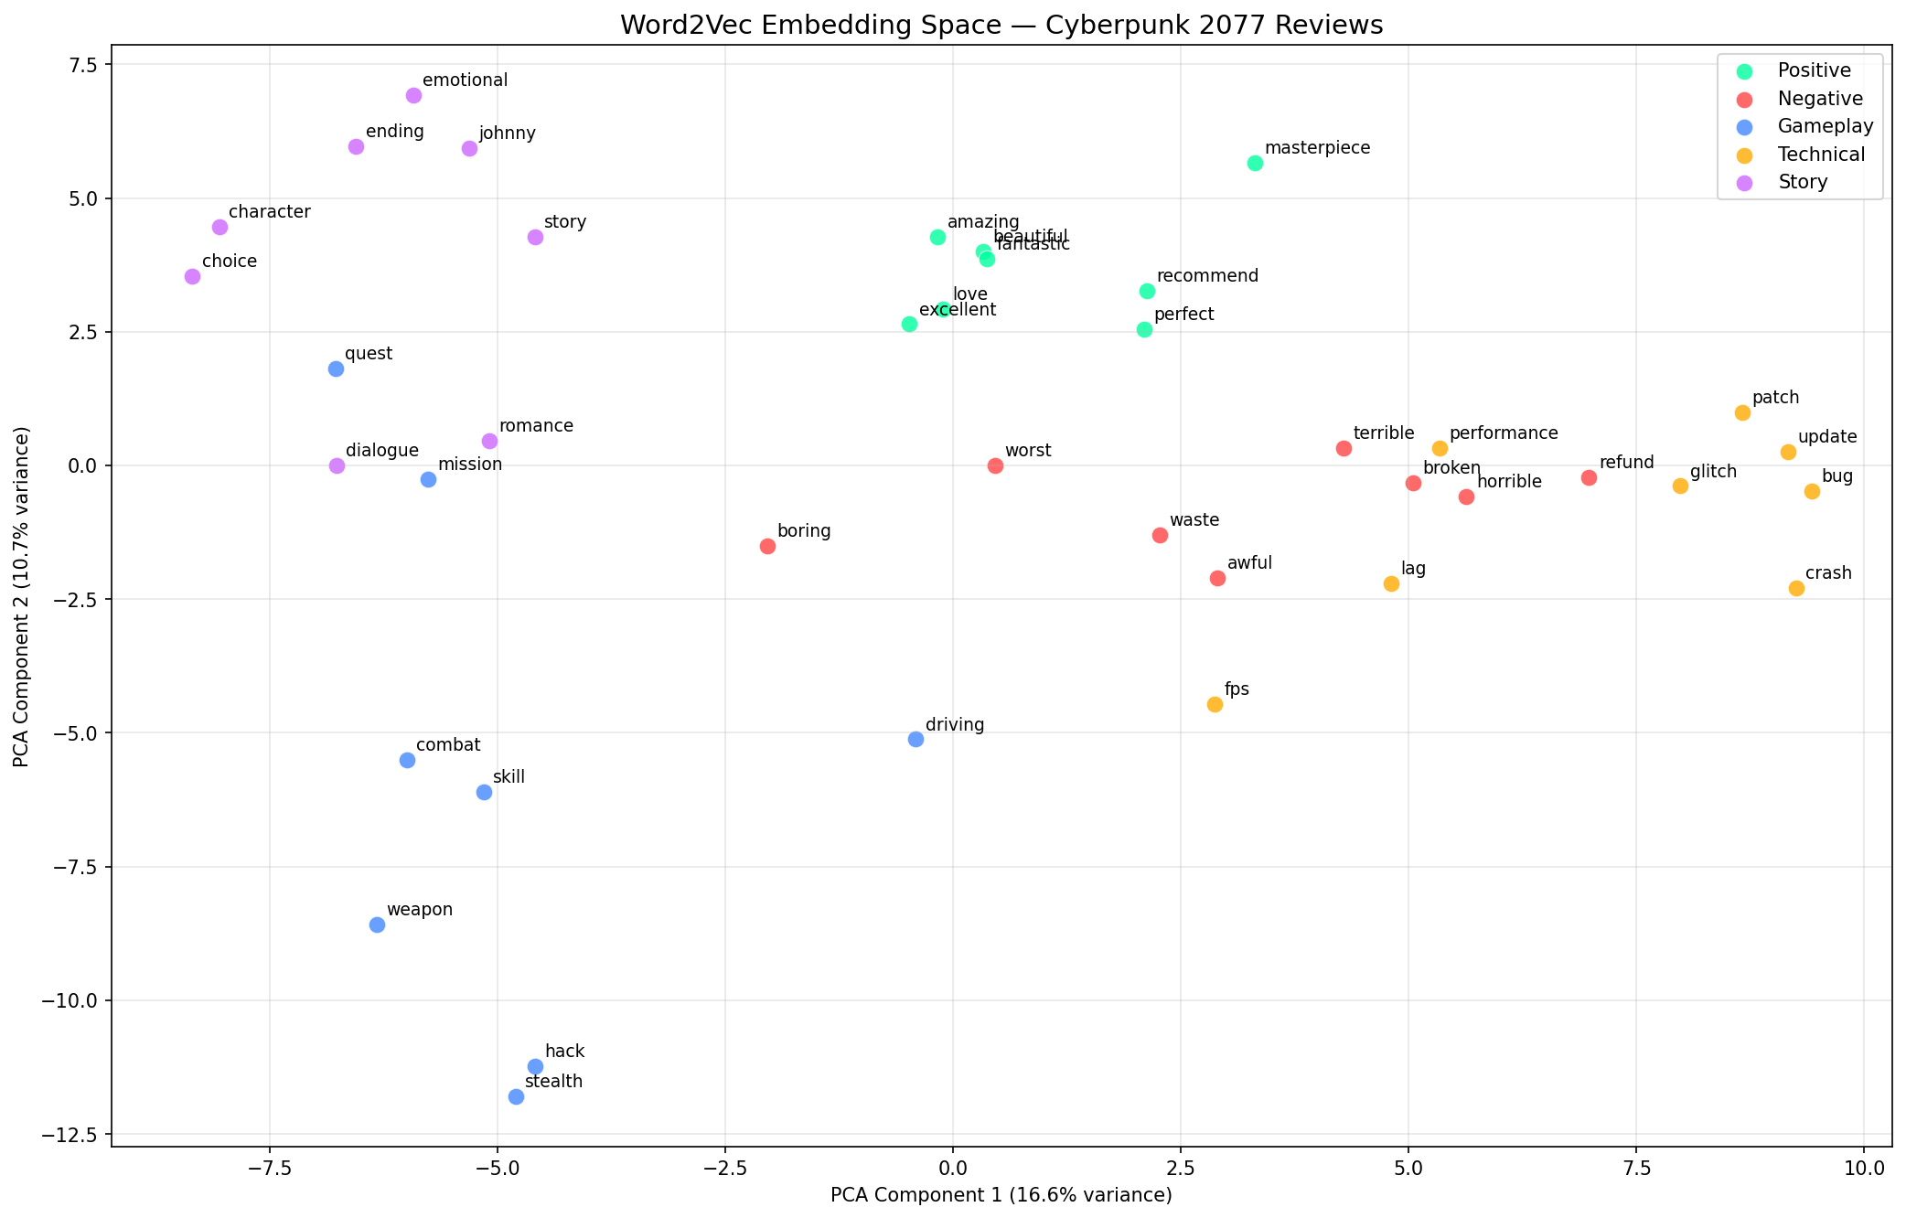

PHASE 3 · MEANING AS GEOMETRY
M13
Word2Vec: Semantic Clusters from Context Alone
Technical issues
bug
glitch .85
crash
freeze .69
lag
Praise
beautiful
gorgeous .80
stunning .67
breathtaking
Narrative
story
storyline .83
plot .67
narrative
VECTOR ARITHMETIC
bug + fix − crash ≈ patch
graphic + good − bad ≈ amazing
story + excellent − terrible ≈ storyline
PCA check: positive & negative words separate in space
6,115 words · 100-D · CBOW
Takeaway Trained on our own corpus it even clusters typos (“reccomend”) with their correct forms.
Cyberpunk 2077 · NLP Project · Hochschule Aalen
11
Notes:
Method 13: Word2Vec, trained from scratch on our own corpus with the CBOW architecture 6,115 words as 100-dimensional vectors, from about 55,000 tokenized reviews. The cluster cards show what it learned purely from context: 'bug' and 'glitch' sit at 0.85 cosine similarity, 'beautiful' and 'gorgeous' at 0.80, 'story' and 'storyline' at 0.83 and it even clusters the misspellings of 'recommend' with the correct form. The vector arithmetic works on domain concepts: bug plus fix minus crash equals patch. The small PCA projection is just a sanity check: positive and negative words separate in space, meaning sentiment emerged from context alone 27% of variance shown in 2D. These embeddings are not a demo: they power query expansion in the search engine next.

Slide 12
PHASE 3 · DOCUMENT RETRIEVAL
M14
A Search Engine Over 62,000 Reviews
→
→
→
Query
Expand (M13)
Vectorize (M9)
Rank
natural language
+ Word2Vec neighbours
same tf-idf space
cosine similarity
EXAMPLE QUERY EXPANSION IN ACTION
Query “How is the story and characters?”
Expanded + storyline · plot · plotline
Top hit “Really enjoying the plotline so far!” (cos 0.60)
Takeaway Embeddings bridge the vocabulary gap (“plot” ≈ “story”) this engine becomes the “R” in RAG.
Cyberpunk 2077 · NLP Project · Hochschule Aalen
12
Notes:
Method 14: document retrieval a full search engine. A query is expanded with its Word2Vec neighbours, vectorized into the same tf-idf space as the reviews, and ranked by cosine similarity. The expansion is the clever part: someone asking about the 'story' should also find reviews praising the 'plot' a review saying 'the plot is riveting' never contains the word 'story', so pure keyword search would miss it. This connects three methods in one system: tf-idf provides the vector space, Word2Vec provides the expansion, cosine similarity provides the ranking. And this engine is exactly the retrieval component that RAG needs on the next slide.

Slide 13


PHASE 3 · THE CAPSTONE
M15
RAG: Answers Grounded in Real Reviews
Question
WORKED EXAMPLE
↓
Q “Does the game still have bugs and crashes?”
Query Expansion (M13)
Retrieved evidence (top-5):
“Bugs: 10/10, Game: 8/10” · “Must play experience…” · 3 more (incl. non-English, still ranked correctly)
↓
Retrieval (M14)
↓
Prompt rule: “Answer ONLY from these reviews” → no hallucination
Top-5 Reviews
A (grounded) “Yes several players still report bugs, and one warns they can hurt the experience. But even those reviewers rate the game positively and recommend it overall.”
↓
Gemini LLM
↓
Final Answer grounded
Takeaway Every claim in the answer is traceable to a retrieved review retrieval + generation, no hallucination.
Cyberpunk 2077 · NLP Project · Hochschule Aalen
13
Notes:
Method 15, the capstone: Retrieval-Augmented Generation. The pipeline on the left shows the full loop: a question is expanded with Word2Vec, our search engine retrieves the 5 most relevant reviews, they are packed into a prompt that says 'answer ONLY from these reviews', and Gemini generates the answer. The result is grounded in actual player evidence including reviews in Portuguese that the retrieval still ranked correctly. Our question about bugs gets an honest, sourced answer: yes, bugs exist, but players recommend the game anyway. RAG connects everything: preprocessing made the index clean, tf-idf built it, Word2Vec expanded the query, and the LLM writes the final answer.

Slide 14
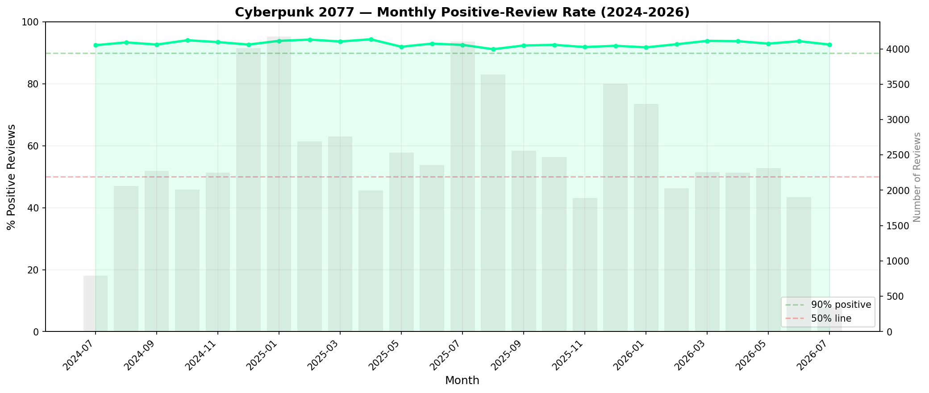


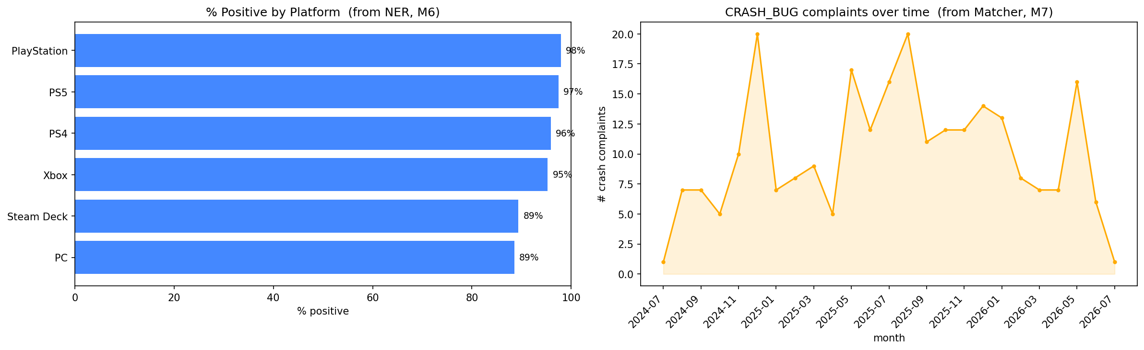

FINAL ANALYSIS · PUTTING THE COLUMNS TO WORK
RESULTS
Findings: Stable Praise, Persistent Complaints
92.7%
positive in Jul 2026 vs 92.5% in Jul 2024. Two years, no decline.
97.5 vs 88.5
% positive: PS5 vs PC the platform gap (NER column).
249
CRASH_BUG mentions rare but never zero (Matcher column).
Takeaway Sentiment is high AND stable the recovery holds; crashes remain the last stubborn weakness.
Cyberpunk 2077 · NLP Project · Hochschule Aalen
14
Notes:
The final analysis combines everything. The timeline shows the answer to our research question: sentiment sits at 92 to 93 percent positive and stays there for two full years this is not a spike but a stable post-recovery state. The platform breakdown from the NER column shows PS5 players are the happiest at 97.5% and PC players the most critical at 88.5% also the largest group. And the crash-bug trend from the pattern-matching column shows complaints persist at a low but non-zero rate bugs are the game's last stubborn weakness, but as RAG showed us, players recommend it anyway.

Slide 15
CONCLUSION
15 Methods, One Pipeline, One Answer
RESEARCH QUESTION
MAIN FINDINGS
What do players praise & still complain about and can we answer questions directly from the reviews?
92–93% positive, stable for 2 years
Praise: Night City · story · Phantom Liberty
Complaints: crashes rare but persistent
RAG answers questions grounded in reviews
LIMITATIONS
FUTURE WORK
English-only corpus
Class weights / SMOTE for imbalance
Multilingual models (incl. German reviews)
Larger retrieval context · transformer embeddings
Alister Charles · Aryan Jadhav Thank you!
Notes:
To conclude, structured as question, findings, limitations and future work. Our research question: what do players praise and complain about now that the game is highly rated, and can we answer questions directly from the reviews. Findings: Cyberpunk 2077 is a stable, loved game 92 to 93 percent positive for two straight years, driven by Night City, the story and Phantom Liberty while crashes remain the one persistent complaint; and yes, our RAG system answers free-form questions grounded in real reviews. Limitations we are open about: the 95-to-5 class imbalance caps negative recall at 0.40, the corpus is English-only, and RAG sees only the top-5 retrieved reviews. Future work: class weighting or SMOTE, multilingual models including German reviews and transformer-based embeddings with a larger retrieval context. All 15 lecture methods worked together as one pipeline from tokenization to a system that answers questions in natural language. Thank you we are happy to take questions.

