Slide 1

FINAL YEAR RESEARCH PROJECT
Review-1 Presentation Proactive Carbon Intelligence: ML-Based Emission Forecasting and Anomaly Detection
Supervised By: Prof. /Dr.
Group No.: 13 | Section: 29
Name of the Student(s) with Regd. No.:
Aryan Sharma – 2241019403
Anand Kumar Sharma – 2241019398
Saswat Dash – 2241004182
Suyash Kumar Anand – 2241001074
Department of Computer Sc. and Engineering
Faculty of Engineering & Technology (ITER)
Siksha ‘O’ Anusandhan (Deemed to be) University
Bhubaneswar, Odisha
1

Slide 2
Presentation Outline
Problem Statement & Motivations
Problem Statement
Motivations
Literature Review
Existing Solutions & Limitations
Proposed Methodology & Approach
Key Components/Modules & Algorithms Used
Dataset & Tools/Technologies
Work Done So Far (Implementation Progress)
Preliminary Results (if any)
Future Work Plan
References
2

Slide 3
Problem Statement
Industrial Carbon Emission Challenge
Industrial facilities are among the largest contributors to global greenhouse gas emissions due to inefficient energy utilization.
Most industries rely on retrospective monitoring systems that detect emission spikes and energy waste only after they occur, leading to financial losses and environmental damage.
Core Problem
Absence of predictive sustainability analytics causes delayed decision-making.
Need for a proactive, intelligent system that forecasts energy consumption, detects anomalous emission patterns, and provides optimization strategies.
No integrated platform currently combines forecasting, anomaly detection, and a user-friendly sustainability dashboard.
3

Slide 4
Motivations
Why This Matters
Increasing global concern over carbon emissions and climate change mandates proactive monitoring solutions.
Industrial sectors contribute ~37% of global CO₂ emissions; even marginal efficiency gains have large-scale environmental impact.
ESG (Environmental, Social, Governance) compliance is becoming mandatory for industries worldwide.
Opportunity for AI
Machine learning can identify hidden patterns in energy data that human analysts miss.
Predictive systems enable preventive action before emission spikes, reducing operational costs and penalties.
Lack of intelligent, integrated monitoring systems creates a clear research and industry gap.
Project Goal
Develop Verdify — a data-driven AI framework for industrial energy waste reduction and emission optimization.
4

Slide 5
Literature Review
Key Findings from Existing Literature
ML widely used for energy prediction: LSTM, GRU, and ARIMA/SARIMA show strong time-series forecasting performance (MAE, RMSE metrics).
Isolation Forest & One-Class SVM are established methods for anomaly detection in industrial sensor data.
Ensemble models (Gradient Boosting, Random Forest) improve prediction accuracy over single models.
CNN-based deep learning achieves high accuracy but is computationally expensive and requires large datasets.
Representative Works
Smith et al. (2022): Random Forest on UCI data — Accuracy 92–95%, F1: 0.91. Stable but limited scalability.
Kumar & Patel (2023): CNN on custom dataset — Accuracy 90–93%, F1: 0.89. Superior feature extraction, high compute cost.
Roy et al. (2020): Hybrid CNN-LSTM model for sequential pattern learning in industrial settings.
Patel & Shah (2022): Transfer learning (VGG16) adapted for sensor-based classification tasks.
5

Slide 6
Research Gap & Improvements
Limitations of Existing Systems
Most existing systems are reactive — they detect anomalies and emission spikes only after they occur.
Limited integration of forecasting and anomaly detection in a single cohesive framework.
Absence of user-friendly dashboards for real-time visualization and decision support.
Existing research lacks optimization modules that recommend actionable emission reduction strategies.
Our Improvements (Verdify)
Predictive + Proactive: LSTM forecasts future emissions before they occur, enabling early intervention.
Integrated Framework: Forecasting, anomaly detection, and optimization combined in one system.
User-Friendly Dashboard: Streamlit-based visualization with alerts, simulations, and insights.
Optimization Module: Regression and Gradient Boosting models recommend efficient operational parameters.
6

Slide 7
Proposed Solution & Architecture
Brain MRI data
System Architecture — Verdify Framework
Input: Structured industrial dataset — Temperature (AT), Vacuum (V), Pressure (AP), Humidity (RH), Power Output (PE).
CO₂ Estimation: Derived using emission factor — CO₂ = PE × 0.82 (kg/kWh).
Power Prediction Module: Linear Regression & Gradient Boosting models trained on environmental features.
Anomaly Detection Module: Isolation Forest computes residuals and flags abnormal emission events.
Visualization Module: Plotted anomalies and trend charts for decision support.
Workflow
Environmental Data (AT, V, AP, RH) → Power Prediction Model → CO₂ Estimation → Residual Calculation → Anomaly Detection (Isolation Forest) → Dashboard Visualization
Preprocessing
CNN-Based Feature Extraction & Selection
Attention Mechanism
Classification
Fig. 1: Workflow of the Proposed Model
[Example Figure for Reference]
Result Analysis
Final Output
7

Slide 8
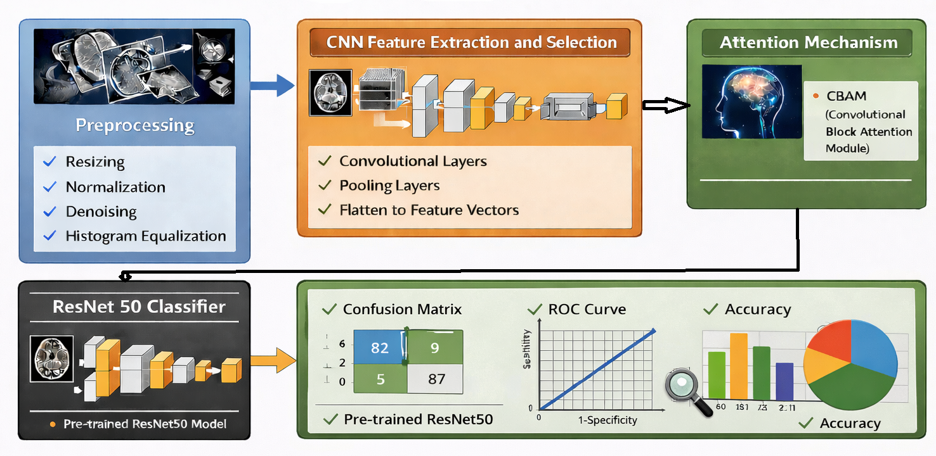
Proposed Solution & Architecture cont.
Module 1: Time-Series Forecasting
Algorithms: LSTM (primary), GRU, ARIMA/SARIMA (baseline)
Purpose: Predict future CO₂ emission levels and energy consumption from historical data.
Metrics: MAE, RMSE, MAPE
Module 2: Anomaly Detection
Algorithms: Isolation Forest (implemented), One-Class SVM, Deep Autoencoders (planned)
Purpose: Identify abnormal energy spikes and unusual emission patterns.
Metrics: Precision, Recall, F1-Score
Module 3: Optimization Modelling
Methods: Multiple Linear Regression, Gradient Boosting Regressor
Advanced: Reinforcement Learning-based policy optimization (planned)
Purpose: Estimate optimal energy usage and simulate emission reduction strategies.
Fig. 2: Schematic Model Diagram of the Proposed Model
[Example Figure for Reference]
8

Slide 9
Dataset & Tools/Technologies
Dataset
Combined Cycle Power Plant Dataset (UCI Machine Learning Repository)
Features: Ambient Temperature (AT), Exhaust Vacuum (V), Ambient Pressure (AP), Relative Humidity (RH), Net Electrical Output (PE)
CO₂ emissions derived: CO₂ = PE × 0.82
Tools & Technologies
Language: Python 3.x | Environment: Jupyter Notebook / VS Code
Data Processing: NumPy, Pandas
Visualization: Matplotlib, Seaborn, Plotly
ML Models: Scikit-learn (Linear Regression, Gradient Boosting, Isolation Forest)
Deep Learning: TensorFlow / PyTorch (LSTM, Autoencoders — planned)
Dashboard: Streamlit (planned deployment)
Database: SQLite / PostgreSQL (optional storage)
9

Slide 10
Progress in Implementation Plan & Methodology
Completed Tasks
Data preprocessing completed — handled missing values, normalized features, split into train/test sets.
CO₂ emission values derived from power output using the emission factor: CO₂ = PE × 0.82.
Linear Regression model implemented and evaluated (RMSE ≈ 4.47).
Gradient Boosting Regressor implemented and compared — outperforms Linear Regression (RMSE ≈ 3.80).
Anomaly Detection using Isolation Forest completed — 192 anomalies flagged (~2% of data).
Visualization of anomalies and emission trends completed using Matplotlib.
Preliminary Results
Linear Regression RMSE: 4.47 | Gradient Boosting RMSE: 3.80 (14.9% improvement)
Anomaly Detection: 192 anomalies detected out of ~9,500 records (~2% abnormal behavior identified)
Model comparison performed — Gradient Boosting selected as primary prediction model going forward.
10

Slide 11
Future Work Plan
Short-Term (Next 4 Weeks)
Implement LSTM model for time-series forecasting of CO₂ emissions and energy consumption.
Evaluate LSTM against Gradient Boosting using MAE, RMSE, and MAPE metrics.
Begin development of the Streamlit-based sustainability analytics dashboard.
Mid-Term (Weeks 5–8)
Integrate all three modules (forecasting, anomaly detection, optimization) into unified Verdify framework.
Add One-Class SVM and Autoencoder-based anomaly detection for comparison.
Implement carbon reduction simulation feature in the dashboard.
Long-Term (Final Phase)
Optimize model performance through hyperparameter tuning and cross-validation.
Explore Reinforcement Learning-based policy optimization module.
Integrate real-time monitoring capabilities and finalize ESG compliance reporting module.
Complete documentation, testing, and final project report submission.
11

Slide 12
References
[1] UCI Machine Learning Repository. Combined Cycle Power Plant Dataset. Available: https://archive.ics.uci.edu/ml/datasets/Combined+Cycle+Power+Plant
[2] Tufekci, P. (2014). Prediction of full load electrical power output of a combined cycle power plant using ML methods. Int. J. Electrical Power & Energy Systems, 60, 126-140.
[3] Liu, F. T., Ting, K. M., & Zhou, Z. H. (2008). Isolation Forest. Proceedings of IEEE ICDM, pp. 413-422.
[4] Hochreiter, S., & Schmidhuber, J. (1997). Long Short-Term Memory. Neural Computation, 9(8), 1735-1780.
[5] Chen, T., & Guestrin, C. (2016). XGBoost: A Scalable Tree Boosting System. ACM SIGKDD, pp. 785-794.
[6] Pedregosa et al. (2011). Scikit-learn: Machine Learning in Python. JMLR 12, pp. 2825-2830. Available: https://scikit-learn.org
12

Slide 13

13

