Slide 1
HOTELSCOPE Insights on Hotel Experience.
Enrolment No. Name of Student
21103077 Aryan Singh
21103078 Harsh Vardhan Singh
Supervisor Dr Prashant Kaushik

Slide 2
HOTELSCOPE Insights on Hotel Experience.
The project HotelScope - Insights on Hotel Experience is a Python-based system designed to generate, analyze, and visualize synthetic data on hotel experiences across various locations. Using libraries like Faker and pandas, it simulates realistic data on customer demographics, visit details, and feedback scores, saved in Excel for analysis. Key features include user-driven filtering by demographics, visit purpose, and feedback, along with visualizations using matplotlib and seaborn. The Judging Factor, a weighted metric of customer satisfaction, helps rank hotels by area or city, highlighting top-rated, least-rated, and most/least visited hotels. This comprehensive tool empowers users with actionable insights for better decision-making.

Slide 3
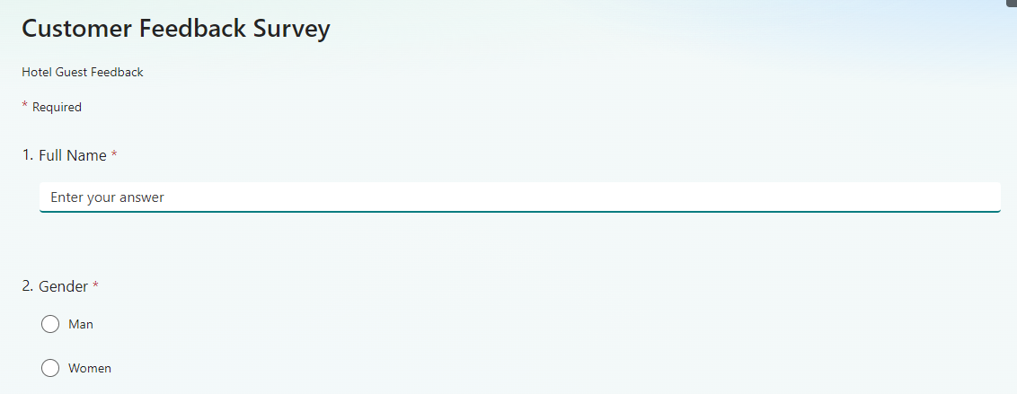
HOTELSCOPE Insights on Hotel Experience.
Steps required for the creation of this project.
Step 1: Creation of template Microsoft form for the real time data to be taken from users.

Slide 4
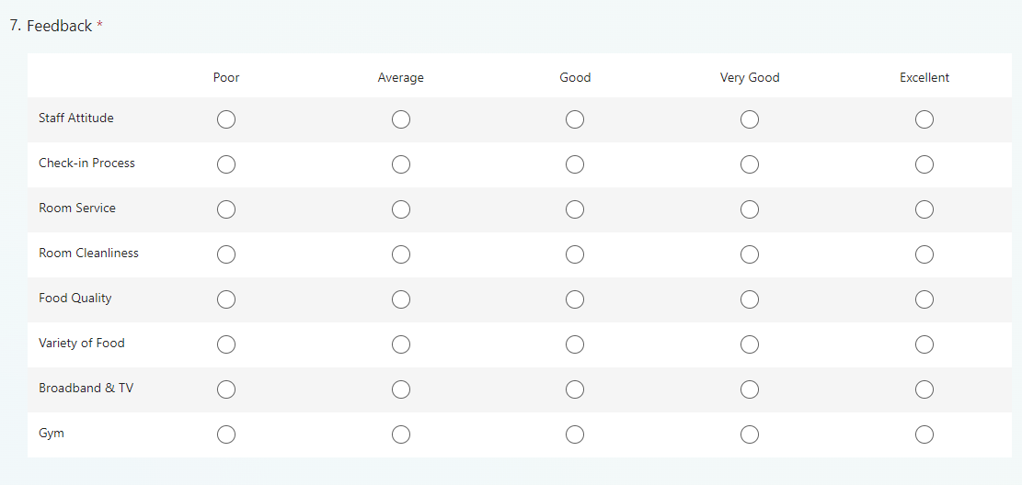
HOTELSCOPE Insights on Hotel Experience.

Slide 5
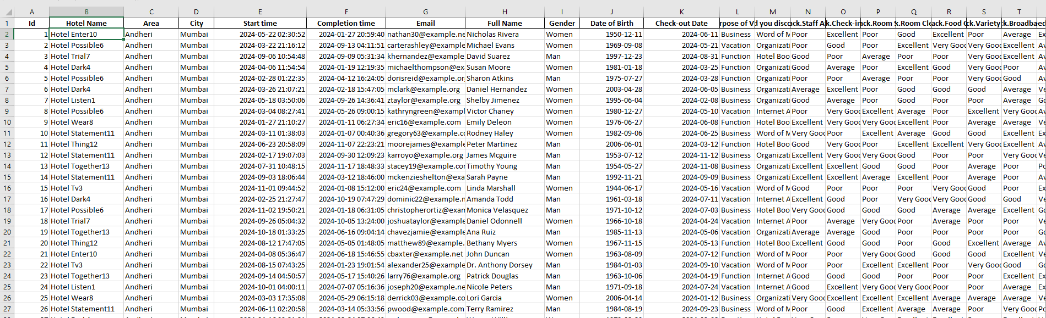
HOTELSCOPE Insights on Hotel Experience.
Steps required for the creation of this project.
Step 2: Generating large amount of data using python code from the given template gathered and storing it in the xlsx format.

Slide 6
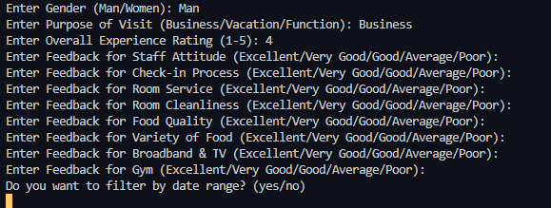
Steps required for the creation of this project.
Step 3: Performing analytics and categorization on the large dataset acquired implementing through various graphs using multiple factors.

Slide 7
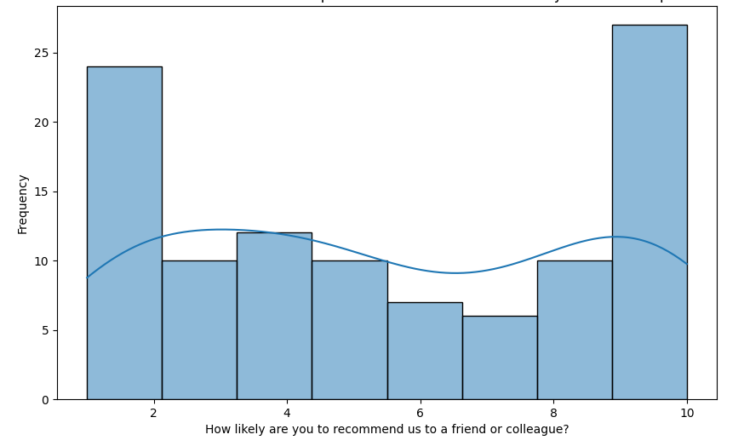
HOTELSCOPE Insights on Hotel Experience.

Slide 8
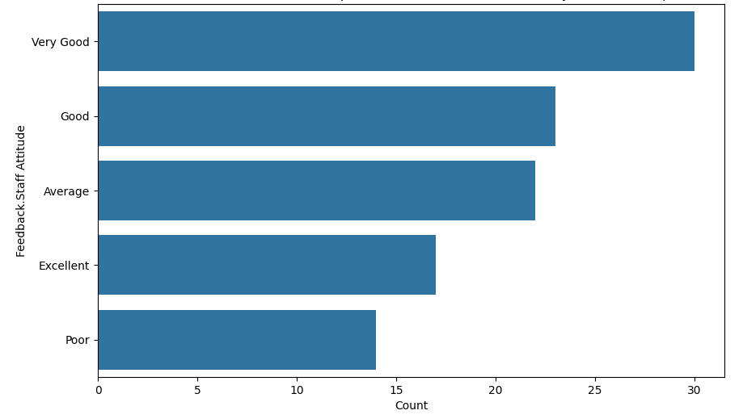
HOTELSCOPE Insights on Hotel Experience.

Slide 9
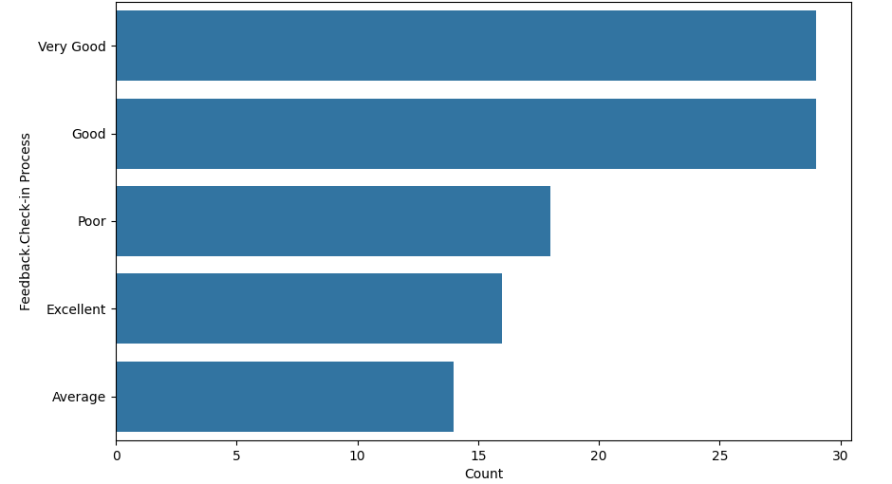
HOTELSCOPE Insights on Hotel Experience.

Slide 10
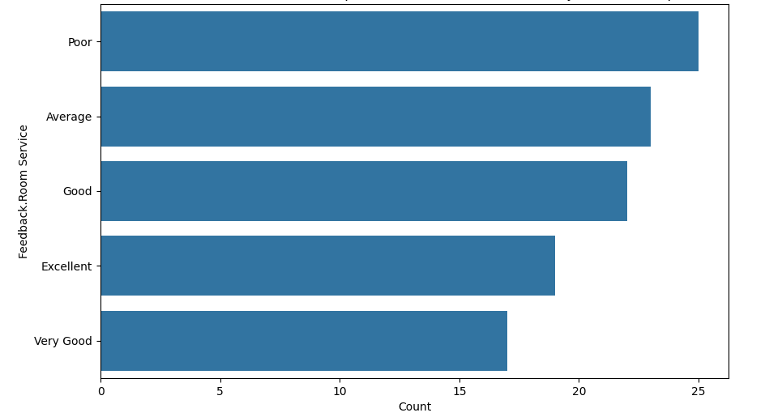
HOTELSCOPE Insights on Hotel Experience.

Slide 11
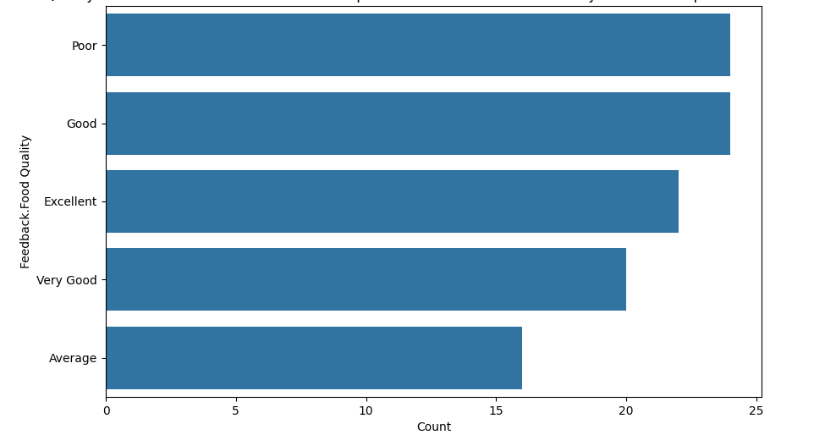
HOTELSCOPE Insights on Hotel Experience.

Slide 12
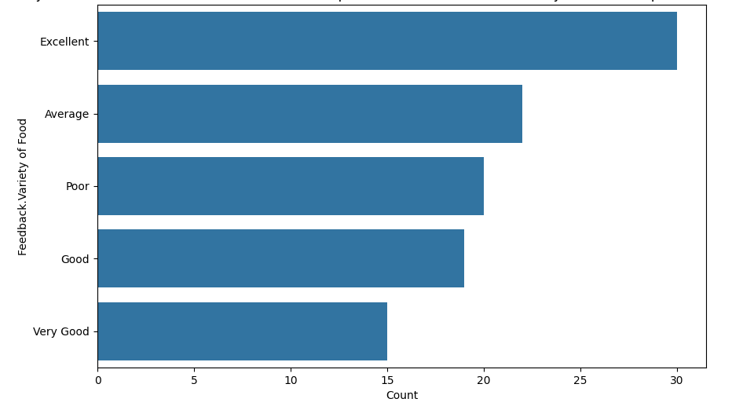
HOTELSCOPE Insights on Hotel Experience.

Slide 13
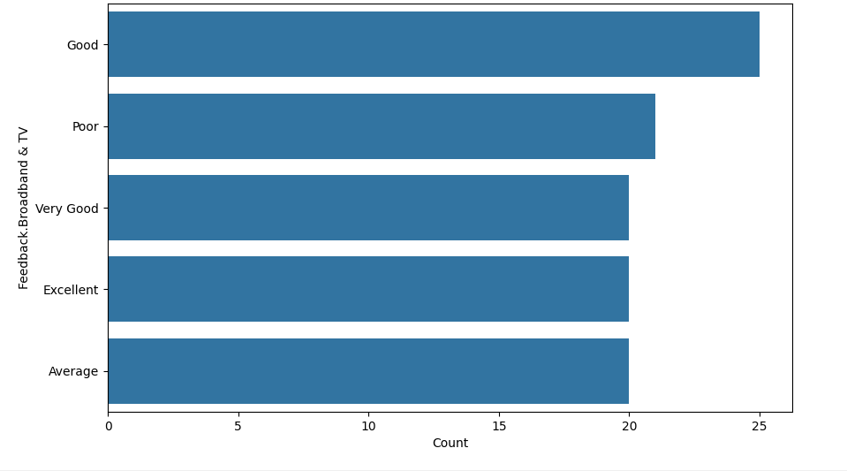
HOTELSCOPE Insights on Hotel Experience.

Slide 14
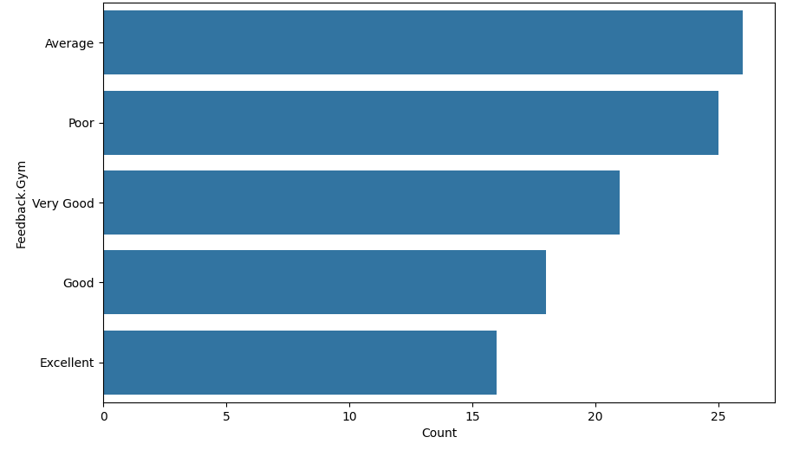
HOTELSCOPE Insights on Hotel Experience.

Slide 15
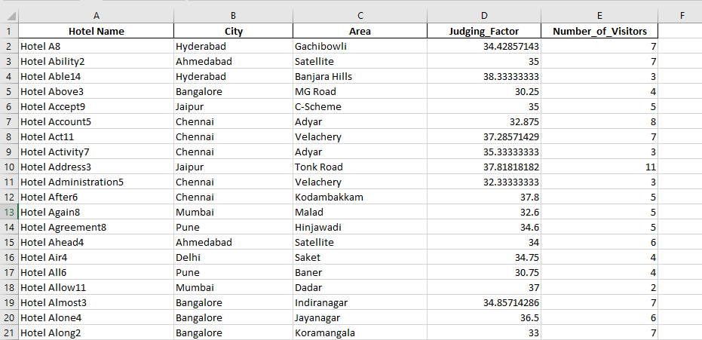
HOTELSCOPE Insights on Hotel Experience.
Steps required for the creation of this project.
Step 4: Calculation of the judging factor and grouping of all hotels in a particular area and city and calculating the number of guests visited.

Slide 16
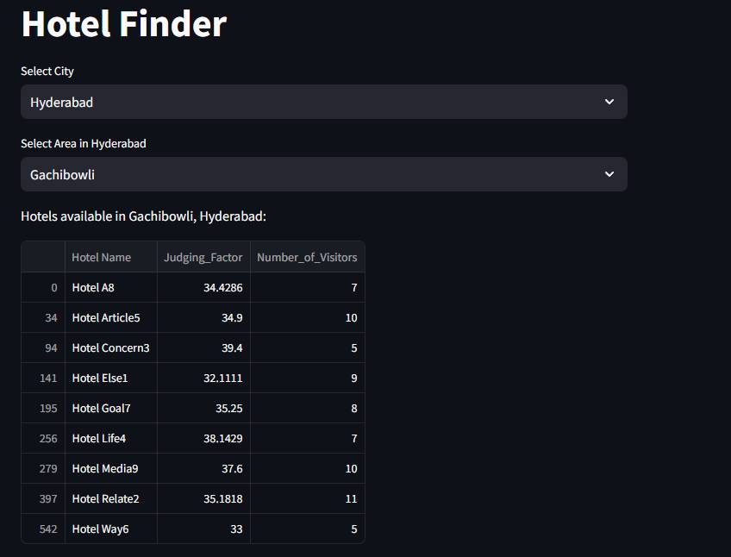
HOTELSCOPE Insights on Hotel Experience.
Steps required for the creation of this project.
Step 5 :Creating a dashboard for the users to find the best hotels including the number of visits and scores at the same time for the stays.

Slide 17
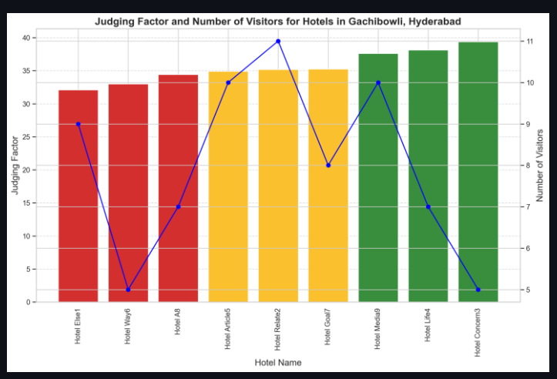
HOTELSCOPE Insights on Hotel Experience.

Slide 18
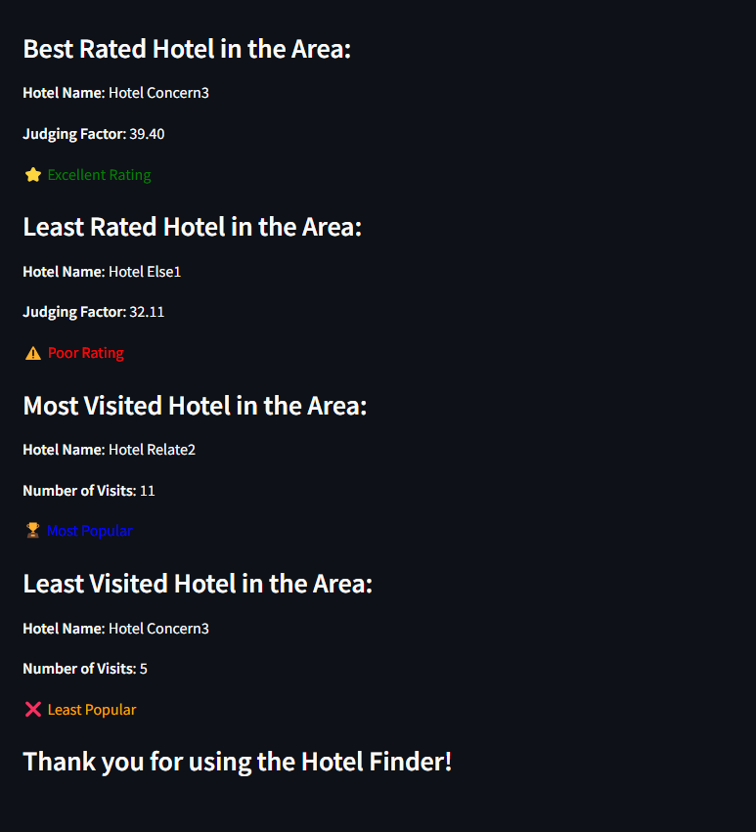
HOTELSCOPE Insights on Hotel Experience.

Slide 19
Conclusion
The “HotelScope” system effectively addresses the dual need of travelers and hotel administrators by providing a comprehensive evaluation of hotel performance. It calculates a Judging Factor based on user reviews and ratings, enabling travellers to make informed decisions. Simultaneously, it empowers hotel administrators to analyse customer feedback, identify areas for improvement, and enhance their services. With its scalable and modular design, the system is adaptable for future enhancements, such as advanced analytics and cloud integration, making it a valuable tool for improving transparency, user satisfaction, and service quality in the hospitality industry.

Slide 20
HOTELSCOPE Insights on Hotel Experience.
THANK YOU

