Slide 1
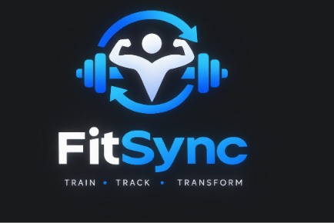
FitSync
A gym management Android app for members, trainers and admins
Member
Trainer
Admin
By –Aryan – 70022400566
-Aarushi -70022400560

Slide 2
Project overview
FitSync digitises day-to-day gym operations in one Android app.
Members log workouts, check in and track membership.
Trainers build plans and follow member progress.
Admins assign trainers, approve renewals and view reports.
3
user roles
19
app screens
9
database tables
2

Slide 3
Three roles, three workflows
M
Member
T
Trainer
A
Admin
Log personal workouts
Check in and view attendance
Renew membership, view trainers
View assigned members
Create workout plans
Monitor member progress
Manage members and trainers
Assign trainers to members
Approve renewals, view reports
3

Slide 4
Getting started: welcome, sign up, login
1
Welcome and role selection
2
Sign up
3
Login
Landing screen with the logo, then a role screen routing to the Member, Trainer or Admin dashboard.
Name, email, password and role. Needs a valid @gmail.com or @nmims.in email and 8+ characters.
Verifies the salted password hash, then opens the dashboard matching the user's role.
Session details are kept on the device so the user stays signed in until logout.
4

Slide 5
Member activities
1
Dashboard
2
Workouts
3
Progress
Personal greeting and shortcuts to every member feature.
Add exercises with sets, reps and weight; tick them off when done.
Completed versus total exercises at a glance.
6
Trainers
4
Attendance
5
Membership
One-tap check-in, visit count and last visit.
See plan, status and end date; request a renewal.
Browse trainers and see who is assigned to you.
5

Slide 6
Trainer activities
1
Trainer dashboard
2
My members
Home screen with quick access to members, plans and progress.
List of members the admin has assigned to the trainer.
3
Create workout plan
4
Member progress
Pick an assigned member and add exercises with sets and reps.
Review each member's completed workouts.
6

Slide 7
Admin activities
1
Admin dashboard
2
Manage members
3
Manage trainers
Central hub for managing the gym.
View members and assign each one a trainer.
See all registered trainers and their details.
4
Memberships
5
Gym reports
Approve or reject renewal requests.
Total members, trainers, active memberships and today's check-ins.
7

Slide 8
Extra Components
1.
Password Hashing
2.
Shared-Preferences
3.
Role-based control
Defined in PasswordUtils.java
Used in SignupActivity.java (when creating an account) and LoginActivity.java (when logging in).
Defined in FitSyncSession.java
Keeps the user logged in across app restarts and routes them to the right dashboard.
Used in RoleSelectionActivity, MainActivity and the dashboards
Three separate user types, each with their own screens. This is a design pattern, not a library.
3

Slide 9
How the activities work together
Admin
Trainer
Member
Everyone
assigns a trainer to a member
→
creates a workout plan
→
completes exercises and checks in
→
sees progress and reports update
Membership renewals follow the same loop: member requests, admin approves or rejects.
8

Slide 10
Data layer and security
Local SQLite database (6 tables)
Security and validation
users
trainer_assignments
workout_plans, workout_exercises
attendance
memberships, renewal_requests
Passwords salted and hashed with PBKDF2
Email domain and password length checks
Role-based screens and account status
Foreign keys link users, plans and records
9

Slide 11
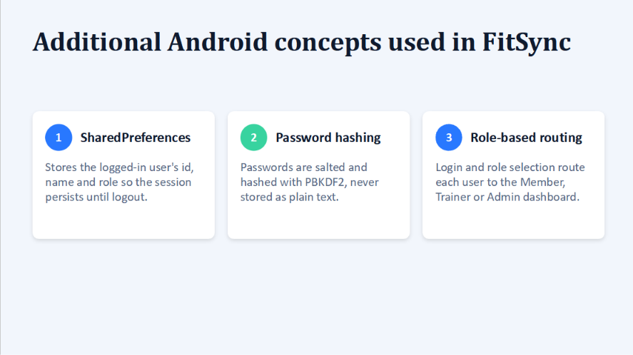

Slide 12
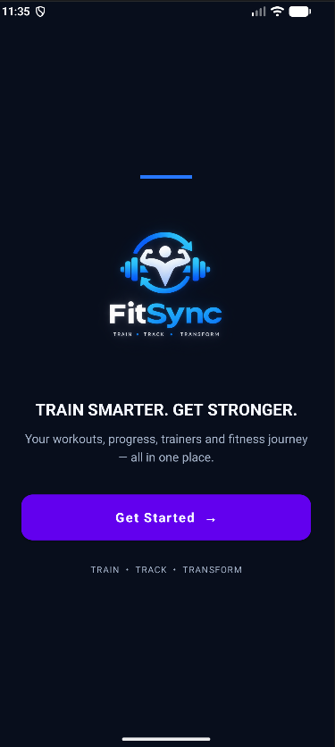
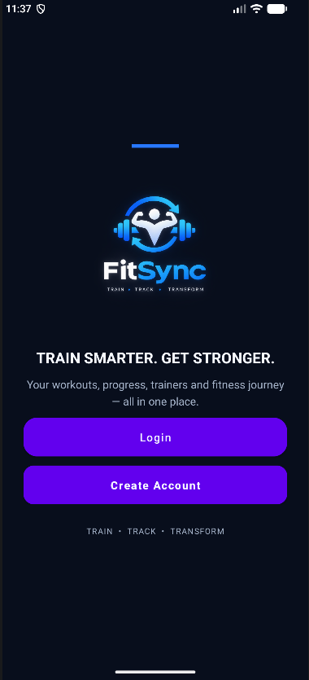
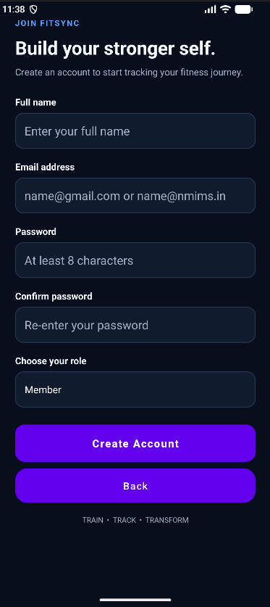
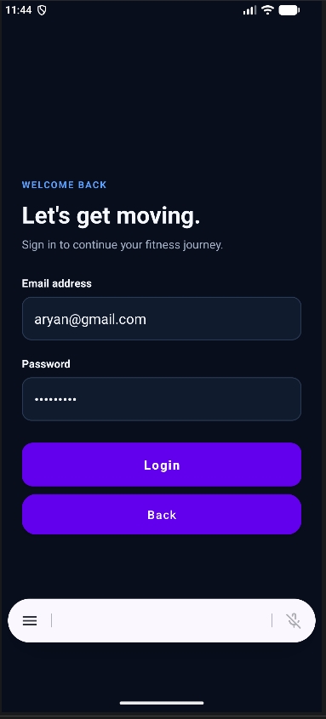
APP DISPLAY WORKFLOW
→
→
→

Slide 13
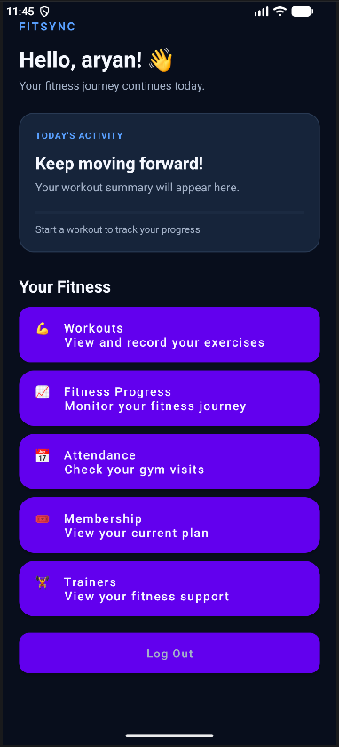
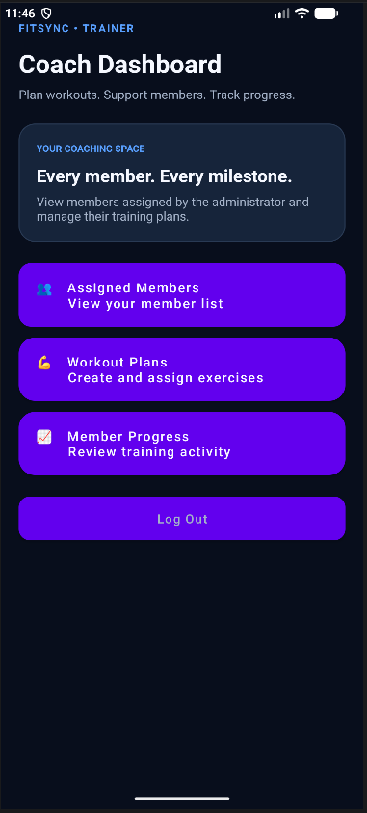
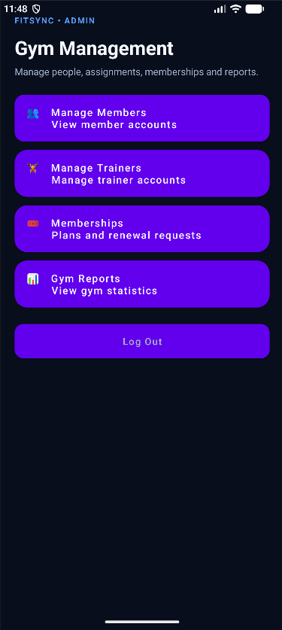
APP DISPLAY WORKFLOW

Slide 14
Train
Track
Transform
Thank you

