Slide 1
Customer Shopping Behavior Analysis
3,900 transactions · 18 features · Executive-level insights derived from observed purchasing patterns

Slide 2
Dataset at a Glance
3,900
18
Transactions
Features
Cross-category purchase records
Demographic, behavioral, and transactional variables
50
37
Locations
Missing Ratings
U.S. states represented in the dataset
Addressed through category-level median imputation
This structured dataset integrates demographic, purchase, and shopping-behavior signals, all standardized within PostgreSQL to support rigorous downstream analysis and executive decision-making.

Slide 3
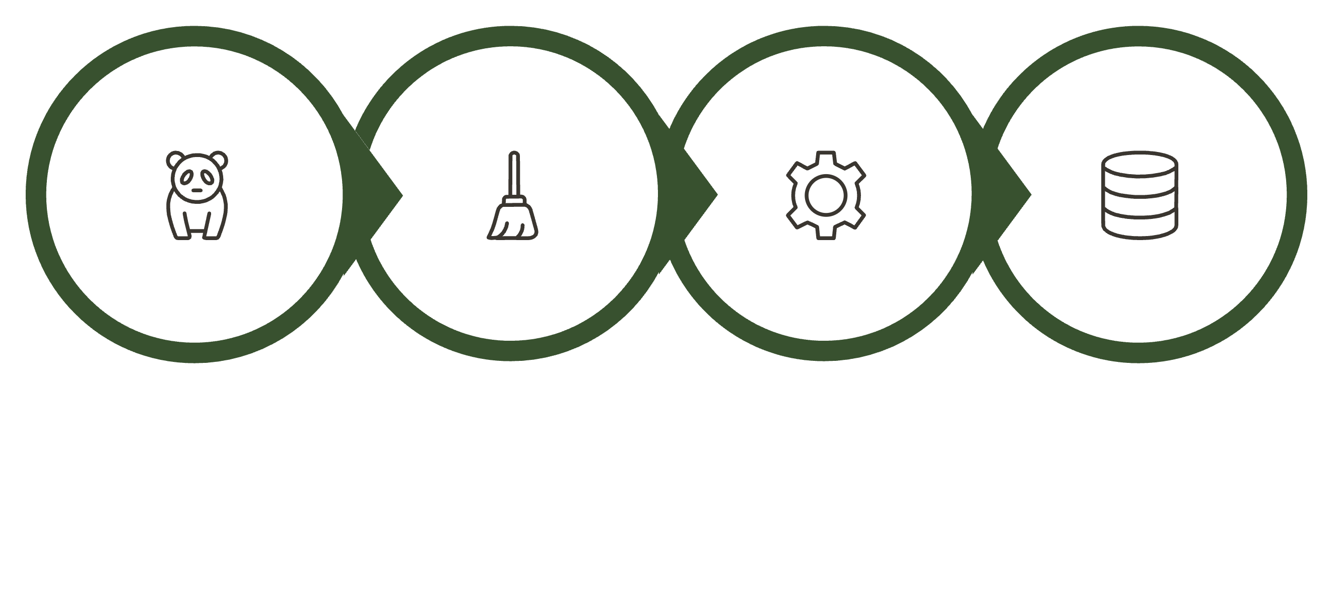
Data Pipeline: Python to PostgreSQL
Engineer High-Value Features
Ingest & Assess
Normalize & Standardize
Operationalize in PostgreSQL
Redundant promo_code_used was removed after validating its overlap with discount_applied, improving schema efficiency and reducing feature duplication without sacrificing analytical coverage.

Slide 4
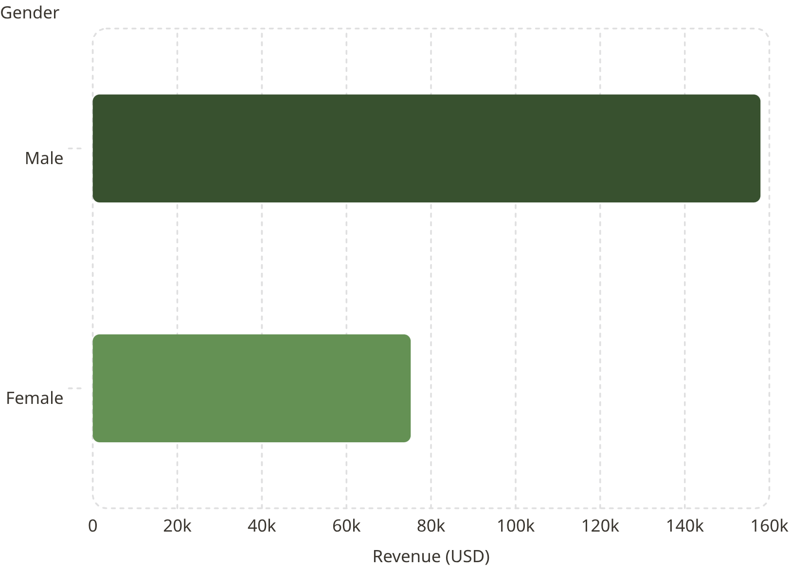

Revenue by Gender
Male Customers Account for 68% of Revenue
Male customers generated $157,890, compared with $75,191 from female customers, representing a 2.1x revenue differential and a clear concentration of value in the male segment.
Strategic priority: Evaluate female customer acquisition, engagement, and retention to close the revenue gap and broaden the monetization base.

Slide 5
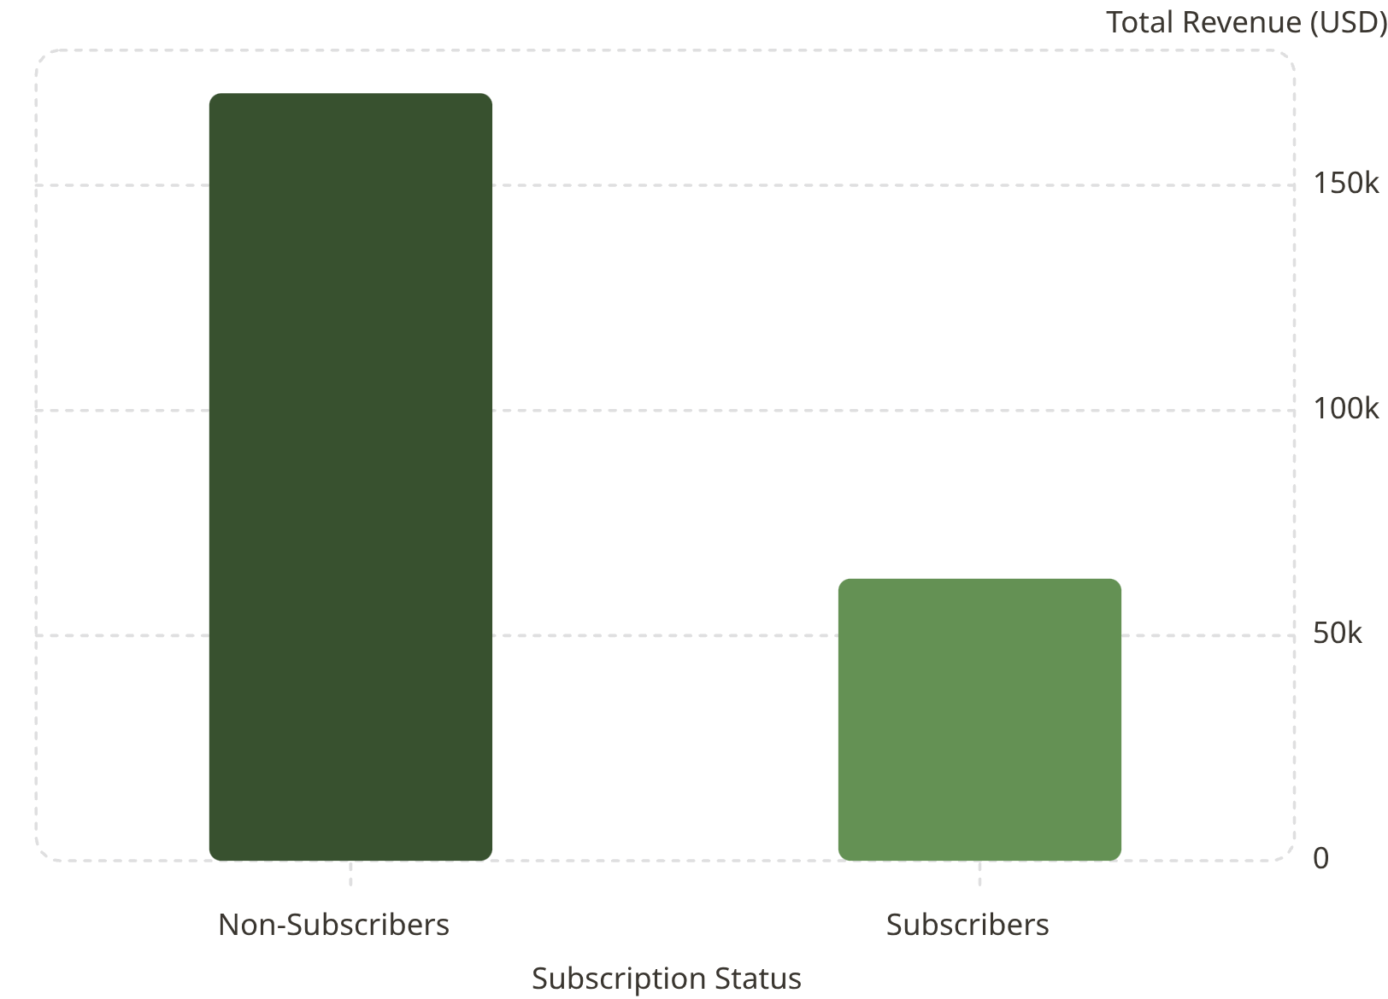
Subscribers vs. Non-Subscribers
Non-Subscribers Generate 73% of Revenue
Non-subscribers account for $170K in revenue, representing 73% of the current base. Average spend remains nearly identical at approximately $59.50 per customer, indicating a substantial opportunity to convert high-value, high-frequency buyers into recurring subscribers.
Strategic priority: accelerate subscription conversion among active non-subscribers to expand recurring revenue and improve lifetime value.

Slide 6
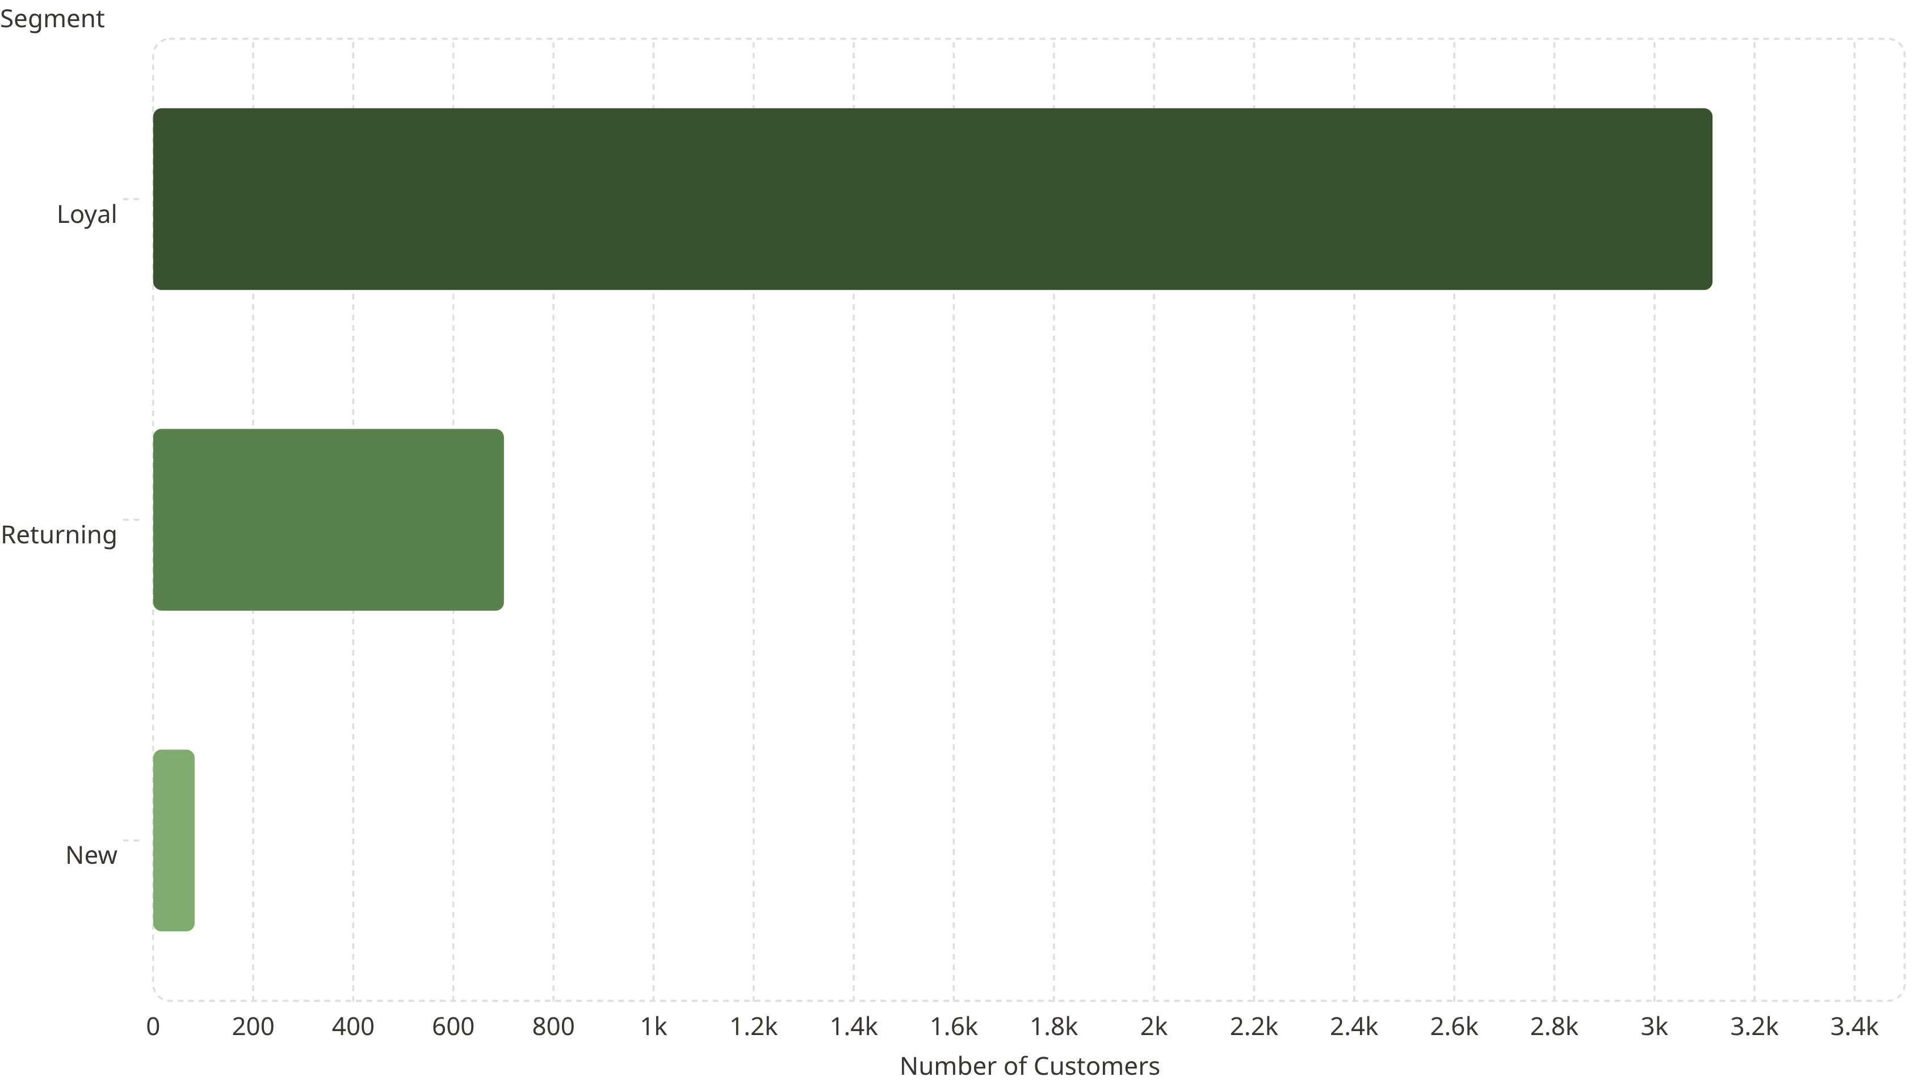
Customer Segmentation
Loyal Customers Represent the Core of the Base
80% of customers are Loyal, indicating a highly stable retention foundation. The limited volume of 83 New customers points to a meaningful acquisition constraint that may be limiting overall growth.
Loyal (80%) — 3,116 customers, underscoring strong recurring engagement
Returning (18%) — 701 customers, representing an important reactivation segment
New (2%) — 83 customers, highlighting an urgent need to strengthen acquisition channels
Strategically, the customer base is healthy but concentrated. Near-term growth should prioritize expanding top-of-funnel acquisition while sustaining retention and increasing conversion from returning customers into loyal advocates.

Slide 7




Top Products by Category
Accessories
Clothing
Footwear
Outerwear
Jewelry · Sunglasses · Belt
Accessory assortment reflects strong breadth across high-margin, add-on purchase categories and supports basket expansion.
Blouse · Pants · Shirt
Core apparel offerings indicate a balanced mix of essential wardrobe staples with consistent demand potential.
Sandals · Shoes · Sneakers
Footwear remains a strategic category for conversion, combining utility-driven purchases with repeat buying behavior.
Jacket · Coat
Outerwear provides seasonal relevance and higher-ticket potential, strengthening assortment depth during peak demand periods.

Slide 8

Strategic Recommendations
Loyalty Program Expansion
Incentivize repeat purchasing to accelerate retention and deepen Loyal segment penetration.
Discount Policy Optimization
Recalibrate promotional depth to preserve margin integrity while sustaining conversion lift.
Premium Product Positioning
Prioritize top-rated offerings in campaigns to strengthen perceived value and improve response rates.
Precision Audience Targeting
Concentrate spend on high-value age cohorts and express-shipping users with the strongest revenue potential.

