Slide 1
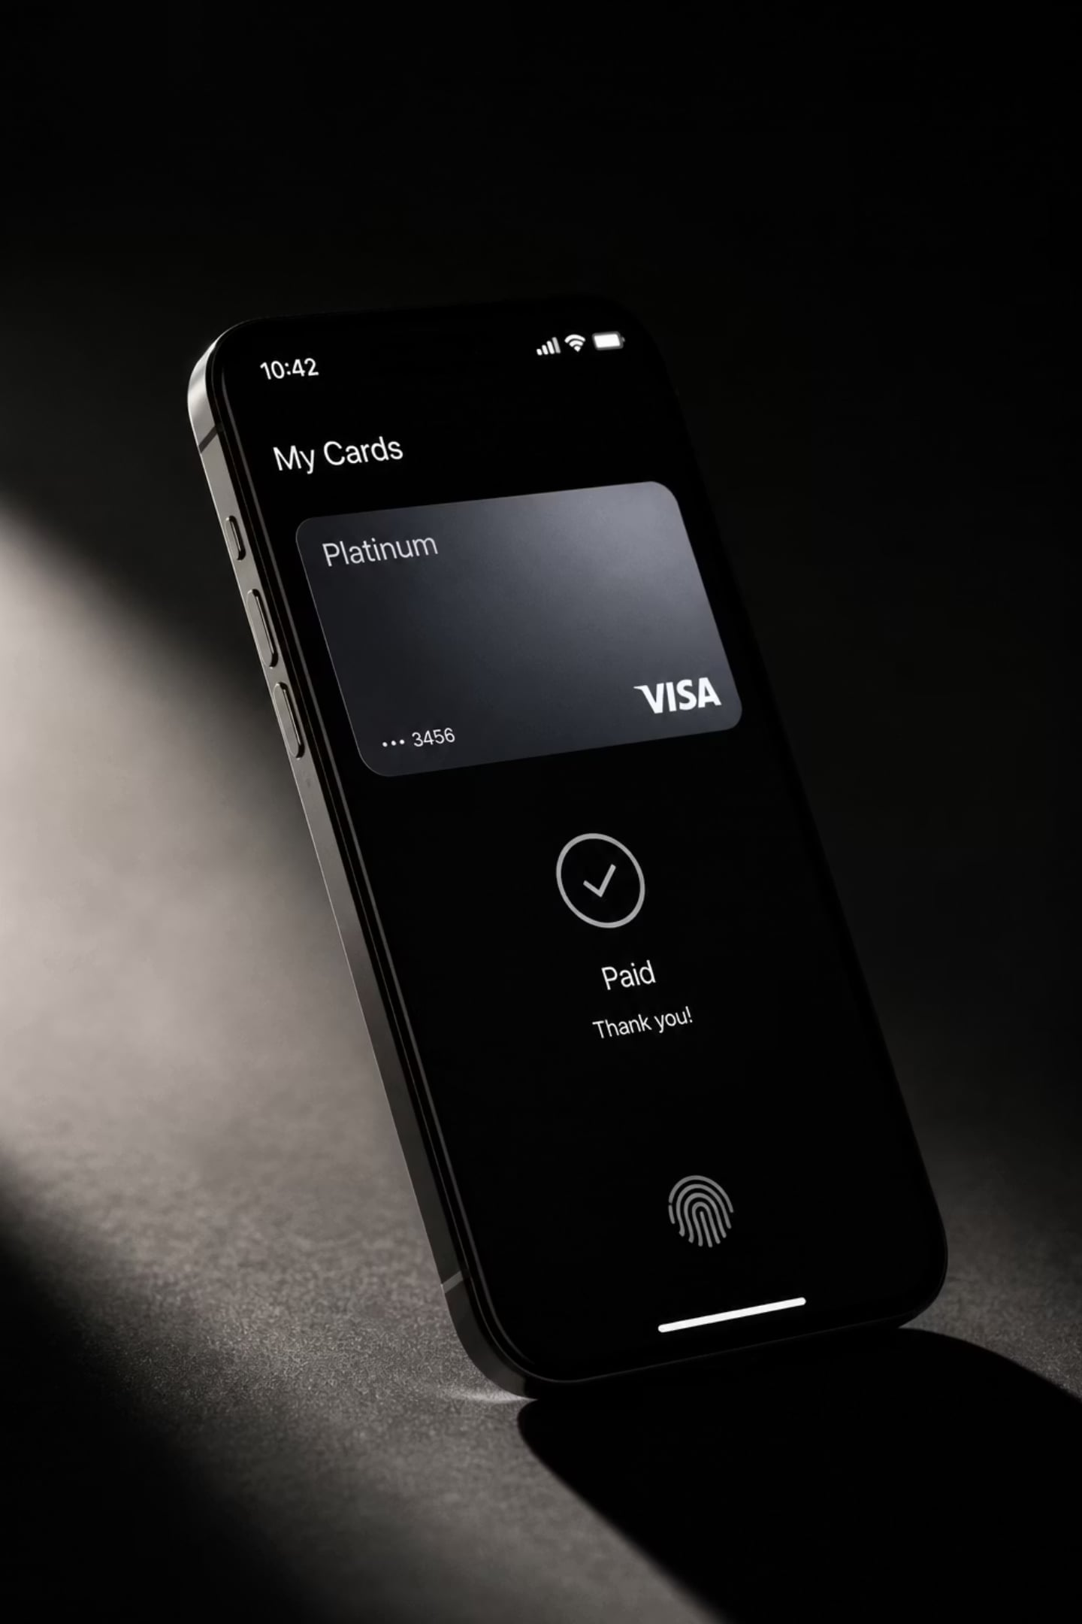
PhonePe Digital Payment Analytics
Power BI Dashboard Project — Aryan Rai, Data Analyst
An end-to-end business intelligence solution analyzing ₹3,333M in transactions across PhonePe's four core service categories — built to surface actionable insights for product, operations, and growth teams.
POWER BI
DAX
POWER QUERY
EXCEL
DATA ANALYTICS

Slide 2

Project Overview
Objective & Business Problem
Tools & Stack
Build an interactive Power BI dashboard to analyze PhonePe transactions and generate actionable business insights across four service verticals. The core challenge: understand transaction trends, monitor KPIs, identify payment failure patterns, and evaluate service performance — all from a single unified view.
Excel
Power BI
Raw data source & cleaning
Dashboard & visualization
Dataset
Power Query
DAX
~50,000 transaction records in Excel covering Insurance, Loans, Money Transfer, and Recharge & Bills — January through December 2024.
ETL & transformation
Calculated measures & KPIs
Deliverables
5-page interactive dashboard (Home, Insurance, Loans, Money Transfer, Recharge & Bills) with KPI cards, slicers, bar charts, pie charts, and area charts.

Slide 3


Dataset Architecture & Data Model
Table Structure
Data Model & Cleaning
1
The model follows a star schema — All_Users and All_Transactions serve as fact/dimension tables linked to service-specific tables, enabling robust cross-filter analysis in Power BI.
All_Users
Removed duplicates
Master user table — User_ID, Name, Age, Join_Date. Acts as primary lookup for relationship modeling.
Ensured transaction-level uniqueness across all 50K records.
Type corrections & missing values
2
Corrected data types, handled nulls, transformed date fields.
All_Transactions
Month column via Power Query
Unified transaction log — Transaction_ID, Amount, User_ID, Service, Service Type, Payment Status, Reason, Date.
Derived for time-intelligence DAX measures and monthly trend visuals.
3
Service Tables
Recharge_Bills, Money_Transfer, Loans, Insurance — each with category-level columns (Loan Type, Transfer Type, Insurance Type, etc.).

Slide 4
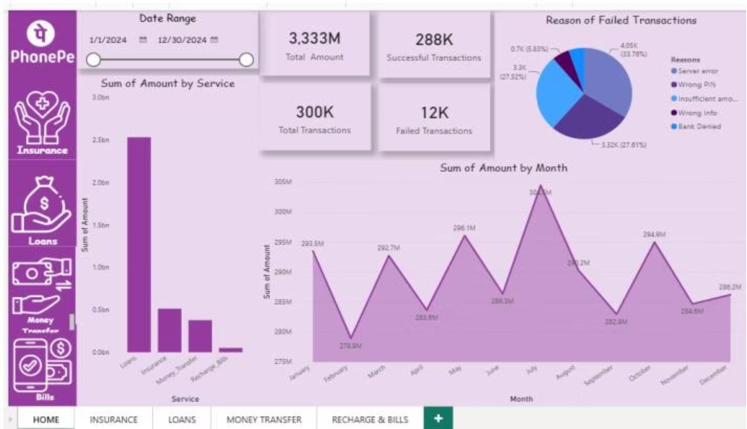
Home Dashboard — Transaction Overview
₹3,333M
300K
Total Transaction Amount
Total Transactions
Across all services, Jan–Dec 2024
288K successful · 12K failed
96.75%
Jul
Success Rate
Peak Month
Platform-wide payment reliability
₹333.3M — Feb was lowest at ₹278.9M
Top Failure Reasons

Slide 5
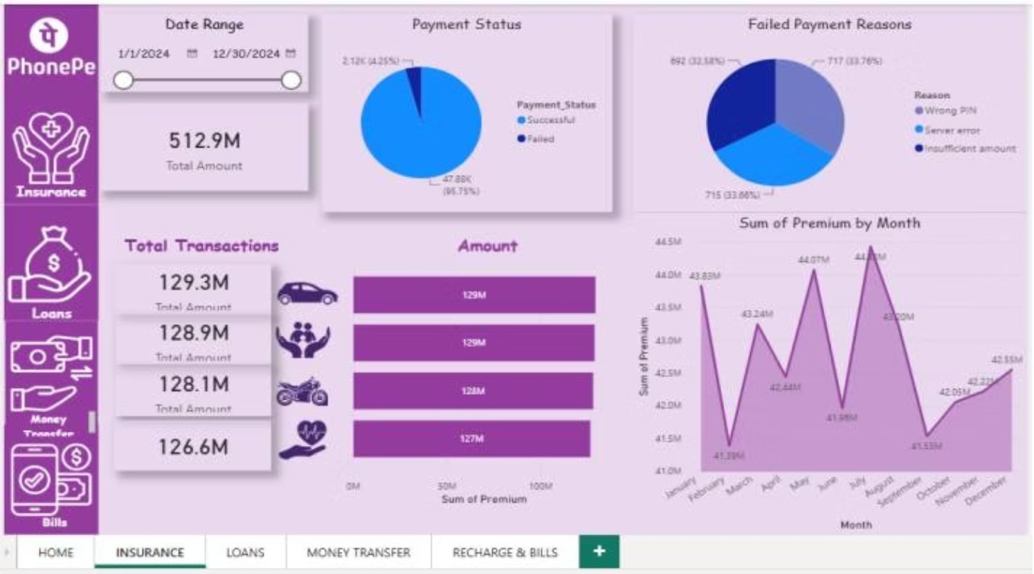
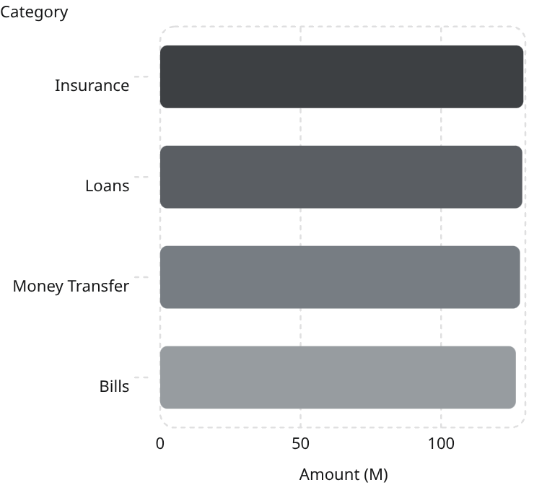
Insurance Dashboard
₹512.9M
All four service categories contribute near-equally to total platform volume, underscoring PhonePe's balanced multi-vertical revenue model. Insurance leads marginally at ₹129.3M.
Service Category Contribution (₹M)
Total Premium Collected
Jan–Dec 2024, all insurance types
96.75%
Success Rate
47.80K successful · 2.12K failed transactions

Slide 6
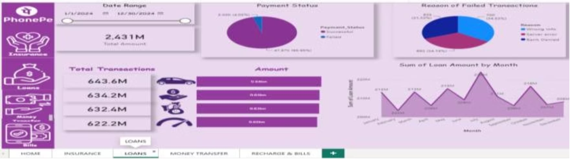

Loans Dashboard
Loan Types Tracked
Key Findings
Gold Loan
Mutual Fund
~₹1.03M/month baseline
Highest individual transaction amounts
High-value transactions alongside Gold
Consistent loan disbursement throughout the year — minimal seasonal variance except November.
Auto Loan
Credit Score
Unique disbursement patterns
Usage-linked loan eligibility tracking
₹2.03M spike — November 2024
Likely driven by festive season lending demand; 2× the monthly baseline, warrants infrastructure pre-planning.
DAX Measures Applied
Total Loan Amount
Success Rate %
Monthly Loan Trend
Failure Count by Reason
Primary failure: Payment Info errors
Data entry or validation failures at submission — a UX/form-validation improvement opportunity.

Slide 7
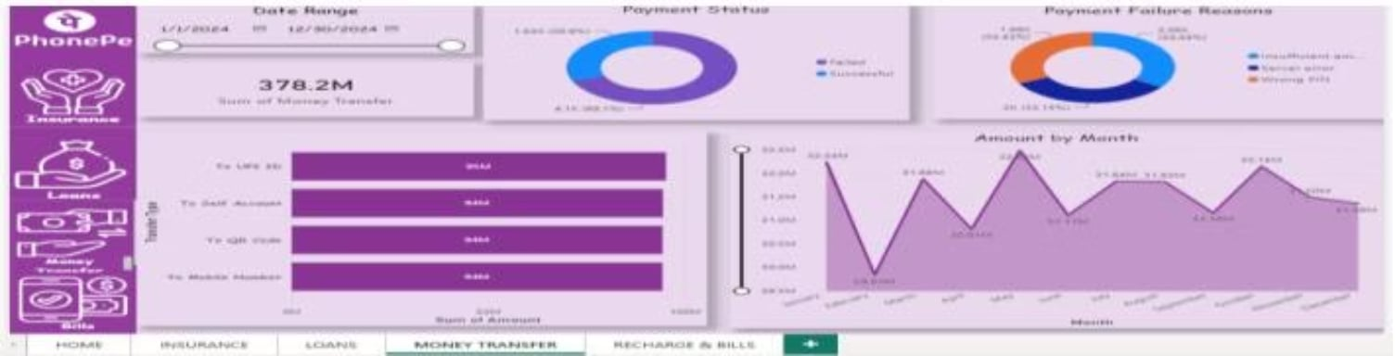





Money Transfer Dashboard
₹378.2M
~₹30M
Total Transfer Volume
Per-Method Contribution
All methods combined, Jan–Dec 2024
UPI ID · Bank Account · QR Code · Mobile Number — near-equal split
100%
₹2.03M
Failure Cause
November Peak
Insufficient Amount accounts for all failed transfers
Consistent with platform-wide seasonality; baseline ~₹1.03M/month
Transfer Methods
Visualization Approach
To QR Code
To Bank Account
Line chart for monthly trends
~₹30M — contactless merchant payments
~₹30M — IMPS/NEFT equivalent transfers
Visualizes the baseline-to-November spike pattern across the full year.
To UPI ID
To Mobile Number
Bar chart for method comparison
~₹30M — P2P UPI address transfers
~₹30M — phone-linked instant transfers
Highlights the equal contribution across all four transfer channels.
Slicers for date range filtering
Enables drill-down by month, quarter, or custom range for ad hoc analysis.

Slide 8
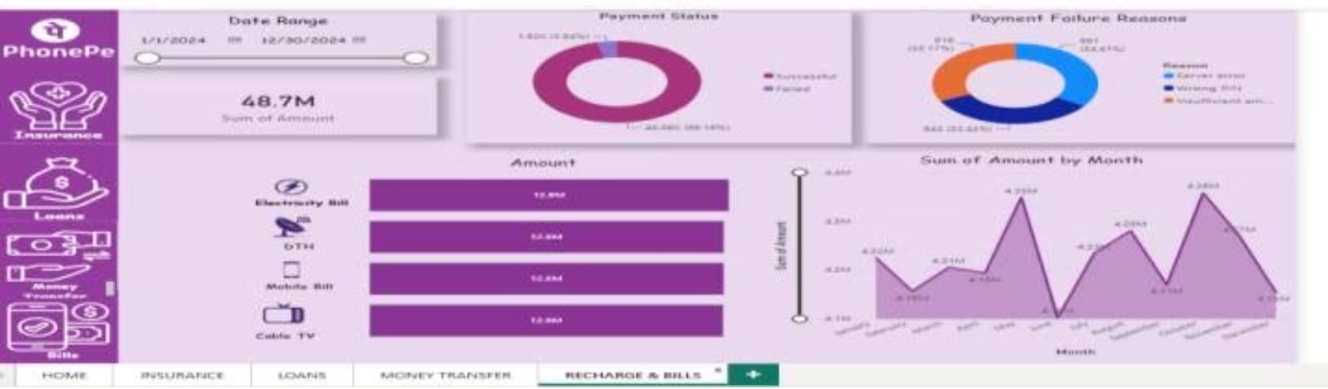
Recharge & Bills Dashboard
₹48.7M
Bill Categories & Patterns
Electricity Bill
DTH
Total Processed
~₹10M · Highest frequency, predictable monthly cadence
~₹10M · Subscription renewals driving consistent volume
All bill categories, Jan–Dec 2024
~₹10M
Mobile Bill
Cable TV
~₹10M · Postpaid recharges and plan renewals
~₹10M · Steady despite OTT competition
Per-Category Split
Electricity · DTH · Mobile · Cable TV — near-equal distribution
Failure Pattern
Key Business Insight
Insufficient Amount accounts for 100% of failed bill payments — mirroring Money Transfer failures and reinforcing the case for platform-wide pre-transaction balance validation.
Monthly baseline: ~₹1.03M/month with a November peak of ₹2.03M. No major seasonal spikes unlike Loans or Insurance.
Uniform distribution across bill types signals broad user adoption with no single utility dominating — indicative of a mature recurring-payment user base. The consistent low failure rate further confirms reliable payment infrastructure for everyday utility transactions.

Slide 9

Key Insights & Recommendations
Platform Diagnostics
Actionable Fixes
96.75%+ Success Rate
01
Platform reliability is strong. The 3.25% failure rate is concentrated in three fixable root causes: Wrong PIN, Wrong Info, and Server Errors — none structural.
Improve server uptime at peak hours
Server Error causes 25.70% of all failures platform-wide and 33.60% in Insurance — direct uptime investment yields outsized reliability gains.
Loans Drive Highest Value
02
Loan services contribute the highest transaction amounts across all verticals — a key revenue segment to protect and scale with targeted reliability investments.
Add pre-transaction balance validation
Insufficient Amount drives 100% of Money Transfer and Bills failures — a single validation layer eliminates this category entirely.
Seasonal Peaks: July & November
03
Both months consistently record 2× baseline transaction volume. Infrastructure scaling should be planned ahead of these windows to avoid Server Error spikes.
Strengthen PIN/info validation UX
Wrong PIN (27.52%) and Wrong Info (27.61%) together account for over 55% of failures — better inline UX prompts reduce these at no infrastructure cost.
04
Optimize banking integrations
Bank Denied failures (5.83%) require deeper integration-layer debugging with partner banks for smoother resolution pathways.
Skills Demonstrated
EXCEL
POWER BI
POWER QUERY
DAX
DATA CLEANING
KPI REPORTING
DASHBOARD DESIGN
BUSINESS ANALYTICS

Slide 10
Sources
Project Report
PhonePe_Project_Report.pdf

