Slide 1
Project Presentation
Machine Learning Model for Course / University Recommendation
Presented By:
Aryan Karki
Presented To:
Uhdam.com Group

Slide 2
Introduction
Objective: Develop a course recommender system based on student preferences.
Dataset: University information and eligibility criterion of 50 Australian Universities.
Importance: Enhance student experiences and facilitate informed decision-making.

Slide 3
Overview
Dataset Exploration and Analysis
Data Preprocessing and Feature Engineering
Model Selection
Model Building
Model Evaluation
User Interface Integration

Slide 4
Key Insights
Data Preprocessing: Addressed missing values and inconsistencies in the dataset. ( handled different cases)
Model Selection: Chose matrix factorization with TruncatedSVD (Singular Value Decomposition).
Why? Accommodates mixed data types, provides latent factors for recommendation (reduced dimensionality), computational efficiency.
User Interface: Implemented a user-friendly interface for easy interaction. (with streamlit library)

Slide 5
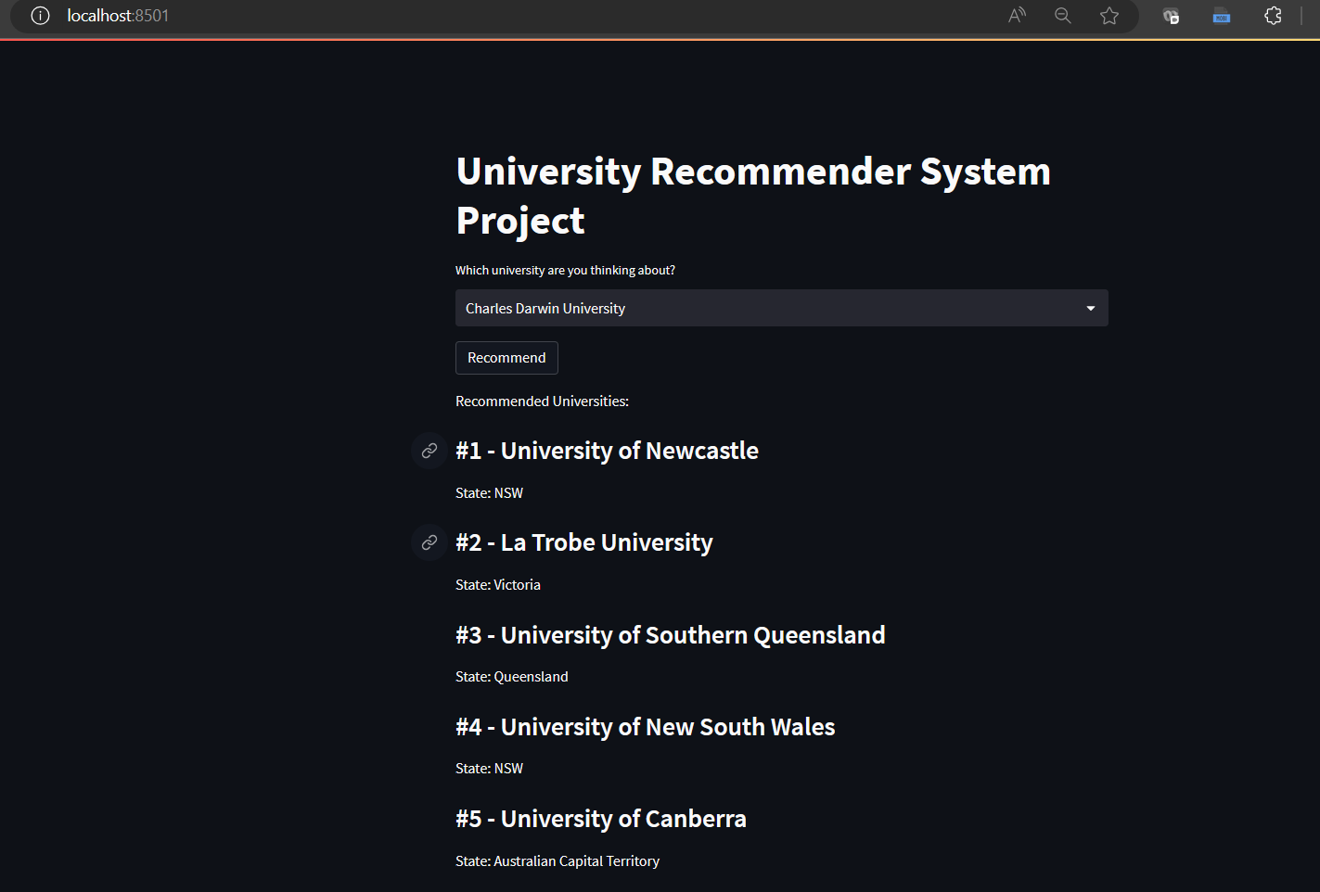

Slide 6
Challenges Faced
Data Quality: Inconsistent and incomplete data requiring heavy preprocessing required.
No labeled data: lack of labeled data, user feedback data or ground truth data made evaluation of model very difficult.
Interpretability: Strived to provide transparent and explainable recommendations within the given data parameters.

Slide 7
Additional Improvements & Extensions
Additional Features: Student demographics, Academic Performance, Course Prerequisites and/or Student Reviews.
Hybrid Recommender Systems: collaborative filtering and content-based filtering, leading to more accurate and diverse recommendations.
User Feedback: Incorporating user feedback greatly enhances the recommendation system.
Contextual Recommendations: Time of the year, Current trends in the job market, or personalised career goals can further enhance the relevance and timeliness of the recommendations.

Slide 8
Conclusion
University recommender system developed to empower student choices.
Key insights: Effective data preprocessing, matrix factorization using TruncatedSVD.
Challenges faced: Limited labeled data (evaluation of model difficult) , data quality, and interpretability.
Future improvements: Additional features, user feedback, and hybrid techniques.

Slide 9
THANK YOU!!!

