Slide 1


Self-Care Application
SHRI RAMDEOBABA COLLEGE OF ENGINEERING AND MANAGEMENT, NAGPUR
Department of Information Technology
Sem -VII (2022-23)
Project Seminar on -
by
Anshul Sharma (30)
Aryan Khandelwal (34)
Raunak Gandhi (51)
Under the guidance of
Prof. Ashish Chandak
IT Department, RCOEM, Nagpur

Slide 2
Contents
Problem Definition
Introduction
Methodology
Application Advantages
Timeline
Current Status
References

Slide 3
Problem Definition
A utility application that provides the user with various resources related to self-care domain and signifies the importance of self-care which helps an individual to live well and improve the quality of life.

Slide 4
Introduction
Self-care is intending, planning and actually taking the time to attend to your basic physical, mental and emotional needs – and making sure you get it. It is the conscious rest which helps you recharge your batteries. It is not inherently indulgent or selfish, it is necessary.
As adults, we are solely responsible for managing our own health, emotions, and personal growth. Self-care is the set of practices that allow us to accomplish this. The first step in quality self-care is to learn what it is and understand its importance.

Slide 5
Introduction (contd.)
Self-care should not be viewed as something you only do if you have time. Neither is self-care something that should only be a reward that can be gained once other tasks are completed.
Self-care, if practiced appropriately, needs to be an integral part of your daily life. Fortifying your emotional, physical, and spiritual health through self-care is the foundation for your overall health and well-being.

Slide 6
Methodology
Database Type Selection
(NoSQL-MongoDB)
Creating Cluster to host the database
Finalising the Database Schema
Designing of Collections data format
Application Development using Flutter
Finding and updating of resource records into database
Defining the deliverables for the application
Feedback and Suggestions from a professional

Slide 7
Application Advantages
This application will provide users all the required information in one place.
The application will only consist of the data which is fully authenticated and highly rated and has already been used by users.
It will help the users to understand the need of self-care.
This will make users aware of the importance of self-care & why one need to take care of themselves.

Slide 8
Timeline
Project modules to be completed in VII Sem -
Designing the Database (1 wk)
Refining deliverables (- wk)
Updating the Database documents (- wk)
Development of a cross platform application using flutter (9 wk)
Integration of modules (4 wk)
Deployment of application (1 wk)

Slide 9
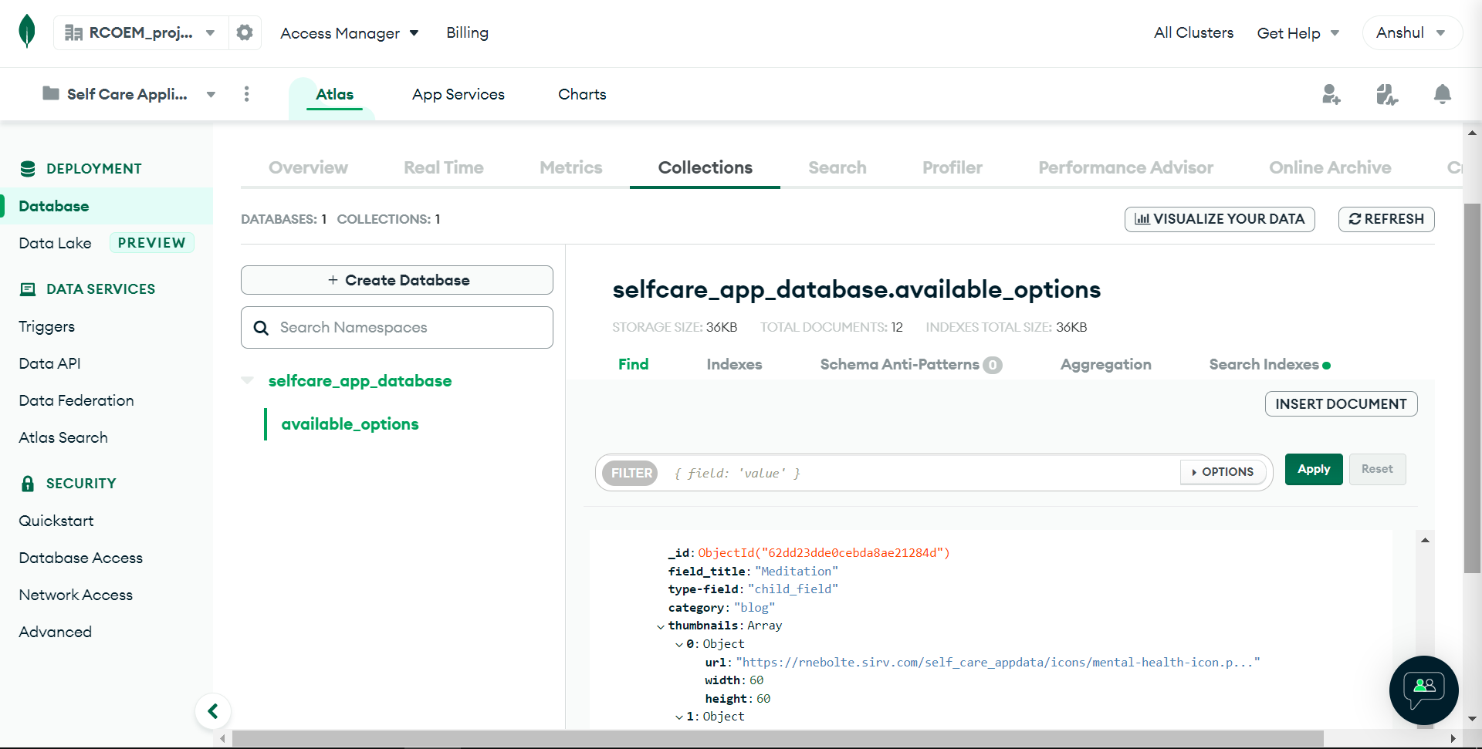
Current Status (contd.)
MongoDB cluster hosting the database

Slide 10
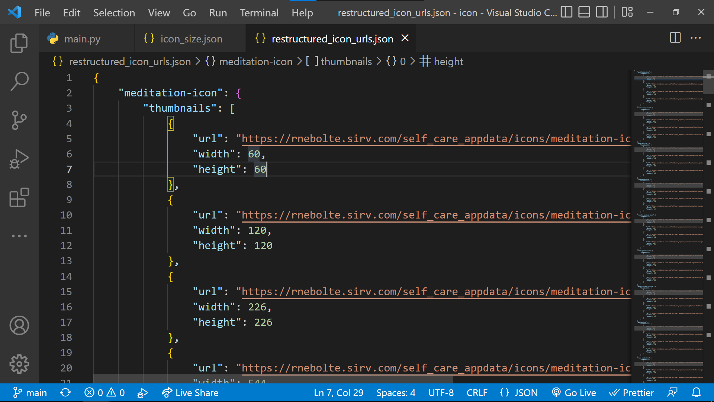
Current Status (contd.)
URL of Resized dimensions

Slide 11
References
Site References
https://www.sih.gov.in/sih2022PS
https://www.mongodb.com/docs/
https://coachcampus.com/coach-portfolios/research-papers/sandra-dangelo-the-importance-of-self-care/
https://psychcentral.com/blog/what-self-care-is-and-what-it-isnt

Slide 12
Thank You!

