Slide 1
SMART INDIA HACKATHON 2026 * NATIONAL SCREENING STAGE
DrishtiCare
Quality-aware, explainable diabetic-retinopathy screening for rural healthcare workflows - built in MATLAB and Simulink.
Problem statement
Sponsor
Team
SIH Team ID
SIH 26038
MathWorks
6 members + mentors
________________
ENGINEERING PROTOTYPE - NOT A CLINICAL DEVICE. No clinical validation has been performed. Grades, Grad-CAM overlays, OOD flags and lesion candidate counts are engineering demonstrations and must not be used for diagnosis, treatment or triage decisions.

Slide 2
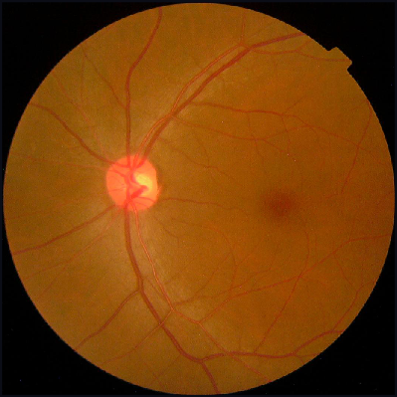
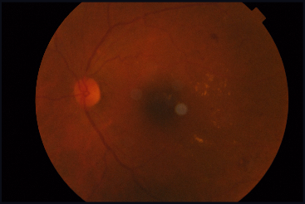
THE PROBLEM, AND WHAT WE ACTUALLY BUILT
Diabetic retinopathy is found late, because screening capacity is the constraint
Where the load actually falls
At the planning assumption of 100,000 patients a year, our own measured operating point generates 153.6 specialist referrals per working day - 38,406 a year.
So the useful question is not "can a CNN grade a retina". It is what does the system do with an image it should not answer?
General ophthalmology is not the binding constraint. For vitreoretinal grading it is retina specialists, at roughly one per 1.26 million population.
Our answer: a screening workflow whose quality gate runs before the model. A poor or unfamiliar image is withheld for recapture rather than graded. That refusal behaviour - not the classifier - is the product.
Both images are real fundus photographs from the locked APTOS validation split, captured by the running application (results/visual_qa/).
Referral demand: data/analysis/simulink_resource_simulation/scenario_results.csv, row D100. Workforce constraint: Vashist et al. 2021, citing WHO 2020. Full citations on the impact slide.
Graded
Withheld
Quality PASS. The image proceeds to grading, referral routing and evidence.
Quality FAIL. The classifier is never invoked, no grade is produced, and the case is routed to recapture or manual review.
Engineering prototype. Not a clinical device. No clinical validation performed. Not for diagnosis or treatment decisions.
2

Slide 3
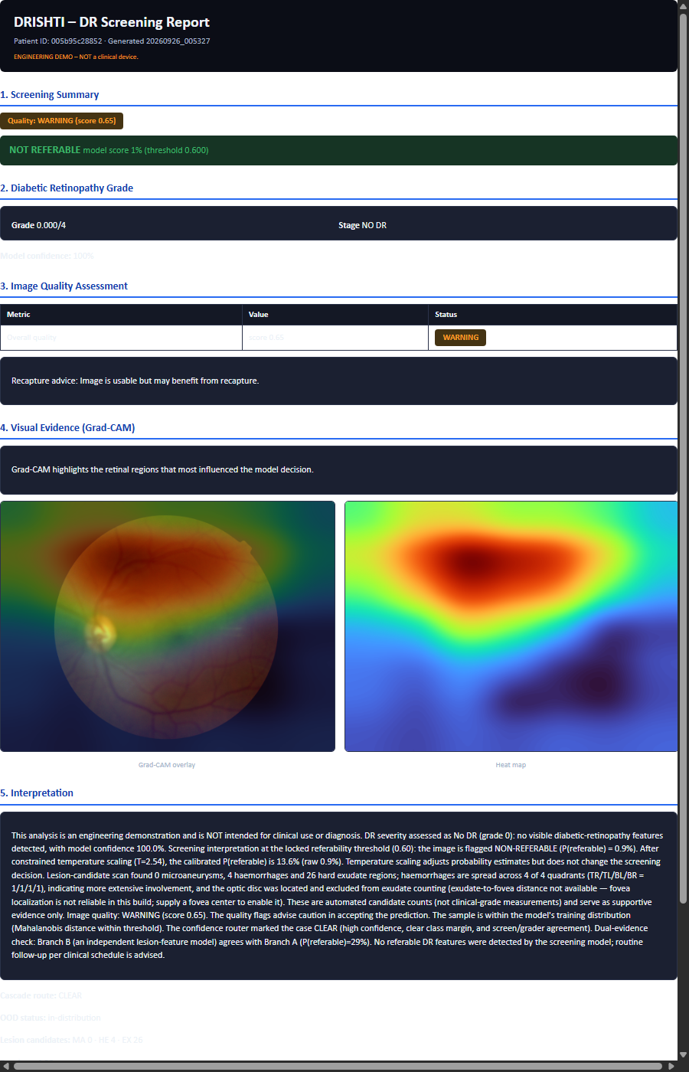
THE WORKFLOW
The quality gate runs before the AI, not after it
This ordering is the whole design. A screening system that grades every image it is handed has no way to say “I don't know”.
IMAGE
>
QUALITY
>
AI
>
REFERRAL
>
EVIDENCE
>
HUMAN
fundus photograph
focus * brightness * foreground fraction
5-class grade + referable score
referable rule locked at 0.60
model attention * lesion candidates
specialist review
WITHHELD AI never executed * grade stays NaN. RECAPTURE / MANUAL are the only safe outcomes for a FAIL image.
Quality FAIL is a hard gate, not a display setting.
Referral is a locked rule.
Uncertainty is routed, not averaged away.
The classifier is never invoked, no Grad-CAM is computed, and the output carries an explicit withheld state rather than a silent blank.
Referable is P(referable) >= 0.60. The threshold is provenance-pinned and was not retuned.
The cascade router sends borderline cases to REVIEW and the least confident to ABSTAIN.
The branded A4 report is a real artifact written to disk from the same result struct that drives the screen - seven sections including the non-clinical disclaimer.
In the shipped path the model input is the raw resized image. Enhancement is a display aid only, because the A/B experiment showed enhancement measurably hurt grading (docs/task-tracker.md Task 9B).
Engineering prototype. Not a clinical device. No clinical validation performed. Not for diagnosis or treatment decisions.
3

Slide 4
FEASIBILITY
What is built and measured, and what is not
Built: running, measured, verified. Planned / blocked: named blocker, named owner - not hidden, not silently dropped.
BUILT
PLANNED / BLOCKED
Hardening programme P0-P25
External validation - BLOCKED, not performed.
230/230 checks PASS
Messidor-2 needs ADCIS registration; Sin-NP DR 2019 needs a data request. Owner: team, on dataset licensing. Harness written, 6/6.
Image quality gate
3,662 images: PASS 65.48% / WARNING 26.68% / FAIL 7.84%
Minority-recall experiments - deliberately switched off.
5-class DR grader
Target-boosted weighting and targeted augmentation on Severe and Proliferative are disabled in the training script by operator decision. Owner: mentor approval.
ResNet-18, EyePACS-pretrained. QWK 0.8914 on the locked 733-image split
Binary referable classifier
Grad-CAM localisation agreement - measured, and weak.
sensitivity 0.9060 / specificity 0.9471 at the locked 0.60 threshold
Saliency-in-lesion 3.1%, pointing game 7.4%, mean IoU 0.035. MACE not measured. We did not retrain to chase a better number.
OOD advisory detector
Mahalanobis, locked p99 34.22. Surfaces in the narrative; never alters a route
Cascade router
Fovea localisation - failed.
CLEAR 648 / REVIEW 75 / ABSTAIN 10
0 of 10 held-out images within 300 px. The pipeline therefore emits no fovea-derived distance. Revisit if fovea-labelled data appears.
Temperature calibration
T = 2.5382, display-only
Image enhancement - excluded on evidence.
Grad-CAM, lesion evidence, Branch B
The A/B experiment showed it degraded grading, so the deployed path feeds the model the raw resized image.
running, weaknesses documented
Dashboard and branded A4 report
Vessel segmentation in production - excluded on evidence.
headless verification 35/35 PASS; report verification PASS
Adding vessel features reduced Branch-B AUC from 0.8969 to 0.8810, so the branch ships without them. Negative result kept in the record.
Simulink district model
a genuine .slx reproducing its reference engine over 250 days; 11/11 checks PASS
Unseen-input rehearsal harness
19 foreign-camera images, 4/4 contract checks PASS
Engineering prototype. Not a clinical device. No clinical validation performed. Not for diagnosis or treatment decisions.
4

Slide 5
MEASURED PERFORMANCE
Locked 733-image validation split, seed 42
Every figure below is frozen under a written contract: no retuning of the threshold or the calibration temperature, and no use of the sealed official test set.
0.8281
0.6805
0.8914
0.9060
0.9471
0.9796
0.7821
Accuracy
Macro F1
Quadratic weighted kappa
Sensitivity, referable DR
Specificity, referable DR
ROC-AUC
PR-AUC
0.60
2.5382
733
Referral threshold - locked, provenance-pinned
Calibration temperature - display-only
Validation images (2,929 train, seed 42)
PER-CLASS RECALL - WHERE THE WEAKNESS IS
0.9834
0.6081
0.7850
0.4872
0.5254
No DR
Mild NPDR
Moderate NPDR
Severe NPDR - weak, main 5-class weakness
Proliferative DR - weak, experiments off
OPERATIONAL BEHAVIOUR, MEASURED
65.48 / 26.68 / 7.84 %
648 / 75 / 10
34.22
0.1028 s/img
11.03 s/img
Quality gate, n = 3,662
CLEAR / REVIEW / ABSTAIN
OOD bound (locked p99)
Model-only inference
Full demo path, median
Verdict on APTOS validation: internal, single-dataset.
The two latency figures are deliberately not conflated: 0.1028 s/img is model screening only, 11.03 s/img is the complete demo path. High-resolution fundus photographs are slower again - a judge supplying a full-resolution image should expect roughly 30-45 s.
Engineering prototype. APTOS-internal held-out validation only; external validation is not performed. Not a clinical device, not for diagnosis or treatment decisions.
5

Slide 6
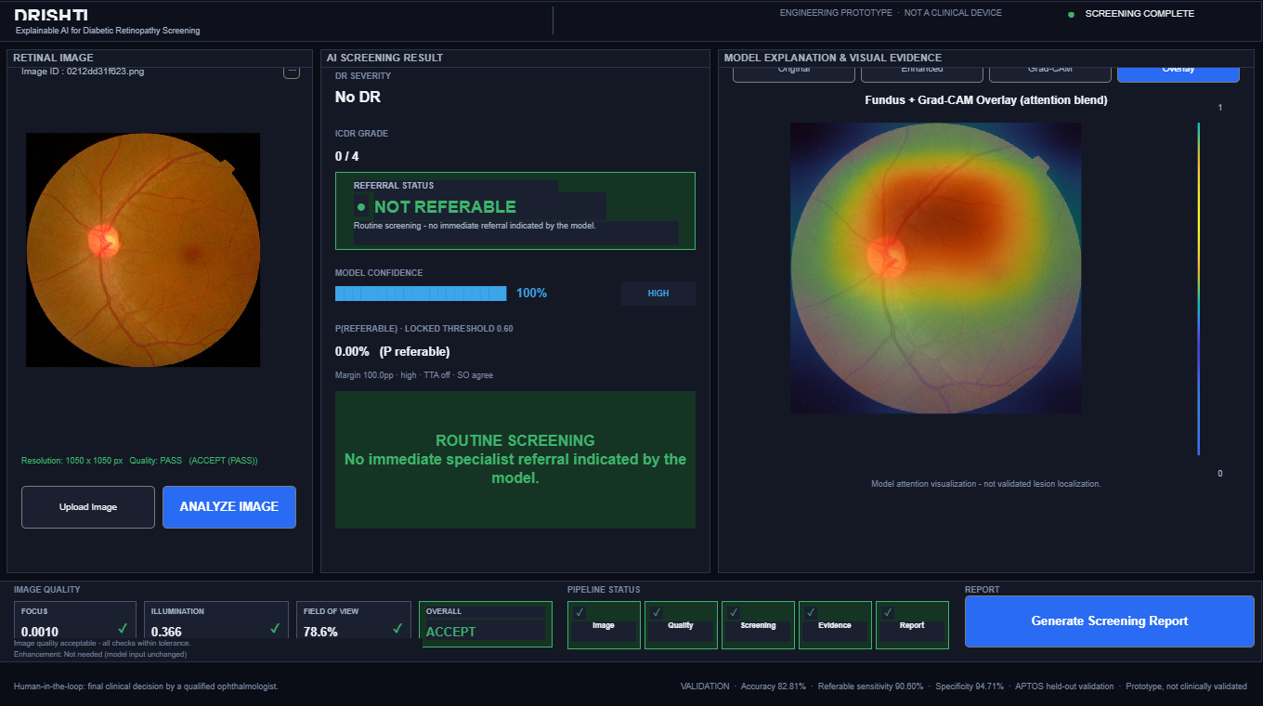
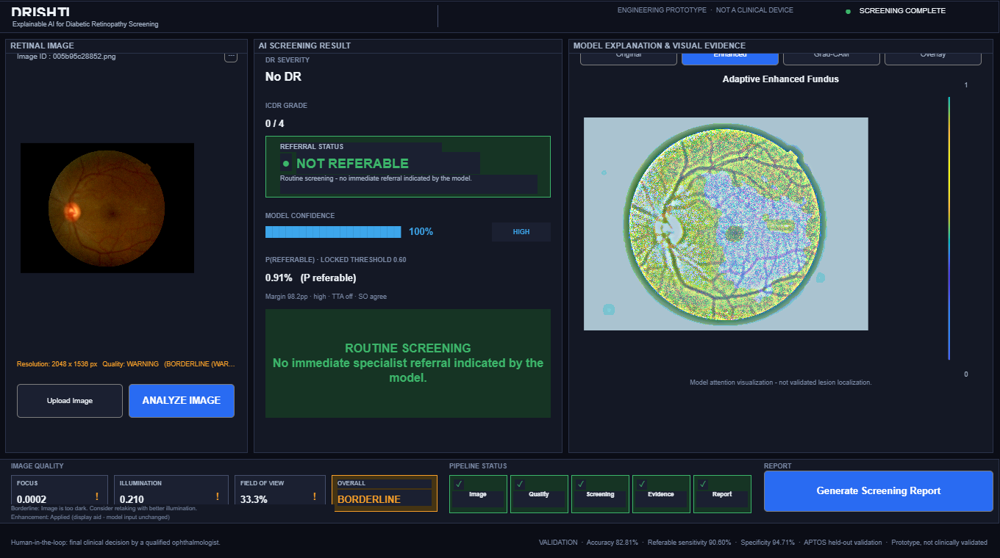
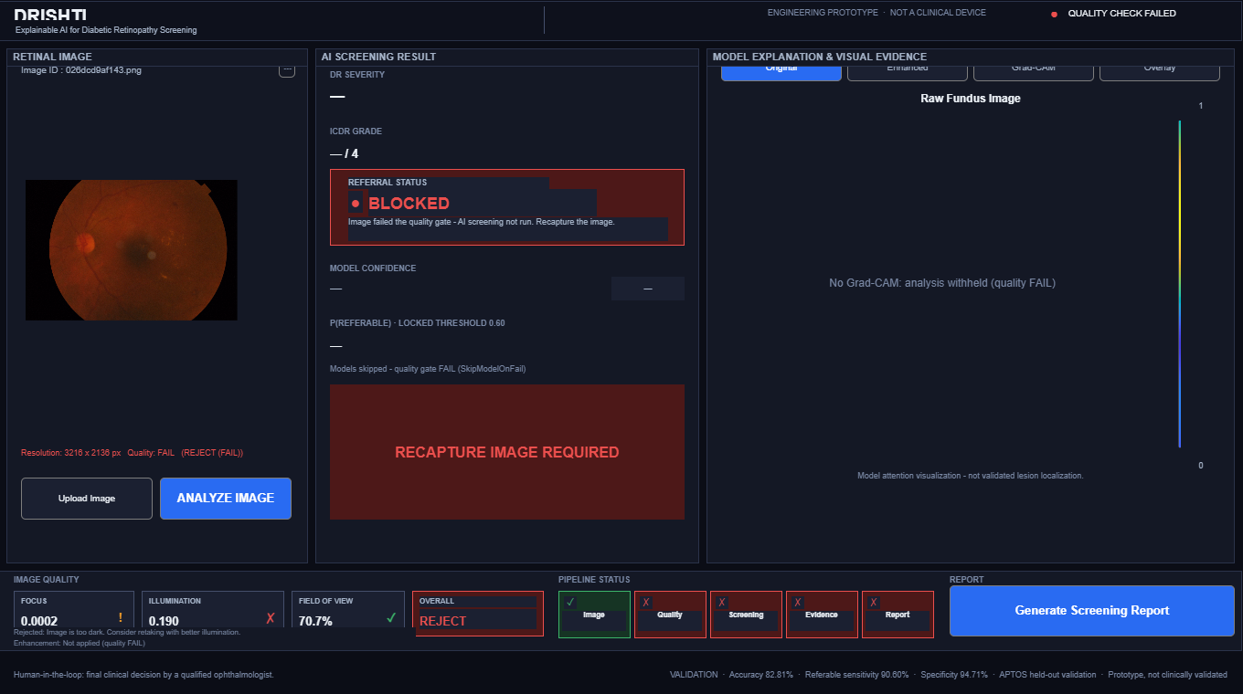
THE DIFFERENTIATOR
It refuses. We tested that on images it had never seen
Every automated check in this project had run on the same split the champions were selected on. We then ran the full pipeline end to end on 19 unseen fundus images from three foreign cameras - DRIVE test, the IDRiD B testing set, and real-world web fundus from DRIMDB. Nothing was retrained or tuned, the 0.60 rule was untouched, and the model hashes are unchanged.
19 / 19
4 / 4
8
42%
completed. No crash, no unhandled exception.
contract checks PASS: valid route band, quality FAIL never auto-answered, locked 0.60 rule still holds.
quality FAIL images - every one withheld before any model execution.
of unseen images withheld, against 7.84% FAIL on APTOS. The gate over-rejects foreign cameras.
The safety contract is not an APTOS artefact.
PASS
Every quality FAIL was withheld before the model ran, and the locked decision rule was reproduced on every image that did reach the classifier.
graded and routed, with confidence and evidence.
The OOD detector genuinely fires out of distribution.
WARNING
It flagged unseen images above its locked 34.22 bound. It remains advisory only and altered no route in this run.
proceeds, but flagged as borderline.
Over-refusal is the safe direction to fail.
FAIL
A withheld image is never auto-answered. Expect “AI grading skipped, please recapture” - that is the designed behaviour.
AI grading skipped; the model is never called.
The honest negative finding.
One DRIMDB image the dataset itself labels as ungradable passed the quality gate and came back a confident referable grade, routed CLEAR, with its OOD distance just under the bound. Neither gate caught it, and we are not tuning it away - the threshold and the OOD bound are provenance-pinned.
Engineering prototype. Not a clinical device. No clinical validation performed. Not for diagnosis or treatment decisions.
6

Slide 7
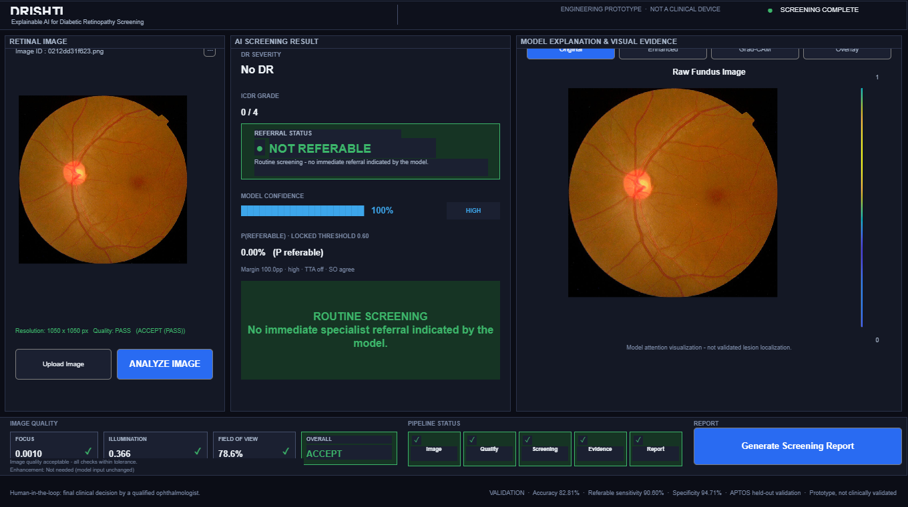
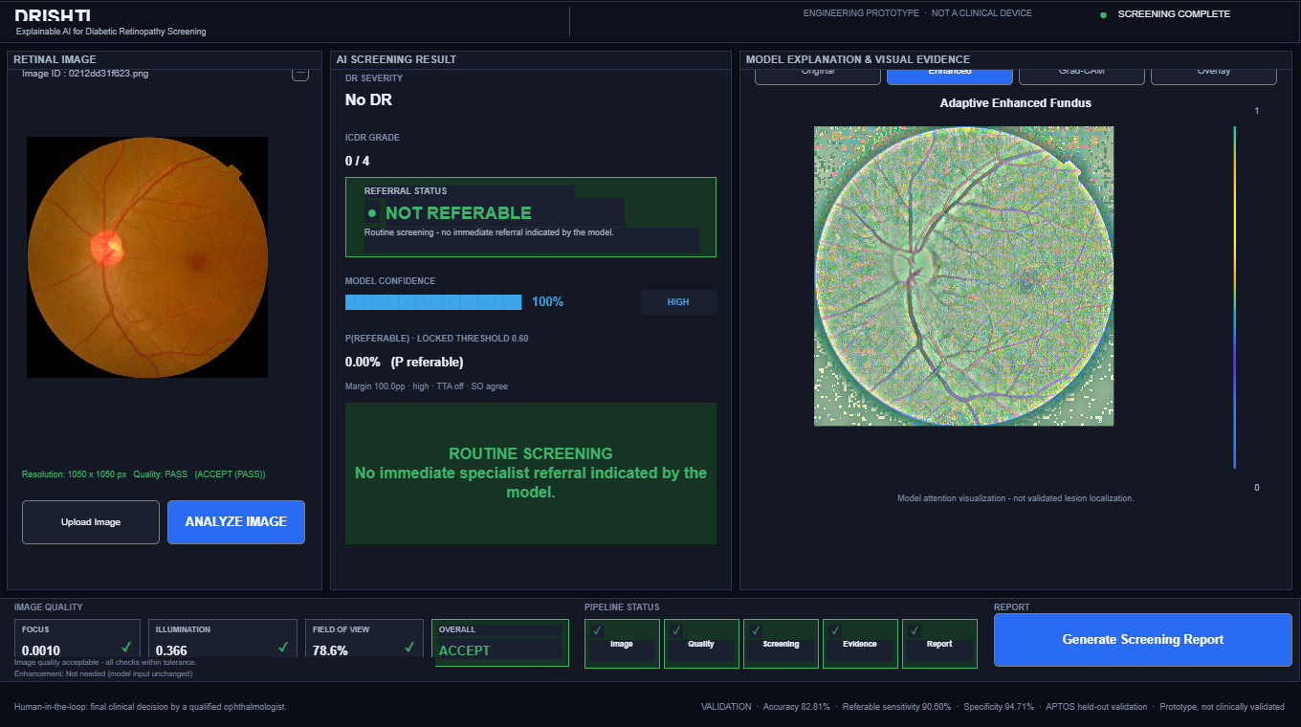
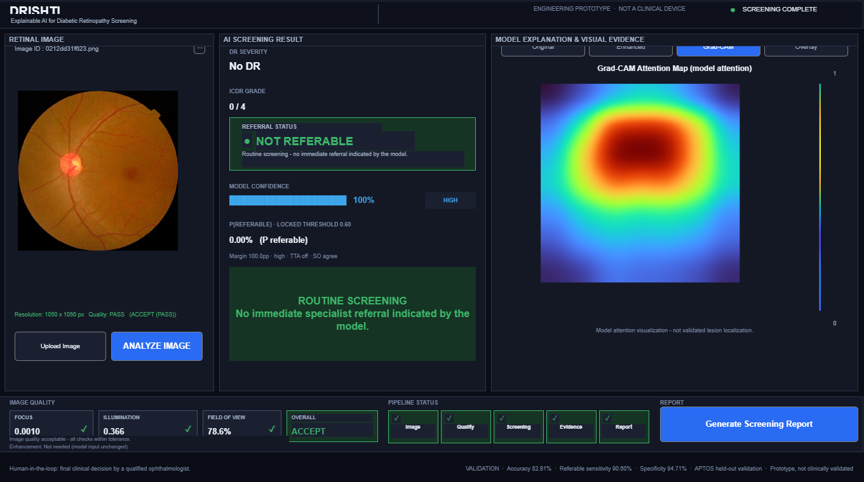
EXPLAINABILITY
Grad-CAM shows model attention. It is not lesion localisation.
Four views of one real case from the running application. The heat-map is a statement about where the model looked, not about where a lesion is - and we measured how far apart those two things are.
Original
Enhanced
Grad-CAM
Overlay
the model input, unchanged.
display aid only. Not the model input.
regions that most influenced the decision.
for the reviewer's eye, not a finding.
WE MEASURED OUR OWN EXPLAINABILITY AGAINST IDRID LESION MASKS
3.1%
7.4%
0.035
n/m
saliency mass inside a lesion mask
pointing-game accuracy
mean IoU, top-20% pixels
MACE - not measured
Against an areal chance baseline of 0.0220, that is about 1.39x chance. The alignment is weak, and we did not retrain the model to improve a visualisation metric. We publish the number because a screening prototype that overstates its own evidence is not deployable.
Say “model attention”, not “lesion localisation”.
The second claim is not supported by our own measurement and we do not make it.
Lesion counts are candidates, not findings.
The microaneurysm detector has patch AUC 0.976 but detection recall of only 0.113, and the classical detectors over-fire on unfamiliar images.
Calibration is presentation-only.
T = 2.5382 makes the displayed confidence usable; it is not evidence of external generalisation.
Engineering prototype. Grad-CAM is model attention, not lesion localisation. Not a clinical device; not for diagnosis or treatment decisions.
7

Slide 8
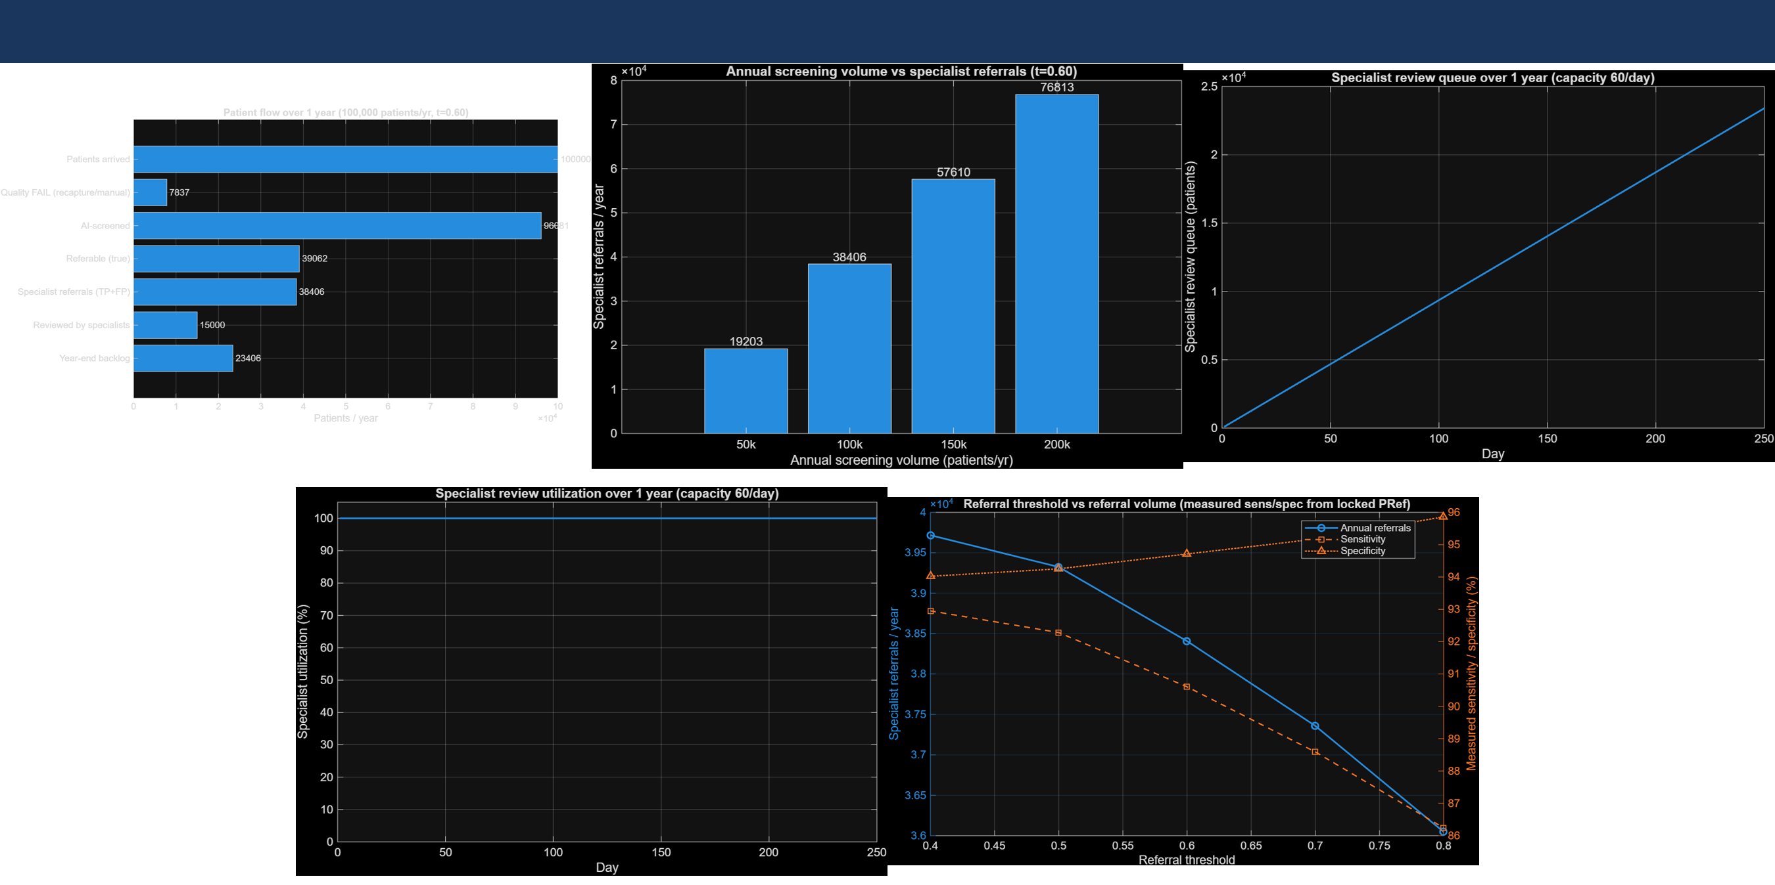
DISTRICT-SCALE SIMULATION
The bottleneck the model exposes is specialist review, not AI processing
Five panels from one simulation: patient flow, referral demand, queue growth over the year, utilisation against the capacity scenarios, and workload by referral threshold.
96,081
38,406
39.97%
153.6
7.68
Images reaching AI screening
Referrals generated
of screened never consume specialist time - 60.03%
Referrals per working day
Specialists implied, 20 exams/reviewer/day
Engineering resource-planning simulation. Not clinical validation and not a staffing prescription.
The measured input is our locked-split operating point (sensitivity 0.9060, specificity 0.9471 at threshold 0.60). Patient volume, prevalence, specialist capacity and the recapture rate are labelled assumptions, not measurements. The .slx reproduces its reference engine exactly over 250 days; 11/11 sanity checks pass.
THE BREAK POINT
At 60 reviews/day the year ends at a 23,406 backlog. At 120/day, still 8,406. Only at ~180 reviews per day does the queue clear, at 85.3% utilisation. A second, independent discrete-event simulation reaches the same conclusion.
Engineering prototype. Simulation outputs are not clinical or operational claims. Not a clinical device; not for diagnosis or treatment decisions.
8

Slide 9
IMPACT
Three national statistics, each carrying its source and its year
We verified every figure we quote. Where our own earlier draft did not survive verification, we say so on the slide rather than quietly swapping it.
74.2 million
Indian adults aged 20-79 with diabetes, 2021. India's own ICMR-INDIAB-17 national survey puts the same year nearer 101 million - the two use different methods and are not interchangeable, so we name the body.
IDF Diabetes Atlas, 10th ed. 2021 - Sun H. et al., Diabetes Res Clin Pract 2021;183:109119, doi:10.1016/j.diabres.2021.109119. ICMR-INDIAB-17 - Anjana R.M. et al., Lancet Diabetes Endocrinol 2023, doi:10.1016/S2213-8587(23)00119-5. Superseded: the widely quoted 77 million figure is the IDF 2019 estimate (9th ed.) and has been revised twice since. Do not present it as current.
16.9% - 18.1%
Roughly 1 in 6 to 1 in 5 Indians with diabetes aged 50 and over have diabetic retinopathy. We give the range because two national-survey-grade sources disagree, and the honest reading is a band rather than a decimal.
18.1% (95% CI 14.8-21.4), age 50 - Jotheeswaran A.T. et al., Indian J Endocrinol Metab 2016;20(Suppl 1):S51-S58, doi:10.4103/2230-8210.179774. 16.9% (95% CI 15.9-17.9) - MoHFW/NPCB National Survey 2015-19, Vashist P. et al., Indian J Ophthalmol 2021, doi:10.4103/ijo.IJO_1310_21. Not defensible for all adults: the same meta-analysis gives 14.9% for age 30, and the authors themselves flag their own denominator as weak.
1 : 65,221
Indian ophthalmologists per person, about 15 per million, nationally. The binding constraint for automated vitreoretinal grading is roughly 19x worse: about one retina specialist per 1.26 million people.
Vashist P. et al., Human resources and infrastructure for ophthalmic services in India, Indian J Ophthalmol 2025;73(11):1679-1686, doi:10.4103/IJO.IJO_2816_24; data collected 2020-21, 20,944 ophthalmologists. Retina specialist density: WHO 2020, cited in Vashist et al. 2021. Verification note: a lower rural scarcity figure in our own earlier draft did not survive checking - it traces to a Vision 2020 planning target for Asia, not an Indian count.
MEASURED BY US
733
3,662
19
250-day
230/230
held-out images, locked validation
images in the quality audit
unseen rehearsal images, 3 cameras
district simulation horizon
hardening programme checks PASS
Engineering prototype. Not a clinical device. No clinical validation performed. Not for diagnosis or treatment decisions.
9

Slide 10
LIMITATIONS
What this system cannot do yet
These are on the slide, not in the appendix. A prototype that hides its measured negatives is not safe to hand to a screening programme.
Item
What we measured
Status
Blocker or owner
External validation
Not performed. The reported 0.9060 / 0.9471 / 0.9796 / 0.7821 are APTOS-internal, on a single dataset.
BLOCKED
Messidor-2 (ADCIS registration) and Sin-NP DR 2019 (data request) both need a human download. Harness written, 6/6 checks pass.
Grad-CAM vs lesion masks
Saliency-in-lesion 3.1%, pointing game 7.4%, mean IoU 0.035, about 1.39x areal chance.
MEASURED WEAK
MACE not measured. We did not retrain to improve a visualisation metric.
Confident grade on an ungradable image
One DRIMDB image the dataset labels Bad passed the quality gate and came back referable, routed CLEAR. Neither gate caught it.
OPEN
Recorded, not tuned away - the threshold and OOD bound are provenance-pinned.
Fovea localisation
0 of 10 held-out images within 300 px of ground truth.
FAILED
No fovea-derived distance is emitted; the field stays unavailable with an explicit narrative line.
Severe / Proliferative recall
0.4872 and 0.5254 - the main 5-class weakness.
OFF BY DECISION
Target-boosted weighting and targeted augmentation are disabled in the training script. Owner: mentor approval.
Microaneurysm detection
Patch AUC 0.976, but detection recall only 0.113 at the evaluated threshold.
LOW RECALL
Counts are reported as candidates, never as findings.
Optic-disc generalisation
Locates 9/10 within 300 px on IDRiD, but only 10.6% acceptance on APTOS validation.
LIMITED
Trained on a different camera set; the honest hardware-threshold refusal works as designed.
Image enhancement
The A/B experiment showed it degraded grading.
EXCLUDED ON EVIDENCE
Excluded from the inference path; retained as a display aid only.
Vessel segmentation
Adding vessel features moved Branch-B AUC from 0.8969 to 0.8810.
EXCLUDED ON EVIDENCE
Measured negative result, kept in the record rather than forced into production.
Engineering prototype. Not a clinical device. No clinical validation performed. Not for diagnosis or treatment decisions.
10

Slide 11
TEAM, RESOURCES AND REFERENCES
Everything here is reproducible from a public repository
Entry
Problem statement SIH 26038 * sponsor MathWorks
DATASETS, STATED PLAINLY
Team
6 members + mentors * SIH Team ID __________
APTOS 2019
grading data. Used.
Repository
github.com/Aryan41211/DrishtiCare
IDRiD
lesion and optic-disc ground truth. Used for evaluation, not for classifier selection.
DRIVE
vessel study. Used.
Stack
MATLAB and Simulink; ResNet-18 transfer learning, EyePACS-pretrained, class-balanced
DRIMDB
downloaded and licence-cleared, used only in the unseen-input rehearsal. Not used in any reported result.
Launch
launchRetinaAI.m from the repository root
Messidor-2, Sin-NP DR 2019
not obtained. External validation remains blocked.
Governance
frozen model contract with SHA-256 hashes, a decision log, and a per-task evidence record
REFERENCES
Vashist P. et al. (2021)
National survey of DR, 21 districts, n = 5,986 examined. Indian J Ophthalmol 69(11):3087-3094. doi:10.4103/ijo.IJO_1310_21
How to read every number in this deck.
Each is traceable to a committed artifact - the frozen contract, the validation reports, the rehearsal record, the simulation CSV, or a cited publication with a DOI. Where a figure was only provisional, we labelled it provisional rather than dropping the caveat. Where our own earlier draft did not survive verification, we left it visible and marked it unsupported. We would rather show a weaker number we can defend than a stronger one we cannot.
Jotheeswaran A.T. et al. (2016)
DR prevalence by age band, systematic review. Indian J Endocrinol Metab 20(Suppl 1):S51-S58. doi:10.4103/2230-8210.179774
Vashist P. et al. (2025)
Ophthalmic workforce and infrastructure, national survey. Indian J Ophthalmol 73(11):1679-1686. doi:10.4103/IJO.IJO_2816_24
Sun H. et al. (2021)
IDF Diabetes Atlas 10th edition, India estimate. Diabetes Res Clin Pract 183:109119. doi:10.1016/j.diabres.2021.109119
Anjana R.M. et al. (2023)
ICMR-INDIAB-17 national diabetes survey. Lancet Diabetes Endocrinol. doi:10.1016/S2213-8587(23)00119-5
Pradeepa R., Mohan V. (2021)
Tabulation of the IDF 2019 India estimate. Indian J Ophthalmol 69(11):2932-2938. doi:10.4103/ijo.IJO_1627_21
DrishtiCare is an engineering prototype for Smart India Hackathon 2026. Not a clinical device. No clinical validation has been performed. Not for diagnosis, treatment or triage decisions.
11

