Slide 1

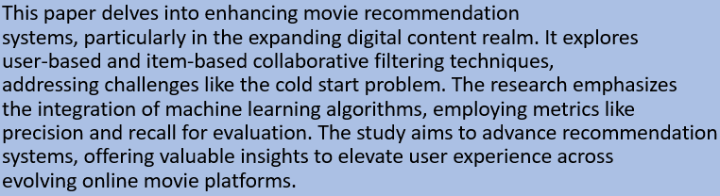


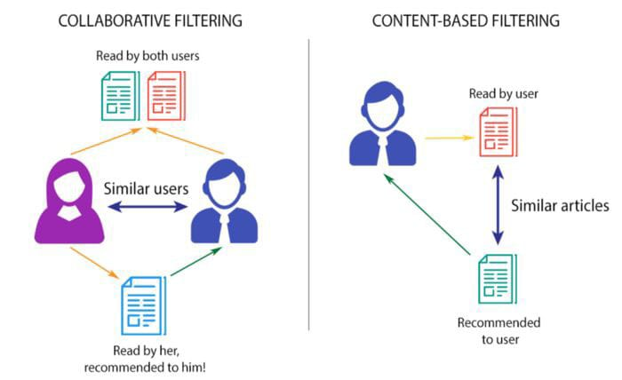
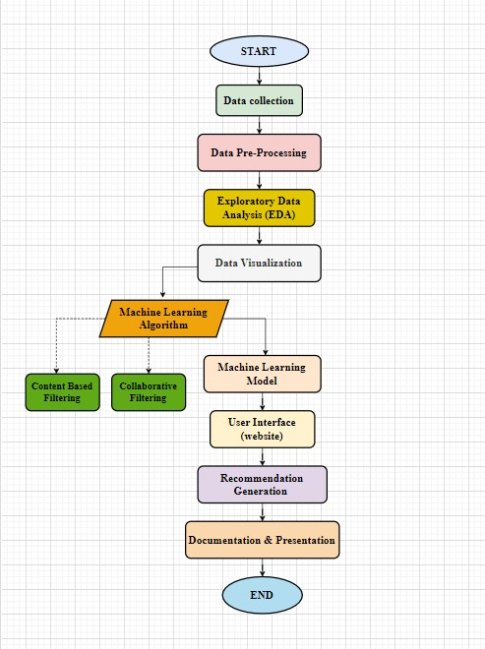
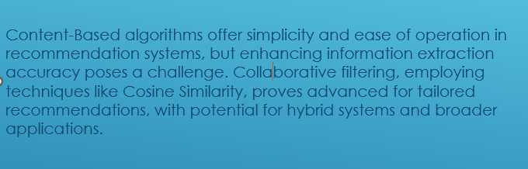
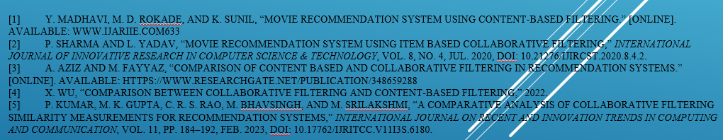


Capstone Project
FilmFinder360:
by
Team No. 08
Shruti Pathak(E23MCAG0033), Aryan Sood(E23MCAG0047),Yatharth Aggarwal(E23MCAG0051), Shreyanshi Mukesh(E23MCAG0014)
Abstract
Introduction
Proposed Method
Conclusions
References
Experimental Results and Discussion
Team No. – 08

