Slide 1
InstaMEDS
​

Slide 2
IDEA DESCRIPTION: InstaMEDS is an innovative healthcare system designed to seamlessly integrate various components, providing a comprehensive solution for both patients and healthcare providers. This holistic platform combines appointment scheduling, machine learning-based disease prediction, medication necessary, and precautions required.

Slide 3

Problem Statement:
Patients currently encounter prolonged wait times and inefficiencies in accessing essential medical services, resulting in substantial resource wastage within the healthcare system. This inefficiency is, posing a significant challenge to timely and adequate healthcare support.

Slide 4

Problems we are addressing :
Instant Diagnose
Patients endure an average wait time of 4 hours for in-person appointments, leading to frustration, discomfort, and compromised overall healthcare experiences. Visualize quality intellectual capital
The healthcare system incurs a staggering annual loss of $150 billion due to missed appointments and inefficiencies in the appointment system, exacerbating financial burdens on both healthcare providers and patients.

Slide 5

Solution Overview :
InstaMEDS addresses these challenges by offering a multifaceted solution. The machine learning-based disease predictor enhances early detection and intervention, leading to better patient outcomes and reduced healthcare costs.

Slide 6




Tech Stack
ReactJS
Flask
Tailwind CSS
Python
Scikit-Learn
Disseminate standardized metrics

Slide 7
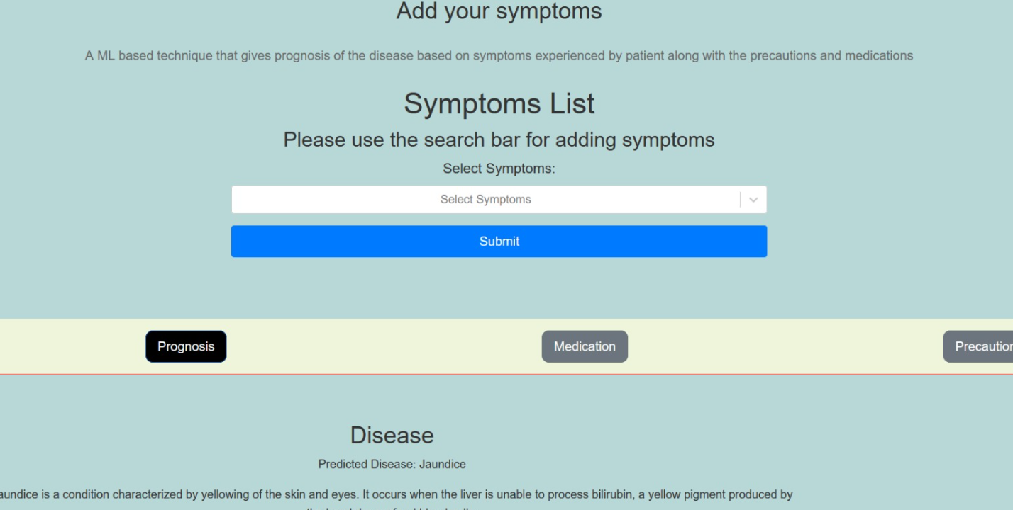
Snippets
Our Disease detector, Select the symptoms you are facing , our ML model will predict the disease, prescribed medications and the precautions

Slide 8
Thank you
From UVXII

