Slide 1
Cold vs Hot tumour immune phenotypes from bulk RNA-seq
TCGA colon (COAD) and rectum (READ) adenocarcinoma · ssGSEA + ESTIMATE labelling · hypothesis testing, dimensionality reduction, clustering, six classifiers, survival, and held-out cohort validation.
BT3041 — Analysis and Interpretation of Biological Data · IIT Madras · 2025–26
This deck summarises a full computational pipeline (10 Python modules) from raw GDC downloads to publication-style figures. Discovery cohort: 294 COAD samples; external test: 109 READ samples. All numeric results on result slides are loaded from outputs/tables when you run build_presentation.py — regenerate after re-running the pipeline.
https://github.com/Aryan7865/cold-hot-tumour-classification

Slide 2
Clinical and scientific motivation
Why bulk RNA-seq for immune phenotype?
Immune checkpoint inhibitors (e.g. anti–PD-1) can produce durable responses in a subset of microsatellite-instable colorectal cancers, but most metastatic CRC remains checkpoint-refractory. Clinical benefit correlates with an inflamed, T-cell–rich (“hot”) microenvironment versus an immune-excluded or deserted (“cold”) state. Multiplex immunohistochemistry is informative but not universally available. Bulk RNA-seq is increasingly standard in research and translational settings: it measures thousands of transcripts per tumour simultaneously, enabling both exploratory visualisation and formal inference. Our project asks whether computational immune scores and downstream statistics/ML can recover hot–cold–intermediate structure from expression alone, and whether a classifier trained in one TCGA cohort predicts labels in a second, independent cohort — satisfying BT3041’s emphasis on large-scale omics, hypothesis testing, and validation.
References: Charoentong et al., Cell Reports 2017; Yoshihara et al., Nat Commun 2013 (ESTIMATE)

Slide 3
Research questions
Mapped to the course project workflow
Exploratory: Do PCA, ICA, MDS, t-SNE, and UMAP reveal gradients or clusters that relate to immune-derived Hot/Cold/Intermediate labels?
Hypothesis-driven: After filtering, do tens of thousands of genes show Hot vs Cold differences by parametric and non-parametric tests, with Benjamini–Hochberg and Bonferroni control of false positives?
Clustering: Do k-means, hierarchical (Ward), and DBSCAN partitions agree (ARI/AMI) with ssGSEA tertiles?
Classification: Can pipelines including kNN, linear/RBF SVM, logistic regression, Random Forest, and XGBoost predict phenotype under stratified 5-fold CV?
Validation: Does the best discovery model generalise to TCGA-READ patients never used in training?
Outcome: Do Kaplan–Meier curves and Cox/PLS models link immune tertiles to overall survival on COAD?
Presentation target: 7 min talk + 3 min Q&A (per course schedule)

Slide 4
Data acquisition & cohort design
TCGA GDC · STAR unstranded counts · harmonised gene symbols
Acquisition: NCI Genomic Data Commons REST API; expression files downloaded in batches with retries (single large tar streams often truncated on unstable links). Parsed STAR counts collapsed to gene-symbol × sample matrices; duplicate gene symbols and replicate aliquots were merged per our parser. Phenotype labels: single-sample GSEA (gseapy) plus ESTIMATE immune/stromal scores; within each cohort, samples ranked by immune score and split into upper, middle, and lower thirds (Hot / Intermediate / Cold). This yields roughly balanced classes for classification. Downstream statistics use 16,723 filtered genes on COAD for per-gene tests; machine learning uses the top 5,000 variance genes with univariate ANOVA feature selection (k=500) inside each sklearn Pipeline. External validation freezes the best COAD CV model, retrains on all COAD samples, scores READ after aligning gene order (missing genes in test filled with 0).
config.py: TCGA_PROJECTS = ['TCGA-COAD'], VALIDATION_COHORT = 'TCGA-READ'
Role | Cohort | n | Hot | Cold | Interm.
Discovery + CV | TCGA-COAD | 294 | 100 | 97 | 97
External test | TCGA-READ | 109 | 37 | 36 | 36
Total patients | — | 403 | — | — | —

Slide 5
End-to-end analytical workflow
Ten numbered scripts · one config · shared outputs/
① 01_data_acquisition — GDC bulk + clinical. ② 02_preprocessing — CPM, log₂, expression filters, top-variance subset, optional Shapiro/QQ. ③ 03_immune_scoring — ssGSEA + ESTIMATE → labels + immune_scores tables. ④ 04_dimensionality_reduction — PCA, ICA, MDS, t-SNE, UMAP plots. ⑤ 05_clustering — k-means sweep, Ward dendrogram, DBSCAN; ARI/AMI vs labels. ⑥ 06_hypothesis_testing — per-gene tests + BH/Bonferroni; volcano + heatmaps; χ² on clinical tables. ⑦ 07_classification — six models, stratified 5-fold CV, confusion + ROC. ⑧ 08_survival_analysis — KM, log-rank, penalised Cox, PLS vs survival time. ⑨ 09_validation_external — train COAD → evaluate READ. ⑩ 10_final_report_figures + report PDF / this PPTX generator.
Together, these steps exercise the course rubric: visual exploration, parametric and non-parametric inference with multiple-testing correction, unsupervised and supervised learning, regression-style survival modelling, and biological interpretation against known immune-gene programmes. Every figure in this deck is taken from outputs/figures/ produced by the pipeline (regenerate after re-running scripts).
Repository layout: data/raw, data/processed, outputs/tables, outputs/figures, outputs/models

Slide 6
Methods (1/2)
Preprocessing, labelling, dimensionality reduction, clustering
Preprocessing (02_preprocessing.py): raw counts converted to counts-per-million (CPM); genes kept if CPM ≥ 1 in at least 20% of samples; then log₂(x + 1). For ML we retain the top 5,000 genes by row-wise variance to stabilise estimation in n≈300 samples. Immune scoring (03_immune_scoring.py): ssGSEA enrichment scores for curated immune gene sets combined with ESTIMATE immune and stromal scores. Labels assigned by within-cohort tertiles of the immune score (Hot = most inflamed third, Cold = least, Intermediate = middle). Dimensionality reduction (04): PCA/ICA/MDS on scaled expression; t-SNE and UMAP computed in 2D (with PCA-based initialisation where applicable for stability). Plots coloured by immune label. Clustering (05): k-means for k=2…6 with silhouette sweep; agglomerative clustering with Ward linkage and dendrogram; DBSCAN on PCA coordinates. Cluster assignments compared to ssGSEA labels using Adjusted Rand Index and Adjusted Mutual Information.
Random seed where applicable: 42

Slide 7
Methods (2/2)
Hypothesis tests, ML, survival, external validation
Hypothesis testing (06): for each gene — Welch two-sample t (Hot vs Cold), one-way ANOVA across three groups, Kruskal–Wallis, Mann–Whitney U, and F-test of variance; p-values adjusted with Benjamini–Hochberg FDR and Bonferroni per family. High-confidence differential expression: BH q<0.05 on t-test plus |log₂ fold-change|>1. Clinical categorical fields tested with Pearson χ² vs label where applicable. Classification (07): six sklearn Pipelines with StandardScaler (except tree/boosting paths), SelectKBest(f_classif, k=500), and classifier; stratified 5-fold CV; metrics include accuracy, balanced accuracy, and macro-averaged F1. Best model by mean balanced accuracy used for external export. Survival (08): time from days_to_death or days_to_last_follow_up; event from vital_status. Kaplan–Meier by label, multivariate log-rank, L2-penalised Cox on ssGSEA cell-type scores, PLS regression of expression against survival time on training samples. External validation (09): re-fit winning pipeline on all COAD samples; predict on READ with identical feature ordering; report confusion matrix, accuracy, balanced accuracy, macro-F1.
Code annex: attach repository or zip of .py files per instructor instructions

Slide 8
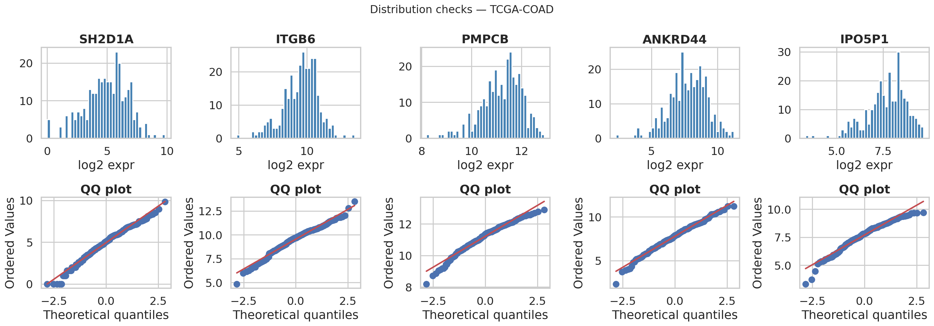
Quality control & distributions
Random genes · histogram + QQ after log-transform
Before relying on t-tests and ANOVA we inspect marginal distributions. Histograms should be unimodal and roughly bell-shaped; QQ-plots should follow the diagonal if normality holds approximately. We still report Kruskal–Wallis and Mann–Whitney as distribution-robust companions to parametric tests.
outputs/figures/preprocessing/dist_check_TCGA-COAD.png

Slide 9
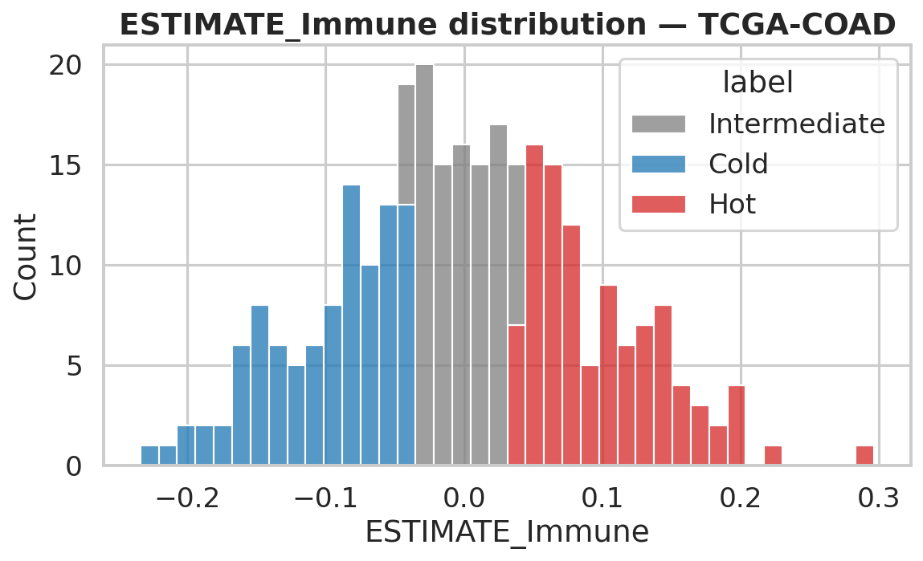
Immune scores and phenotype labels
ESTIMATE immune score by tertile class
Tertile split enforces comparable class sizes and mirrors common practice when no external gold standard exists. Hot tumours concentrate at high ESTIMATE immune scores; Cold at low scores.
Interpretation caveat: labels are algorithm-defined (ssGSEA + ESTIMATE), not pathologist-verified IHC. All supervised metrics therefore measure agreement with this omics-based proxy. That is still scientifically useful: it tests whether linear and non-linear expression structure recovers immune ranking learned from gene-set enrichment. Outputs drive every later step: merged with expression for DE, fed into PCA colours, used as clustering reference for ARI/AMI, and used as y in classification.
outputs/tables/labels_TCGA-COAD.csv · immune_scores_TCGA-COAD.csv

Slide 10
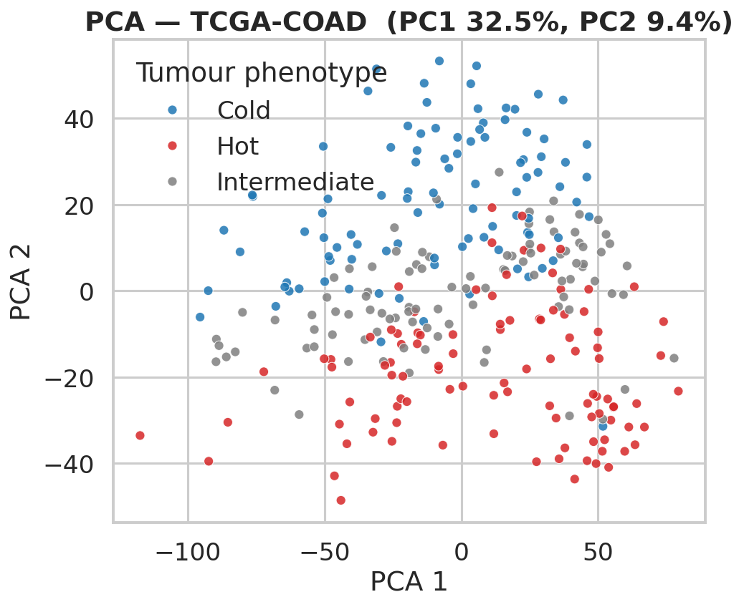
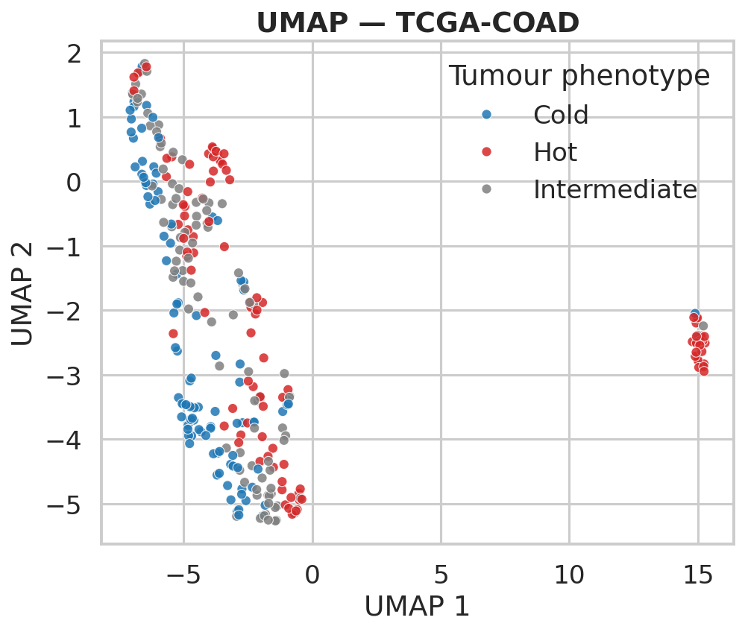
Low-dimensional views (COAD)
PC1 explains 32.5% variance; PC2 9.4%; combined 42.0%
Left: linear PCA — Hot (red) and Cold (blue) separate along PC1, Intermediate (grey) bridges them. Right: non-linear UMAP on PCA-informed embedding — tighter islands, same colour logic. ICA, MDS (metric/non-metric), and t-SNE figures are in the repository for the same cohort.
outputs/figures/dim_reduction/

Slide 11
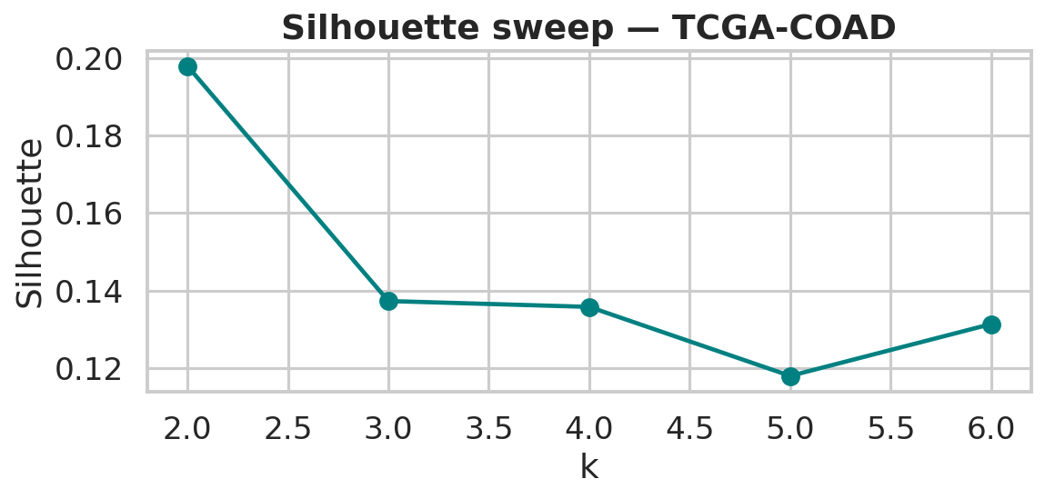
Unsupervised clustering vs ssGSEA labels
k-means k=3: ARI 0.114, AMI 0.119, silhouette 0.137
Silhouette scores peak in the k=2–4 range; we report ARI/AMI against labels for several algorithms and cluster counts in clustering_metrics_TCGA-COAD.csv. Moderate ARI (~0.11) means unsupervised partitions only partially reproduce tertile labels. That is expected: tertiles impose crisp boundaries on a continuous immune axis; k-means also forces equal variance spherical clusters in feature space after PCA. Hierarchical clustering provides a dendrogram for visual inspection of sample–sample similarity; DBSCAN serves as a density-based contrast that does not fix k. Together they satisfy the course clustering requirement beyond a single k-means run.
outputs/tables/clustering_metrics_TCGA-COAD.csv

Slide 12
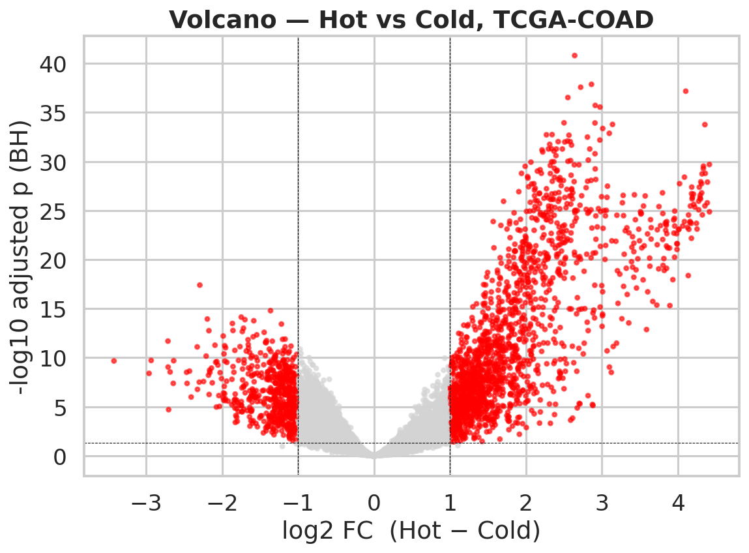
Differential expression & FDR
Per-gene testing on TCGA-COAD
Genes tested: 16,723. Significant at BH FDR q<0.05 — Welch t: 8,198; one-way ANOVA: 10,369; Kruskal–Wallis: 10,280; Mann–Whitney U: 8,362. Stringent DE list (BH on t-test plus |log₂FC|>1): 2,269 genes. Volcano: x-axis log₂ fold-change (Hot − Cold); y-axis −log₁₀(BH q). Red points pass both magnitude and FDR thresholds. Grey cloud = not significant after correction.
outputs/tables/dge_TCGA-COAD.csv · dge_sig_TCGA-COAD.csv

Slide 13
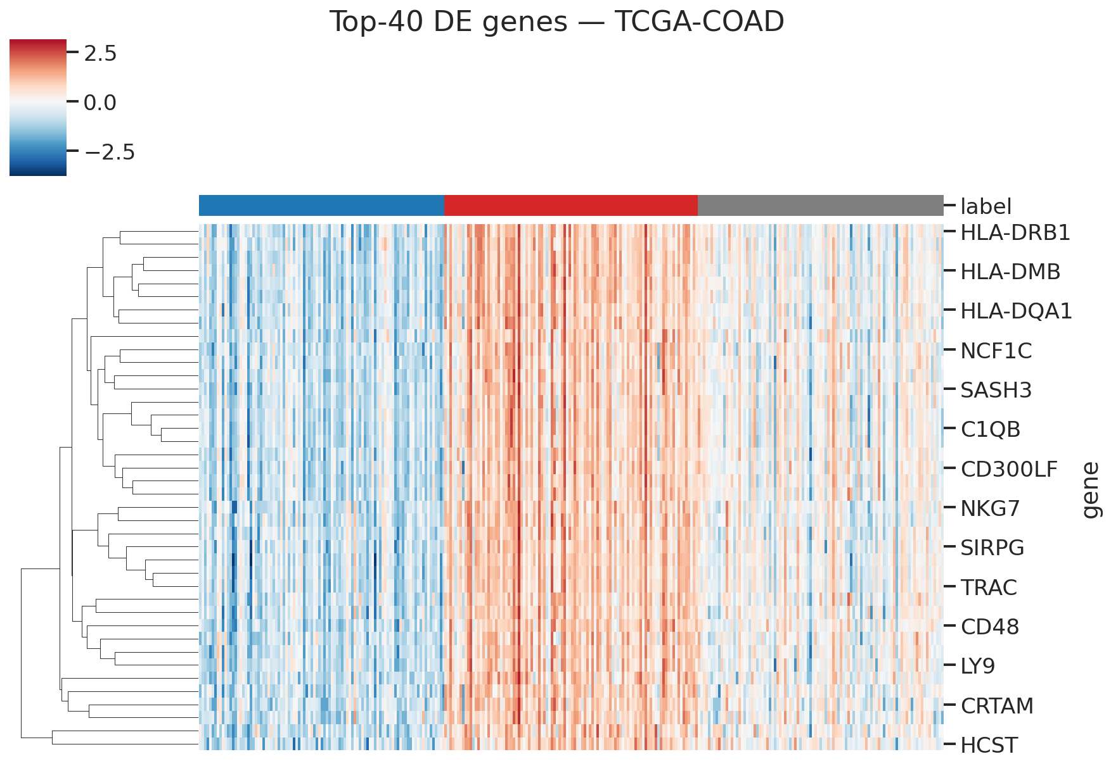
Top ranked DE genes (heatmap)
Forty genes with strongest evidence · z-scored across samples
Columns ordered by immune class; colour = row z-score. Sharp red/blue blocks indicate genes that track Hot vs Cold consistently across patients — candidate biomarkers and pathway-level hypotheses.
outputs/figures/hypothesis/heatmap_top40_TCGA-COAD.png

Slide 14
Biological interpretation
Concordance with published immune-infiltration biology
Among the strongest Hot-associated genes after multiple-testing correction and effect-size filtering are examples such as: HLA-DPB1, HLA-DRA, CD48, PLA2G2D, HLA-DMB, HLA-DPA1, HLA-DQA1, C1QB, HLA-DOA, SLAMF7, … These include MHC class II antigen presentation (HLA-DRA, HLA-DPB1, …), complement cascade (C1QB), lymphocyte signalling (CD48, SLAMF7), and cytotoxic / tissue-resident programmes (GZMK, CXCL13). That pattern matches known biology of T-cell–inflamed tumours and supports the face validity of our ssGSEA-based labels — not random gene noise. We did not run a separate Fisher pathway table in the final deck, but ssGSEA itself is gene-set–centric; optional extension: hypergeometric over-representation on MSigDB Hallmarks for the DE gene list.
Compare e.g. Bindea et al., Immunity 2013; Charoentong pan-cancer immune clusters

Slide 15
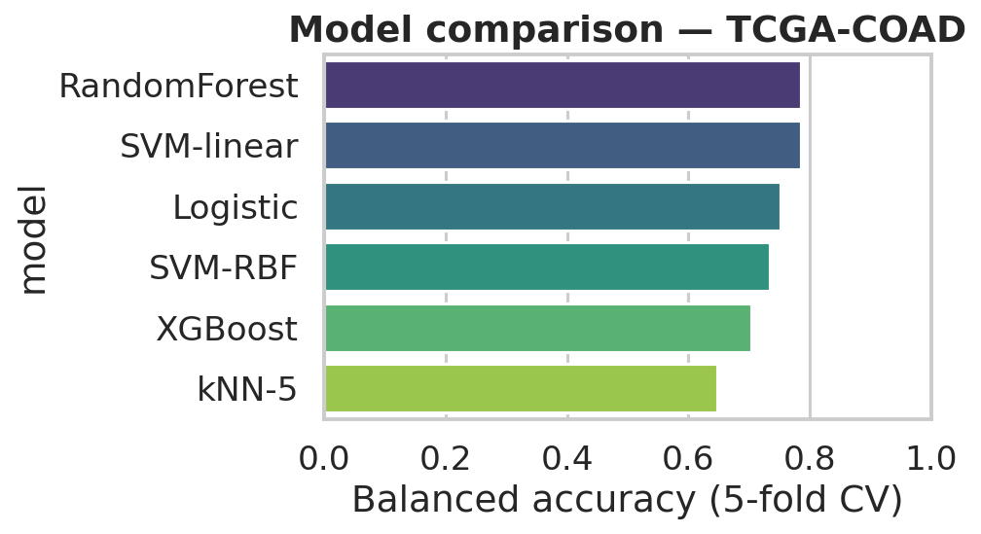
Supervised classification (discovery cohort)
294 COAD samples · stratified 5-fold CV · six algorithms
Leader by mean balanced accuracy: RandomForest (balanced acc 0.785, accuracy 0.786, macro-F1 0.786). Why balanced accuracy: class frequencies are similar but not identical; balanced accuracy averages recall across classes and is less optimistic than raw accuracy on mildly imbalanced problems. Full CV summary (mean across folds): Model Bal.Acc. Acc. Macro-F1 ────────────────────────────────────────── RandomForest 0.785 0.786 0.786 SVM-linear 0.785 0.786 0.784 Logistic 0.752 0.752 0.748 SVM-RBF 0.735 0.735 0.736 XGBoost 0.704 0.704 0.699 kNN-5 0.648 0.649 0.645
outputs/tables/cv_results_TCGA-COAD.csv

Slide 16
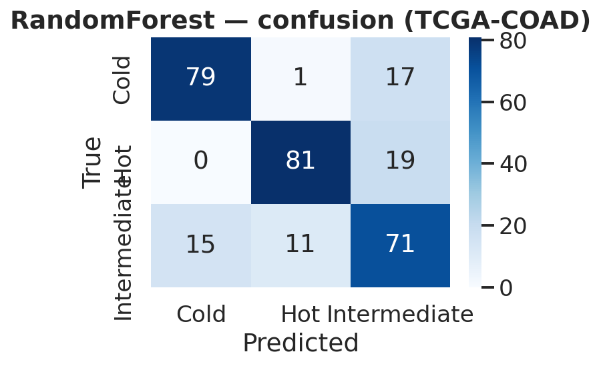
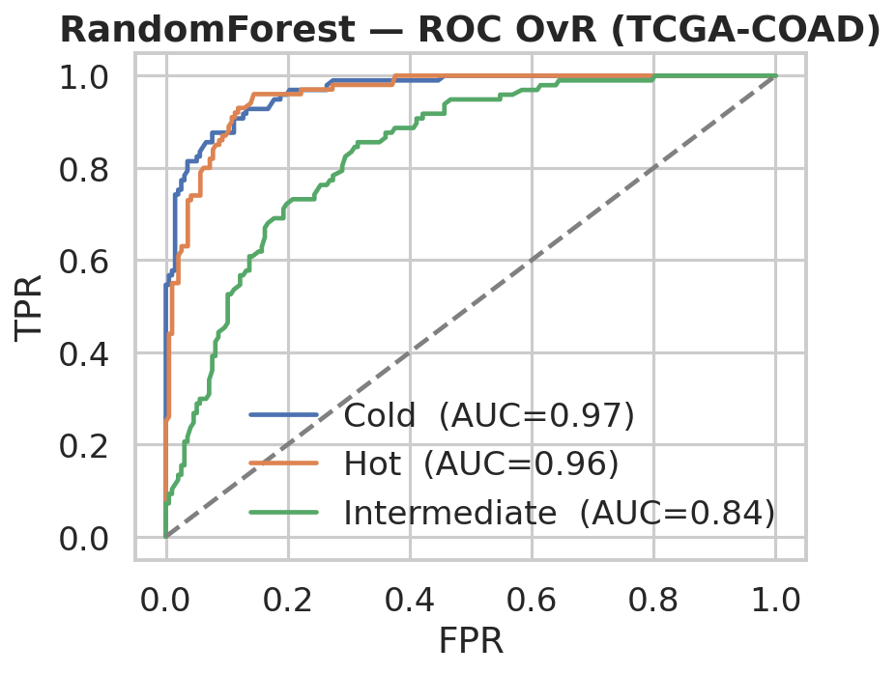
Error structure & calibration (Random Forest)
Same model family as external validation export
Left: cross-validated confusion matrix — most mass on the diagonal; off-diagonal mass often involves Intermediate vs Hot/Cold, consistent with intermediate biology. Right: one-vs-rest ROC curves per class; high AUC for Cold/Hot indicates separability; Intermediate is intrinsically harder.
outputs/figures/classification/TCGA-COAD_RandomForest_*.png

Slide 17
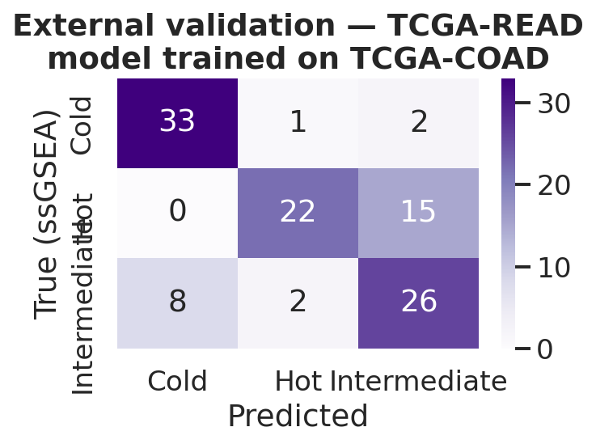
Independent cohort validation
Train on all COAD · evaluate on READ (n = 109) · model = RandomForest
READ patients were never used during model selection or cross-validation; only COAD folds informed the choice of Random Forest. READ expression was subset to the training gene list; any gene absent in READ was imputed as zero expression after alignment. Held-out metrics: • Accuracy 0.743 • Balanced accuracy 0.744 • Macro F1 0.742 Compared to ~33% expected accuracy for random guessing among three classes, the ~0.74 balanced accuracy indicates genuine transfer of signal across cohorts processed under the same GDC pipeline — different patients and tissue sites (colon vs rectum) but comparable assay technology.
outputs/tables/external_validation_summary_TCGA-READ.csv

Slide 18
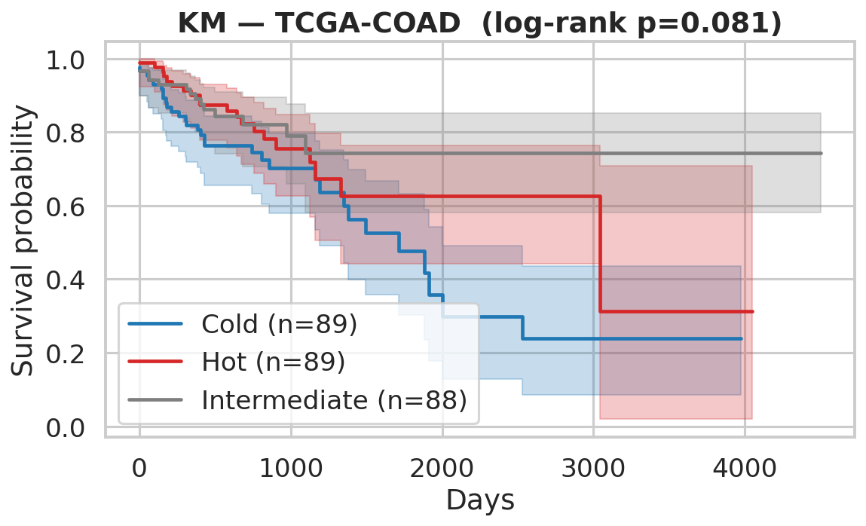
Survival by immune tertile (COAD)
Multivariate log-rank p = 0.081 (χ² statistic = 5.02)
Kaplan–Meier step functions with shaded 95% confidence bands. Visual separation between Cold vs Hot curves is modest at early times and overlaps at long follow-up because of censoring and competing risks. Formal log-rank test across all three labels: p = 0.081 — not significant at α = 0.05. We therefore describe survival differences as hypothesis-generating rather than definitive proof in this cohort. We additionally fit penalised Cox regression on ssGSEA cell-type scores and PLS regression from high-dimensional expression to survival time (see outputs/tables/cox_TCGA-COAD.csv and pls_TCGA-COAD.csv plus survival figures).
outputs/tables/logrank_TCGA-COAD.csv

Slide 19
Discussion, limitations, future work
Critical appraisal — expected in written report
Strengths: (1) large public RNA-seq cohorts with harmonised preprocessing; (2) many complementary tests (parametric + non-parametric + two FDR strategies); (3) transparent immune labelling code; (4) six classifiers with nested feature selection; (5) true external generalisation check on READ; (6) biologically interpretable DE direction. Limitations: (1) ssGSEA tertiles are a computational proxy, not gold-standard pathology; (2) COAD and READ share sequencing platform — we do not demonstrate cross-platform robustness to microarray here; (3) survival is under-powered for strong significance; (4) clinical covariates (stage, MSI) could be added as covariates or stratification in future work; (5) XGBoost underperformed linear models here — likely because ANOVA pre-screening already removes most non-linear signal from the feature matrix. Future directions: integrate MSI status and stage into multivariate models; validate on GEO or single-cell atlases; calibrate predicted probabilities for clinical decision support; explore pathway-level Fisher tests explicitly as in the course slide deck.
Written report: ≤8 pages Arial 12 (per instructor); this PPTX is complementary visual aid

Slide 20
Take-home messages
What you should remember from this project
▸ We built a reproducible omics pipeline on 403 TCGA colorectal samples with explicit train (COAD) vs test (READ) separation.
▸ Genome-wide testing finds 8,198 BH-significant genes by Welch t and 2,269 high-confidence DE genes with large |log₂FC| — enriched for antigen presentation and cytotoxic programmes.
▸ Low-dimensional plots (PCA/UMAP) and clustering (ARI 0.114 for best k-means vs labels) show partial but meaningful alignment with immune tertiles.
▸ Six classifiers; best discovery performance ≈0.79 balanced accuracy under 5-fold CV (RandomForest).
▸ External validation retains ≈0.74 balanced accuracy on 109 READ patients — evidence against pure overfitting.
▸ Survival trend is directionally sensible but not statistically significant at α=0.05 (log-rank p=0.081).
▸ Everything is scripted in Python with version-pinned dependencies; figures regenerate from outputs/.
https://github.com/Aryan7865/cold-hot-tumour-classification

Slide 21
Thank you
We welcome questions on methods, code, or biological interpretation.
Questions?
https://github.com/Aryan7865/cold-hot-tumour-classification

