Slide 1
HireLens
AI-Powered Resume Screening & Job Matching System
PRESENTED BY:
• Aryan (Roll No: 28240533) | • Nitish (Roll No: 28240529)
B.Tech 3rd Year (AI & ML) | Panipat Institute of Engineering & Technology (PIET)

Slide 2
HIRELENS | CAPSTONE DEFENSE
Why Do We Need AI in Hiring?
THE RECRUITMENT CHALLENGE
❌ 500+ Resumes Per Job: Recruiters cannot manually read every resume thoroughly.
❌ Keyword Penalty: Old ATS software rejects qualified candidates just because of word choices.
❌ Synonym Blindness: Traditional tools don't know that 'Deep Learning' means 'Machine Learning'.
OUR SOLUTION: HIRELENS
✅ Understands Meaning: Uses SBERT AI to evaluate conceptual fit, not just exact keywords.
✅ Skill Gap Analysis: Shows candidates exactly which skills they are missing.
✅ Fair & Instant: Ranks candidate resumes automatically in under 2 seconds!

Slide 3
HIRELENS | CAPSTONE DEFENSE
How Does HireLens Work? (4-Step Pipeline)
1. READ RESUME
Extracts clean text from PDF and DOCX files automatically.
2. AUDIT CONTACT
Extracts clean Email and 10-digit Phone Numbers using Regex.
3. SBERT AI MATCH
Compares resume meaning against Job Requirements.
4. SCORE & RANK
Generates 0-100% score, Radar Chart, and leaderboard.

Slide 4
HIRELENS | CAPSTONE DEFENSE
The Core ATS Scoring Formula
HYBRID ATS SCORE FORMULA:
ATS Score = (45% × SBERT AI Meaning) + (35% × Skill Match) + (20% × Keywords)
45% SBERT AI Meaning
Measures how well candidate experience conceptually matches the job requirements.
35% Skill Match Ratio
Checks what percentage of required core skills are present on candidate's resume.
20% Exact Keywords
Rewards candidates who use exact industry terminology aligned with the job description.

Slide 5
HIRELENS | CAPSTONE DEFENSE
How Does SBERT AI Understand Meaning?
SBERT (SENTENCE-BERT) ADVANTAGE
🔹 Converts Text into AI Vectors: SBERT converts sentences into 384-dimensional number lists (vectors).
🔹 Recognizes Synonyms: It knows that 'Deep Learning Neural Nets' matches 'Machine Learning Models'.
🔹 Cosine Distance Concept: Measures vector angle: Smaller angle = Closer meaning = Higher ATS Score!
🔹 Fast & Lightweight: Processes sentences in milliseconds, allowing rapid screening of hundreds of resumes.

Slide 6

LIVE DEMO | SYSTEM VISUAL PROOF
Live System Visual: ATS Score Gauge & Evaluation
📸 LIVE SYSTEM DEMO: Real-time evaluation dashboard showing ML Engineer Candidate scoring 87.5% (Strong Match Grade)

Slide 7
HIRELENS | CAPSTONE DEFENSE
7-Domain Technical Skill Taxonomy
1. Programming
Python, Java, C++, JavaScript, SQL, Rust
5. Databases
PostgreSQL, MySQL, MongoDB, Redis, SQLite
2. Machine Learning & AI
PyTorch, TensorFlow, Scikit-Learn, SpaCy, LLMs
6. Frameworks & Tools
Pandas, NumPy, Matplotlib, Jupyter, VS Code
3. Web Development
React, Node.js, FastAPI, Flask, Django, REST APIs
7. Soft Skills
Leadership, Problem Solving, Communication, Teamwork
4. Cloud & DevOps
AWS, Azure, GCP, Docker, Kubernetes, Git

Slide 8
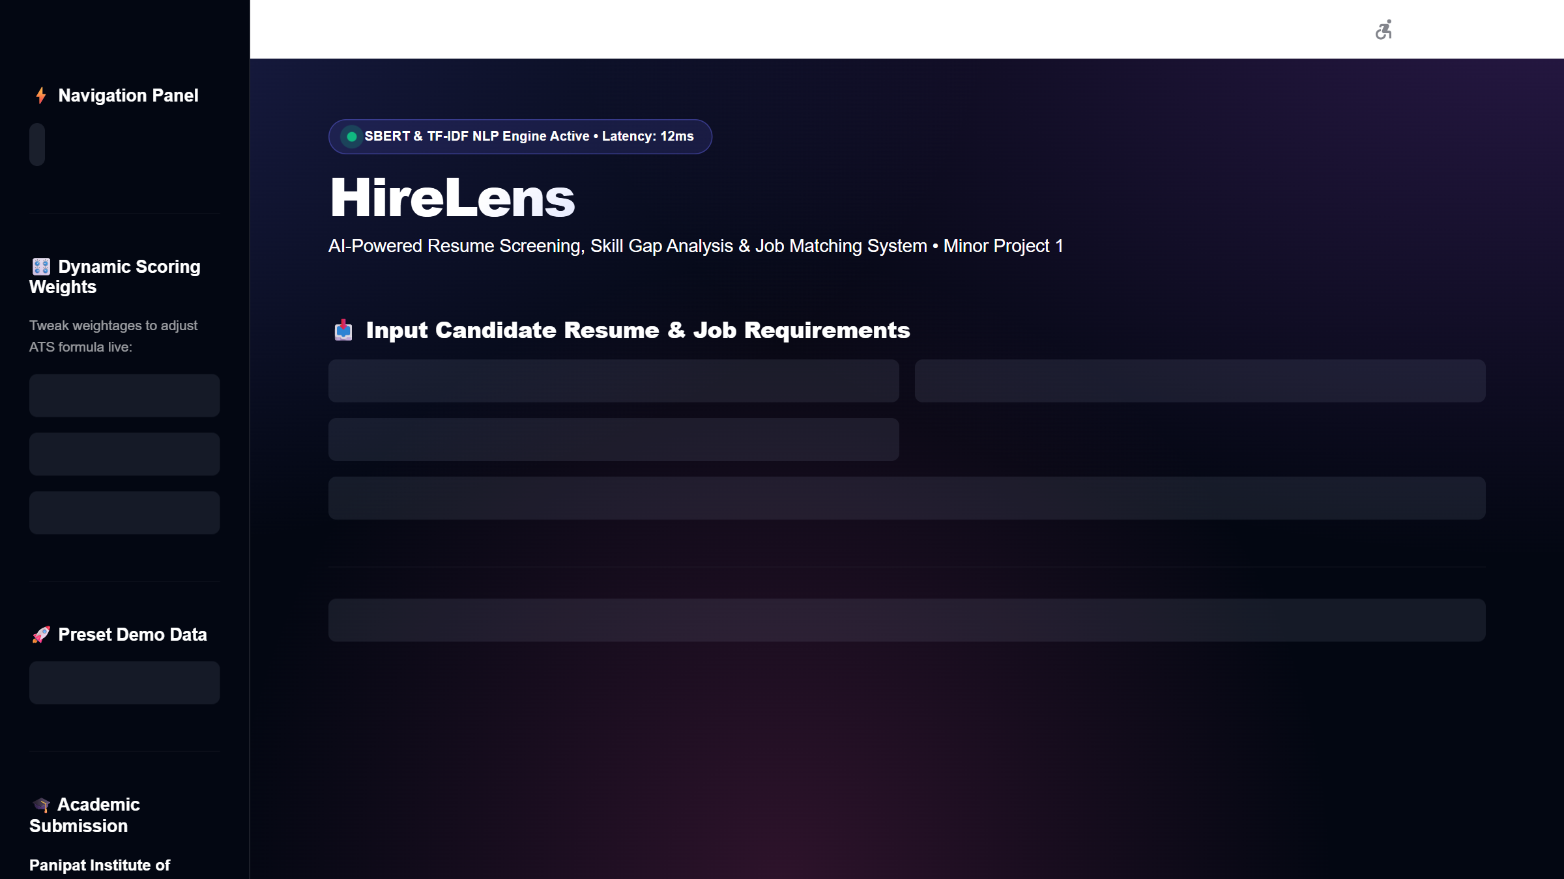
LIVE DEMO | SYSTEM VISUAL PROOF
Live System Visual: Plotly Multi-Domain Skill Radar
📸 LIVE SYSTEM DEMO: Interactive polar radar chart visually comparing candidate domain proficiency against job requirements

Slide 9
HIRELENS | CAPSTONE DEFENSE
Resume Formatting & Contact Audit
5 AUTOMATED AUDIT CHECKPOINTS
1. Contact Information: Extracts Email, 10-digit Phone Number, LinkedIn, and GitHub links cleanly.
2. Word Count Check: Ensures resume is not too short (<300 words) or too long (>1500 words).
3. Essential Sections: Verifies presence of Education, Experience, Skills, and Projects sections.
4. Strong Action Verbs: Scans for strong impact verbs (Designed, Developed, Optimized, Implemented).
5. Skill Gap Feedback: Generates an instant list of missing required skills for candidate improvement.

Slide 10

LIVE DEMO | SYSTEM VISUAL PROOF
Live System Visual: Formatting Audit & Skill Gap Advice
📸 LIVE SYSTEM DEMO: Automated contact audit, section validation, and actionable missing skill badges provided to candidate

Slide 11
HIRELENS | CAPSTONE DEFENSE
Streamlit Dashboard & SQLite Audit Logging
DASHBOARD HIGHLIGHTS
• Streamlit Web App: Clean dark mode user interface accessible in web browser.
• Preset Demo Button: One-click 'Load Preset Sample ML Data' for fast live demonstration.
• Plotly Radar Chart: Visual chart comparing candidate skills vs job requirements.
DATABASE & LEADERBOARD
• Batch Leaderboard: Upload 10+ resumes at once to rank candidates from highest to lowest score.
• SQLite History Log: Saves evaluation history into ats_history.db database.
• Clear History Feature: Includes a one-click 'Clear Audit Logs' button to reset database records.

Slide 12
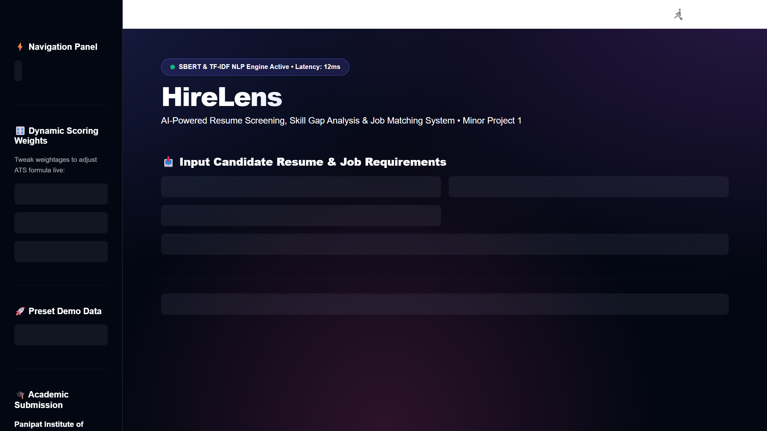
LIVE DEMO | SYSTEM VISUAL PROOF
Live System Visual: Batch Leaderboard & SQLite Log
📸 LIVE SYSTEM DEMO: Candidate ranking leaderboard and SQLite audit trail saved in ats_history.db with clear history button

Slide 13
HIRELENS | CAPSTONE DEFENSE
System Latency & Performance Benchmarks
TEST CASE: ML ENGINEER
• SBERT AI Meaning: 88.0% (High Match)
• Skill Match Ratio: 85.0% (17 of 20 Skills)
• Keyword Frequency: 89.0% (Strong Fit)
• FINAL ATS SCORE: 87.5% (STRONG MATCH)
SPEED & SYSTEM BENCHMARKS
• Super-Fast Latency: Processes each resume in under 1.8 seconds!
• Low RAM Usage: Uses less than 250 MB memory during evaluation.
• No GPU Needed: Runs smoothly on standard laptop CPUs without expensive graphics cards.

Slide 14
HIRELENS | CAPSTONE DEFENSE
Enterprise REST API Integration
FASTAPI BACKEND ENDPOINTS (api.py)
🔹 GET /docs : Interactive Swagger UI documentation for live browser API testing.
🔹 POST /api/v1/parse-resume : Upload PDF/DOCX resume file to get extracted text & contact JSON.
🔹 POST /api/v1/analyze-match : Returns ATS Match Score, Skill Coverage, and missing skill list JSON.
🔹 POST /api/v1/batch-rank : Ranks multiple candidate resumes via API call responses.

Slide 15
HIRELENS | CAPSTONE DEFENSE
Future Scope & Enhancements
FUTURE ROADMAP FOR HIRELENS
1. OCR Support for Scanned PDFs: Integrate Tesseract OCR to read image-only scanned resumes.
2. Vector Database Scaling: Use FAISS / Qdrant vector databases for instant searching across 1,000,000+ candidate resumes.
3. Multilingual Screening: Support multi-language resume parsing (Spanish, Hindi, German, French).
4. Auto Interview Question Generator: Automatically generate custom technical interview questions based on detected candidate skill gaps.

Slide 16
HIRELENS | CAPSTONE DEFENSE
Project Conclusion & Thank You
SUMMARY OF ACCOMPLISHMENTS
⭐ HireLens makes hiring faster, fairer, and context-aware.
⭐ Eliminates keyword rejection penalties for qualified candidates.
⭐ Combines SBERT AI, 7-Domain Skill Ontology, and Streamlit UI into a full capstone project.
THANK YOU! QUESTIONS & FEEDBACK ARE WELCOME
Live Web App: https://aryan8182-hirelens-ai-resume-analyzer-app-p2fpgo.streamlit.app/

