Slide 1

Seasonal Agriculture Performance Analysis
Aryan
Panipat Institute of Engineering and Technology
AICTE STU ID : STU6a191e1abc17a1780031002

Slide 2

PROBLEM STATEMENT
Agricultural activities are strongly influenced by seasonal variations in environmental conditions (such as rainfall, temperature, and humidity), farming practices, input resource availability, and market conditions. Consequently, agricultural performance (crop yield, production efficiency, and farm profitability) differs significantly from one season to another (Kharif, Rabi, and Zaid).
However, raw agricultural data does not clearly explain how agricultural performance changes across seasons or what key drivers govern these variations.
The core problem is to analyze the given agricultural dataset and investigate seasonal differences in agricultural performance by identifying meaningful patterns, trends, relationships, resource usage variations, and financial differences within the available data.

Slide 3
Project Description Seasonal Agriculture Performance Analysis project is a focused Data Analytics major project designed to investigate how agricultural performance, resource usage efficiency, and farm profitability vary across different farming seasons (Kharif, Rabi, and Zaid) in India. Using a comprehensive dataset of 4,000 farm-level records across 28 numerical and categorical parameters, the project applies data cleaning, statistical modeling, univariate, bivariate, and multivariate visualizations to discover meaningful seasonal patterns, environmental relationships, resource trade-offs, and economic outcomes.
Introduction & Dataset Scope:
Covers 4,000 individual farm records across 7 major Indian states and key agricultural districts.
Evaluates 28 variables spanning 5 core dimensions:
Geographical & Crop Context: State, District, Crop, Season.
Environmental Parameters: Rainfall (mm), Avg Temperature (°C), Humidity (%), Sunlight Hours/Day, Soil pH, Soil Moisture (%).
Farm Inputs & Resources: Farm Area (Ha), Nitrogen, Phosphorus, Potassium (NPK), Irrigation Method (Drip, Sprinkler, Flood, Rainfed), Fertilizer (kg/ha), Pesticide (L/ha), Seed Quality Score.
Productivity Metrics: Crop Yield (Tonnes/Ha), Total Production (Tonnes), Water Used (m³), Water Efficiency (
t/1000m3
t/1000m
3
), Disease/Pest Risk (%).
Economic Outcomes: Market Price (INR/Tonne), Total Cost (INR), Revenue (INR), Net Profit (INR).
Data Analytics Pipeline & Methodology:
Data Cleaning & Quality Assessment: Detection and median imputation of missing values, duplicate removal, and numerical validation checks.
Statistical & Exploratory Analysis: Calculation of mean, median, standard deviation, IQR, and skewness across Kharif, Rabi, and Zaid.
Outlier & Anomaly Detection: IQR-based lower/upper bound calculations and boxplot analyses to identify high-cost/low-yield farm anomalies.
Data Visualizations: High-impact pie charts, histograms with KDE, boxplots, correlation heatmaps, crop-season yield/profit matrices, and scatterplots.

Slide 4

WHO ARE THE END USERS?
Farmers deciding which crops to grow in which season
Agricultural policymakers and government agriculture departments, for seasonal planning support
Agri-fintech and crop insurance companies, for seasonal risk assessment
Agronomists and researchers studying seasonal performance patterns
Agri-business and supply chain planners forecasting seasonal production

Slide 5

Technology Used
Python — core programming language for the analysis
Pandas, NumPy — data cleaning and manipulation
Matplotlib, Seaborn — data visualization
SciPy (stats module) — one-way ANOVA statistical testing
Jupyter Notebook — documentation and analysis environment

Slide 6
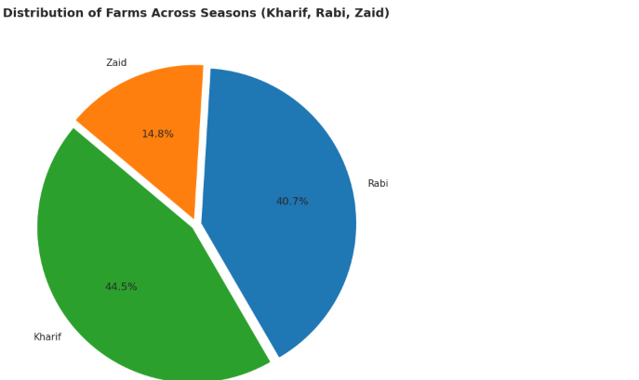
RESULTS

Slide 7
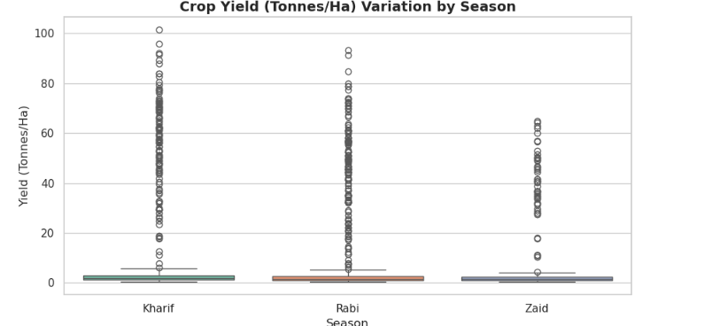
RESULTS

Slide 8
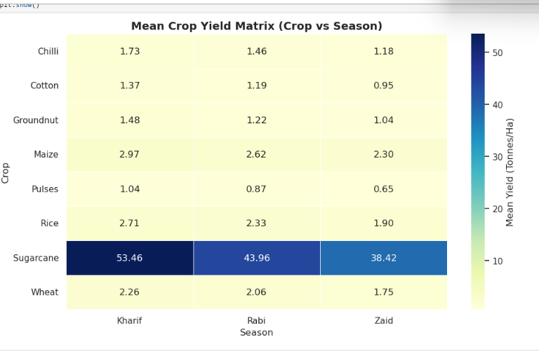
RESULTS

Slide 9
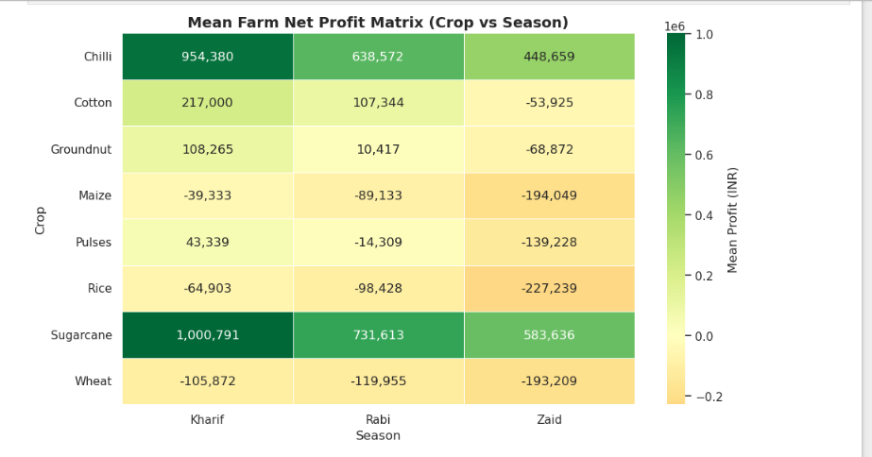
RESULTS

Slide 10
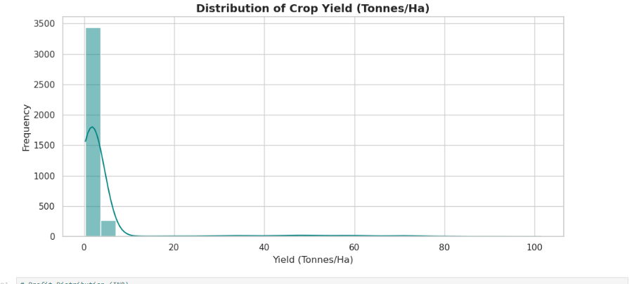
RESULTS
One-way ANOVA: Profit differs significantly across seasons (p < 0.001); the Yield difference is not statistically significant (p = 0.21)

Slide 11
Future scope
1. Predictive Machine Learning (ML) Models
Crop Yield Prediction: Implement regression models (e.g., Random Forest, XGBoost, Ridge Regression) to predict farm yield (Tonnes/Ha) based on weather conditions and soil NPK levels.
2. Interactive Business Intelligence (BI) Dashboards
Streamlit / Dash Web Application: Build a lightweight web application enabling non-technical users (farmers, extension officers) to filter data by State, District, Crop, and Season dynamically.
PowerBI / Tableau Integration: Create executive dashboards displaying real-time KPIs (Total Production, Average Water Efficiency, District-wise Profit Margins).
3. Real-Time IoT & Weather API Integration
Live Climate Data: Integrate Indian Meteorological Department (IMD) or OpenWeatherMap APIs to fetch live weather, temperature, and humidity forecasts.
IoT Soil Sensor Data: Connect real-time soil moisture and pH sensor streams to update irrigation schedules dynamically.
4. Geospatial (GIS) & Satellite Imagery Analysis
NDVI Index Tracking: Incorporate satellite imagery (e.g., Sentinel-2, Landsat) to calculate Normalized Difference Vegetation Index (NDVI) for assessing crop health and drought stress across regions.
GIS Map Layers: Visualize district-wise agricultural productivity and water scarcity zones on interactive choropleth maps (Folium / GeoPandas).

Slide 12
GitHub Link
Complete project code, dataset and Jupyter Notebook are available on GitHub:
https://github.com/Aryan8182/Vois-data-analyticas-project
Seasonal_Agriculture_Performance_Analysis.ipynb — fully executed notebook
seasonal_agriculture_performance_dataset.csv — source dataset used for the analysis

Slide 13
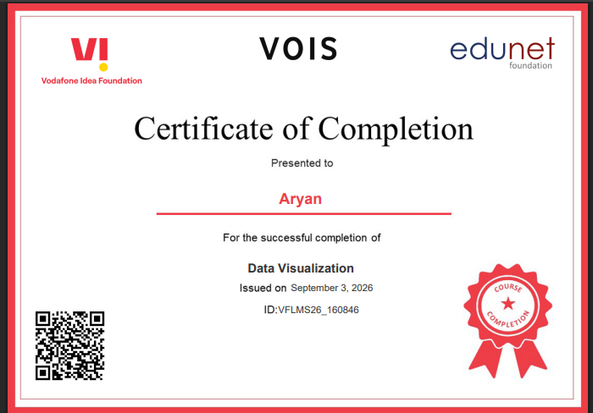
VOIS Course completion certificate - Course name- Data Visualization

Slide 14
Thank you
Aryan
Panipat Institute of Engineering and Technology

