Slide 1
1M1B AI FOR SUSTAINABILITY · IBM SKILLSBUILD & AICTE
GreenGuide
A retrieval-grounded AI assistant for local waste, air quality,
and climate-action guidance
Aryan · Panipat Institute of Engineering & Technology
SDG 13 · SDG 12 · SDG 11

Slide 2
PROBLEM STATEMENT
Sustainability information exists —
but it isn't reaching people
How might we use AI to make local climate, waste, and sustainability information accessible and actionable, so that residents and students can make informed daily decisions and reduce their environmental impact?
Scattered
Dense
Static
Waste rules, AQI advisories, and climate guidance live across separate municipal PDFs, CPCB circulars, and government websites.
Official documents use technical, legal language that isn't written for a resident trying to make a quick decision.
A basic FAQ page can't answer a specific, free-form question like "can I recycle a greasy pizza box?"
02

Slide 3
SDG ALIGNMENT
Anchored to three Sustainable
Development Goals
SDG 13
SDG 12
SDG 11
Climate Action
Responsible Consumption
& Production
Sustainable Cities
& Communities
Primary focus — helps individuals take informed, everyday climate action through practical guidance rather than abstract awareness.
Correct waste segregation and recycling-code guidance reduces contamination and improves downstream recycling rates.
AQI-aware, city-specific guidance helps residents adapt daily behaviour to local environmental conditions.
03

Slide 4
AI SOLUTION OVERVIEW
A retrieval-augmented generation (RAG)
pipeline, not a static FAQ
1
2
3
4
Query
Retrieve
Ground
Generate + Cite
→
→
→
A user asks a free-form question in plain language.
The system searches a knowledge base of waste, AQI, and climate documents for the most relevant passages.
Only the retrieved passages are passed to the language model as context — it may not use outside knowledge.
The model produces a plain-language answer and cites which source document it drew from.
Tech stack: PDF ingestion → text chunking → keyword/vector retrieval → grounded LLM response (IBM Granite / Claude) → source-cited answer
04

Slide 5
TARGET USERS
Built for the people making
day-to-day sustainability decisions
Residents & households
Students & campuses
Need quick, trustworthy answers on waste segregation and recycling without reading a municipal PDF.
Can adopt the assistant for hostel/campus waste and sustainability awareness drives.
Sensitive health groups
Local governance bodies
Elderly, children, and those with respiratory conditions who need clear AQI-based activity guidance.
Can plug in their own official documents to give citizens a searchable, always-available interface.
05

Slide 6
RESPONSIBLE AI CONSIDERATIONS
Designed to refuse rather than
guess
Fairness
Transparency
Knowledge base sourced from official government/municipal documents rather than opinion content, to avoid skewed or region-biased advice.
Every answer cites the specific source document it drew from, so a user can verify the guidance directly.
Ethics
Privacy
The assistant explicitly declines to answer when a question falls outside its knowledge base, instead of generating a plausible-sounding guess.
No personal data is collected or required to use the assistant; queries are not linked to user identity.
06

Slide 7
EXPECTED IMPACT
What changes if this is deployed
Residents
Get instant, source-backed answers instead of guessing or defaulting to "just throw it in the bin."
Municipal bodies
See fewer contaminated recycling loads as segregation guidance becomes easier to follow correctly.
Public health
Sensitive groups adjust outdoor activity around real-time AQI, reducing avoidable exposure.
Scalability
Swapping in a different city's documents localizes the assistant without rebuilding the pipeline.
Impact statement: if implemented, residents get correct, source-verified guidance in seconds instead of navigating dense municipal PDFs — the direct beneficiaries are residents (faster, more confident decisions) and municipal bodies (cleaner waste streams, fewer AQI-related health incidents).
07

Slide 8
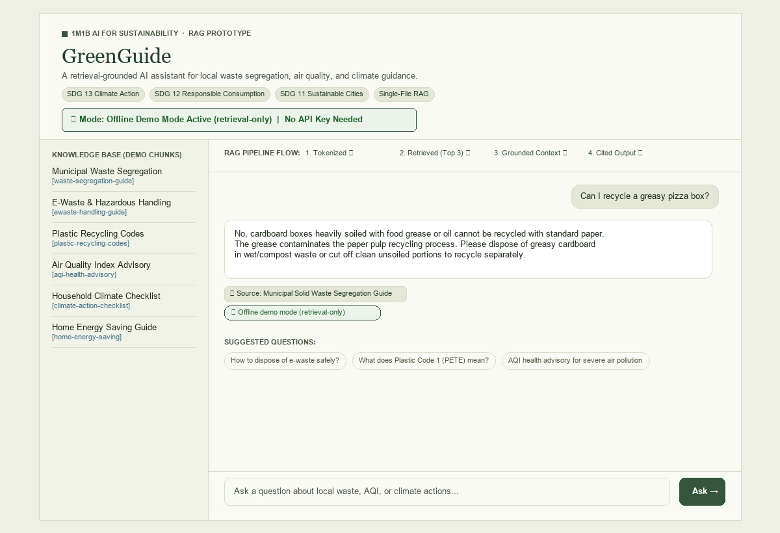
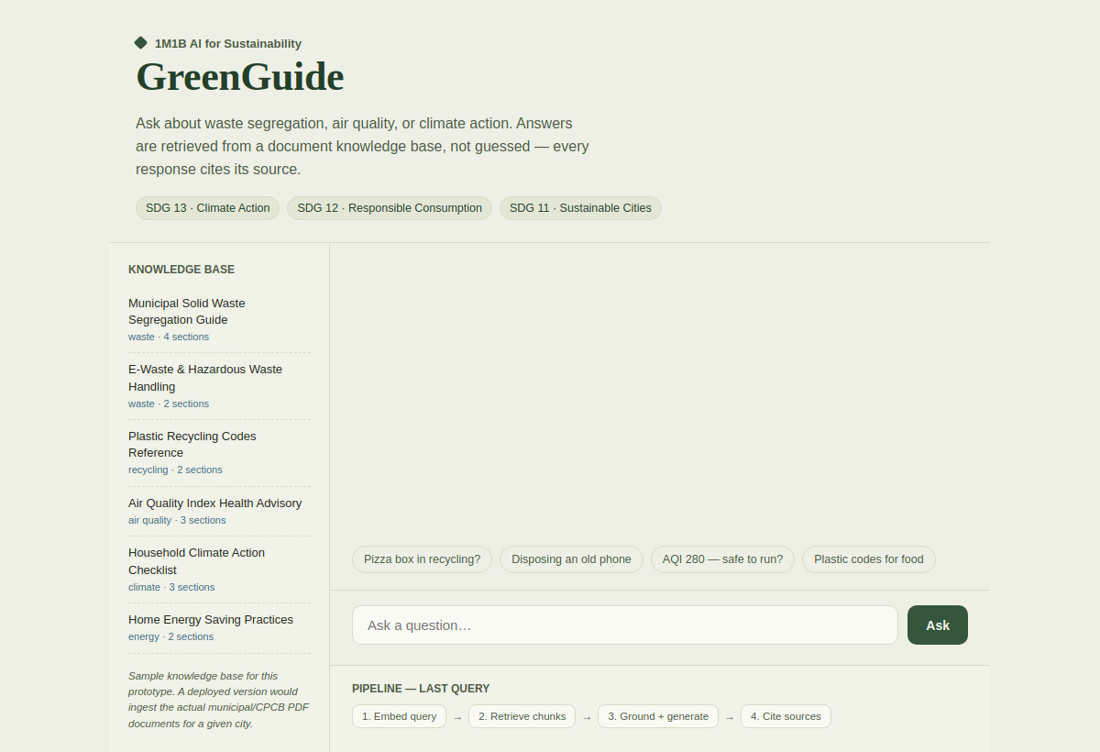
PROTOTYPE — LIVE SCREENSHOT
The working browser prototype
Actual screenshot of the deployed GreenGuide interface — knowledge base panel, suggested questions, input box, and live pipeline tracker.
08

Slide 9
PROTOTYPE — SAMPLE INTERACTION
Walkthrough: a grounded answer
Retrieval runs live in the browser against the knowledge base shown on the previous slide, then a grounded LLM call generates the reply below.
Can I put a used pizza box in the recycling bin?
No — a food-soiled pizza box shouldn't go in dry recyclables because grease contaminates the recycling stream. It should go into wet/organic waste instead (Source 1).
Municipal Solid Waste Segregation Guide
Pipeline trace: query embedded → 3 chunks retrieved from "Municipal Solid Waste Segregation Guide" → grounded generation → source cited
09

Slide 10
Thank you
GreenGuide · AI for Sustainability Virtual Internship
1M1B · IBM SkillsBuild · AICTE

