Slide 1
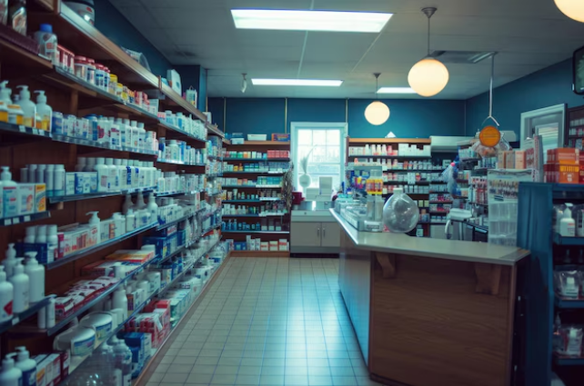

Indian Institute of Technology Madras
BDM
Capstone Project
Enhancing Operational Efficiency and Customer Satisfaction:
A Data-Driven Approach for MS Medical Store
Aryan Bhardwaj 22F2000384

Slide 2
Organization Background
A B2C Medical Shop specialized in eye related product like lubricating drops, antibiotic eye drops, anti-inflammatory gels, and ointments.
Established 15 years ago by Mr Prashant Sharma near Nirphad Eye Hospital in Mathura, Uttar Pradesh.
Serves lower-middle-class to upper-middle-class customer base.
Offers a wide range of 169 different products.
Operates with minimal staff, consisting of only one employee aside from the owner.
1 billing counter to manage traffic.
Operating hours: 8:00 am to 9:00 pm, open every day.
Objectives and Approach
Enhance Inventory Management for High-Demand Products.
Approach : Analyze sales data for top-performing products and categories.
Improve Customer Service Efficiency During Peak Hours
Approach : Identify peak hours from sales data and reduce customer waiting time.
Maximize Revenue Through Discount Strategies and Targeted Promotions
Approach : Analyze discount impact on revenue, promote high-margin products.

Slide 3
Data Collection
Met with the owner to discuss organization workings and problems encountered.
Collected sales transaction data from Marg ERP software for the period April 1, 2024, to August 5, 2024, covering 4,500 invoices and 169 products.
Additional data essential for customer service efficiency analysis like Timestamp and Cost price data was collected over email.
Preprocessing
Python and Excel were used for preprocessing and feature extraction to build a usable dataset.
Extracted each bill number and its corresponding date to create a clear timeline of transactions.
Focused on isolating details such as the selling price, discount, and relevant financial amounts for each product.
Used Excel's "split-into-columns" feature to isolate important attributes like item code, quantity, and package type for each sale.
Removed duplicates, handled missing values, and corrected inconsistencies in the sales data to ensure accuracy and completeness.

Slide 4
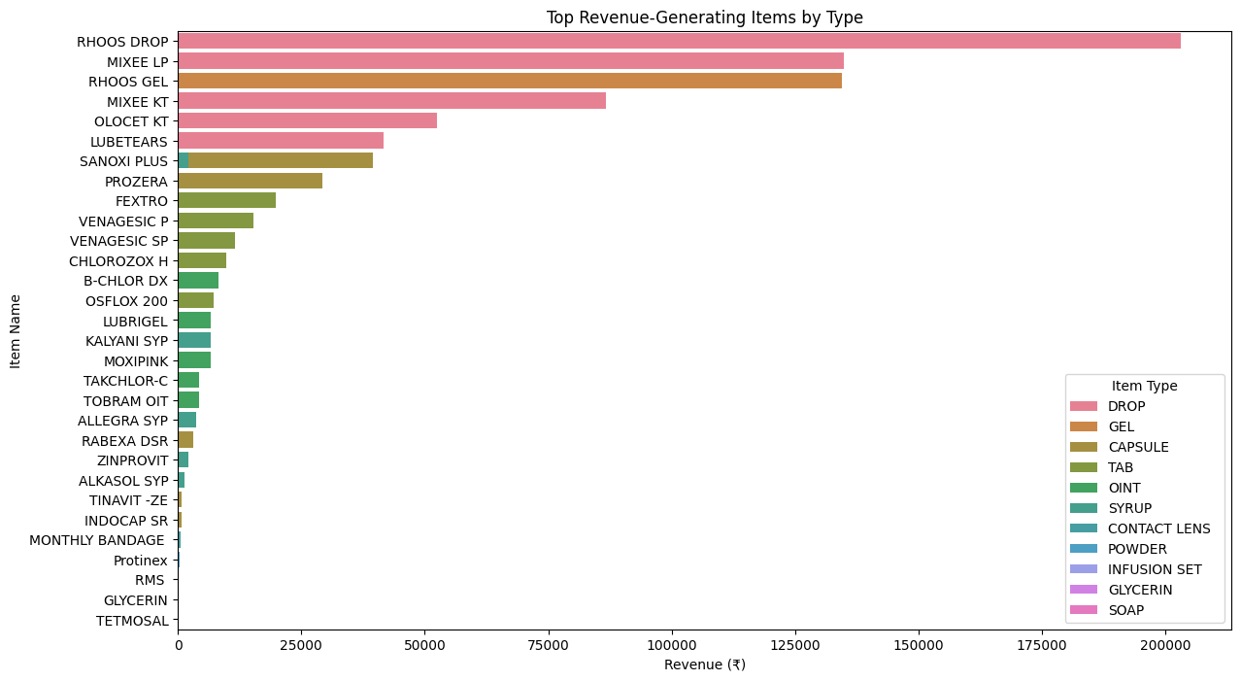
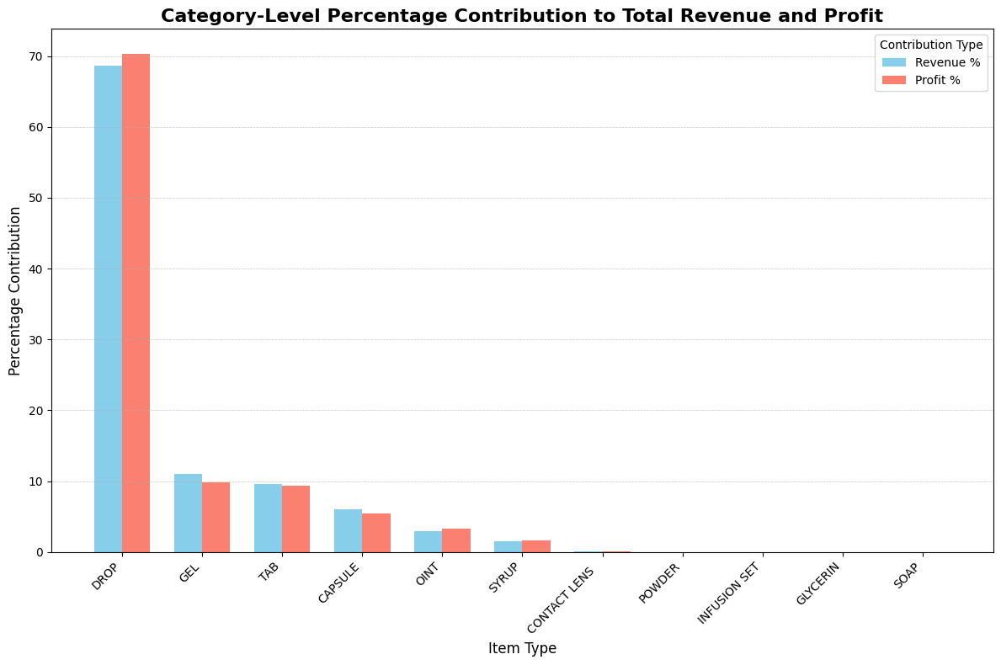
Revenue and Profit Contribution Analysis
The DROP category emerged as the largest revenue contributor, accounting for 68.70% of total revenue and 70.32% of profit. Items like RHOOS DROP and MIXEE LP are key drivers.
Gels and Capsules also contribute meaningfully, with products like RHOOS GEL, SANOXI PLUS, and PROZERA generating significant revenue.
Tablets and Ointments maintain steady sales, but their revenue share is lower. For instance, B-CHLOR DX and VENAGESIC P contribute to stable demand but not to the same extent as drops and gels.
Syrups, Powder, and Infusion Set categories showed minimal revenue contributions, indicating lower customer demand for these items.

Slide 5
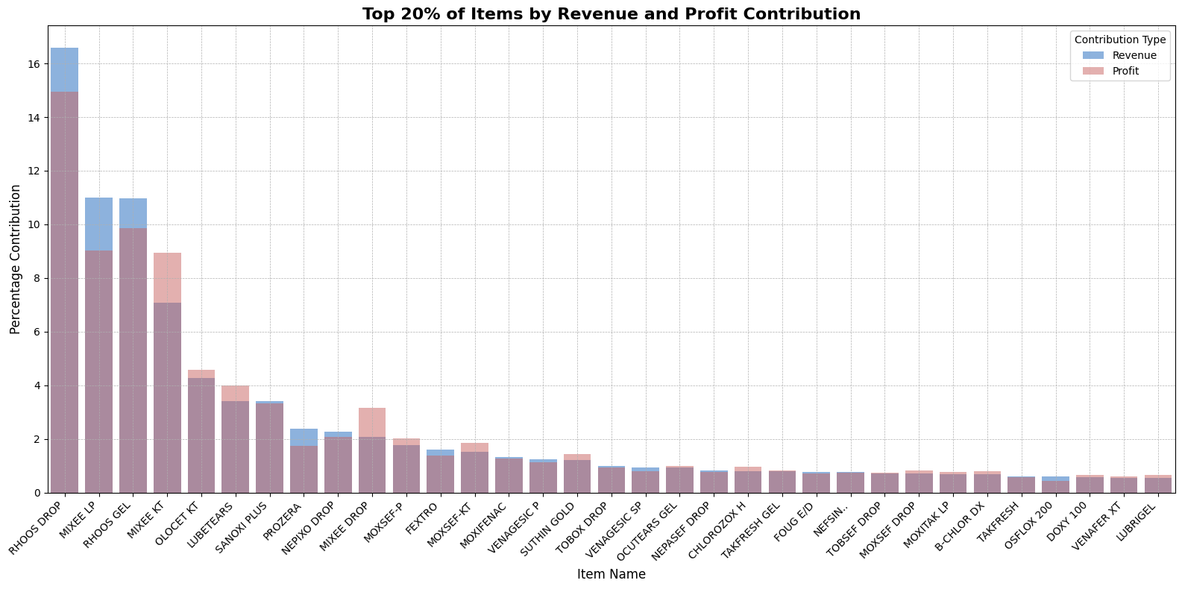
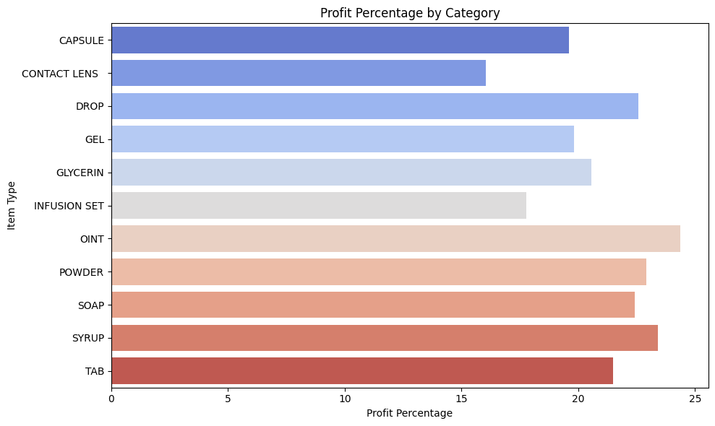
Approximately 84.7% of total revenue and 83.64% of total profit come from just 20% of the products, confirming a strong Pareto distribution and emphasizing the importance of focusing on top-performing items.
The OINTMENT category achieved the highest average profit margin (24.36%), suggesting that despite moderate sales, ointments are highly profitable.
Drops category has the profit margin of 22.56%.
Syrups and Powders follow closely with profit margins of 23.43% and 22.93%, respectively, demonstrating that even low-revenue categories can be profitable.
The average category-level profit percentage is 21.00%.
The average item-level profit percentage is approximately 23.10%.

Slide 6
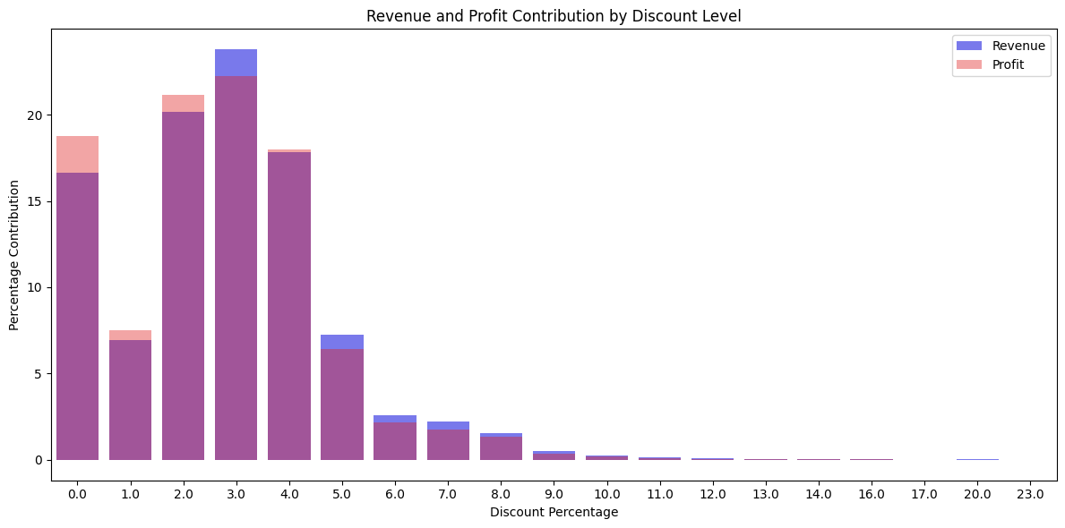
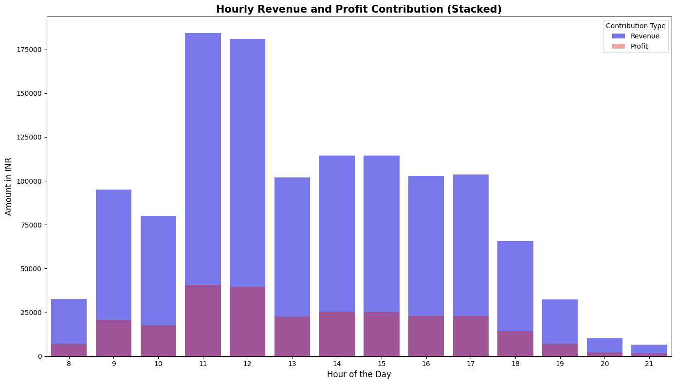
Discounts around 2-4% maximize both revenue and profit.
3% emerging as optimal, contributing the highest revenue (23.78%) and profit (22.25%).
Drops category has the profit margin of 22.56%.
Higher discounts reduce profitability, highlighting that smaller discounts effectively drive sales without eroding margins.
Time-Based Analysis
The peak hours of 11:00 AM and 12:00 PM show the highest revenue and profit.
2:00 PM to 5:00 PM, also generate moderate revenue, though lower than morning peaks.

Slide 7
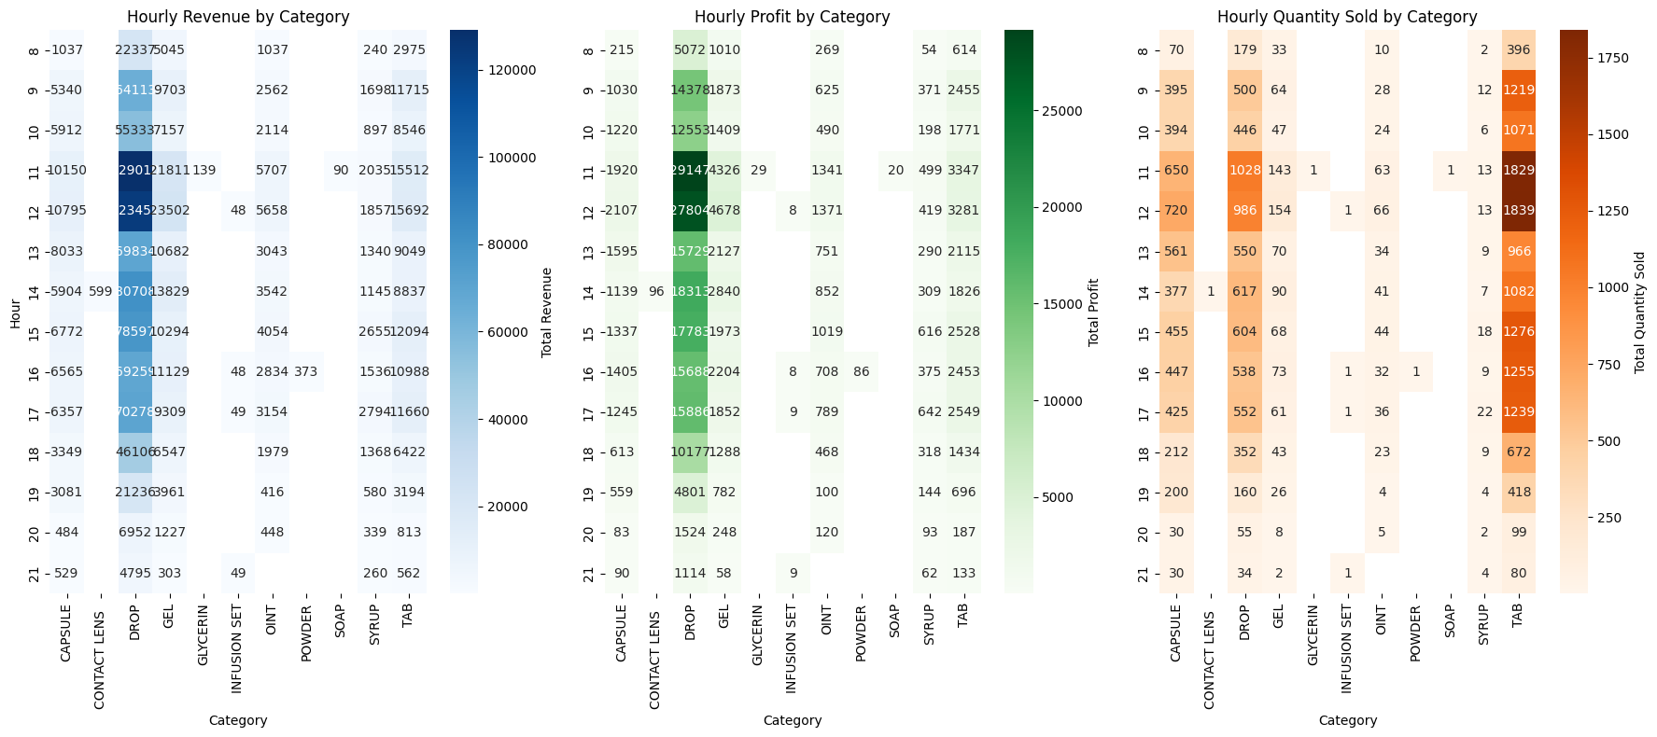
Drop contributes the most to revenue and profit across hours, especially around 11 AM to 12 PM where they reach over 129,000 and 29,000 respectively.
Tablets consistently have the highest quantity sold across all hours, followed by drops. Peak sales for these two categories occur between 11 AM and 12 PM, with over 1800 tablets and 1000 drops sold.

Slide 8
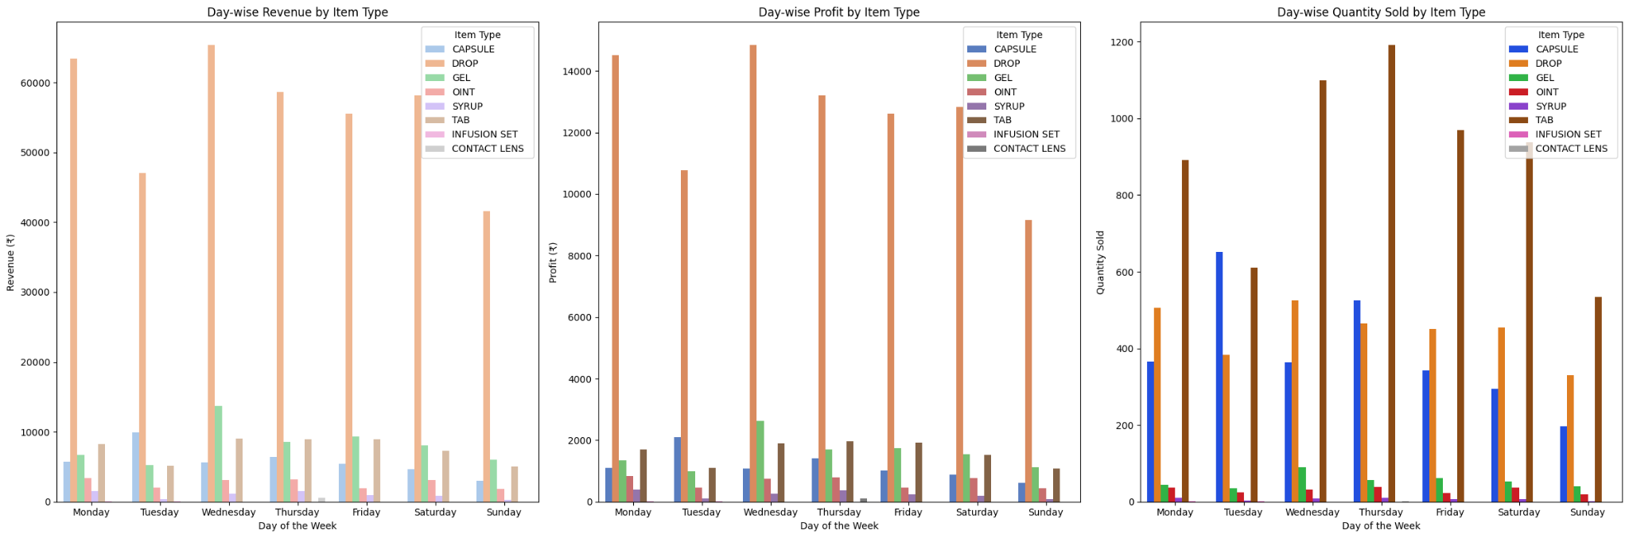
Drops generate the highest revenue and profit throughout the week, especially on Mondays and Wednesdays.
Tablets and capsules also maintain significant revenue but lower than drops, with peak revenue on Mondays and Thursdays.
Gels and ointments show moderate sales, with revenue peaking on Wednesdays, Thursdays, and Fridays.
Tablets are the most sold item type, with sales peaking on Thursdays (over 1,190 units).
Capsules see significant demand, especially on Tuesdays (around 652 units), while ointments and gels maintain a stable but lower volume throughout the week.

Slide 9
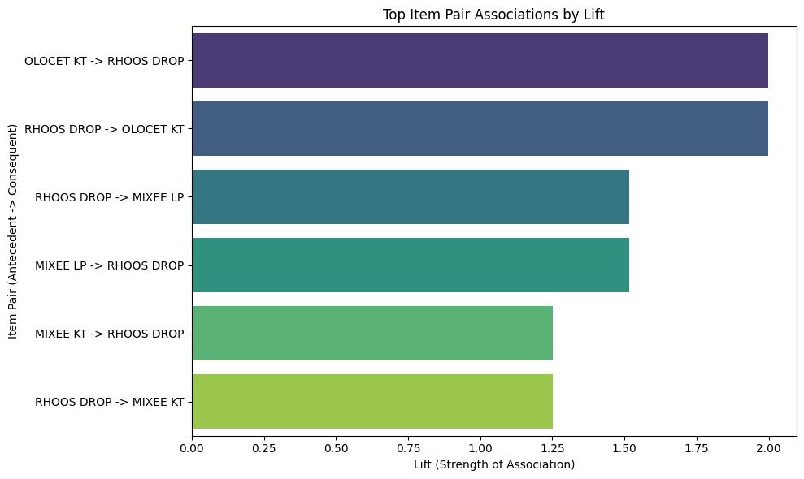
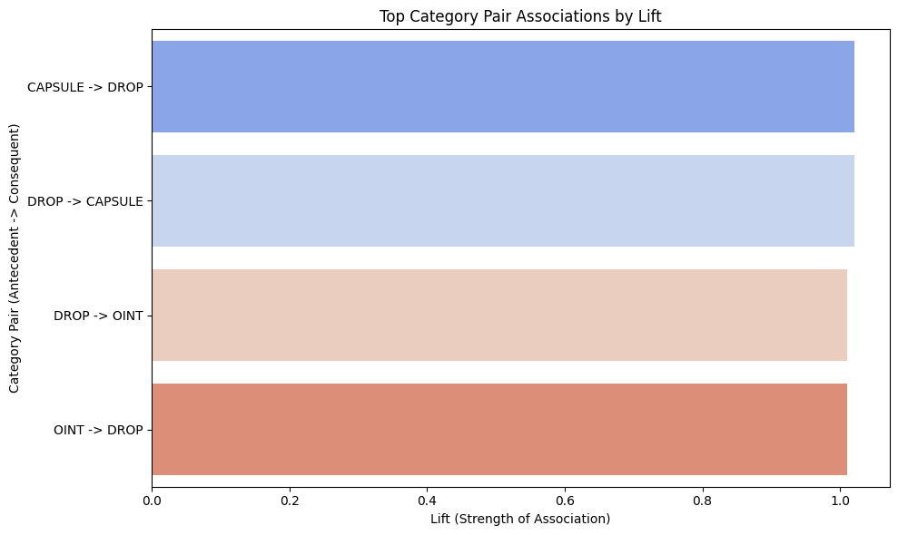
Market Basket Analysis
OLOCET KT and RHOOS DROP show a strong association with the highest lift value of 1.99, indicating they are frequently bought together. They appear together in 5.6% of transactions (support) and have a 68.4% chance (confidence) of being bought together when one is purchased.
RHOOS DROP and MIXEE LP also display significant association, with a lift of 1.51. This pair has a support of 9.6%, and 28.1% confidence.
CAPSULE and DROP categories are highly associated, with a lift of 1.02. The support for this category pair is 6.8%, and 86.9% confidence.
DROP and OINT have a lift of 1.01 with a support of 7.5%.

Slide 10
Recommendations
Inventory Management Optimization: Optimize inventory by prioritizing high-revenue, high-demand products like RHOOS DROP and MIXEE LP. Optimize restocking using sales data to prevent stockouts and overstocking. Use product pairings (e.g., OLOCET KT & RHOOS DROP) for reducing inventory cost.
Customer Service Efficiency: Improve customer service during peak hours (11 AM–12 PM) by hiring a part-time assistant. Focus on reducing wait times and enhancing customer satisfaction, leveraging high hourly revenue to justify staffing costs.
Marketing & Revenue Enhancement: Boost revenue through targeted promotions and marketing. Test different strategies, such as highlighting product pairings (RHOOS DROP and MIXEE LP), optimizing discounts (2–3%), and offering incentives like free eye checkups on purchases above ₹500. Evaluate outcomes and refine campaigns for maximum impact.
—-Thank You—

